Slide 1
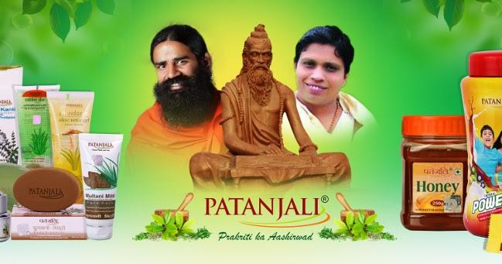
Business Strategy of Patanjali
Masai school’s project

Slide 2
Content
About Patanjali
About Market
Failure Cause and Effect Analysis
What could go Wrong ?
Growth Opportunities in Current Scenario

Slide 3
About Patanjali
Patanjali
Company size
Revenue model
Marketing strategy
Customer analysis
Product/Service analysis

Slide 4
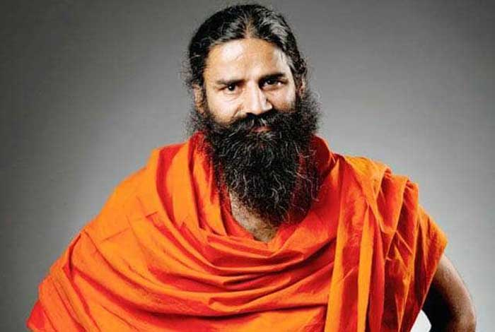


Patanjali
Multinational consumer products manufacturer
In Haridwar (Uttarakhand)
Formed in 2006 by Baba Ramdev and Acharya Balkrishna
Baba Ramdev
Acharya Balkrishna

Slide 5
Company size
Financial : Patanjali estimated its annual turnover for the 2016–17 fiscal year at ₹10,216 crore (US$1.3 billion).
Employees : Patanjali has 25,000 employees
Investors : Patanjali Shareholders NRI Couple Sunita and sarwan Poddar, a follower of Ramdev, gave the Balakrishnan the first loans to kickstart the business. They have 3 % shareholding in the Ayurveda business whereas Balakrishnan holds the 94% stake in Patanjali.
Stakeholders : Acharya Balkrishna is managing director and 6 other director

Slide 6
Revenue model
Patanjali has a huge loyal customer base with great marketing strategies in hand.
the company includes several distribution strategies including:
1. Patanjali Chikitsalaya: Doctors checkup the health of patients without any charge and recommend Patanjali's Ayurvedic medicine.
2. Swadeshi Kendra: The outlets of Patanjali where you can find all the household and non-medicine products.
3. Patanjali Arogya Kendra: Yoga experts guides for yoga exercises and fitness tips and training for the customers. Also, they suggest various Ayurvedic medicines.

Slide 7
Marketing strategy

Slide 8
Customer analysis

Slide 9
Product/Service analysis

Slide 11
Failure Cause and Effect Analysis
Socioeconomic factors faced by Patanjali
Economic Factors:
· Patanjali is recognized as an affordable brand in the lower middle class and middle class segment and would like to remain the same. The GST introduced in India has been a great boon for Patanjali.
· The increased income potential of the middle class in India has been an advantage for Patanjali.
Social Factors:
· Populations around the world, as a whole, are becoming more health conscious. Patanjali as a brand is Ayurvedic and hence side effect free. The products are considered healthy as they are mineral and herbal.
· Baba Ramdev is a very well-known and established face in India He has conducted yoga camps all over India From time to time he also expressed his nationalist sentiments through the media and this is the reason why people want to believe in his brand.

Slide 12
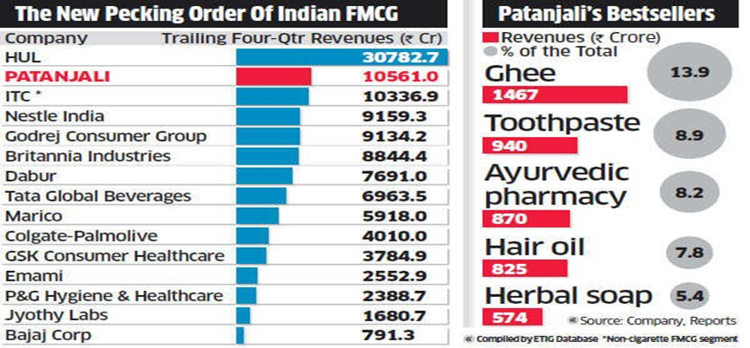
Position of Patanjali in the market compared to other competitors
· With the brand face of Baba Ramdev, the vast variety of herbal and ayurvedic products (approx. 900 products as of now) and on the back of patriotism Patanjali entered the market with a boom.
· Patanjali hampered the sales of various big brands like Colgate Palmolive, HUL, P&G, Dabur etc. It’s toothpaste brand “Dant Kanti” gave a strong fight to Colgate’s toothpaste, Patanjali honey get into straight fight with Dabur honey.
· In 2013-14 year Patanjali had revenue of about Rs. 1,184 Cr which nearly doubled to Rs. 2006 Cr in 2014-15.
· Most successful year of the company was the year 2016-17 in which the company garnered a staggering revenue of about Rs.10,561 Cr which is more than double of its previous year revenue.
· Company entered the Rs.10,000 Cr club in just six years of establishment.

Slide 13
PR (Public Relations) and Media

Slide 14
What could go Wrong ?

Slide 16
Growth Opportunities in Current Scenario

Slide 18
Thank you

