Slide 1
TRAVELOGUE
Guided By:-
Prof.Ashish Patel
Made By:-
MOHIT PATEL(100300107052)
KISHAN PATEL(100300107079)

Slide 2
Abstract:-
An Android application.
Tourist selects source place , destination place & routes.
Helps the tourist by giving information of various public transports
Suggest places
Push Notification of places coming in between
Makes photo album
One push connectivity to Gujarat Tourism.
Also user can add new tourist place to database.

Slide 3
Problem Statement:-
Homesick people do not have route and transport information.
Last moment plans are made.
People get frustrated while collecting information.
Don't have information of nearby tourist places
Has to maintain his photo album manually

Slide 4
Problem Solution:-
Provides shortest route to their destined place
Different modes of transports available
Gives notification when tourist place is nearby
Creates a photo album with geo-tagging

Slide 5
Project Scope:-
One should find routes easily.
One should easily get public transports schedule.
Show Images of tourist places.
Suggest places and also notify them.
Create a Photo Album.

Slide 6
Project Objectives:-
Easy User Interface.
Timely updates of places should take place.
Updating transport schedules.
Display On Demand tourist places.
Secure Application.
Backup data.

Slide 7
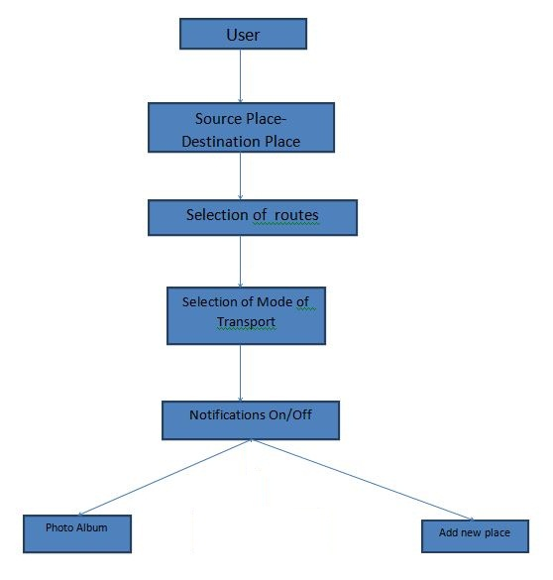
Flow Diagram:-

Slide 8
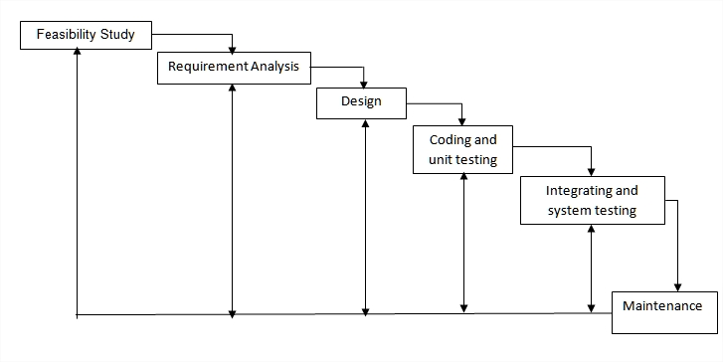
Process Model

Slide 9
Reasons for Waterfall Model
Most of the requirements of the project are fixed and already thought of very less functionality updating is expected in future.
Minimal wastage of time and effort and reduces the risk of schedule slippage, or of customer expectations not being met.

Slide 10
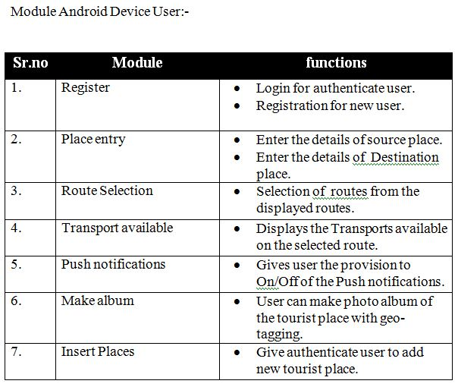
Modules and features:-

Slide 11
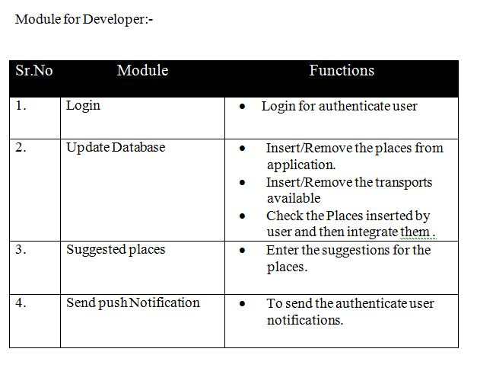
.

Slide 12
System requirement:-
Hardware Requirements
For Developer:-
A computer with dual core processor having 2GHz processing speed 2Gb RAM
160Gb of Hard disk
For User:-
An Android smart phone with 512MHz processor
Software Requirements
For Developer:-
Windows or Linux operating system
Eclipse IDE
Android SDK
SQLite
PHP/Visual Studio/JVM
IIS or Apache(depending on operating system)
For User:-
An Android version 2.3 or later

Slide 13
Non-functional requirements
Support for different network channels
Support for different Android platforms
Usability
Efficiency
Reliability

Slide 14
Tools & Technology:-
Eclipse IDE with ADT bundle
Adobe Photoshop CS6
SQLite
Java servlet/.NET Framework

Slide 15
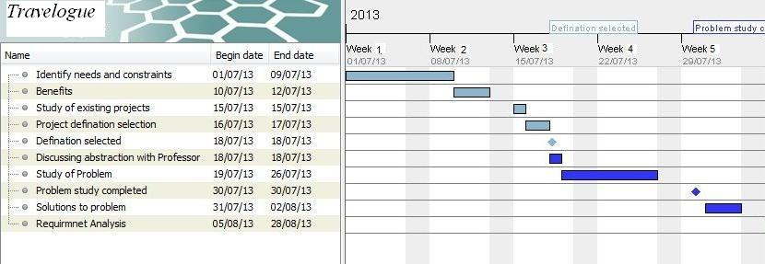
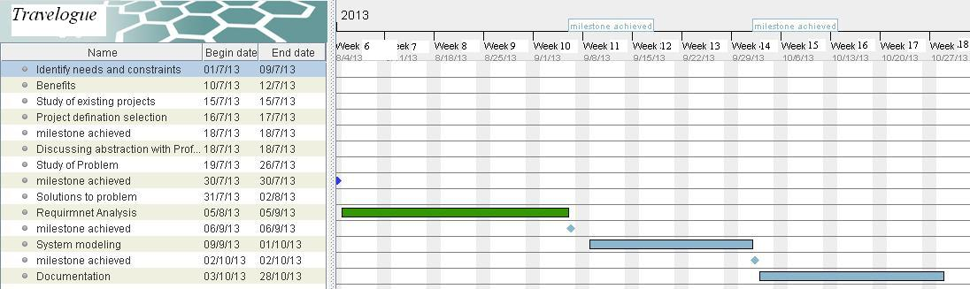
Work Flow:-

Slide 16
Project Risk:-
Scheduling(High turnover).
Lack of experience.
Hardware unavailability or crash.
Technology will not meet expectations.

Slide 17
Design:-
System Design
System Design includes:
Front End
Back End
Back end design contains database design and it is represented by Data Dictionary.

Slide 18
Front end design:-
UML Diagrams
Use case Diagram
Activity Diagram
Sequence Diagram
Graphics Design
Snapshots

Slide 19
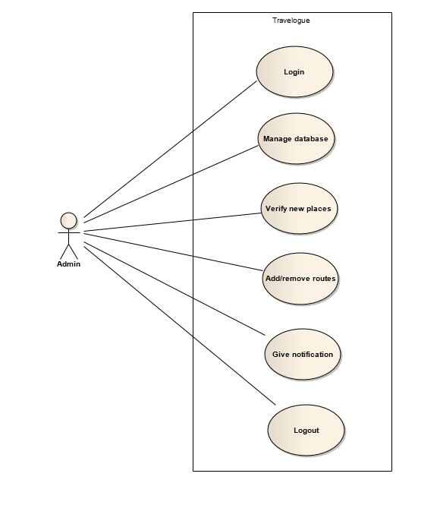
Use Case:- Admin

Slide 21
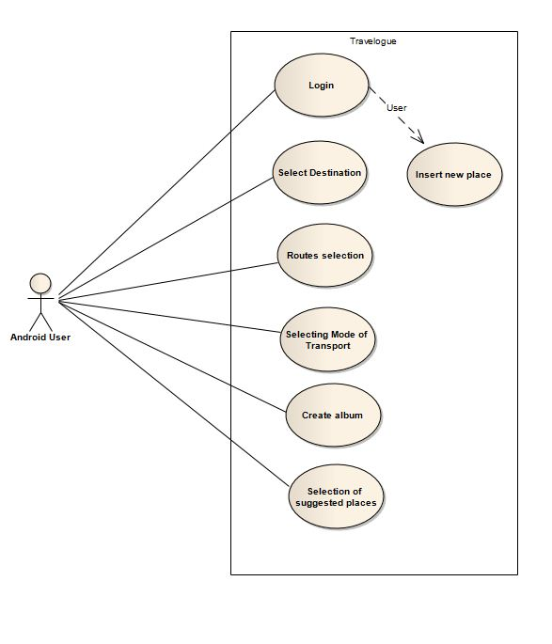
User

Slide 22
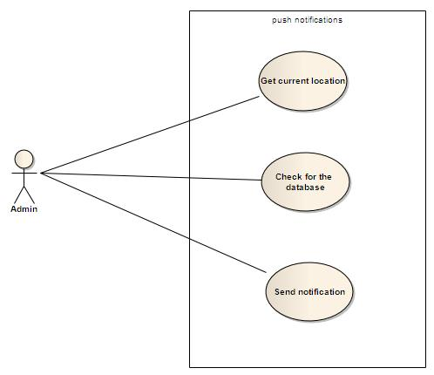
Push notification

Slide 23
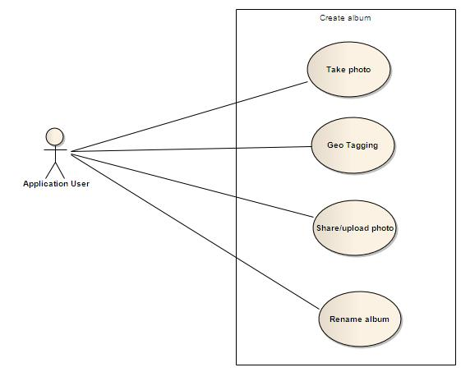
Create Album:-

Slide 24
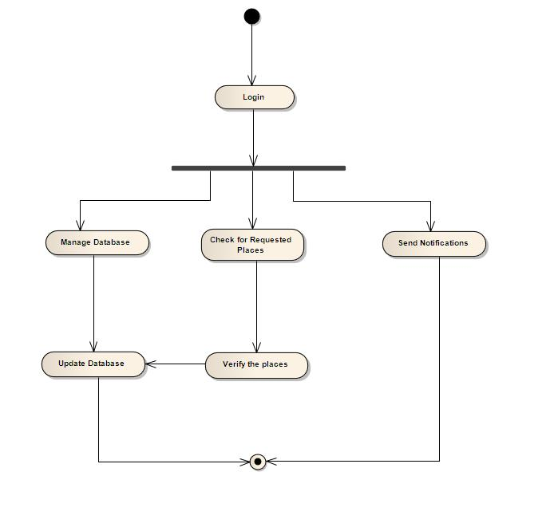
Activity Diagram:- Admin

Slide 25
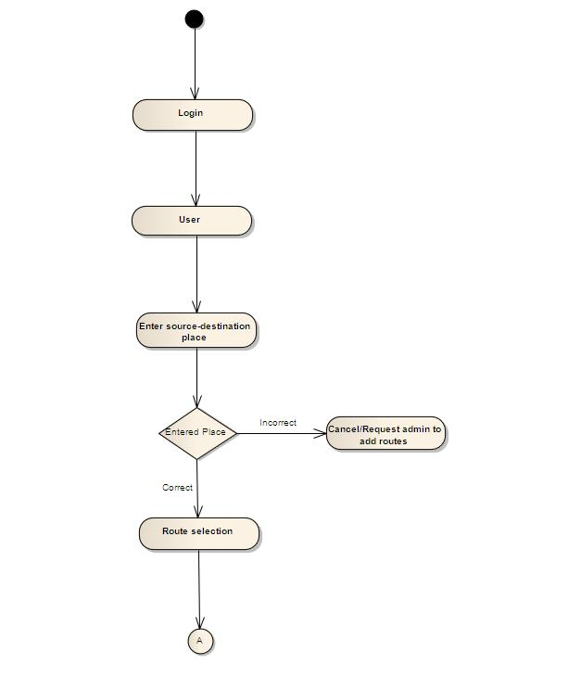
User

Slide 26
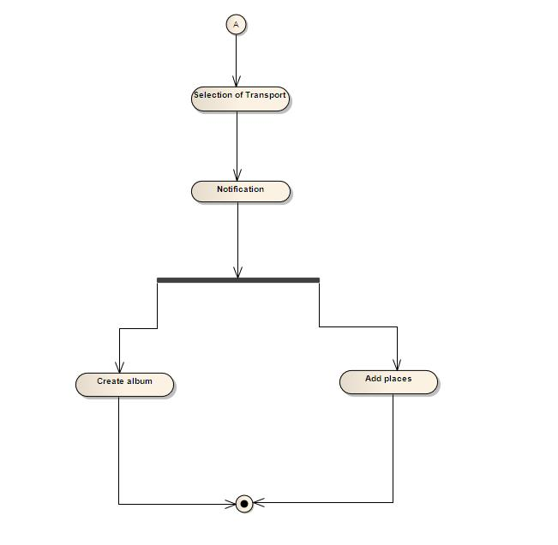
.

Slide 27
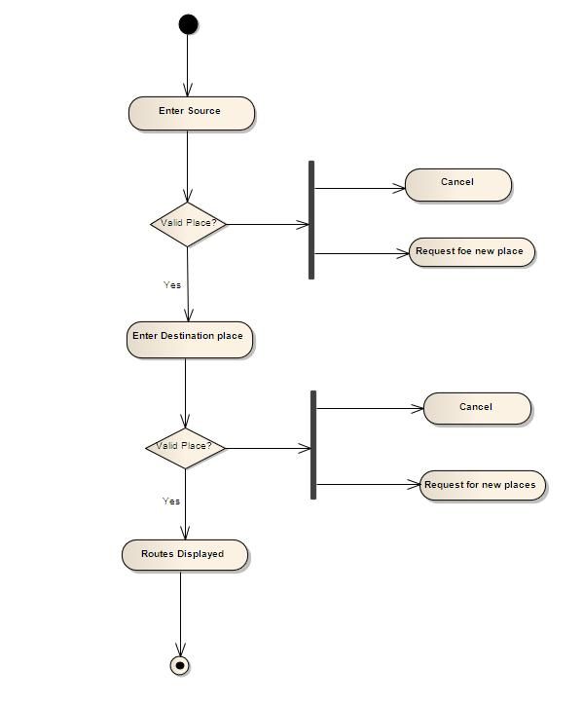
Place Selection:-

Slide 28
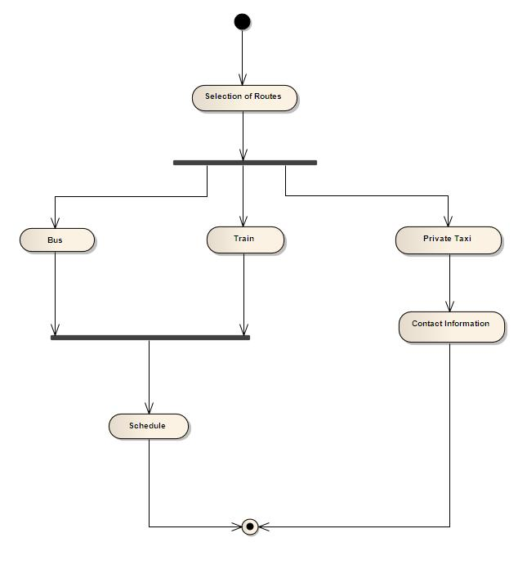
Transport Selection:-

Slide 29
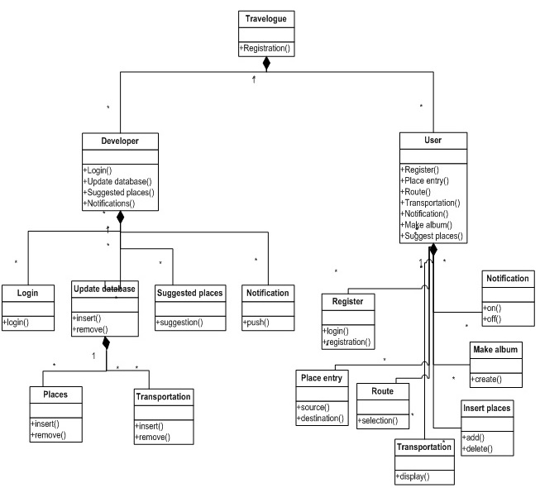
Class Diagram:-

Slide 30
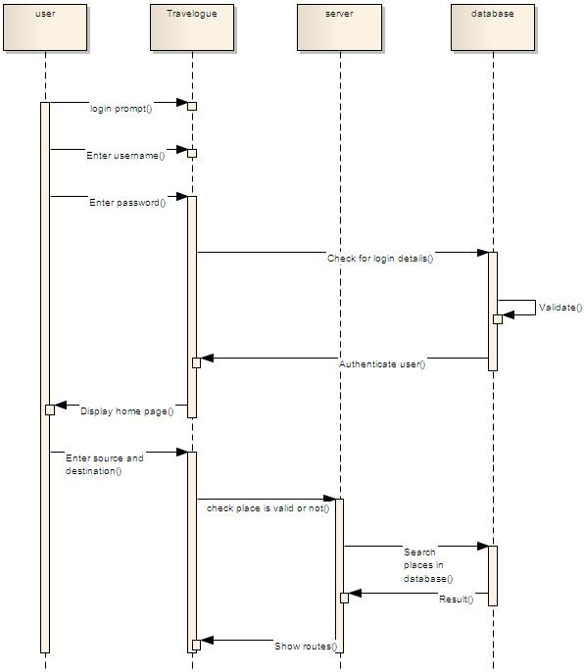
Sequence Diagrams:-

Slide 31
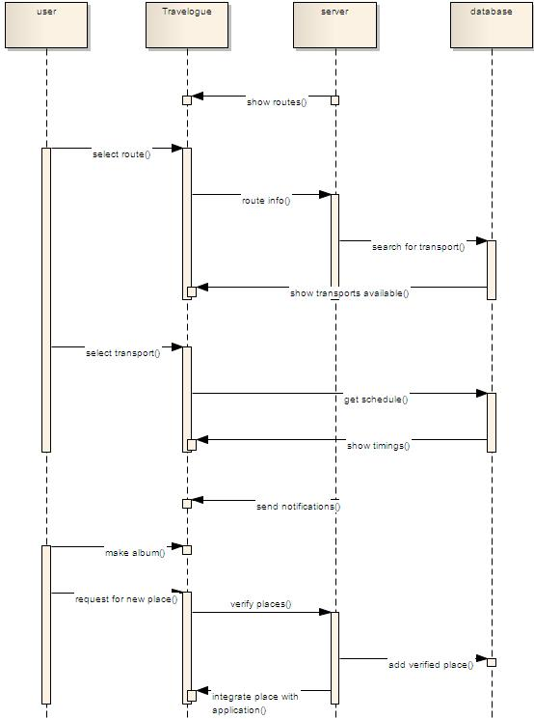
.

Slide 32
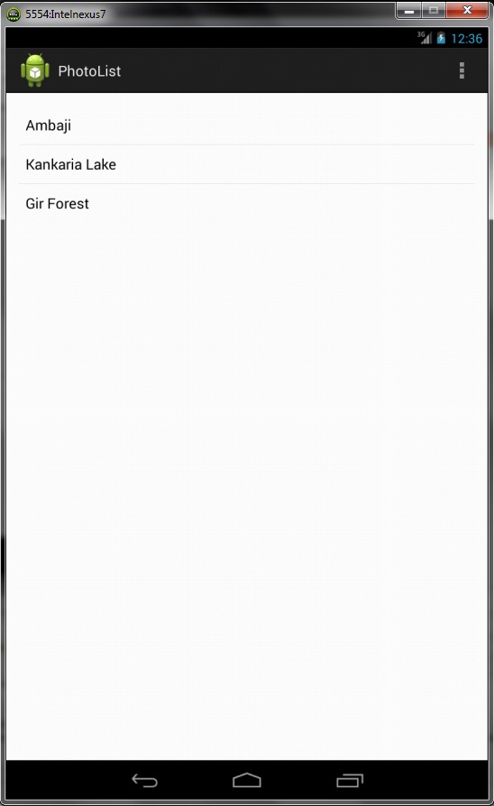
Graphics Design:-

Slide 33
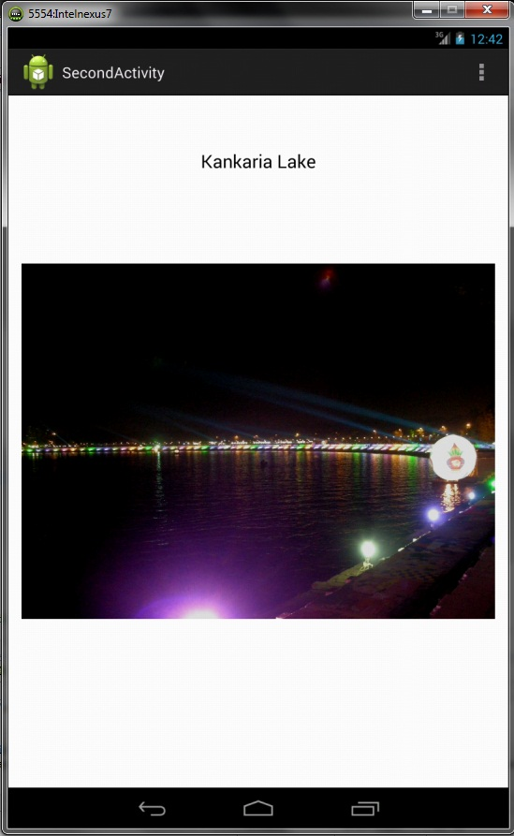
.

Slide 34
Database Design:-

Slide 37
.
THANK
YOU

