Slide 1
SQL Class
First Day

Slide 2
How Many cloud databases and Services are available
Cloud Computing means using the internet to store, manage, and process data instead of using your own computer or local server. The data is stored on remote servers, that are owned by companies called cloud providers such as Amazon, Google, Microsoft. These companies charge you based on how much you have used their services.
# Cloud-Based Services
Software as a Service(SaaS)
Platform as a Service
Infrastructure as a Service
Anything as a Service
Function as a Service

Slide 3
Software as a Service(SaaS)
Software-as-a-Service (SaaS) means using software over the internet instead of installing in on your computer. You don’t have to worry about downloading, updating, or maintaining anything- the company that provides the software handles all of that.

Slide 4
Platform as a Service
PaaS is a type of cloud service that gives developers the tools they need to build and launch apps online without setting up any hardware and software themselves.
With PaaS, everything runs on the provider’s server and is accessed through a web browser. The provider takes care of things like servers, storage, and operating systems. Developers just focus on writing and managing the app.

Slide 5
Infrastructure as a Service
Infrastructure as a service (IaaS) is a cloud service where companies rent IT resources like servers, storage, and networks instead of buying and managing them.
It’s like outsourcing your computer hardware. The cloud provider gives you the basic building blocks (like virtual machines, storage, and internet access), and you use them to run your apps and services.
You pay based on how much you use – by the hour, week, or month. The way, you don’t need to spend a lot of money on buying hardware.

Slide 6
Anything as a Service
It is also known as Everything as a Service. Most of the cloud service providers nowadays offer anything as a service that is a compilation of all of the above services including some additional services.

Slide 7
Function as a Service
FaaS is a cloud service that lets you run small pieces of code – called functions- without managing any servers. You just write your code, upload it, and it runs only when triggered by an event, like a button click or a file upload.
FaaS is event-driven, meaning the code runs only when something specific happens. You don’t need to keep a sever running in the background – it starts automatically when needed and stops when the job is done. That’s why it is also called serverless (even though servers are still used, they’ re managed entirely by the provider).

Slide 8
Cloud Databases
Provider’s | SQL | NoSQL | Object Oriented
AWS | AWS-RDS(Relational database service), Aurora | AWS DynamoDB | Amazon Neptune
Microsoft Azure | Azure SqlDB | Azure CosmosDB | Azure CosmosDB
Google cloud platform | Google Cloud SQL | Google Firestore
IBM | IBM DB2 | Cloudant
MongoDB |  | MongoDB Atlas

Slide 9
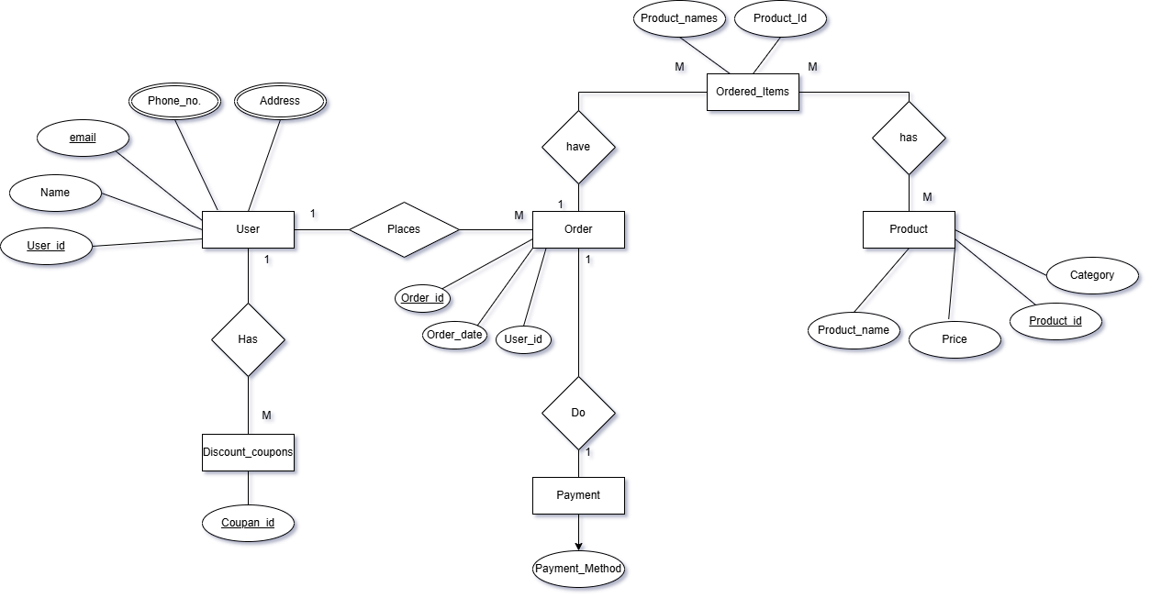
ER Diagram of Online Shopping Platform

