Slide 1
pgAdmin
USER INTERFACE GUIDE

Slide 2
INTERFACE

Slide 3
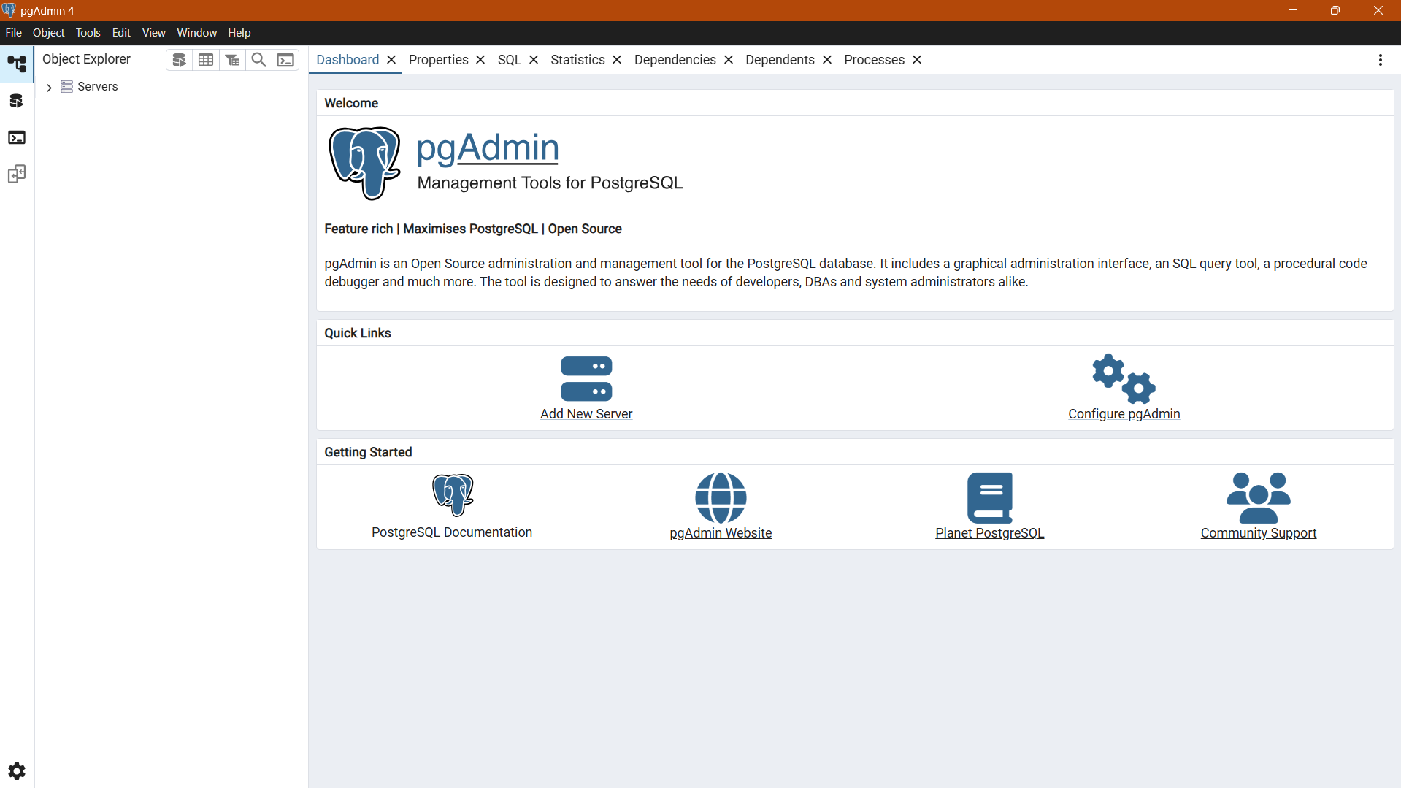
When pgAdmin opens, the interface features a menu bar and a window divided into two parts: the Object Explorer tree control in the left pane, and a tabbed browser in the right.

Slide 4
DASHBOARD

Slide 5
Click the Add New Server button to open the Register - Server dialog to add a new server definition.
Click the Configure pgAdmin button to open the Preferences dialog to customize your pgAdmin client.

Slide 6
Server Dialog
Use the Server dialog to describe a connection to a server

Slide 7
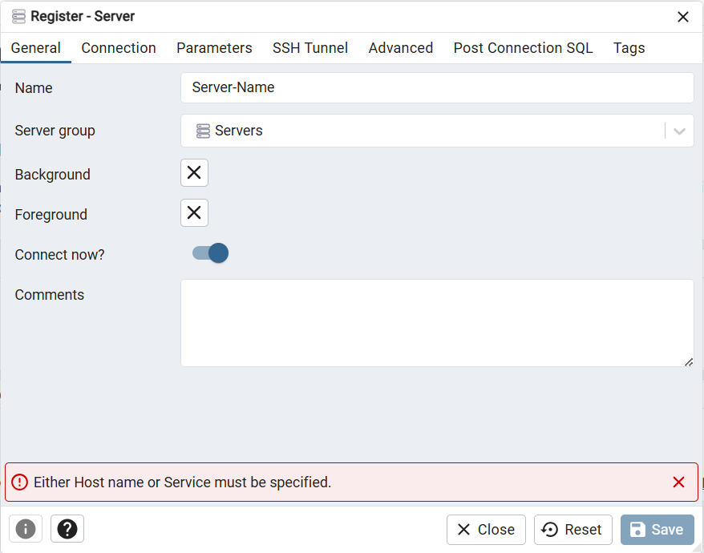
Use the Name field to add a descriptive name for the server; the name specified will be displayed in the Object Explorer.
Use the drop-down list box in the Server group field to select the parent node for the server; the server will be displayed in the Object Explorer control within the specified group.
If the Connect now? checkbox is checked, the client will attempt a connection to the server upon completion of the dialog; this is the default
Provide a comment about the server in the Comments field.
Use the fields in the General tab to identify the server:

Slide 8
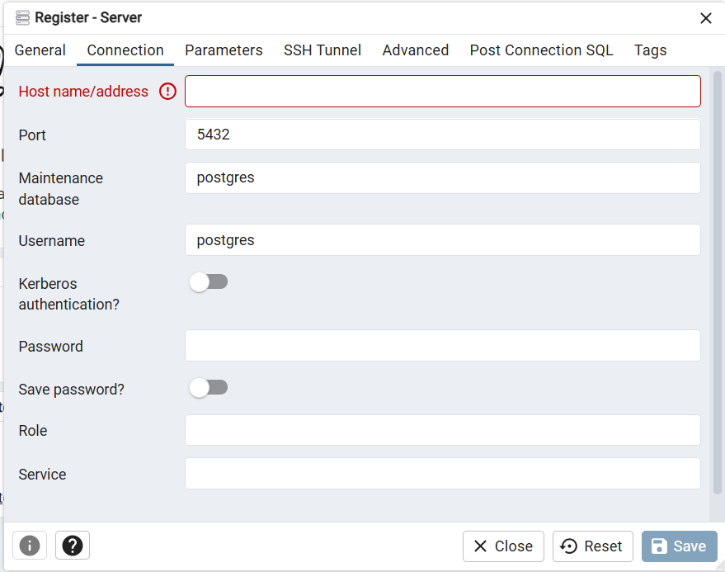
Specify the IP address of the server host
Enter the listener port number of the server host in the Port field. The default is 5432.
Use the Maintenance database field to specify the name of the initial database to which the client will connect.
Use the Username field to specify the name of a role that will be used when authenticating with the server.
Use the Password field to provide a password that will be supplied when authenticating with the server.
Check the box next to Save password? to instruct pgAdmin to save the password for future use.
Click the Save button to save your work.
Use the fields in the Connection tab to configure a connection

Slide 9
Tabbed Browser
The right pane of the pgAdmin window features a collection of tabs that display information about the object currently selected in the pgAdmin tree control in the left window. Select a tab to access information about the highlighted object in the tree control.

Slide 10
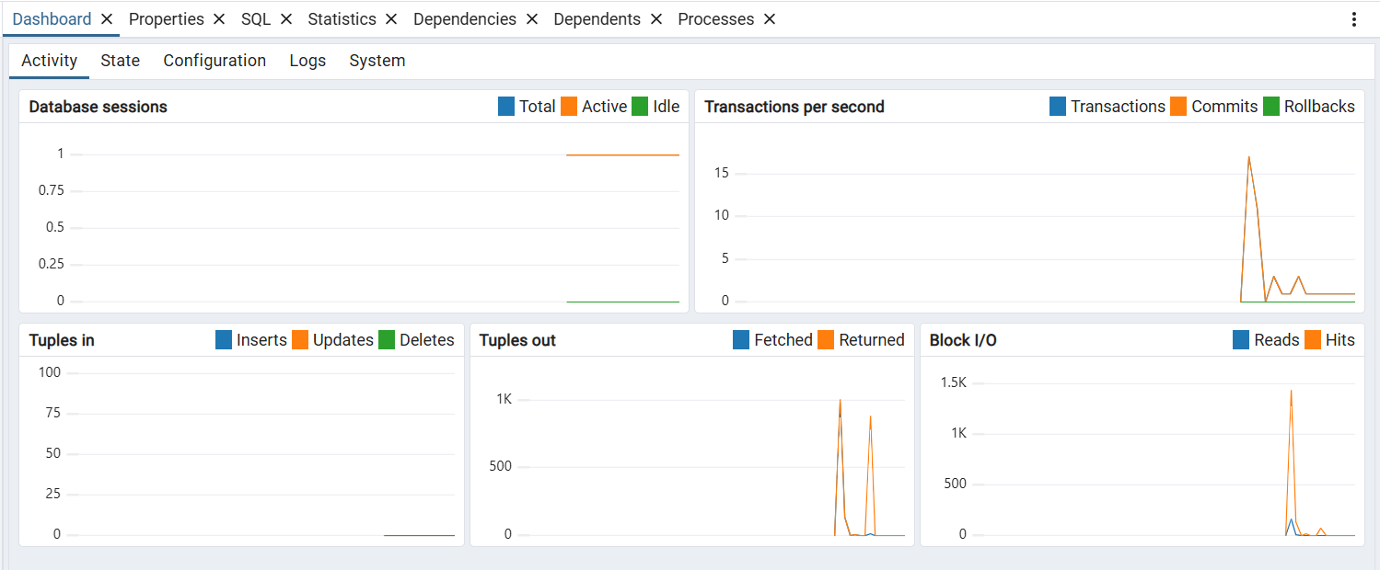
The graphs and tables on the Dashboard tab provides an active analysis of system statistics and the usage statistics for the selected server or database.

Slide 11
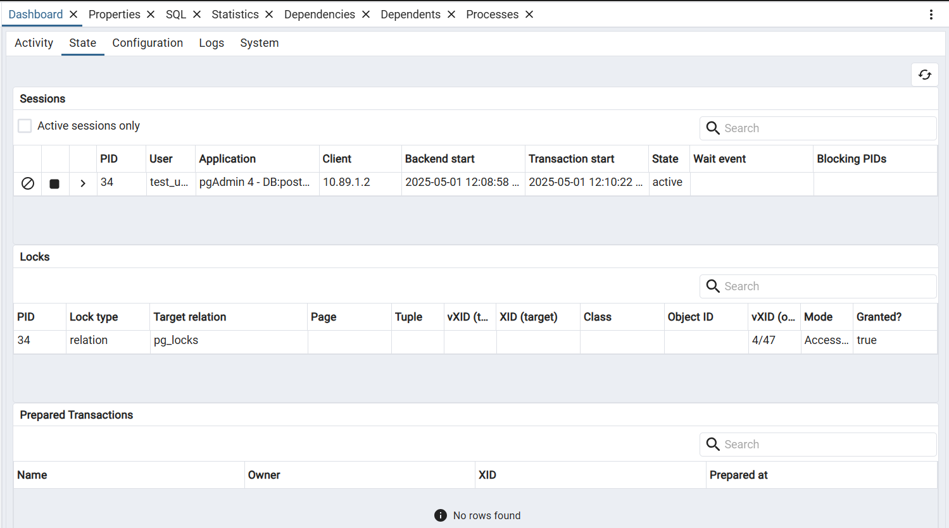
Click the Stat tab to get the usage statistics for the selected server or database:

Slide 12
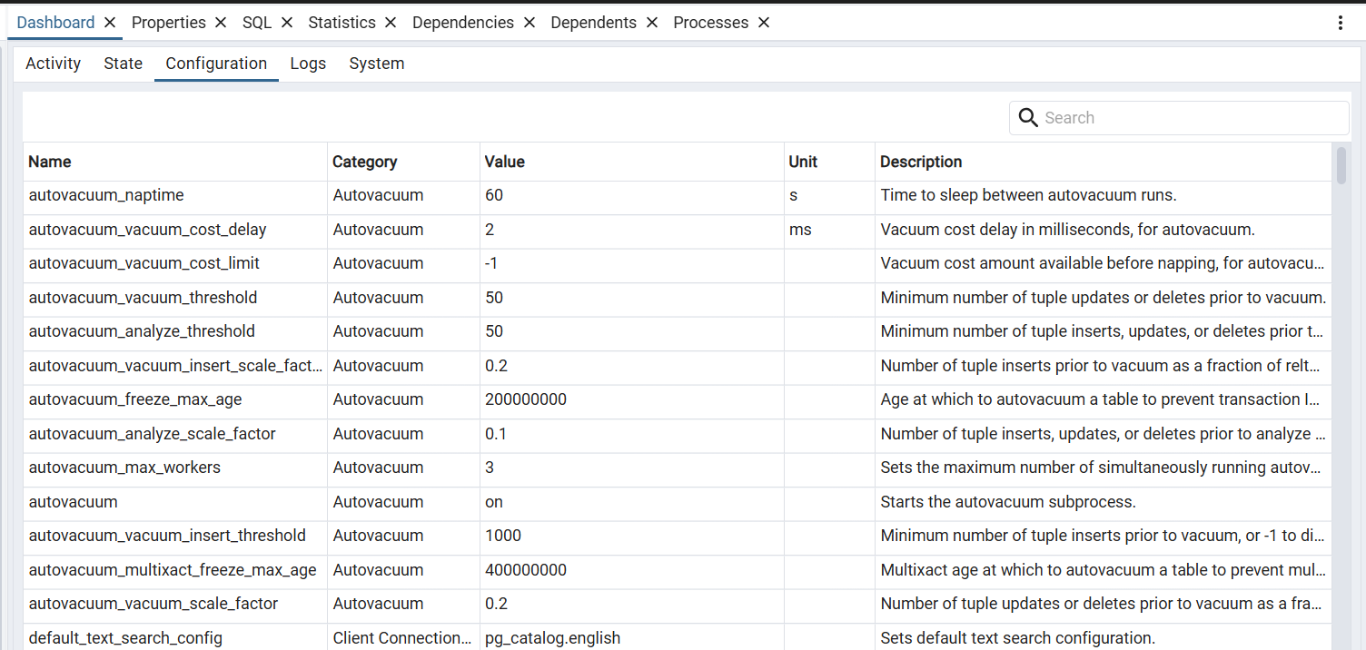
Click the Configuration tab to get the server configuration details.

Slide 13
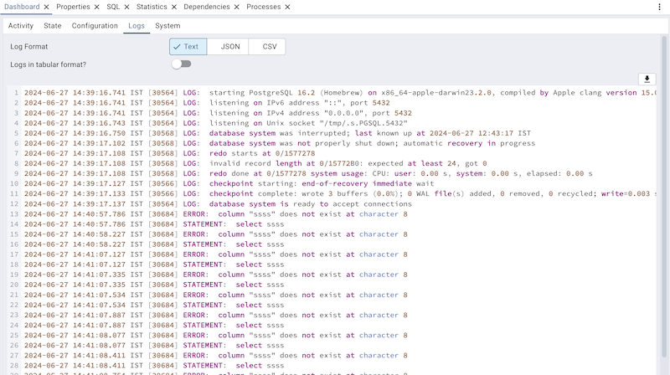
Click the Logs tab to get the server logs.

Slide 14
TOOLBAR
The pgAdmin toolbar provides shortcut buttons for frequently used features like the Query Tool, View/Edit Data, Search Object and the PSQL Tool. This toolbar is visible on the Object explorer panel.

Slide 15
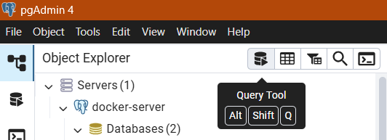
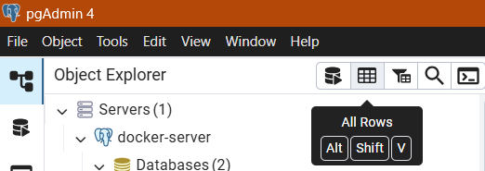
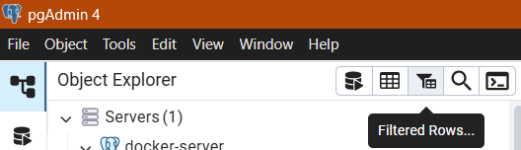
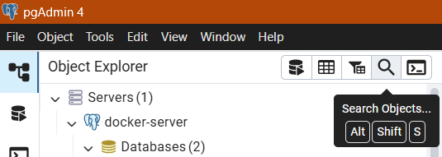
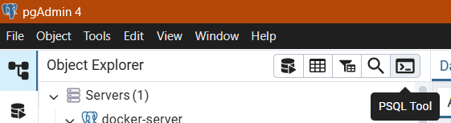
Use the Query Tool button to open the Query Tool in the current database context.
Use the All Rows button to view/edit the data stored in a selected table.
Use the Filtered Rows button to access the Data Filter popup to apply a filter to a set of data for viewing/editing.
Use the Search objects button to access the search objects dialog. It helps you search any database object.
Use the PSQL Tool button to open the PSQL in the current database context.

Slide 16
MENU BAR
The pgAdmin menu bar provides drop-down menus for access to options, commands, and utilities. The menu bar displays the following selections: File, Object, Tools*, and Help.

Slide 17
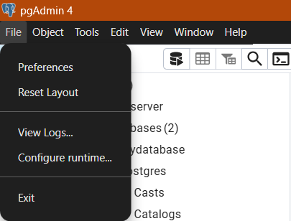
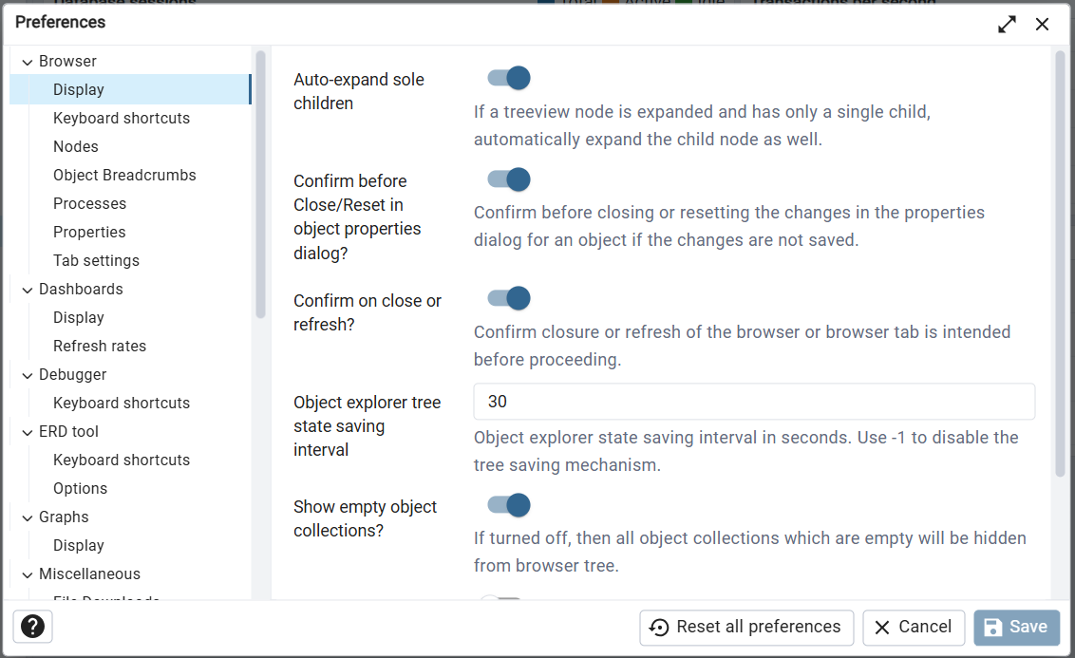
According to your needs, you can customize Your Preferences

Slide 18
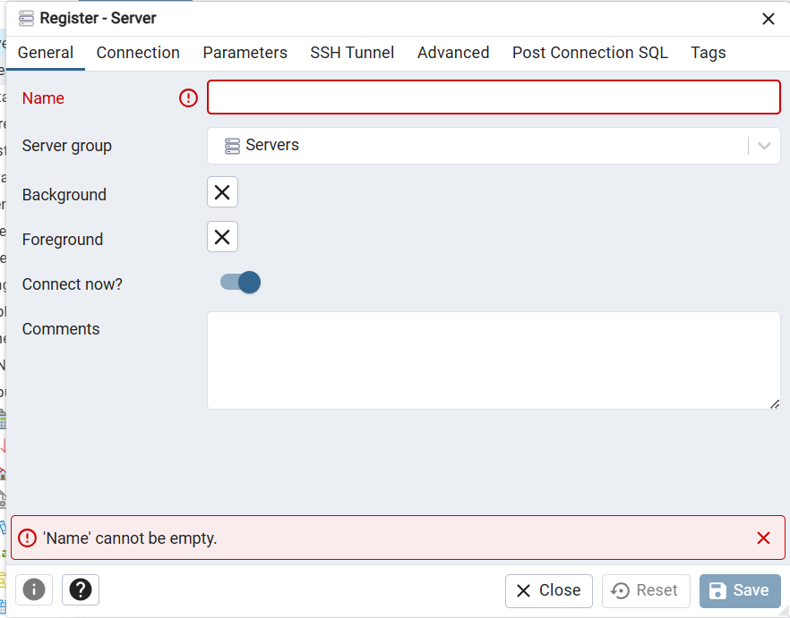
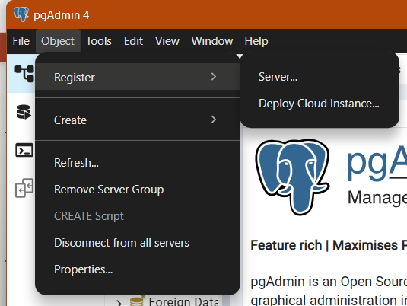
Object Menu On Servers
Register New Server

Slide 19
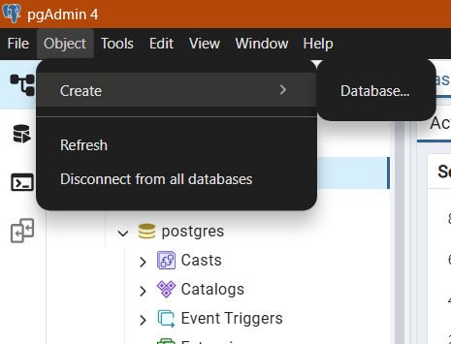
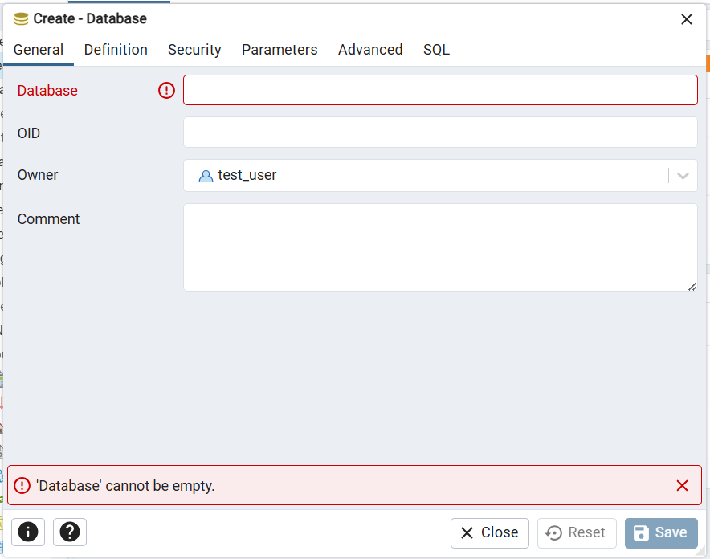
Object Menu On Databases
Create new Database

Slide 20
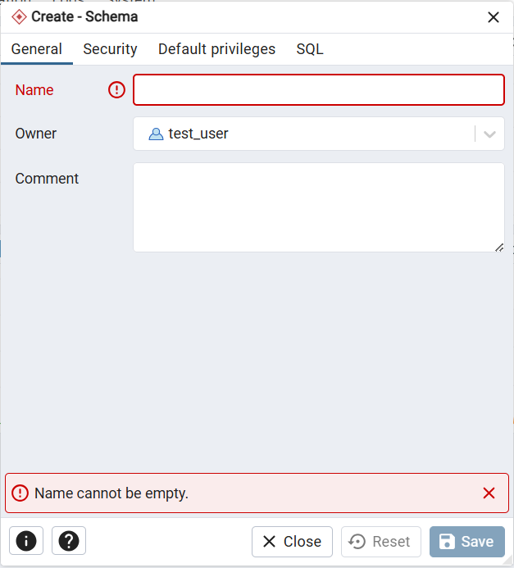
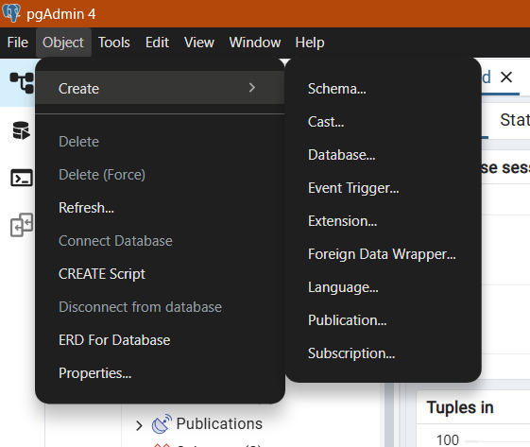
Objects on Single Database
Create Schema

Slide 21
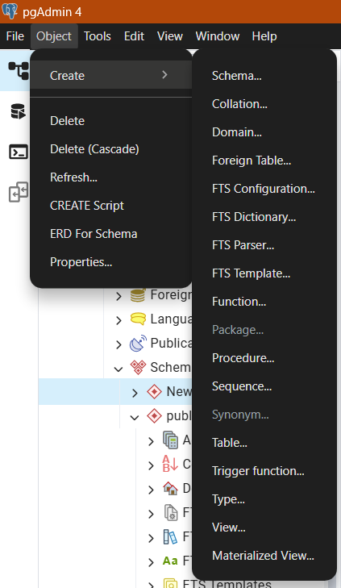
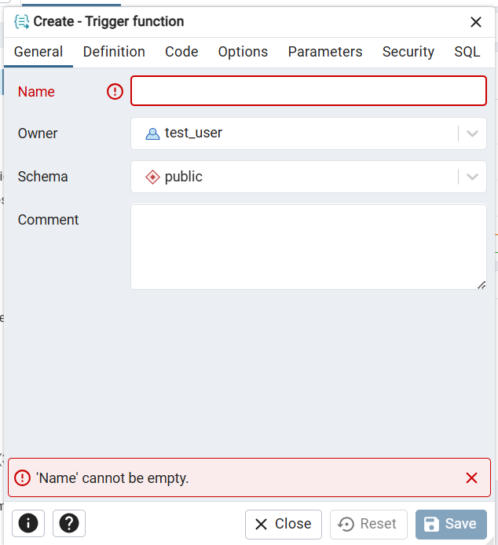
Objects on Schema
Create Trigger

Slide 22
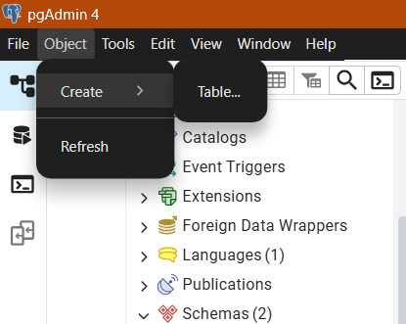
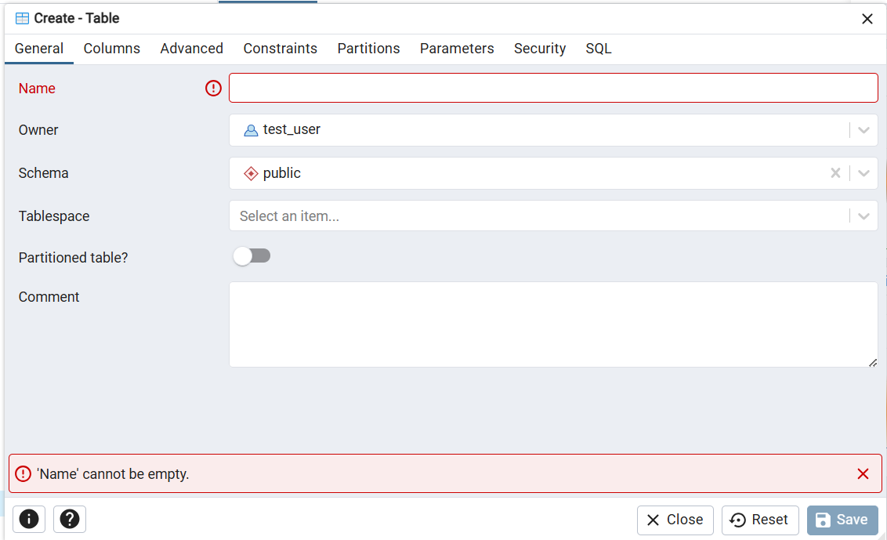
Objects on Tables
Create Tabels Using Interface

Slide 23
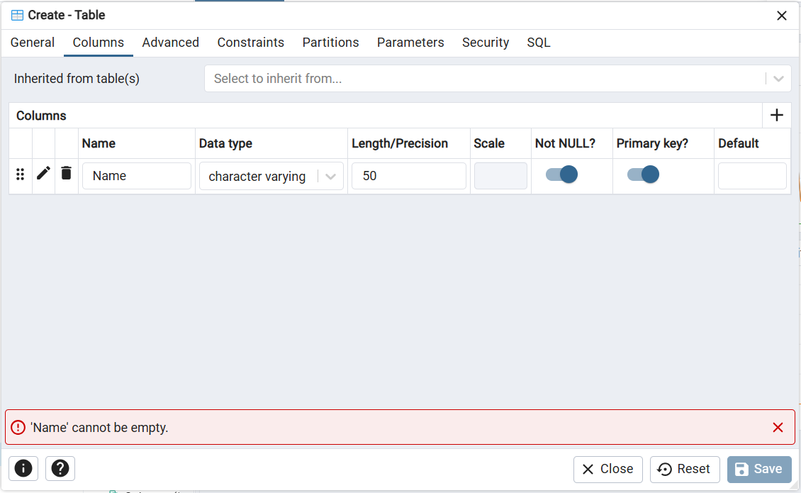
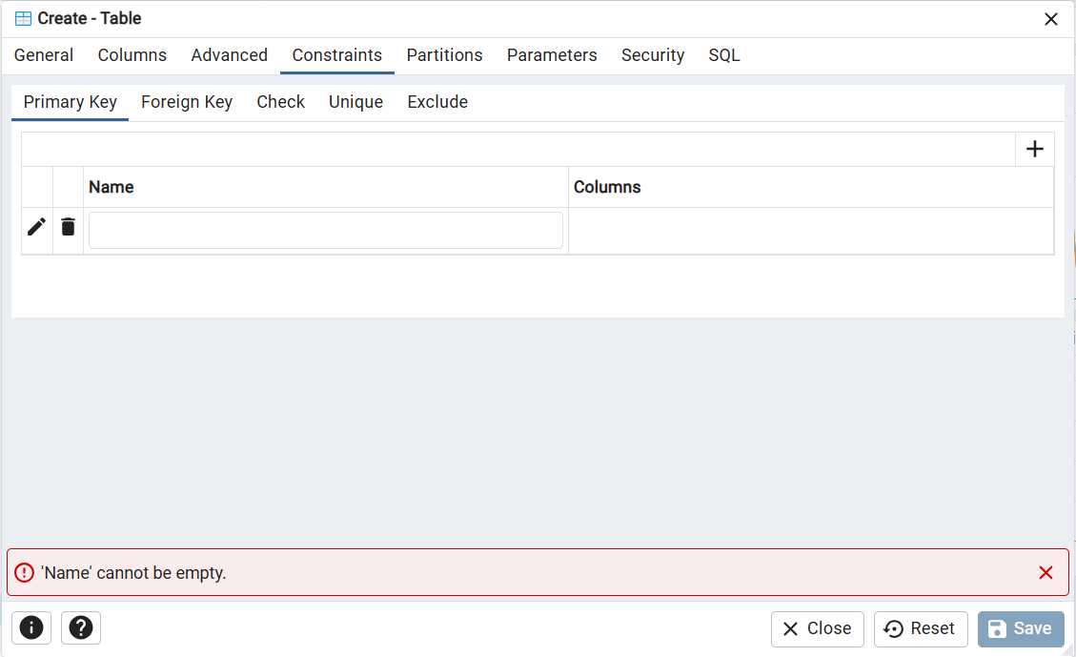
Define Columns and Constraints here

Slide 24
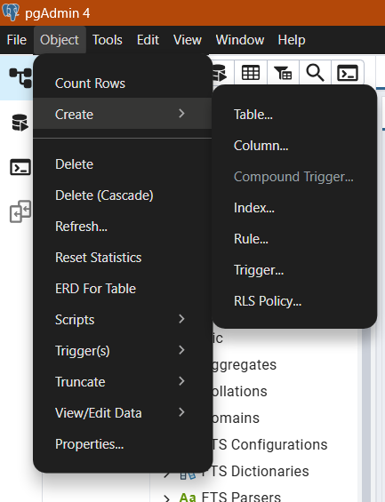
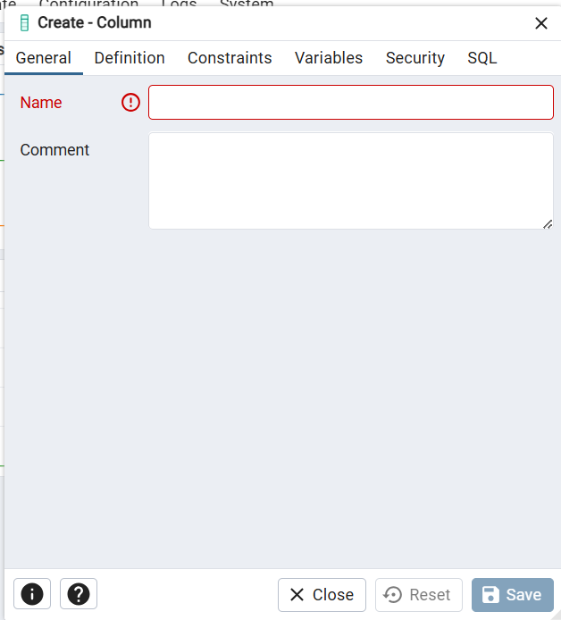
Objects on Table
Creating columns using Interface

Slide 25
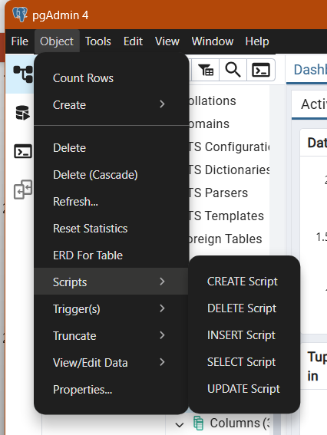
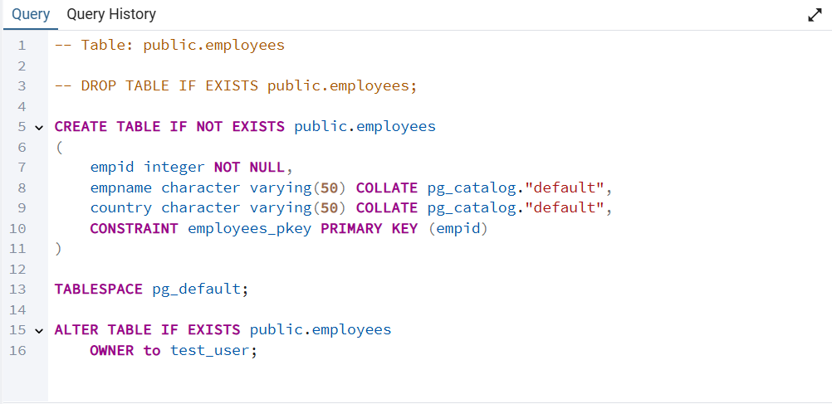
It will generate the script for you like this
Objects on Single Database

Slide 26
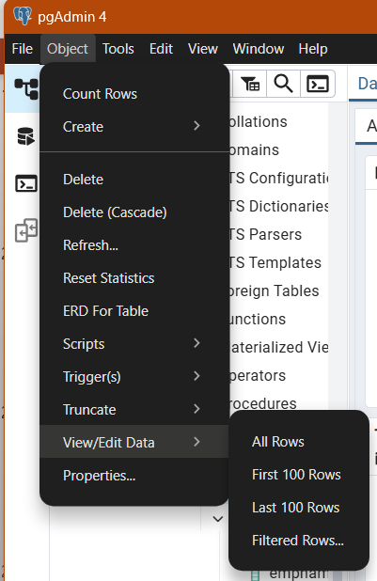
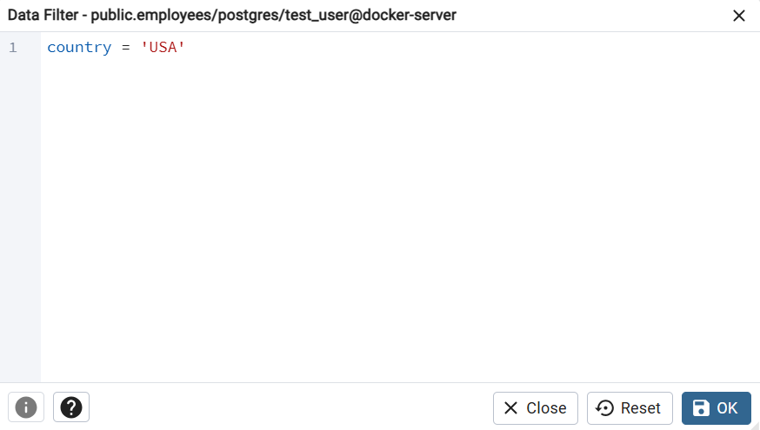
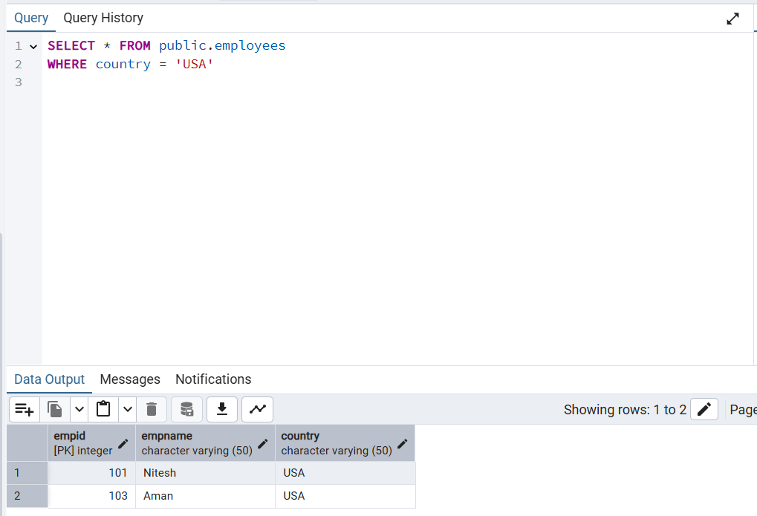
Objects on Single Database
Just provide the condition and it will give the output

Slide 27
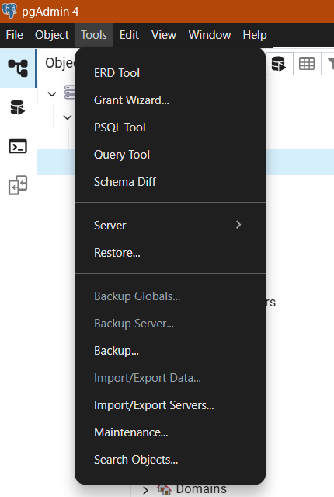
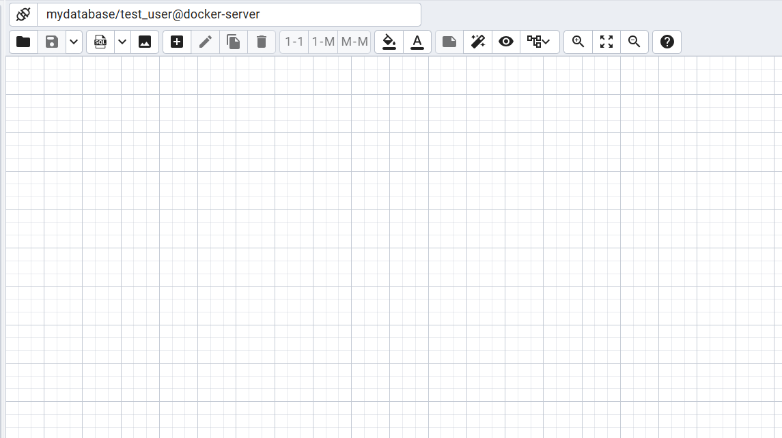
It provides a basic tool for creating ER diagrams
TOOLS

Slide 28
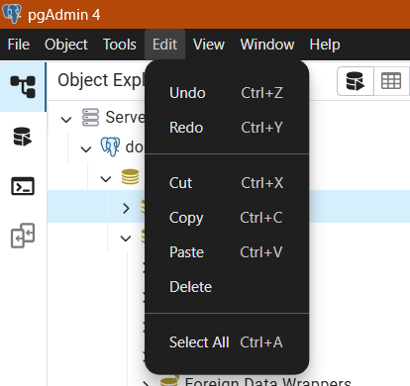
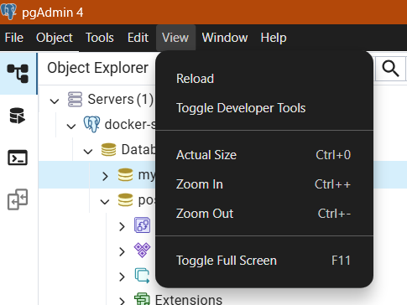
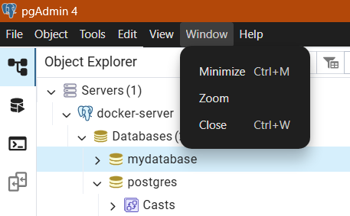
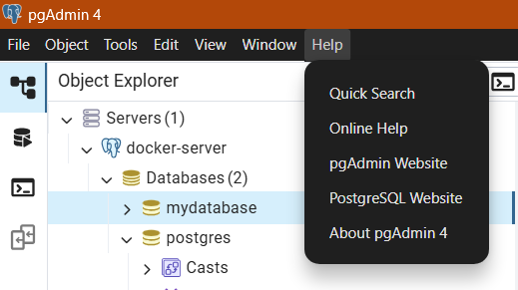

Slide 29
TREE CONTROL
The left pane of the main window displays a tree control (Object explorer) that provides access to the objects that reside on a server.

Slide 30
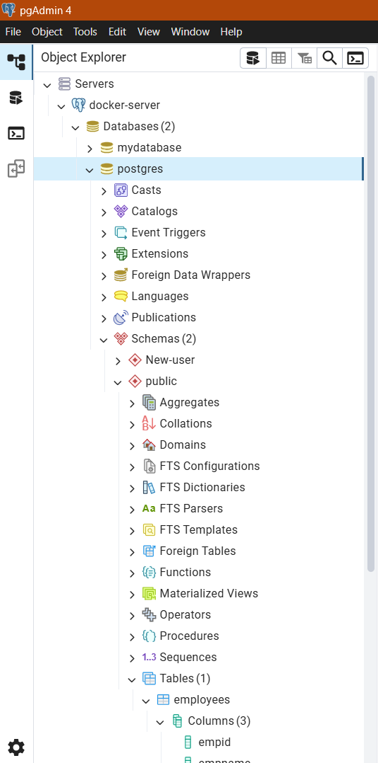
You can expand nodes in the tree control to view the database objects that reside on a selected server. The tree control expands to display a hierarchical view:
You can also drag and drop certain objects to the Query Tool which can save time in typing long object names. Text containing the object name will be fully qualified with schema. Double quotes will be added if required. For functions and procedures, the function name along with parameter names will be pasted in the Query Tool.

Slide 31
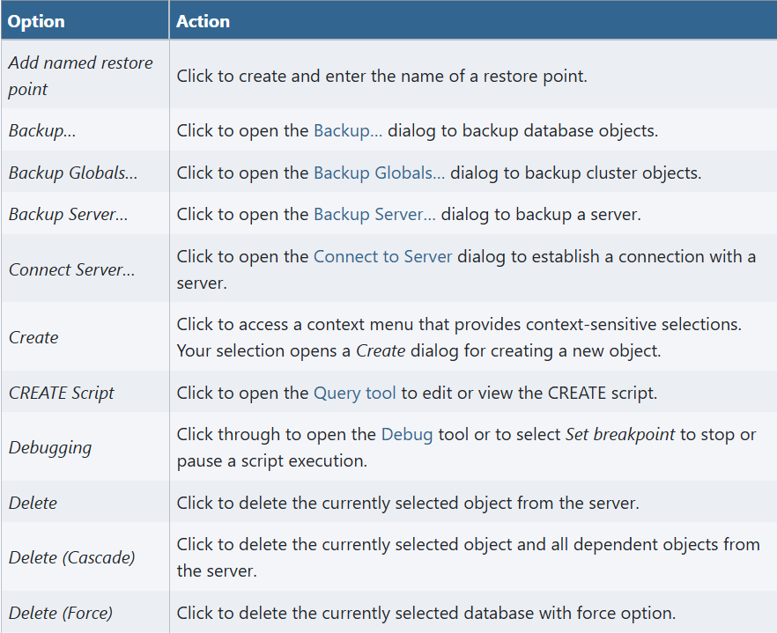
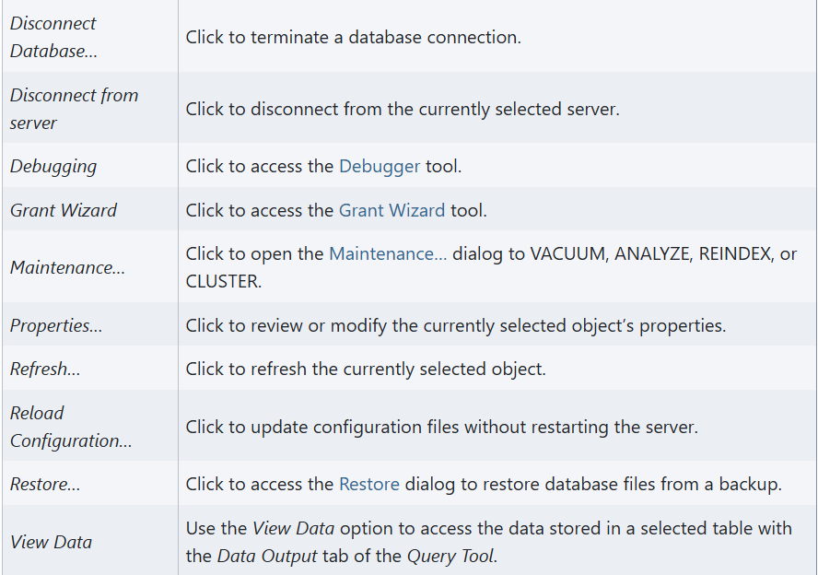
Access context-sensitive menus by right-clicking on a node of the tree control to perform common tasks.

Slide 32
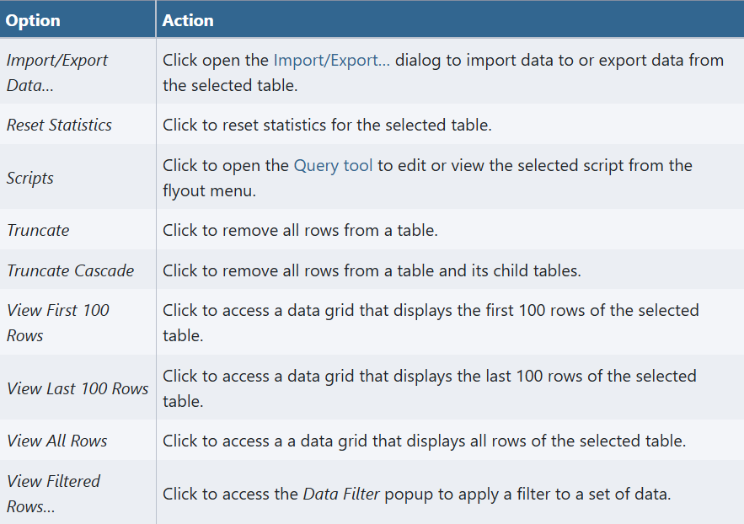
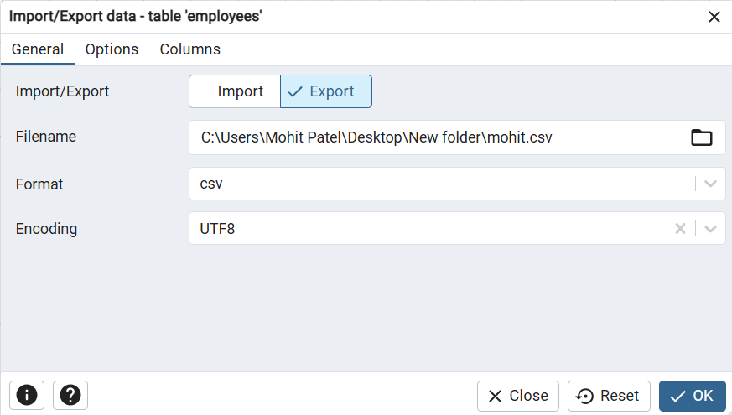
The context-sensitive menu’s associated with Tables and nested Table nodes provides additional display options (options appear in alphabetical order):
Import/Export Dialog

Slide 33
Thank You

