Slide 1
Network Security
Wireless security beyond password cracking
Mohit Rajain

Slide 2
Who am I ?
Final Year Btech ( ECE ) student @ NIT Delhi
Network security Enthusiast
Love to play with Firewalls , Antivirus etc
Past experience in System Administration , Full stack ( MEAN ) Web Development
Love to Write my own tools for attack / defense
Other Interests :- Operating systems , Binary exploitation etc

Slide 3
Agenda
Network attacks in wired Lan environments
Protection in wired Lan
Layout of modern networks ( wired + wireless )
Difference between wired and wireless security
Most powerful situation to acquire in any network
Wireless attacks
Why NTP ?
Captive portal attacks
Conclusion and some wild thoughts

Slide 4
Network attacks in wired environment
Rouge DHCP server
ARP spoofing
ICMP redirection
MAC flooding
DHCP pool exhaustion attack
VLAN hopping
More ...

Slide 5
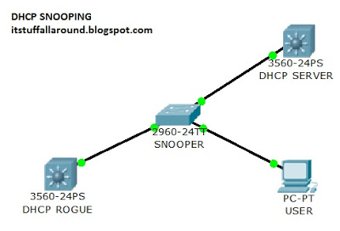
Rouge DHCP Server
Source :- http://itstuffallaround.blogspot.com/2013/09/implement-dhcp-snooping-rogue-prevention.html

Slide 6
Demo - ISC DHCP Server on linux
# new attack range
subnet 10.30.48.0 netmask 255.255.252.0{
range 10.30.48.2 10.30.48.200;
option domain-name-servers 10.30.48.1;
option routers 10.30.48.1;
option broadcast-address 10.30.51.255;
default-lease-time 6000;
max-lease-time 7200;
}

Slide 7
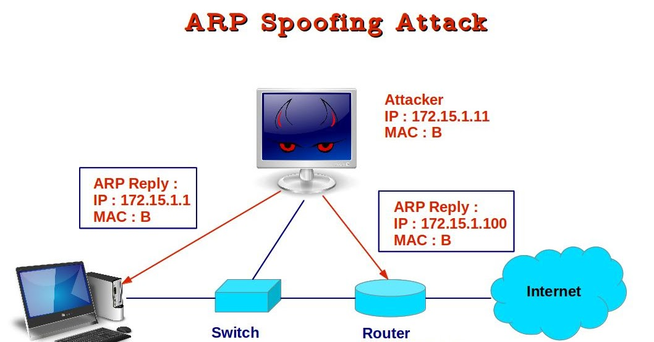
Arp Spoofing
Source :- https://images.duckduckgo.com/iu/?u=https%3A%2F%2Ftse1.mm.bing.net%2Fth%3Fid%3DOIP.OVLOFcAgqm7asmIYogARKAHaD4%26pid%3D15.1&f=1

Slide 8
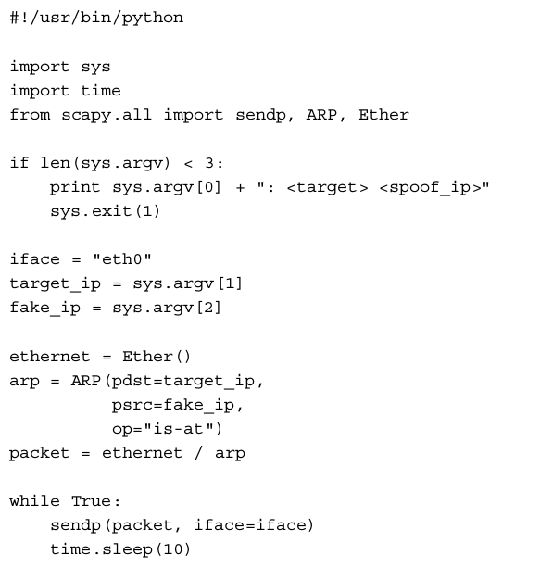
Demo - Using Scapy ( python library )
Source :- Understanding Network Hacks

Slide 9
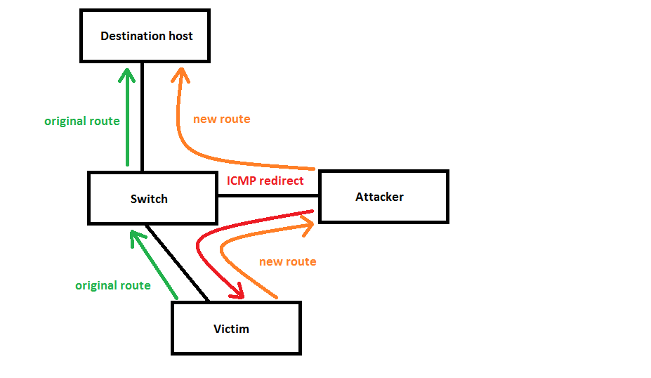
ICMP redirection
Source :- https://images.duckduckgo.com/iu/?u=https%3A%2F%2Ftse2.mm.bing.net%2Fth%3Fid%3DOIP.U8NZrRibxMNhvJNjTxkTlgHaET%26pid%3D15.1&f=1

Slide 10
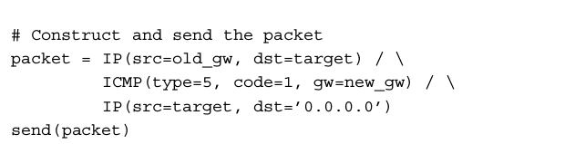
Demo :- Using ( python library )
Source :- Understanding Network Hacks

Slide 11
Mac flooding :-
Attack on the CAM table of the switch , this leads to broadcasting of the packets to all the ports of the switch.
Using :- Scapy ( python library )
DHCP pool exhaustion attacks
A single client acquires all the ip address from the pool . And this could lead to DoS attack on the DHCP server .
Using :- Scapy ( python library )

Slide 12
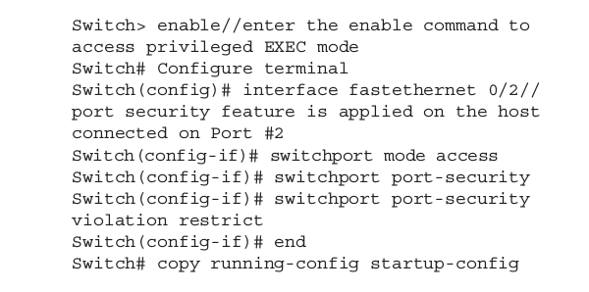
Security measures in wired environments
Port security ( managed switches only )

Slide 13
Security measures in wired environments
Dhcp snooping ( managed switches only )

Slide 14
No moves left

Slide 15
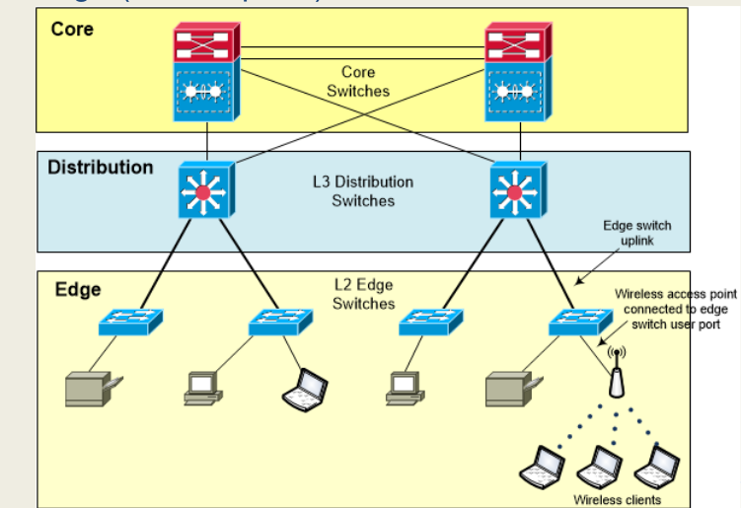
Modern network layouts
Source :- https://wififorbeginners.com

Slide 16
Difference between wired and wireless networks ( Security )
Wifi broadcasts every traffic signal
Wired infrastructure broadcasts only limited traffic like DHCP ,arp etc
Easy to get into monitor mode in Wireless networks
Its not possible without attack on switch (CAM flooding ) or using port mirroring

Slide 17
More Differences
Wireless traffic ( layer 2 frames ) usually encrypted
There is no encryption at all in wired networks
Wireless attacks are possible even without connecting to the wireless network ( without associating , authenticating )
This is not possible to in wired networks , we need to plug in the ethernet cable

Slide 18
More Differences
Wireless traffic ( layer 2 frames ) usually encrypted
There is no encryption at all in wired networks
Wireless attacks are possible even without connecting to the wireless network ( without associating , authenticating )
This is not possible to in wired networks , we need to plug in the ethernet cable

Slide 19
Most powerful situation in mixed networks
Get control over the main switch nothing else

Slide 20
Wireless Attacks
Rouge Access point :-
Pros :-
Easy to pull off
Mitm ( God mode :- you can do anything with client )
Cons :-
Easily detected by WIDS
Position dependent ( more nearer to the victim )

Slide 21
Demo Time
Rouge Ap
Using :- Hostapd on Linux

Slide 22
Deauth
Pros :-
very easy to pull off
uesd to empower other attacks
Useful to annoy wireless services
Cons :-
Nothing useful if used alone
Can be detected using WIDS

Slide 23
Demo Time
Deauth Attacks
using :- Scapy ( python library )

Slide 24
Packet Injection
DHCP packet injection
Arp packet injection
DNS packet injection
NTP packet injection
And many more

Slide 25
Packet injection continued
Pros :-
Can be used to bypass switch measures ( port security , dhcp snooping etc )
Hard to detect
Cons :-
Hard to pull off , time dependent
use other attacks like deauth
Position dependent

Slide 26
Demo Time
DHCP packet injection
Using :- Scapy ( python library )
dhcpinjection.py
Arp packet injection
Using :- Scapy ( python library )
arpinjection.py

Slide 27
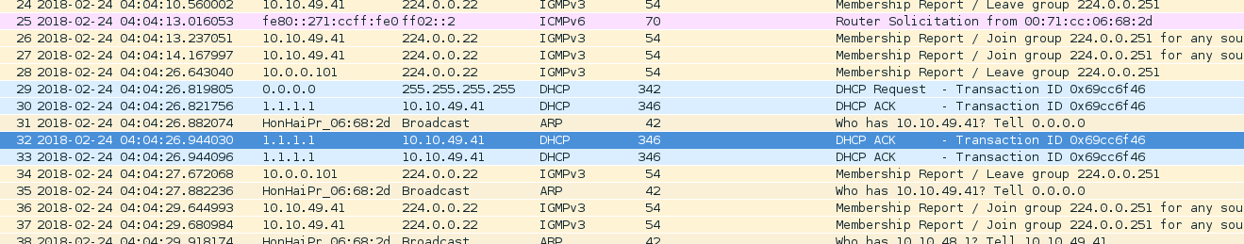
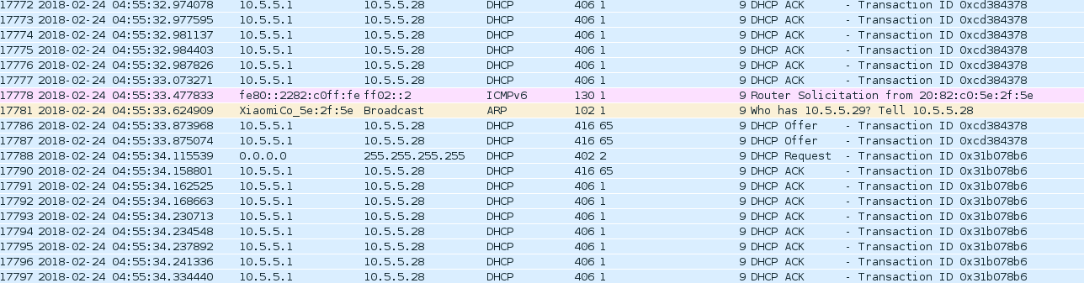
Analysis of packet injection attacks
Attacker loses here :-
Attacker was successful to inject packets after 50 mins

Slide 28
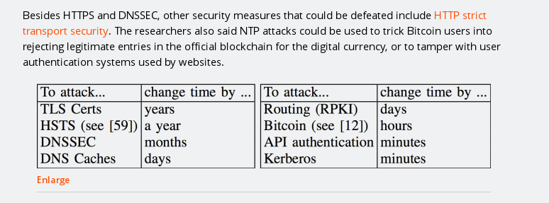
Why we attack NTP ?
Source :- https://arstechnica.com/information-technology/2015/10/new-attacks-on-network-time-protocol-can-defeat-https-and-create-chaos/

Slide 29
Captive Portal attacks
They are usually open WIFI with some login form
Rouge Access point attack can be used to get credentials for login form
Phishing can be done on the clients accessing the WIFI
As the HTML page is automatically loaded on the client's device , malicious javascript can also be executed on the client's device .

Slide 30
Conclusion
Wireless networks are less safer than wired networks .
WIDS should be used to protect from wireless attacks .
Encryption cracking ( aka password cracking ) is an important part of wireless security .
But this is not the end , many attacks happens with and without it .
Captive portals are useful but beware of phishing.

