Slide 1
Network Security
Attacks / Defense in local Networks
Mohit Rajain

Slide 2
Agenda
Why Local Networks ?
Most Important services of a network
Owning a network
ARP spoofing
Rogue DHCP server
Attack on DNS
Phishing on local Network
Defense Techniques

Slide 3
Why local Networks ?
When we are connected to internet , we are present in some local network behind firewall .
Example :- Ethernet, wifi @ home , colleges , offices , malls etc .
Firewall protects us from internet but attacks within local network are still possible .

Slide 4
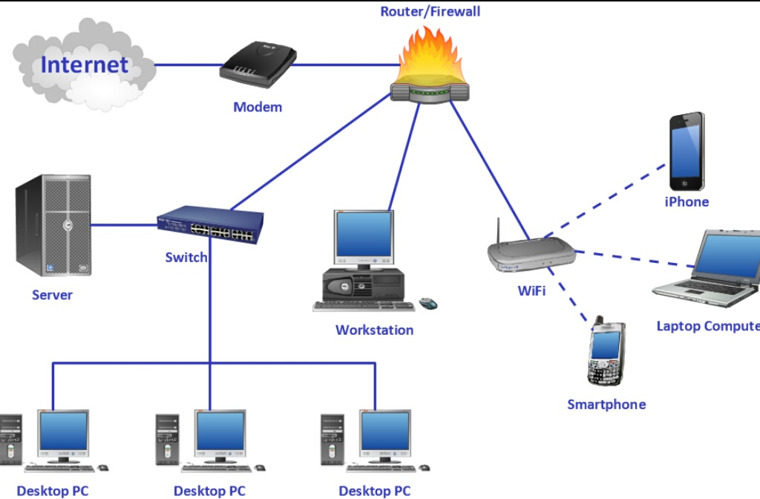

Slide 5
Most Important services of a network
Gateway :- It lets us connect to connect to internet or other networks .
DHCP server :- it is responsible for providing basic network configuration to clients
DNS server :- it is responsible for resolving our domains like facebook.com to IP address like 172.217.31.110 .
ARP resolution:- It is responsible for converting IP address 10.10.10.26 to MAC 00:00:00:00:00:12 inside a network .

Slide 6
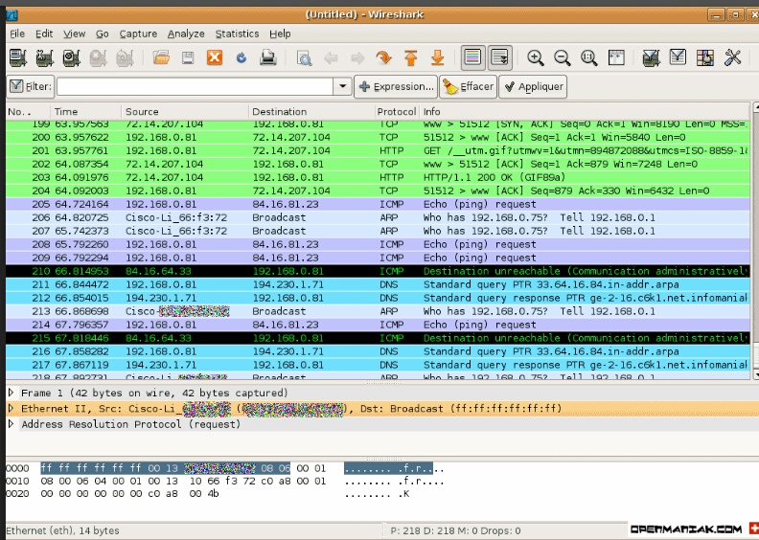

Slide 7
Passive attack in a network
If you are present in a network then you can capture packets of others ( but to some extent only ) by getting in promiscuous / monitor mode .
This is a kind of passive attack . You can just sit and watch packets going through .
All non encrypted credentials can still be captured and can be used against victim .
Most of traffic today ( HTTPS ) is encrypted . So can't do much with it . But still DNS requests reveals browsing habit and what apps are installed on your phone .

Slide 8
Active Attacks : owning a network
What an attacker wants is full control over victim's data . This can be possible only when he/she is able to interrupt network services .
And attacking on network services lead him to own the network .
What he can do after owning a network :-
He can alter your content and so can phish you .
Redirect you to his own network services like fake servers for facebook.com , gmail.com etc .
He can insert malware , adware etc in your requested content .
Or at least he can stop your networking services .

Slide 9
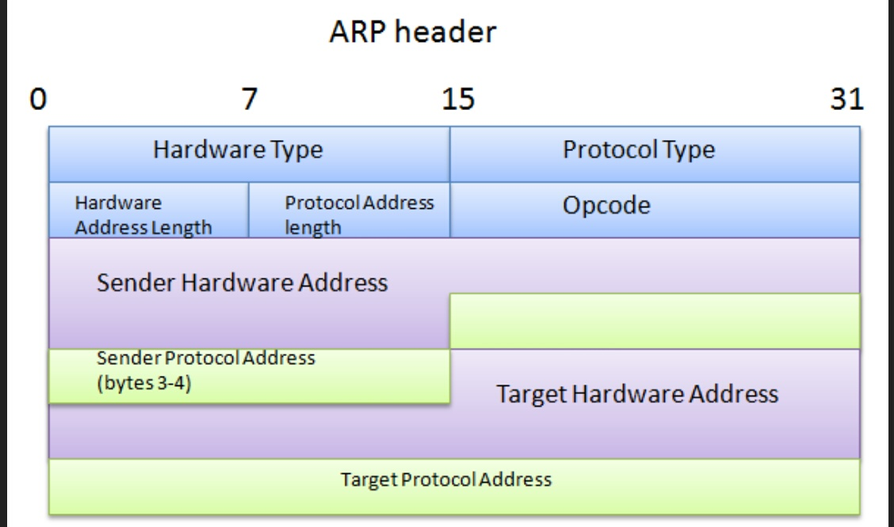
What is ARP ?
The Address Resolution Protocol (ARP) is a communications protocol used for resolution of Internet layer addresses into link layer addresses, a critical function in the Internet protocol suite .

Slide 10
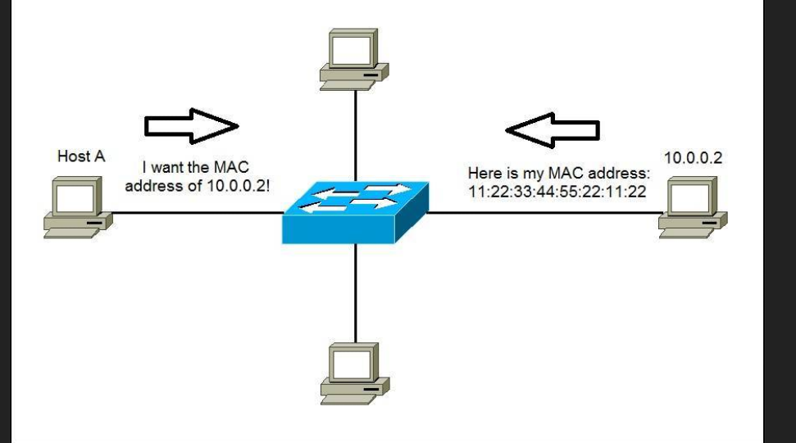
How arp work ?

Slide 11
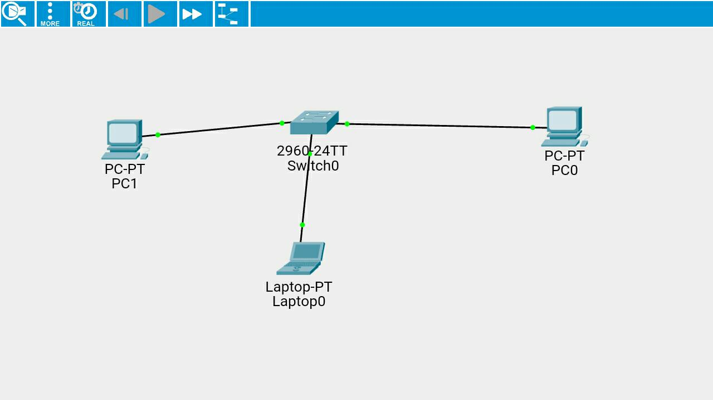
Demo of arp cache poisioning .

Slide 12
