Slide 1
Department of Master of Computer Applications
Minor Project (MCA461P) – Phase-2
FocusSense – Eye & Head Pose Detection for Study Concentration
Mohit Raj(1RV24MC070)
Sameer Patel(1RV24MC091)
Under the Guidance
of
Dr. Andhe Dharani
Professor

Slide 2
Agenda
Incorporation of Suggestions of previous review
Objectives
Functional Requirements ( Modules description)
Non-functional Requirements ( Relevant to the project )
Architectural Design
Modules identified
System Design
Implementation

Slide 3
Incorporation of Suggestions of previous review
The following improvements were made:
Implemented temporal modeling using LSTM instead of frame-based decisions.
Added head pose estimation (Pitch, Yaw, Roll).
Improved data collection strategy with labeled sequences.
Added real-time inference buffer (30 frames) for stability.
Enhanced visual feedback for demo and validation.
These changes improved accuracy and real-time reliability.

Slide 4
Objectives
Primary Objective:
To detect user focus or distraction in real time using eye and head movement patterns.
Secondary Objectives:
Capture eye movement and head pose using webcam.
Extract meaningful features instead of raw pixels.
Use deep learning (LSTM) to learn temporal attention behavior.
Provide real-time visual feedback (Focused / Distracted).

Slide 5
Functional Requirements
Module Specification (Table 1):
Module No. | Module Name | Input | Process | Output
1 | Video Capture Module | Webcam feed | Captures live video frames using OpenCV | Video frames
2 | Face Detection & Landmark Module | Video frame | Detects face and extracts 468 facial landmarks using MediaPipe | Facial landmark coordinates
3 | Eye Tracking Module | Eye-related landmarks | Calculates iris center, eye movement, and blink ratio | Eye movement & blink features
4 | Head Pose Estimation Module | Selected facial landmarks | Computes pitch, yaw, roll using solvePnP algorithm | Head pose angles (Pitch, Yaw, Roll)
5 | Feature Extraction Module | Eye features + head pose angles | Combines features into a fixed-length vector | 9-dimensional feature vector

Slide 6
Functional Requirements
Module Specification (Table 2):
Module No. | Module Name | Input | Process | Output
6 | Sequence (Inference) Buffer Module | Feature vectors per frame | Stores last 30 frames as a sliding window | Feature sequence (1, 30, 9)
7 | Focus Classification Module (CNN + LSTM) | Feature sequence | Learns temporal patterns and predicts focus probability | Focused probability score
8 | Decision & UI Display Module | Focus probability | Converts probability to Focused/Distracted and displays result | On-screen focus status
9 | Data Recording Module | Feature sequence + label | Saves labeled sequences as .npy files | Training dataset
10 | Model Training Module | Recorded dataset | Trains CNN + LSTM model | Trained FocusSense model

Slide 7
Non-Functional Requirements
Performance:
Real-time processing (15–30 FPS).
Low latency prediction.
Reliability:
Stable predictions using temporal buffering.
Handles small head movements without noise.
Usability:
Simple webcam-based system.
Clear on-screen feedback.
Scalability:
Can be extended with additional features later.

Slide 8
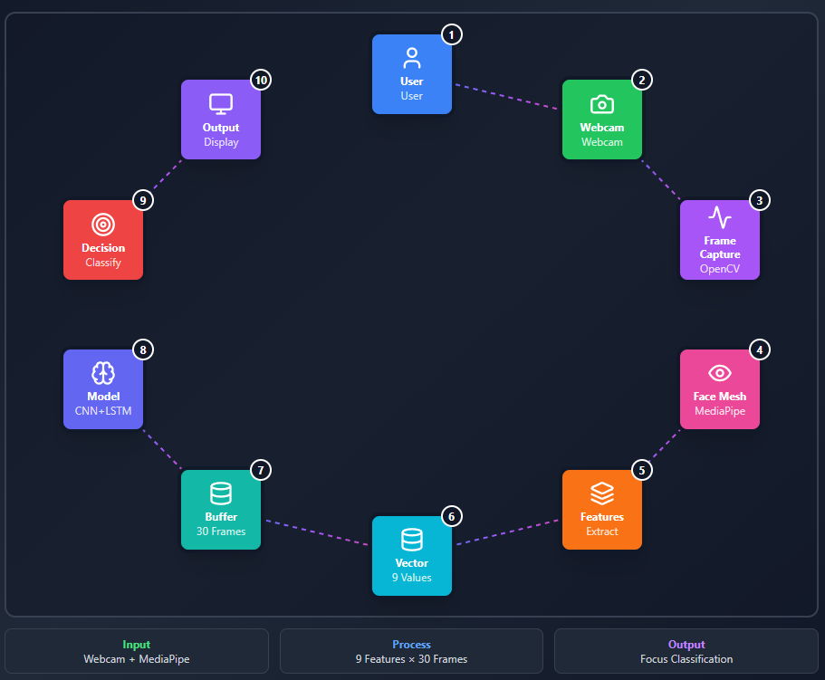
Architectural Design
Architecture Type:
Modular, real-time, ML-based architecture

Slide 9
Data/ Module Definition
Data definition(Feature Vector)
Each frame produces a 9-dimensional vector:
Feature | Description
Pitch | Head up/down
Yaw | Head left/right
Roll | Head tilt
Eye X (L) | Left eye horizontal
Eye Y (L) | Left eye vertical
Eye X (R) | Right eye horizontal
Eye Y (R) | Right eye vertical
Blink Ratio | Eye closure
Stability | Motion consistency

Slide 10
Data/ Module Definition
Module specification / Assumptions made:
Assumptions:
User face is visible to webcam.
Lighting is reasonably stable.
User is seated in front of screen.
Specifications:
Sequence length = 30 frames.
Feature dimension = 9.
Binary classification (Focused / Distracted).

Slide 11
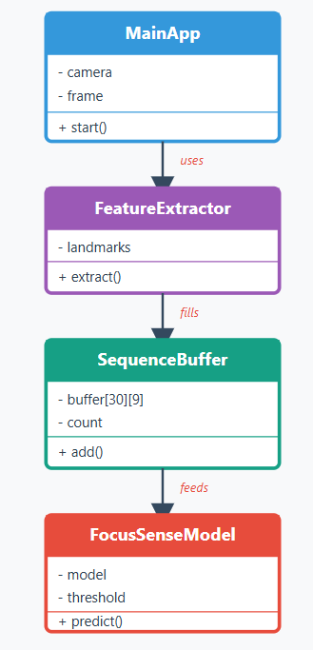
System Design
Object Modeling:
-Draw Class diagram

Slide 12
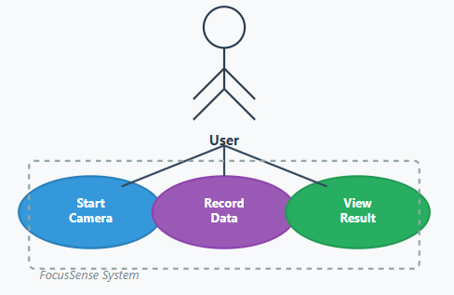
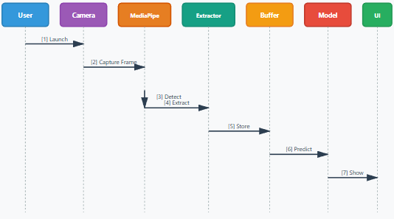
System Design
Dynamic Modeling:
- -
Use case Diagram
Sequence Diagram

Slide 13
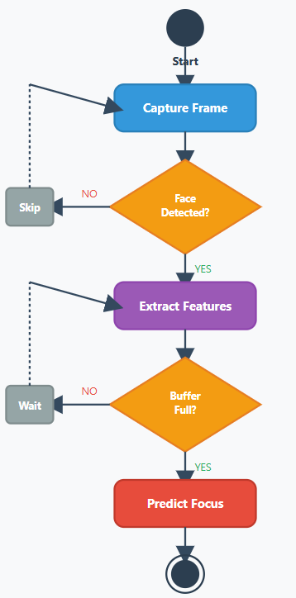
System Design
Dynamic Modeling:
- Activity Diagram

Slide 14
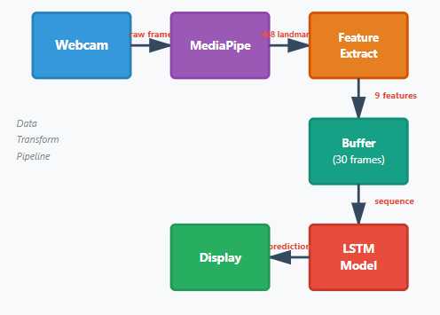
System Design
Functional Modeling:
Data Flow Diagrams

Slide 15
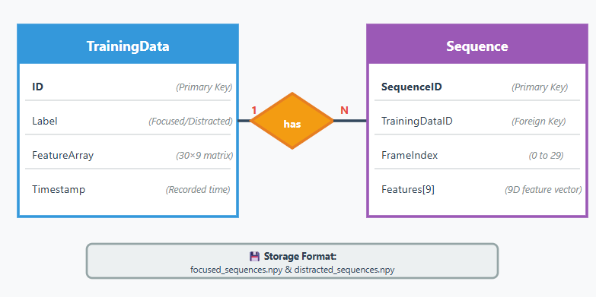
System Design
Database Design (ER Diagram):

Slide 16
System Design
Design Decisions:
Decision | Reason
Feature-based input instead of raw pixels | Reduces computation and enables real-time processing
Use of LSTM model | Captures temporal behavior of attention over time
Fixed sequence length (30 frames) | Ensures stable and smooth predictions
Binary classification (Focused / Distracted) | Simple, interpretable, and effective

Slide 17
System Design
Assumptions:
Assumption | Description
User faces the camera | Required for accurate face and eye tracking
Adequate lighting conditions | Improves landmark and feature detection accuracy
Single user in frame | System is designed to track one face at a time

Slide 18
Implementation
The FocusSense system has been partially implemented and validated as per Phase-2 objectives. Core modules for data collection, model training, and real-time inference are functional.
Completed Implementation Tasks:
Webcam-based face capture using OpenCV.
Facial landmark detection using MediaPipe Face Mesh.
Head pose estimation (Pitch, Yaw, Roll).
Eye movement and blink feature extraction.
Feature vector creation (9 features per frame).
Sequence buffering (30 frames per sample).
Data collection for Focused and Distracted states.
CNN + LSTM model training.
Real-time focus inference and on-screen display.

Slide 19
Implementation
Model Implementation Status:
Model Type: CNN (TimeDistributed Dense) + LSTM.
Input Shape: (30 × 9) feature sequence.
Output: Binary classification (Focused / Distracted).
Training Status: Completed with ~85–88% validation accuracy.
Model successfully loaded and used during real-time execution.
Real-Time System Status:
Live webcam feed integrated.
Face landmarks and head pose visualized.
Inference buffer used for stable predictions.
Focus percentage displayed dynamically.
System responds correctly to head and gaze changes.

Slide 20
Implementation
Current Progress Summary:
Component | Status
Data Collection | Completed (200+ samples)
Feature Extraction | Completed
Model Training | Completed
Real-Time Inference | Completed
UI Visualization | Completed
Optimization & Testing | Ongoing
In Phase-2, we successfully implemented the complete pipeline from data collection to real-time focus inference.
The model is trained and integrated with live video input, and the system produces stable focus predictions.
Further optimization and enhancements are planned for the final phase.

Slide 21
References
MediaPipe Face Mesh Documentation GoogleResearchhttps://developers.google.com/mediapipe/solutions/vision/face_mesh
OpenCV Library DocumentationOpen Source Computer Vision Libraryhttps://docs.opencv.org
TensorFlow & Keras DocumentationGoogle Brain Teamhttps://www.tensorflow.orghttps://keras.io
Recurrent Neural Networks (LSTM)Hochreiter, S. & Schmidhuber, J., 1997Long Short-Term Memory, Neural Computation
Head Pose Estimation using solvePnPOpenCV Tutorialshttps://docs.opencv.org/4.x/d9/d0c/group__calib3d.html
Python Programming Language Documentationhttps://docs.python.org/3
Attention & Eye-Tracking ConceptsDuchowski, A. T. (2007)Eye Tracking Methodology: Theory and Practice

Slide 22
THANK YOU

