Slide 1
Department of Master of Computer Applications
Minor Project (MCA461P) – Phase-3
FocusSense – Eye & Head Pose Detection for Study Concentration
Mohit Raj (1RV24MC070)
Sameer Patel (1RV24MC091)
Under the Guidance
of
Dr. Andhe Dharani
Professor

Slide 2
Agenda
Introduction
Changes suggested in Phase II and Incorporation
Implementation
Testing
Results and Conclusion
Future Enhancements
References
Details of paper publication

Slide 3
Introduction
Online and smart classrooms lack real-time student attention monitoring.
Teachers cannot easily identify:
  Distracted students.
  Overall class focus level.
Manual observation is:
  Time-consuming.
  Subjective.
  Not scalable.
FocusSense solves this using computer vision & analytics.

Slide 4
Problem Statement
To design and implement a system that:
  Automatically detects student attention.
  Works in real time.
  Supports multiple students.
  Stores attention history for analysis.

Slide 5
Scope Of The Project
Online classes.
Smart classrooms.
Student engagement analysis.
Users:
  Students (tracking client).
  Teacher/Admin (dashboard & reports).

Slide 6
Incorporation of Changes
Explain the changes incorporated:
Add Changes implemented:
  Central Flask server.
  Student ID–based joining.
  SQLite database integration.
  Analysis page with charts.
  Admin panel with student history.
  CSV & PDF export.
All Phase-II suggestions implemented successfully.

Slide 7
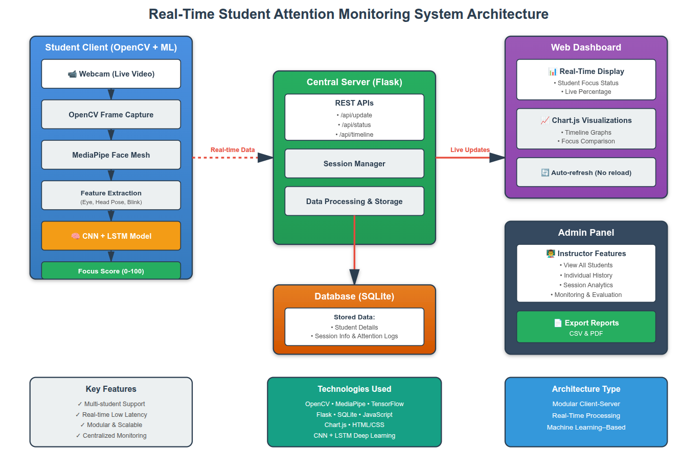
System Architecture
Fig: Workflow System Architecture

Slide 8
Implementation
Project divided into 4 main modules:
  Student Tracking Module
  Server & Database Module
  Dashboard & Analysis Module
  Admin & Reporting Module

Slide 9
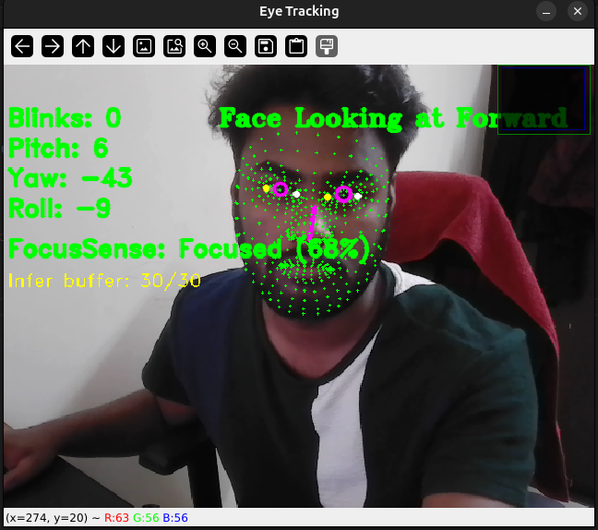
Implementation
Module 1: Student Tracking:
Input:
  Live webcam feed.
Process:
  Face detection (MediaPipe).
  Eye landmarks detection.
  Head pose estimation.
  Attention score calculation.
Output:
  Focus score (0–100).
  Focused / Distracted label.
  Data sent to server.
Fig:Eye tracking window showing

Slide 10
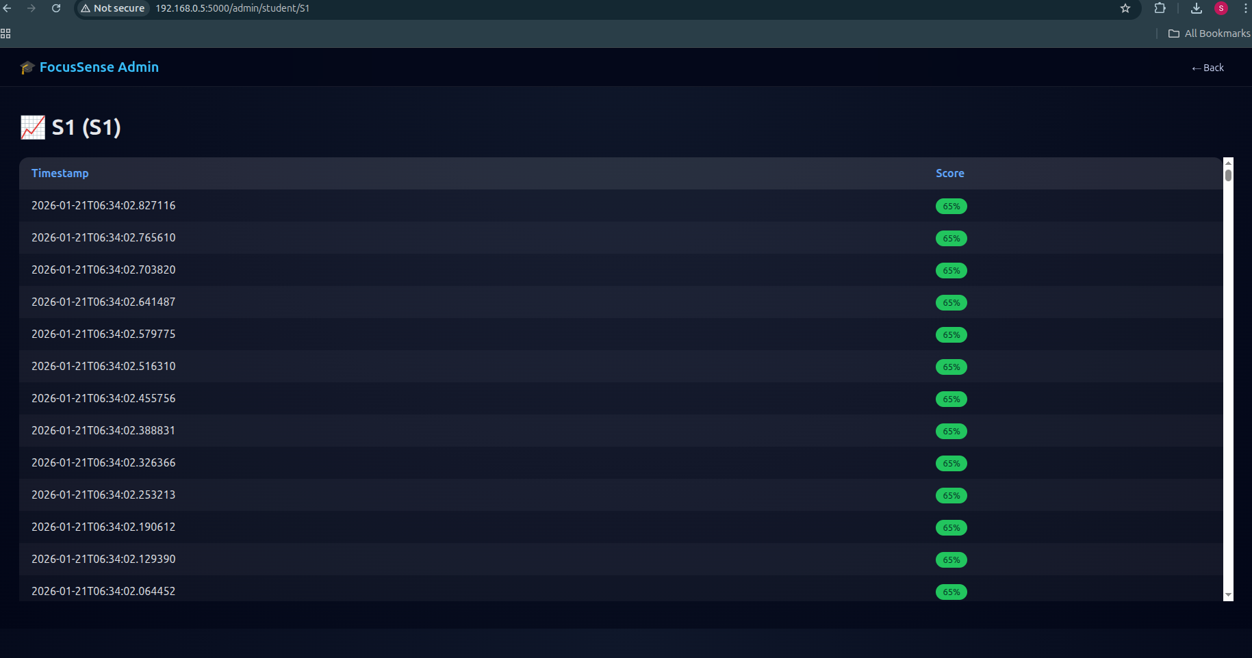
Implementation
Module 2: Server & Database:
Input:
  Student ID
  Name
  Focus score
Process:
  Receive data via REST API.
  Store in SQLite database.
  Maintain session & logs.
Output:
  Stored attention history.
Fig:SQLite table showing attention_logs

Slide 11
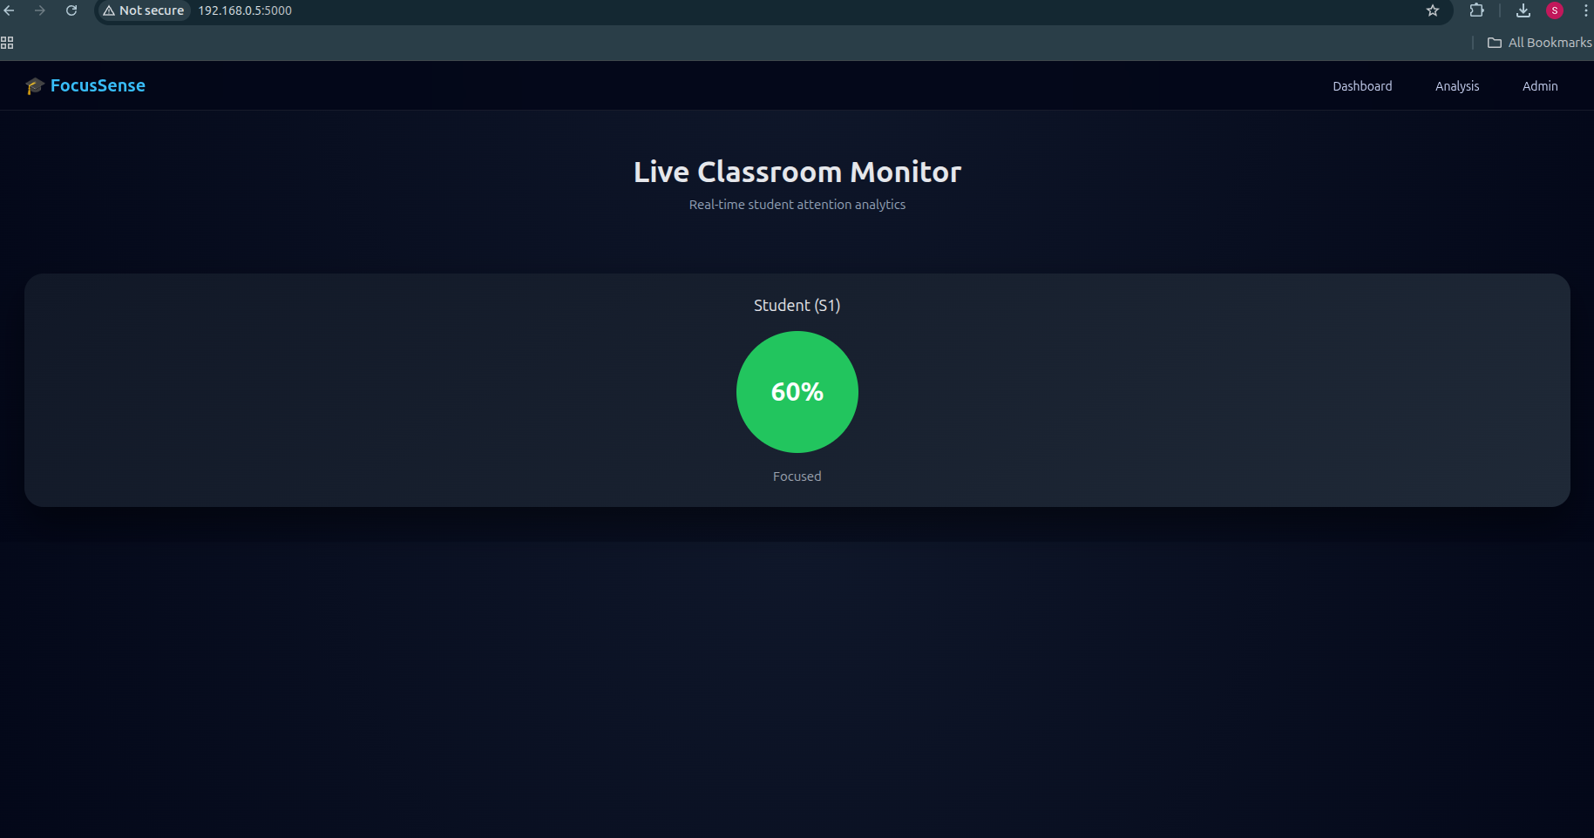
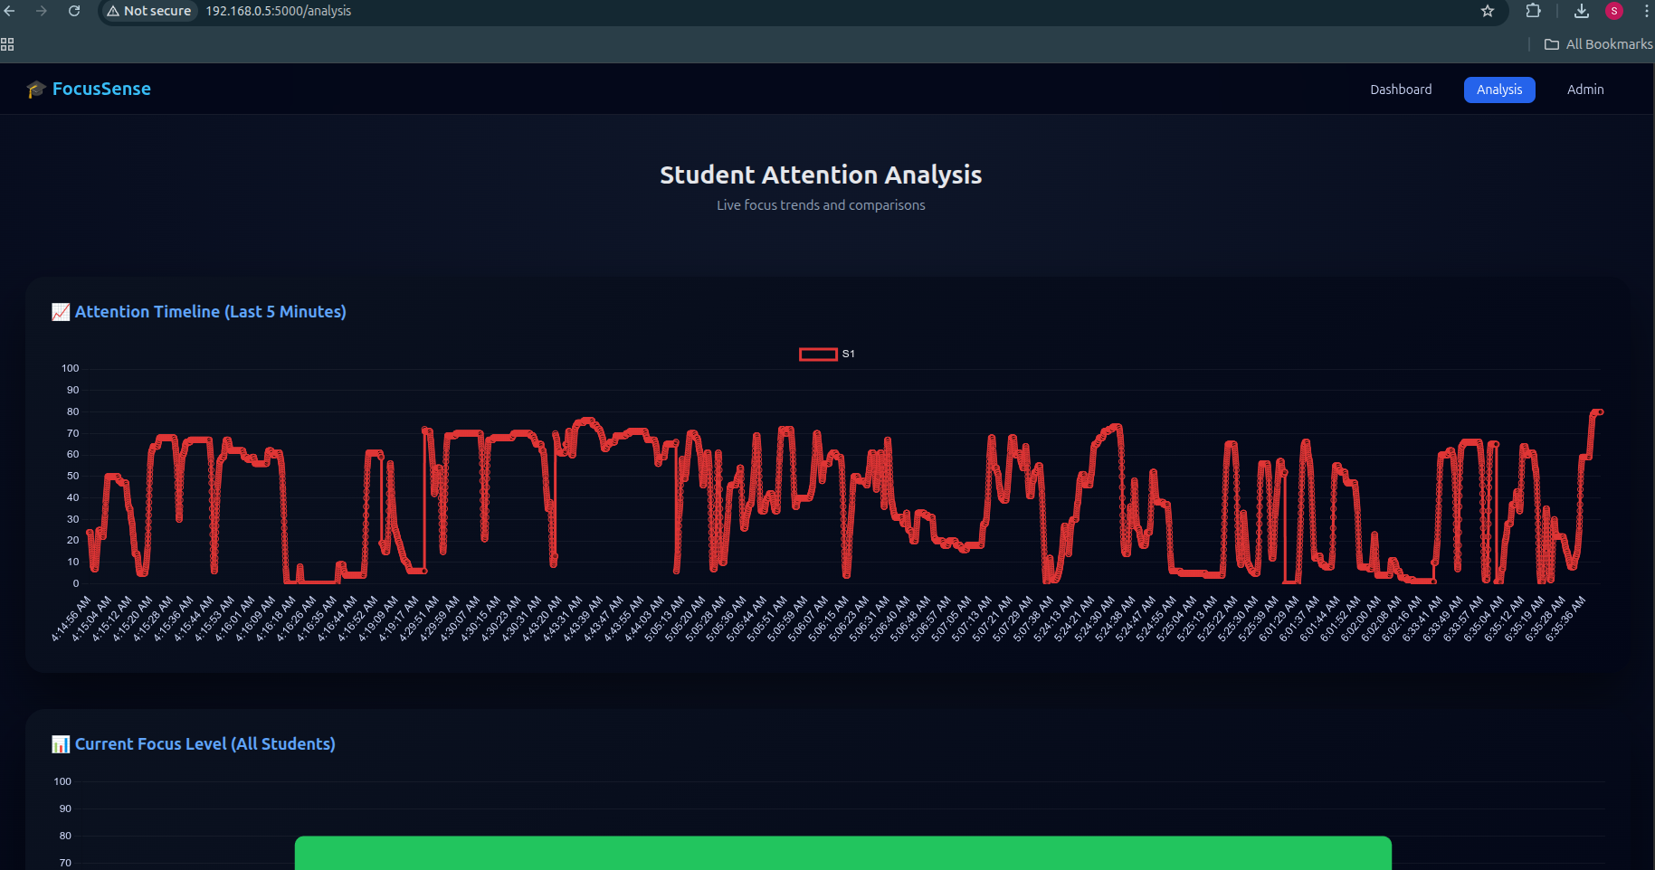
Implementation
Module 3: Dashboard & Analysis:
Input:
  Live database data.
Process:
  Fetch student status.
  Update UI every 2 seconds.
  Render charts using Chart.js
Output:
  Live classroom dashboard.
  Attention timeline graph.
  Current focus bar chart.
Fig:Live dashboard page & Analysis page with line & bar charts

Slide 12
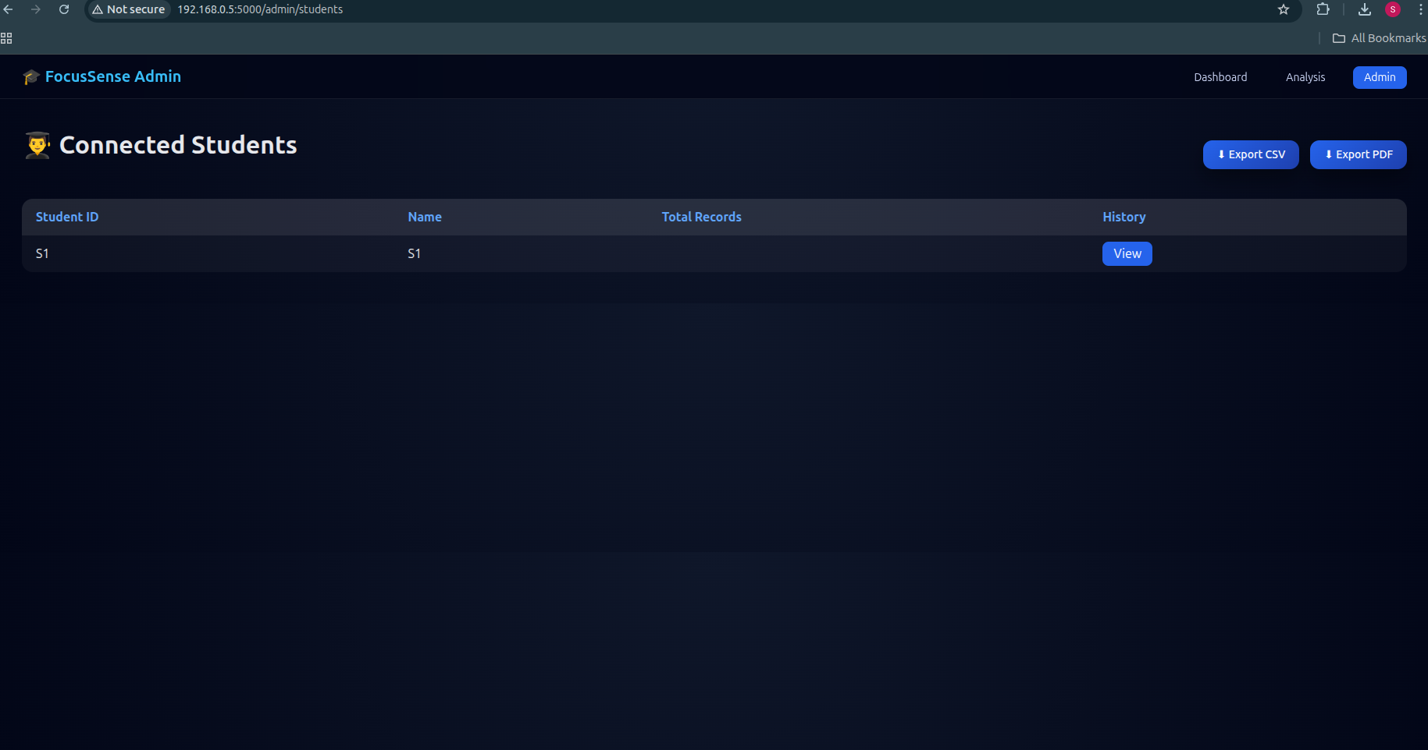

Implementation
Module 4: Admin Panel:
Input:
  Stored database records.
Process:
  Fetch all students.
  Fetch individual history.
  Generate reports.
Output:
  Student list
  Detailed history
  CSV & PDF exports
Fig:Admin student list page & Student history page

Slide 13
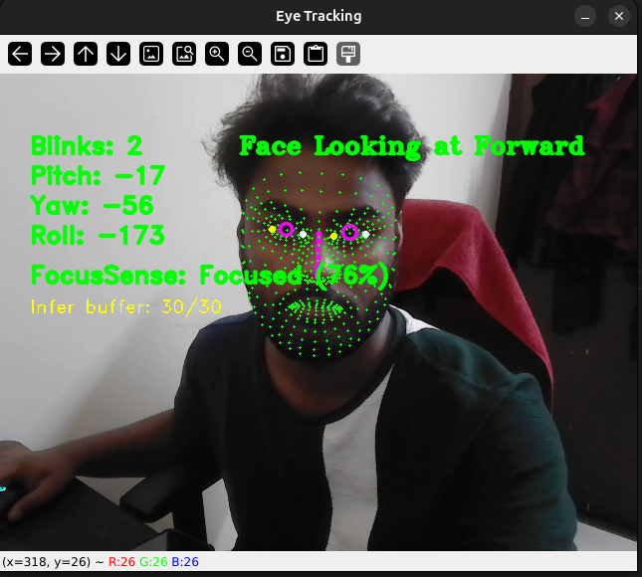
Testing
Test case ID | Feature Tested | Sample Input | Expected Output | Actual Output | Remarks ( Pass/Fail)
TC-01 | Face Detection | Webcam | Face detected | Face detected | Pass
TC-02 | Attention Score | Head movement | Score change | Score updated | Pass
Unit Testing:
Fig:Face tracking window

Slide 14
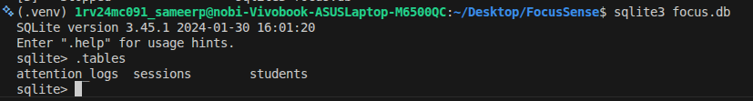
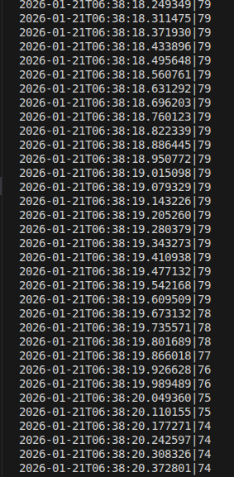
Testing
Test case ID | Feature Tested | Sample Input | Expected Output | Actual Output | Remarks ( Pass/Fail)
TC-03 | DB Insert | Score data | Stored | Stored | Pass
TC-04 | Student ID | New ID | Added | Added | Pass
Integration Testing:
Fig: SQLite log entries

Slide 15
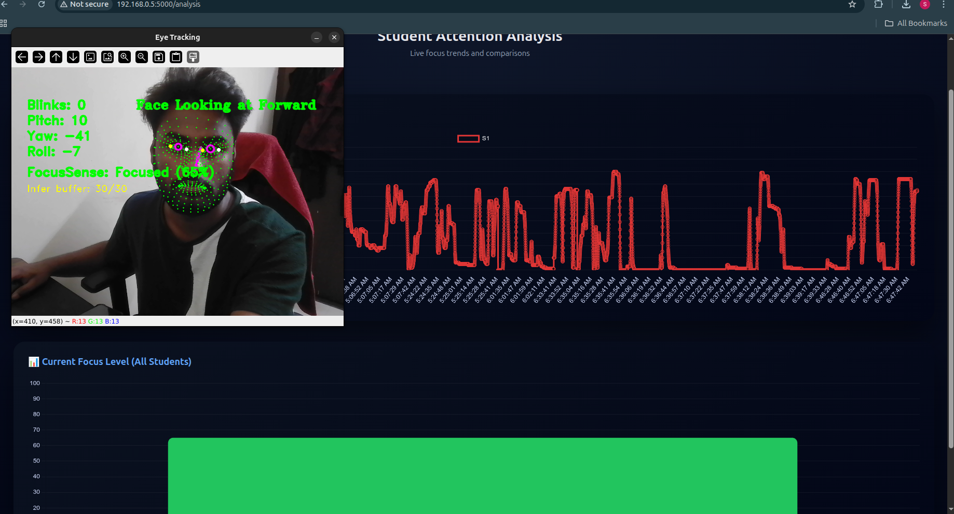
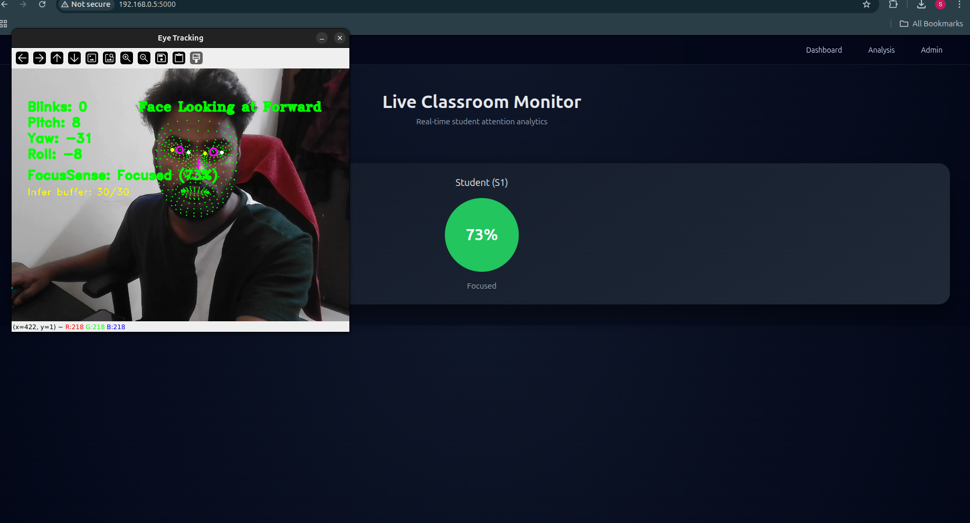
Testing
Test case ID | Feature Tested | Sample Input | Expected Output | Actual Output | Remarks ( Pass/Fail)
TC-05 | Dashboard | Live data | Update | Update | Pass
TC-06 | Admin History | Student ID | Show history | Displayed | Pass
SystemTesting:
Fig:Dashboard & Admin pages

Slide 16
Results and Conclusion
Results:
System successfully tracks student attention.
Supports multiple students simultaneously.
Accurate real-time visualization.
Historical data stored & retrievable.
Reports generated successfully.

Slide 17
Results and Conclusion
Conclusion:
FocusSense meets all project objectives.
Real-time and scalable solution.
Useful for modern online education.
Phase-III implementation completed successfully.

Slide 18
Future Enhancement
Mobile (Android) client
Cloud deployment
Teacher alerts for low attention
Emotion detection
AI-based performance prediction
Role-based authentication

Slide 19
References
OpenCV Documentation,Open Source Computer Vision Library,Available: https://docs.opencv.org/
Google MediaPipe,Face Mesh and Landmark Detection,Available: https://developers.google.com/mediapipe
Flask Documentation,Flask: A Lightweight WSGI Web Application Framework,Available: https://flask.palletsprojects.com/
SQLite Documentation,SQLite – Lightweight Relational Database,Available: https://www.sqlite.org/docs.html
TensorFlow/Keras Documentation,Deep Learning Framework for Model Training,Available: https://www.tensorflow.org/guide/keras
S. K. Chavan and A. A. Patil,“Real-Time Face Detection and Attention Monitoring System,”International Journal of Computer Applications, vol. 176, no. 22, pp. 1–5, 2020.

Slide 20
THANKYOU

