Slide 1
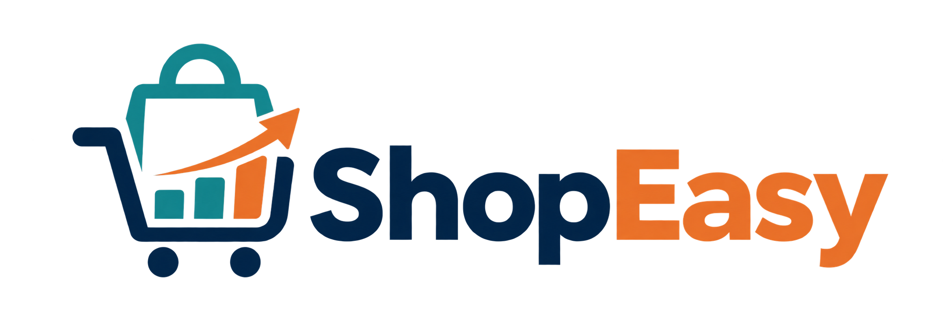
Data Presentation
Marketing Analytics Portfolio Project

Slide 2
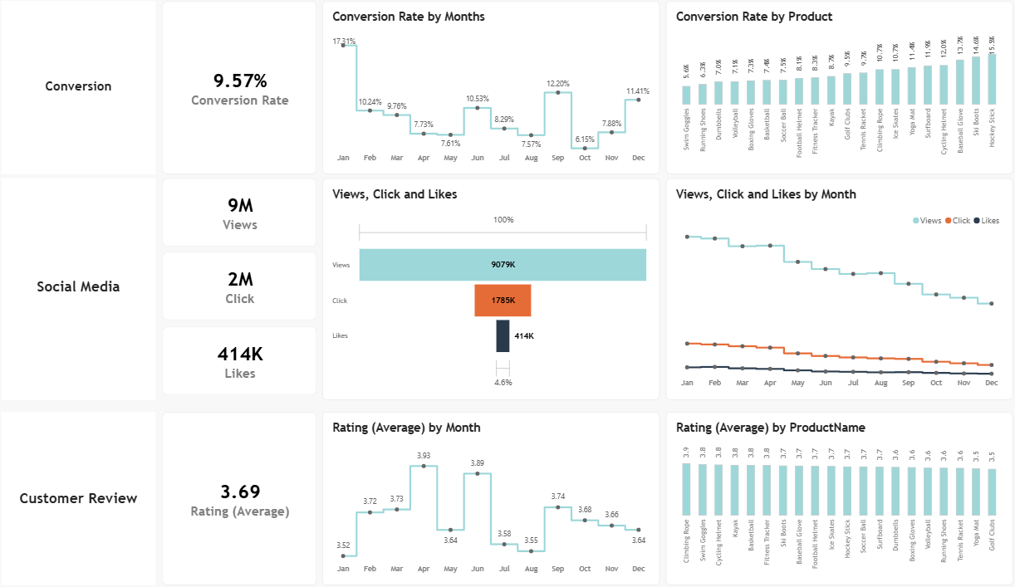
Overview
1
Decreased Conversion Rates
Conversion took a hit in October, dropping to 6.15%, but bounced back strong in December to close the year at 11.41%.
2
Reduced Customer Engagement
Social media engagement slowed down this year, with views falling steadily. Clicks and likes stayed low next to views overall, but the people who did engage stuck around, with a solid 19.66% click-through rate.
3
Customer Feedback Analysis
Ratings held steady all year at an average of 3.69, just under our 4.0 goal. Products scoring below 3.6 are the ones that need attention first.
2

Slide 3
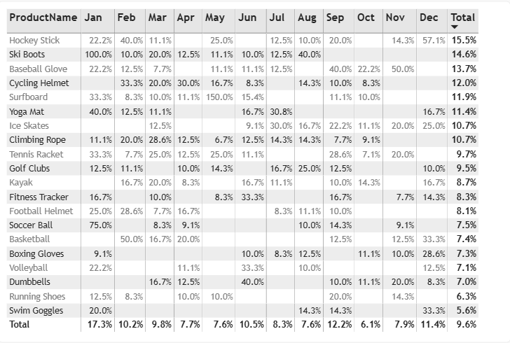
Decreased Conversion Rates
1
General Conversion Trend
Conversion swung a lot from month to month. January came out on top, with smaller peaks in September and December, while April, May, and October lagged well behind the average. It looks like seasonal shopping habits, think New Year and holiday sales, are driving a lot of this, which means there's real room to grow during the slower months with the right push.
2
Lowest Conversion Month
October was the weak spot, sitting at just 6.1% with no single product carrying the month. Worth a fresh look at what promotions or messaging could give this period a boost.
3
Highest Conversion Rates
January led the pack at 17.3%, thanks largely to Ski Boots hitting a perfect 100% conversion. A strong sign that seasonal demand and good marketing timing really pay off.
3

Slide 4
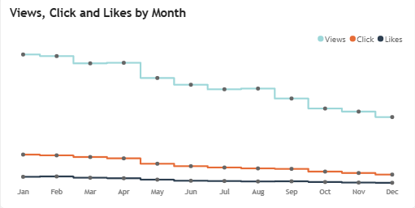
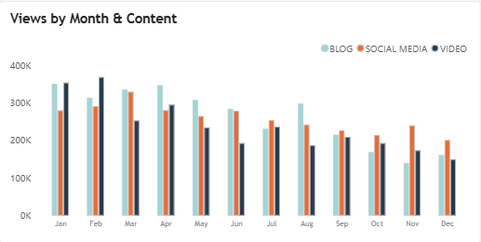
Reduced Customer Engagement
1
Declining Views
Views were strongest from January through April, then kept sliding from May on. Audience interest clearly cooled off after the first quarter.
2
Low Interaction Rates
Clicks and likes stayed pretty flat compared to how many people were viewing. We probably need content that gives people more reason to actually interact, not just scroll past.
3
Content Type Performance
Blog posts pulled in the most views by far, especially early in the year, while social and video content stayed steady but never quite caught up.
4

Slide 5
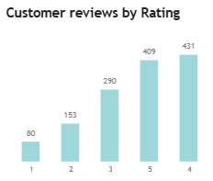
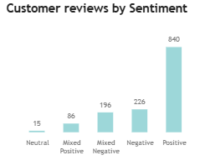
Customer Feedback Analysis
1
Customer Ratings Distribution
Most reviews skew positive, with 431 four star ratings and 409 five star ratings leading the way. The lower end is much smaller, just 80 one star and 153 two star reviews, so customers are largely happy with what they're getting.
2
Sentiment Analysis
840 reviews came back positive, which says a lot about how satisfied most customers are. 226 were negative, and a smaller group landed somewhere in the middle.
3
Opportunity for Improvement
Those mixed reviews are really the opportunity here. If we can figure out what's holding those customers back, there's a good chance we turn them into clear positives and lift satisfaction overall.
5

Slide 6
Goals & Actions
GOAL
ACTION
1
Increase Conversion Rates
Increase Conversion Rates
Figure out what's actually holding conversion back and turn that into clear recommendations. Find where visitors drop off in the funnel and fix those spots.
Lean into the categories that already convert well, like Kayaks, Ski Boots, and Baseball Gloves, with seasonal campaigns timed around January and September.
2
Enhance Customer Engagement
Enhance Customer Engagement
Learn which content types actually get people engaging, then use that to shape a smarter content strategy going forward.
Refresh the content mix with formats people want to engage with, like interactive videos or user generated content, and tighten up calls to action, especially from September through December.
3
Improve Customer Feedback Scores
Improve Customer Feedback Scores
Dig into what customers keep saying, both good and bad, and turn those patterns into real product and service improvements.
Set up a simple process for reviewing mixed and negative feedback, and follow up with unhappy customers directly to fix issues and earn a re-rating toward that 4.0 goal.
6

