Slide 1
Immersive Education

Slide 2


“If simply put Augmented reality is bringing an computer generated object to real world, and Virtual reality is putting a real world entity(Human) to virtual computer generated world.”

Slide 3

Table Of Contents
01
02
03
Problem Statement
Immersive Education
Requirement gathering
04
05
06
Proposed Solution
Market value
Future Scope

Slide 4
Problem statement
Develop an Virtual Reality(VR) powered platform that enhances personalized learning experience for K-12 students.
Interactive multimedia content,such as Simulations and gamification, that engage students and reinforce concepts.
Integration with learning management system and other educational tools to provide a seamless user experience.

Slide 5

What Is Immersive education
Immersive education is a technology powered by augmented reality and virtual reality which helps students to visualise the concepts of any subject which in turn will help them to understand better and will significantly boost their Efficiency of studies.

Slide 6
Requirement Gathering
Software
Hardware
Unity 3D
VR Headset
01
01
RAM(Min. 4GB)
s Google Cardboard
02
02
03
PHP
Hard disk(Min.512GB)
03
Apache Server
04
MySQL
05

Slide 7
Proposed Solution
Virtual Reality (VR) technology has the potential to revolutionize education by providing an immersive and interactive learning experience.
Our proposed solution is to develop a platform that incorporates VR technology into classroom and concepts of various subjects.
Through this platform, users can access virtual classroom, labs, and playground.
An implementation of such solution will bring soul to the concepts by visualizing classroom and learning.
Users just need a VR headset and our powerful application to get the work done!!

Slide 8
Current Market Capitalization
As off 2023, the market capitalization of AR & VR industry of world is estimated to be around $30 billion dollar.
The AR & VR industry is expected to grow at a CAGR of 14% which will result in its market value of approximate $60 billion dollars in 2027.
23 millions jobs are expected to be created by this industry worldwide by the year 2030.
The application of Virtual reality(VR) and Augmented reality(AR) industry can be found in healthcare ,education, sports and entertainment.

Slide 9
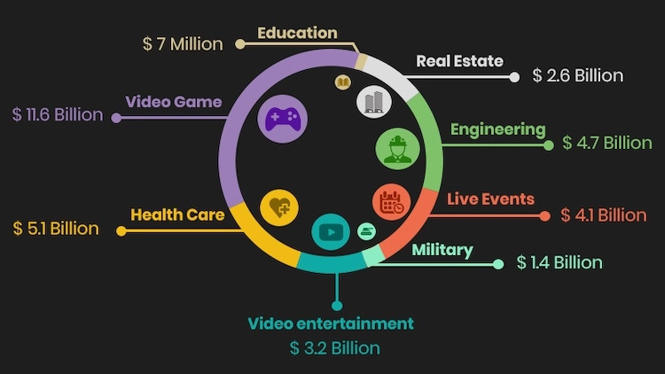
Market share of VR in each Industry

Slide 10
Future scope
More advance and affordable VR Headsets.
Integrate Machine Learning based algorithm to strengthen the functionalities of Immersive Education.
An application of Natural Language Processing can help in speech recognition in immersive education.

Slide 11
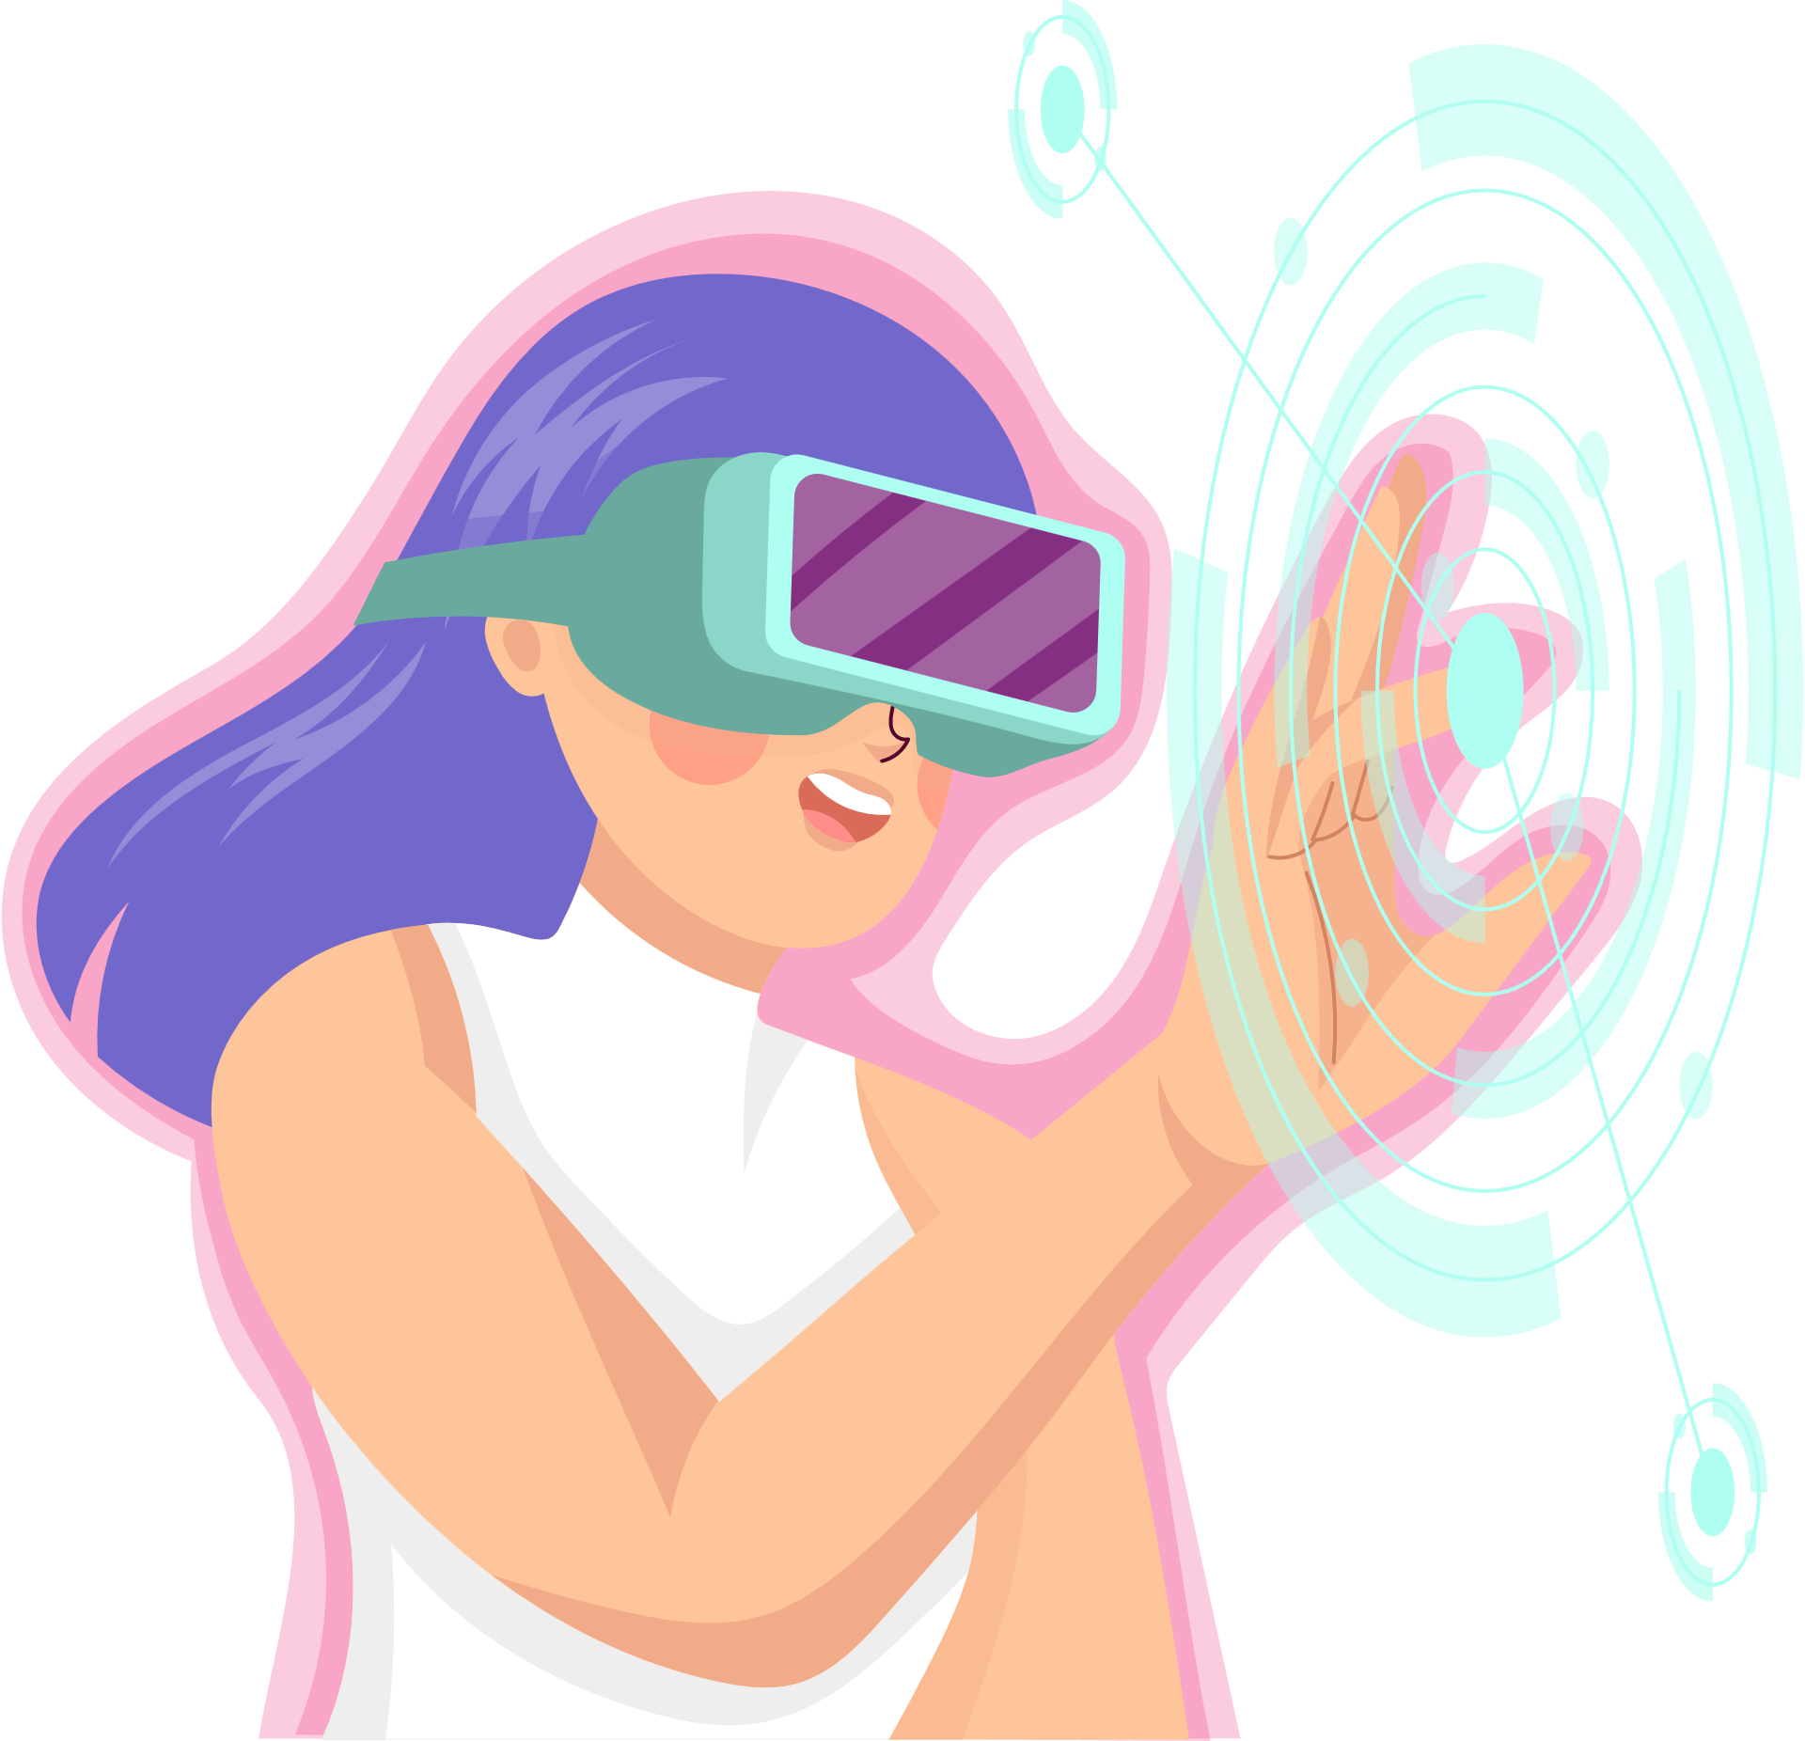
Regards
Team Sanvardhit Bharat.

