Slide 1
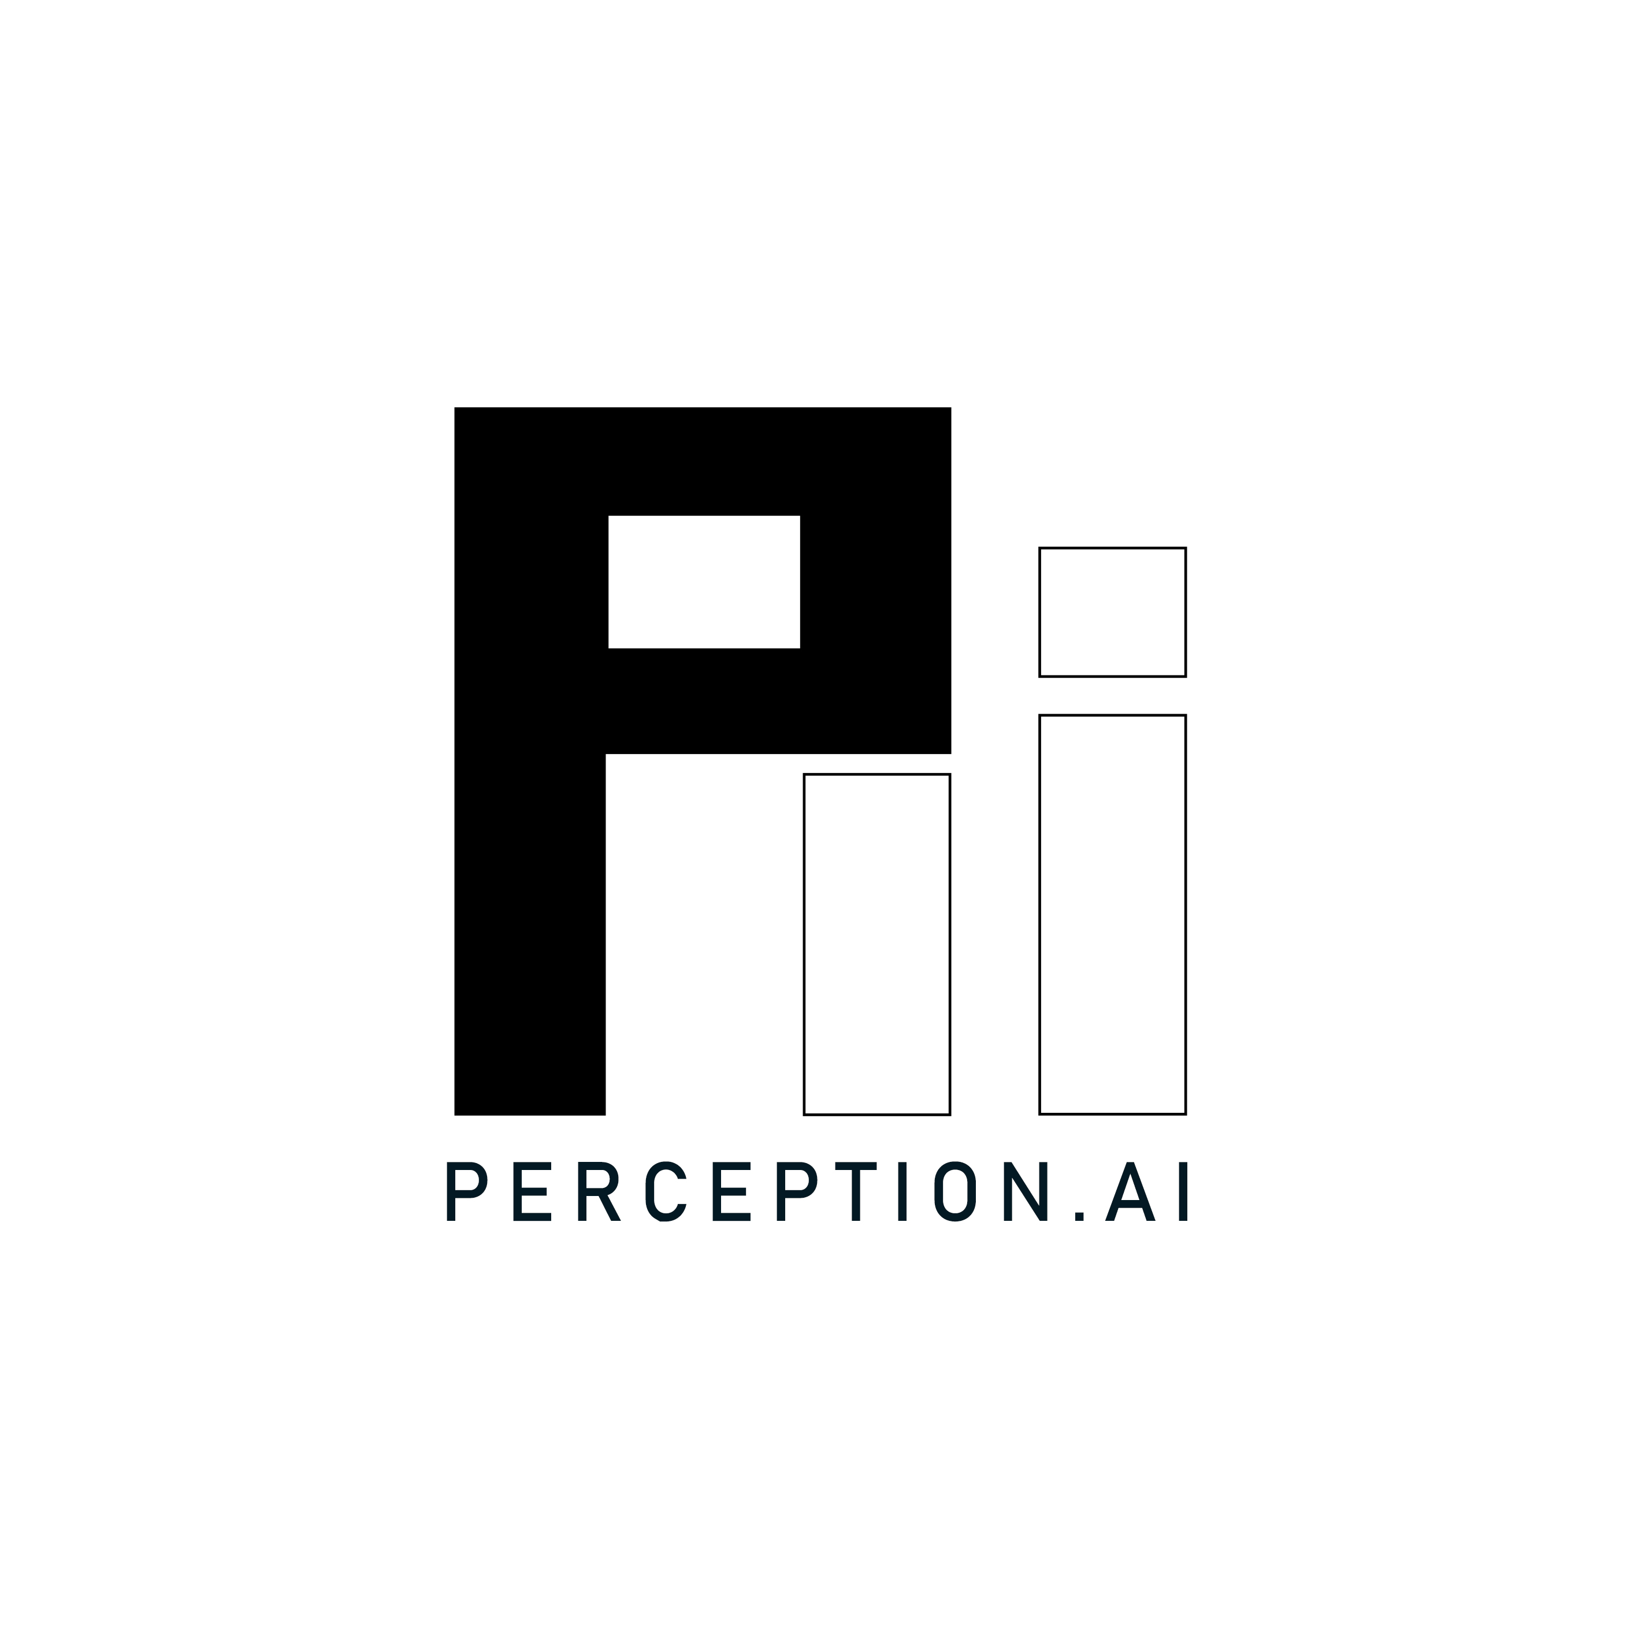
Perception.AI
A finger-worn assistive device for Visually Impaired as well as sighted

Slide 2
Visual Impairment ?
Vision function is classified into 4 categories.
Normal Vision
Moderate vision impairment
Severe vision impairment
Blindness
Low Vision
All Vision Impairment

Slide 3
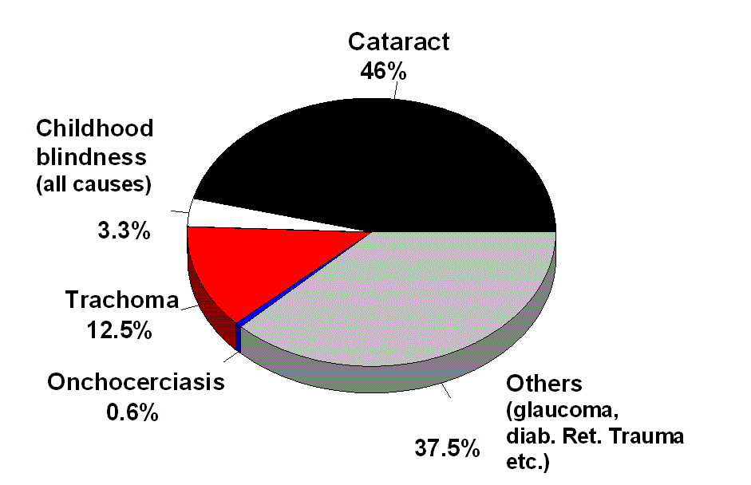
Stats about VI - Around World:
World sight day is observed annually on second Thursday of October, every year to draw attention on blindness and VI.
The stats released on the sight day of last year declare that an estimated 285 million people live with vision impairment, of which, 39 million are blind and 246 million have low vision.

Slide 4
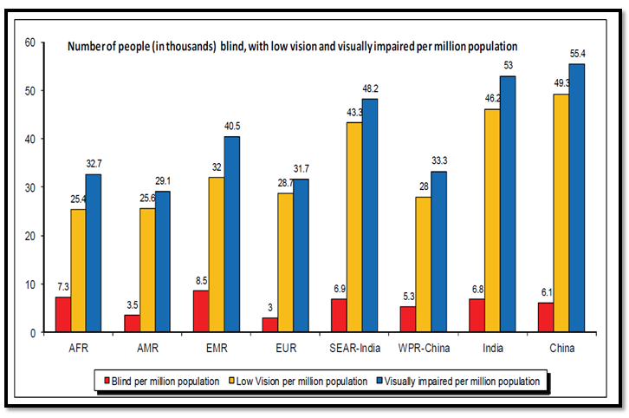
Stats about VI – Across India:
Major portion of world’s VI are in India. Among the 39 million blind population of the world, India has a large proportion of 15 million people. And there is the population of low vision too.

Slide 5
Challenges that VI face:
Environmental: Interaction is difficult. Finding objects during physical movement is a challenge.
Social: Blindness impacts ability of functioning. It restricts them from participating in many activities.
Transportation: Navigating through a city or even a crowded space is tough. It demands them a hard-coded memory.
Reading: There is a large limitation in this. Braille is the only script available for them.
Lot of advantages of Internet are not being acquired.

Slide 6
Existing technology solutions and Researches in progress:
Assisted Vision Smart Glasses: Being developed at Oxford university, this pair of glasses help the VI to detect obstacles around them. It helps in navigation. Feedback is given through a built-in earpiece. The size of this device is large and trials for reducing the size are in progress. This is designed for people with low vision and not for completely blind.
AI glasses: These are being developed at CINVESTAV, Mexico based on computational geometry, AI and ultrasound techniques. These help VI to interact by recognising colours, obstacles, read signs and currency. But this device is a lot expensive (around $1000-$1500, nearly INR 92,500)
Braille e-book reader: The ANAGRAPHS project took up the idea of thermo-hydraulic micro actuation based heating system which activates the Braille dots under control of a microprocessor and a software. But this will be only helpful for blind people who have Braille literacy. And also translation of majority of sources into Braille is expensive.

Slide 7
ARIANNA app: GPS and other navigation systems tend to struggle with indoor environments. This app solves this problem but any reference route should be marked to help this. This is used on a smartphone and so totally blind are not a part of consumers. Also, interaction with mobile app is also a challenge.
AIRA: This is an organization, using augmented reality to connect people of less sight to trained professionals who are dedicated to serve the blind. This requires HR and also networking issues hinder the interaction. Also, AIRA is a subscription based system which charges an amount monthly.
Finger reader: This project from MIT media labs is a finger-worn reading device that recognizes printed text and reads aloud. This can be used for reading purposes. There are some smartphone apps capable of doing this but this device provides a more natural way of interaction with text for VI. Further, it has very potential applications other than helping VI to read.

Slide 8
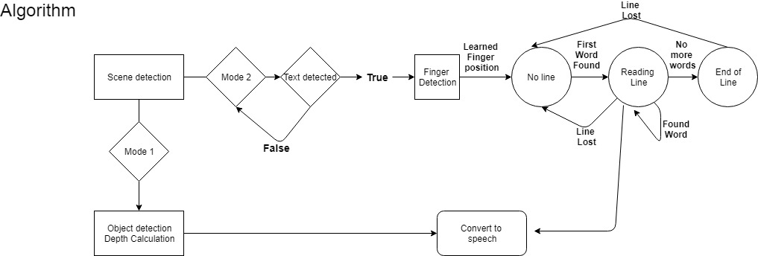
Our Device - Perception.ai:
This is a computer-vision based assistive device for VI which detects the objects in front of them and calculates the distance from them. This is based on depth-calculation using stereo camera(or dual-camera). The info calculated is then converted into speech to give auditory response to the person so that he gets to know and interact smoothly.
Our device also works the same as Finger Reader of MIT labs which can help blind to access the printed text. This is done with the help of advanced machine learning algorithms in support of some hardware.

Slide 9
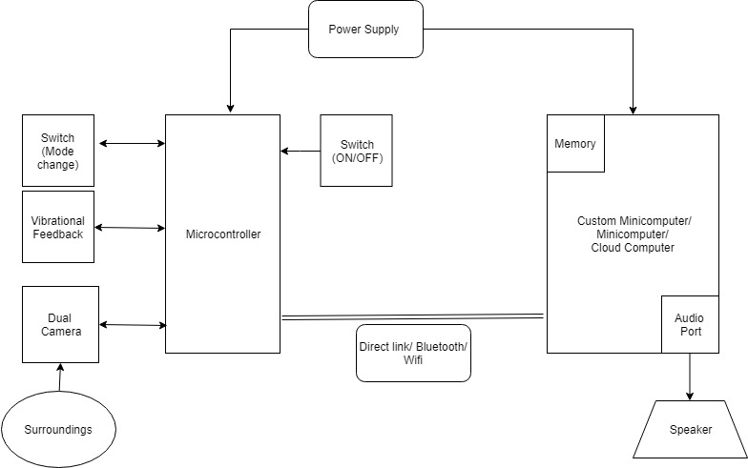
The tasks we are trying to achieve:
Provide VI a smooth interaction by finding objects, obstacles, and help them to navigate easily.
Enable easy reading for them. No other scripts required.
Increase the size of library of VI so that they can access any book any number of times.

Slide 10
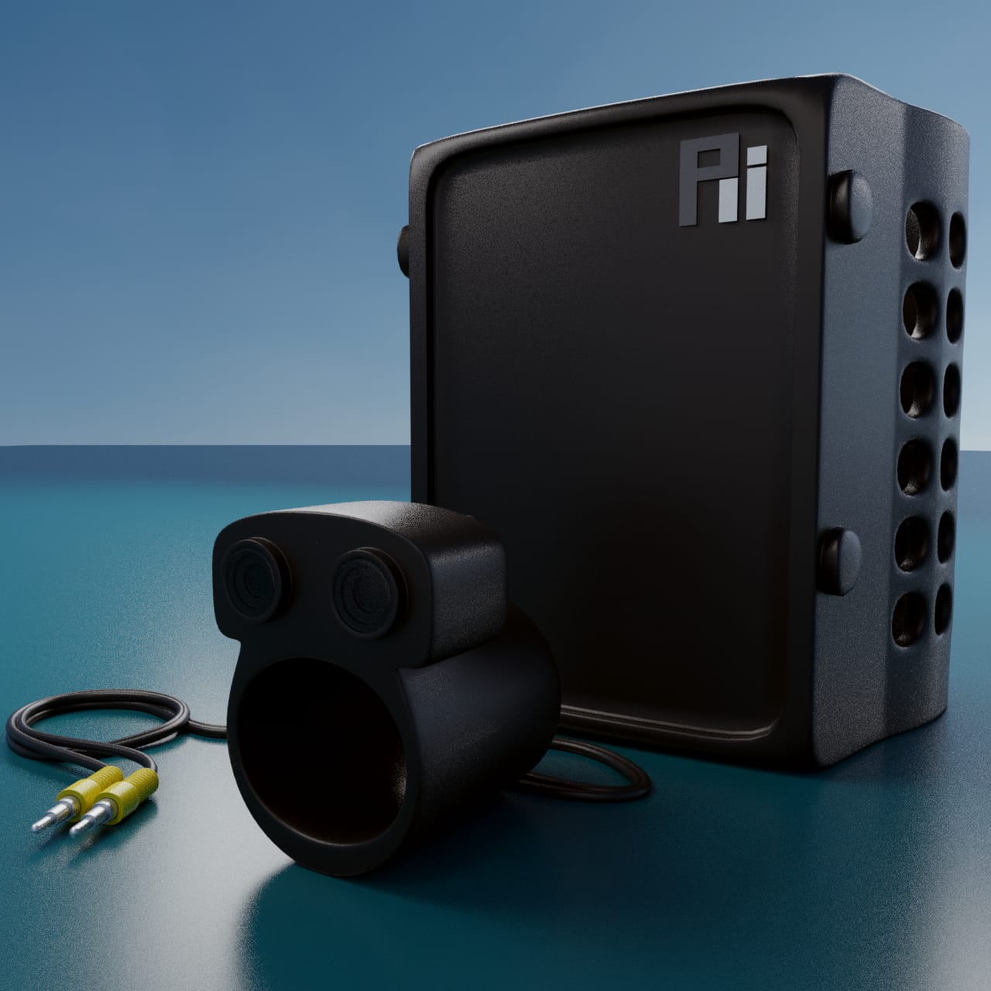
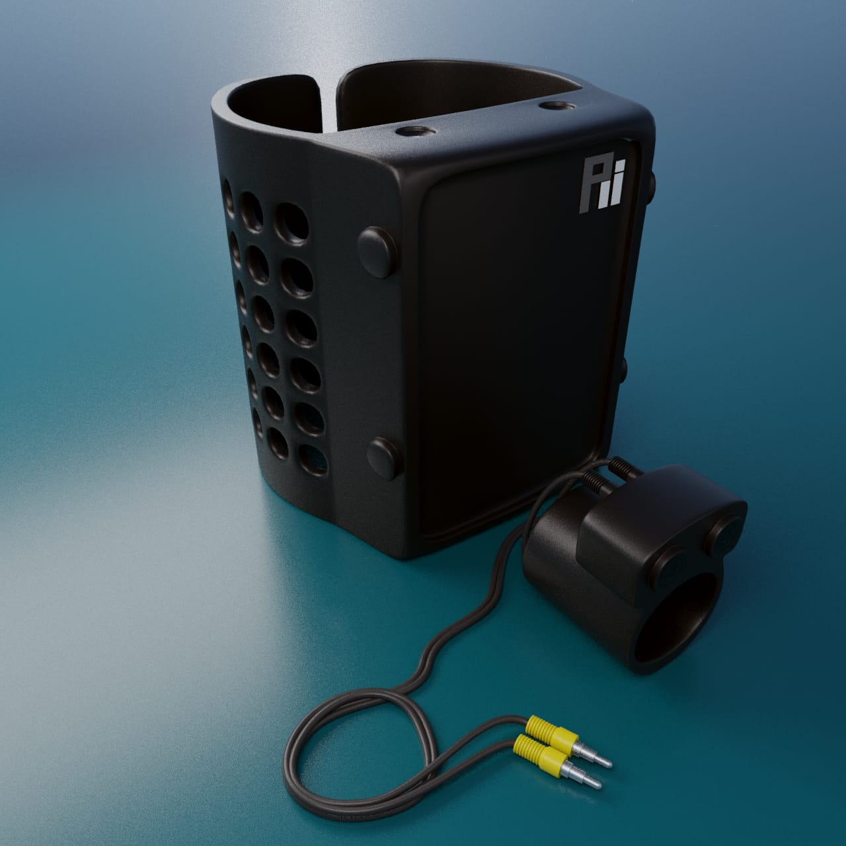
Our model will look like this:

Slide 11
Market Analysis:
Target Customer:
Vision 2020 is a global initiative by WHO which aims at providing vision to blind by 2020. Indian Government is in collaboration with this. So, we intend to approach them with our product.
Some NGOs of the country, like Drishti, are working for the betterment of life of VI. These NGOs are a part of our customer segments.
CSR activities of Maharatna and Navratna companies - focus on education of blind students. These are also form a segment of our customers.
Growth of Target market in next 10 years:
Stats tell that the size of blind population will increase gradually. As social entrepreneurs, it's our responsibility to uplift the society to a greater level of well being.

Slide 12
Value Proposition:
Improve quality of life of VI.
Recognizing immediate environment and Instant interaction.
Accessibility to huge number of resources. These can be books, newspapers, magazines, articles and so on.
USP:“See the world with your ears!”
We are UNIQUE:
No other device is providing the functioning as ours in such a flexible manner.
This device provides independence to the VI users.
Our device has some other potential applications like education of children and it can also be used by sighted people for reading purposes.

Slide 13
Strengths:
Uniqueness of product.
Increasing market opportunities.
Expected support from Govt. policy.
Novelty and proven high accuracy of algorithms.
Weakness:
Our scene detection algorithm works only in still environment.
Innovations in medical science are advancing. Researchers of Max Plank Institute of Research are working on developing an artificial corneal liquid that can help in curing blindness permanently. We will wholeheartedly support this if it is not expensive. But, they have announced an initial cost of 90,000-95,000 INR.
Monetary fund issue – Still we are approaching NGOs and PSUs for funds.

Slide 14
Future Developments:
Currently, for prototype, we are testing the device on Hindi and English but we will extend our reach to other regional languages of India.
We want to make this work for scenes other than still environment too(like traffic). We will include real-time Visual Tracking for that.
We also want our device to detect gestures. So, we will append this function too by gesture detection algorithm.

Slide 15
Revenue Model:
Price (Actual) | Price Quoted to Customers | Difference (Profit per piece) | Gov. Subsidy ( If sanctioned -estimated ) | Price after Subsidy (At which Local NGOs can buy)
Rs.10,000 | Rs. 10,500 | Rs. 500 | 30-35 times | Rs. 300 -400 (approx.)
Revenue Source | Revenue Model
Customers (Gov. / NGOs) | Our stated price to Customers(including all our expenses)- Rs. 10,500 Our Cost Price per piece –Rs.10,000/- Profit per piece – Rs. 500/-
Partners | We have approached few hardware companies , which can provide us our hardware design at a low cost or subsidized rate , if we make them partners.
Advertisement | As saying goes – ‘First Impression is the Last Impression’. With our product we will be distributing a small sample paper in which some common text is written. That would also contain description of device and some advertisements of daily house-hold things .

Slide 16
3 Year Plan
Timeline | Targets Achieved (Expected) | Target for next Fiscal Milestone | Units Produced
December 2018 | Prototype Developed | Market Product Developing and contact the CSR Group events. | 1
June 2019 | Market Product Developed | Fund the Market Product for Mass production | 1000
December 2019 | Mass Production Started | Product Development in other local languages and contact the govt. of other states for execution | 100000
June 2020 | Product Developed in local languages | Real time Implementation and other innovation | 100
December 2020 | Real Time Implementation achieved | Assistive Stick development started for solution extension | 100
June 2021 | Assistive Stick developed | Mass Production of Assistive Stick | 100
December 2021 | Mass Production of Assistive Stick underway with earlier products | Further related innovation to be planned later | 10000

Slide 17
PROFIT ESTIMATION
Milestone | No. of Units Sold | Net Profit
End of 2019 | 7000 | 3500000
End of 2020 | 18000 | 9000000
End of 2021 | 28000 | 14000000
CURRENT STATUS
HARDWARE – Under Development
SOFTWARE – Partially Developed
CASE DESIGN – Developed

Slide 18
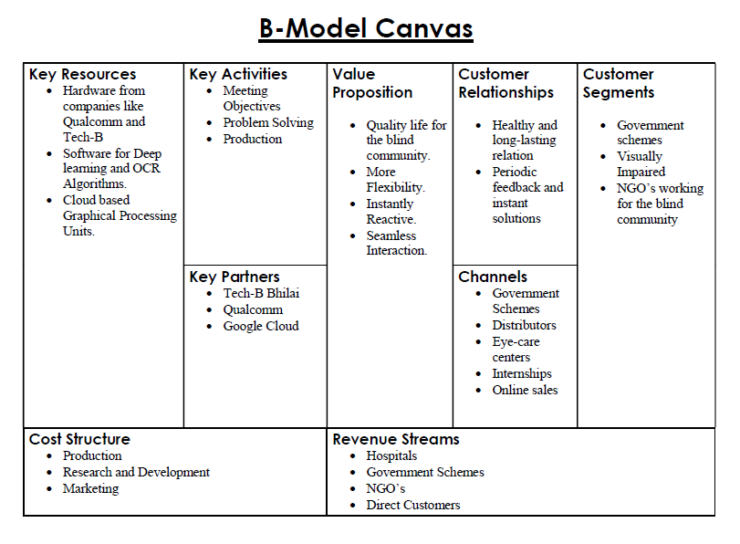

Slide 19
Team Details:
Mohit Sarin
Dheeraj Varma
Shreya Chandrakar
Shikhar Mishra
Bharat Giddwani
Apurva Mishra

