Slide 1
Git Group Assignment
Group 7
Topic - Git fetch

Slide 2
Group Members
→ Vikas Vashishth
→ Nitin Mishra
→ Mohit Saxena
→ Kiran jeet Kaur
→ Sakshi Mittal
Repo link: https://github.com/mohitsaxenaknoldus/group7

Slide 3
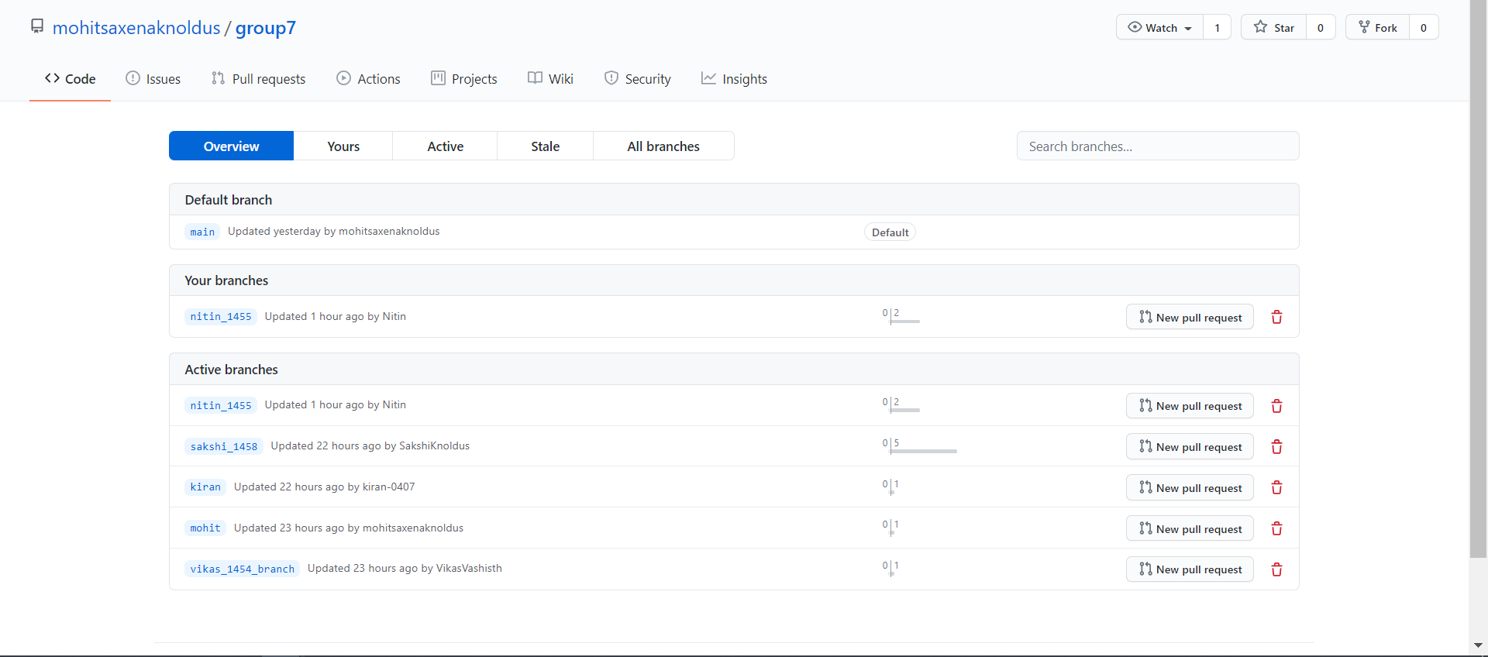
Commit by all the Developers in the Github Repository.

Slide 4
What is fetch?
Git fetch is a command that will just fetch (get) the changes made by our teammates/developers into our local repository.
Using the fetch command not at all going to affect our working directory.
In case we further want to bring our changes from local repository to our working directory, then we have to use git merge command.
Git fetch command is just used to download the changes that other developers have made which we aren’t aware of to see who all has made any changes in that particular project.
Also, while using git fetch, there isn’t any chance of CONFLICT, as we are just seeing/downloading the changes but not actually applying those changes and hence one can use this command as often as they wish to. This command is completely safe.
It allows us to review and merge manually at later time using merge.
It doesn’t change our working directory or staging area, it is entirely safe and we can run it as many time we want.

Slide 5
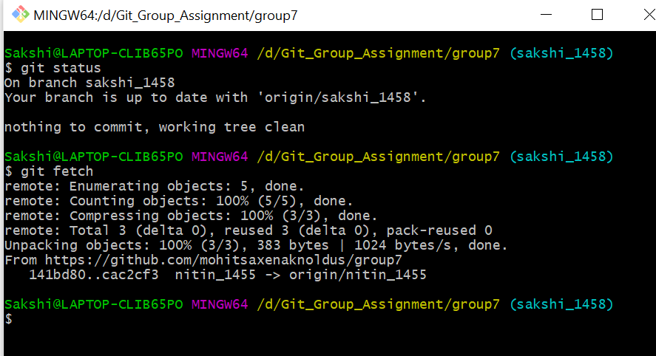
Example of fetch command
As in this Git Group Assignment only, we are a group of 5 people and each of us has committed to the same repository using individual branches created by us. So by running git fetch I was able to see all changes made by my team members.

Slide 6
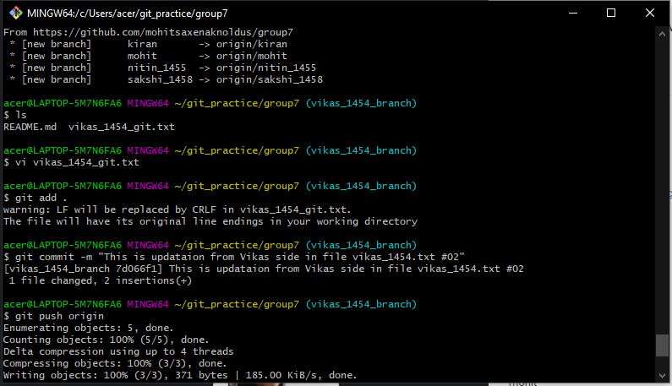
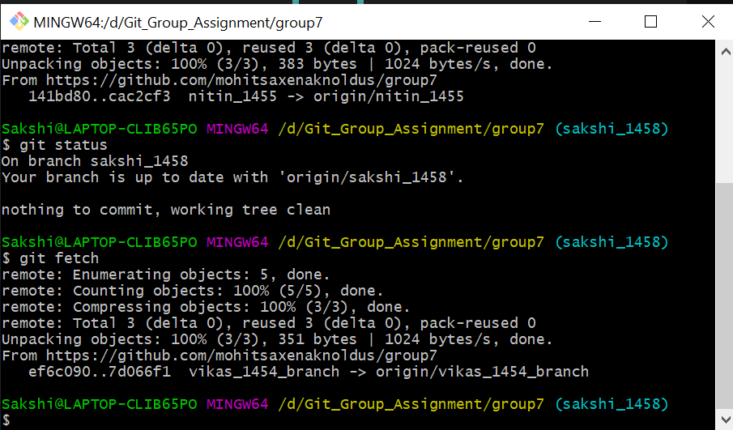
git fetch execution
First the developer has to make the changes in his file before commiting. Then the fetch command will be execute to get the repository.
of the developer.
Picture 2:
Picture 1:
Picture 2:
:

Slide 7
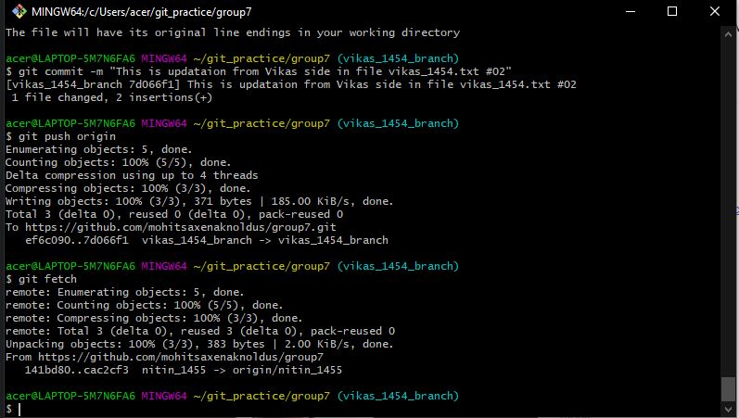
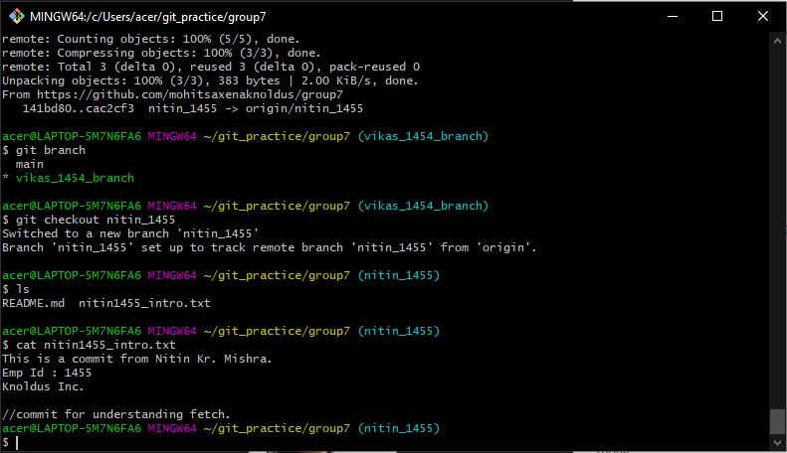
Fetching another branch of the developer.
Displaying the contents of the file by using the branch of the developer.
Picture 3:
Picture 4:

Slide 8
Git fetch commands and options
Command | Description
git fetch --all | Fetch all remotes.
git fetch --append | Append ref names and object names of fetched refs to existing contents of .git/FETCH_HEAD. If not this old data in .git/FETCH_HEAD will be overwritten.
git fetch --force | This overrides the check when git fetch is used with <src>:<dst> and it refuses to update the local branch.
git fetch --dry-run | This will perform a demo run of the command. It will output examples of actions it will take during fetch but won’t apply them.
git fetch <remote> | Fetch all of the branches from repository. This also downloads all of the required commits and files from the other repository.
git fetch <remote><branch> | Fetch specific branch from repository. This also downloads all of the required commits and files from the other repository.

Slide 9
git fetch vs git pull
git fetch | git pull
It downloads only new data from a remote repository (no changes are made in the local repository). | It downloads latest changes from the remote repository and automatically merge those changes in the local repository.
It never changes your data. | It manipulates your data.
It protects your code from merge conflict. | There are chances of merge conflict while using git pull.
It is a simple command. | It is similar to git fetch followed by git merge.

Slide 10
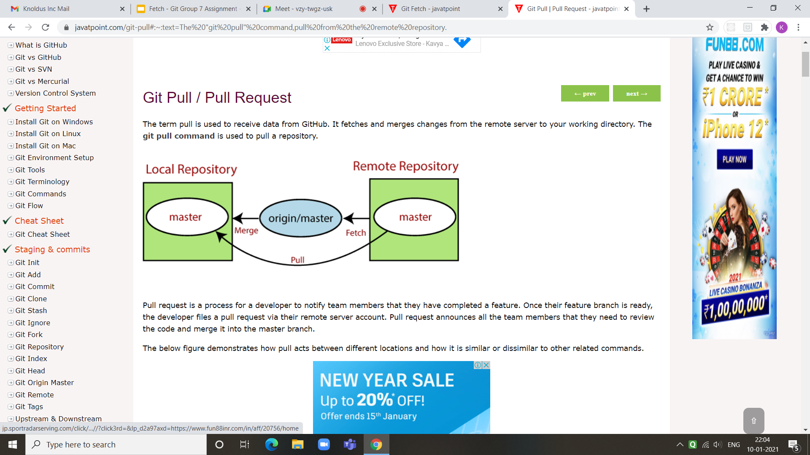
git fetch vs git pull

Slide 11
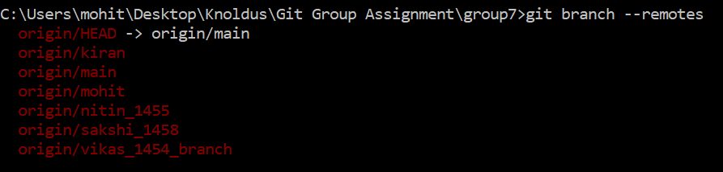
git fetch vs git clone
git clone downloads a copy of the repository into a locally created directory, creates remote-tracking branches for each branch in the cloned repository.
Command for checking the remote-tracking branches: git branch --remotes
After a clone, the git fetch command will update all the remote-tracking branches.

Slide 12
References
https://git-scm.com/docs/git-fetch
https://www.atlassian.com/git/tutorials/syncing/git-fetch
https://www.javatpoint.com/git-pull#:~:text=The%20%22git%20pull%22%20command,pull%20from%20the%20remote%20repository.
https://www.javatpoint.com/git-fetch#:~:text=Git%20Fetch%20vs.&text=Pull%20is%20used%20to%20update,your%20current%20working%20copy%20files.
https://git-scm.com/docs/git-clone

