Slide 1
TASK 2
Task To Do: We have set up a real life-like web application in the form of an online bank portal. Your task is to test this website and find all possible vulnerabilities and loopholes in it. To do so you can use the automatic vulnerabilities scanner “Netsparker” which was taught to you in the session of Automatic Vulnerability Scanner.
You have to find 3 critical vulnerabilities. No matter if they are taught to you or not. Now just choose any 1 amongst that 3 and write a report in your own language.

Slide 2
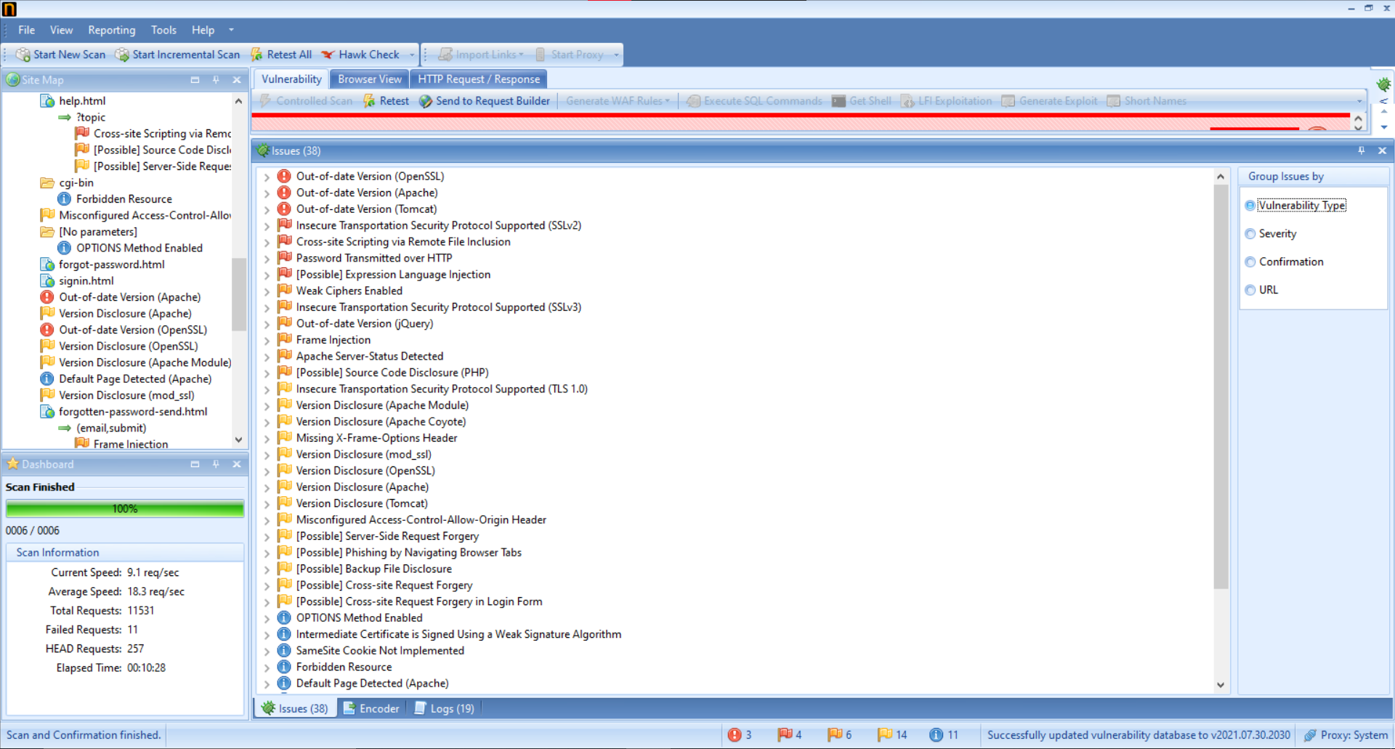
Found Vulnerabilities using Netsparker :

Slide 3
Critical Vulnerabilities:
Out-of-date version (Open SSL).
Out-of-date version (Apache).
Out-of-date version (Tomcat).

Slide 4
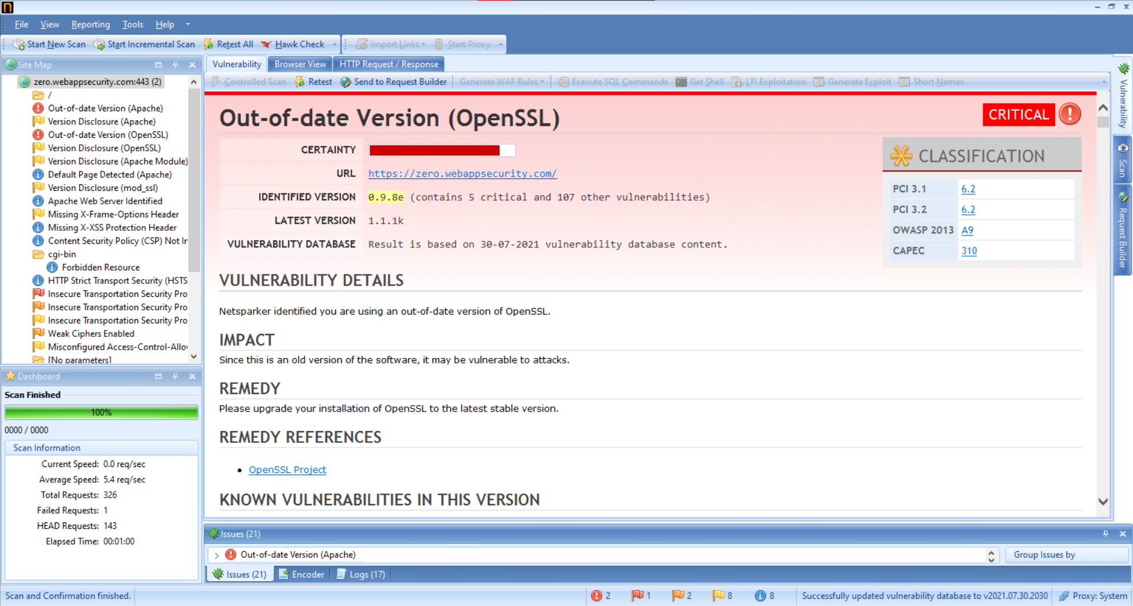
Out-of-date version (Open SSL).

Slide 5
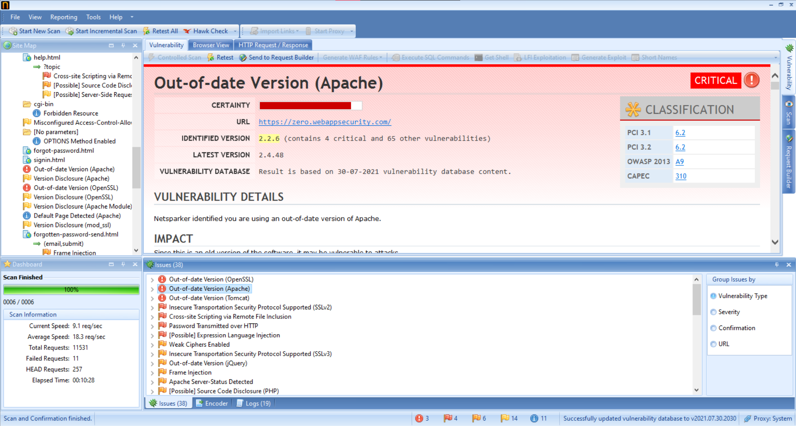
2. Out-of-date version (Apache).

Slide 6
3. Out-of-date version (Tomcat).

Slide 7
REPORT: Out-of-date version (Open SSL)
Vulnerability Title: Out-of-date Version (Open SSL)
URL of the Website: https://zero.webappsecurity.com/
Version: 1.1.1k
Details: Your website is vulnerable, due to expiry of the SSL certificate of your website.
Impact: Attacker can intercepts encrypted data, attacker can MITM (Man In The Middle) attack on
your website due to this vulnerability.
How to Tackle this Vulnerability: Upgrade/upgrade the version of your website. Update the SSL
certificate.

Slide 8
More about Open SSL Vulnerabilities:
Openssl : Security vulnerabilities - CVEdetails.com
Common SSL Attacks: SSL & TLS Key Vulnerability | Venafi

