Slide 1
TASK 3
In this task you are completely free. http://testasp.vulnweb.com/ -
This is the website. Explore the website and try to find vulnerabilities in the website and report it to us. You will be evaluated on your methods and report you submit.

Slide 2
Reflected-XSS into HTML Context in vulnweb.com
State: Not Resolved
URL of the Website: http://testasp.vulnweb.com/
HTML Version: 4.01
Weakness: Reflected Cross-site Scripting
Asset: vulnweb.com (Domain)

Slide 3
Summary:
Acunetix (testasp.vulnweb.com) website is vulnerable, due to Reflected cross site scripting with HTML context.
As per OWASP's definition: Cross-Site Scripting (XSS) attacks are a type of injection, in which malicious scripts are injected into otherwise benign and trusted websites.
This happens because one of the there in input search parameter cannot filter strictly arrivals and also there is not encoded the output which is displaying on screen.

Slide 4
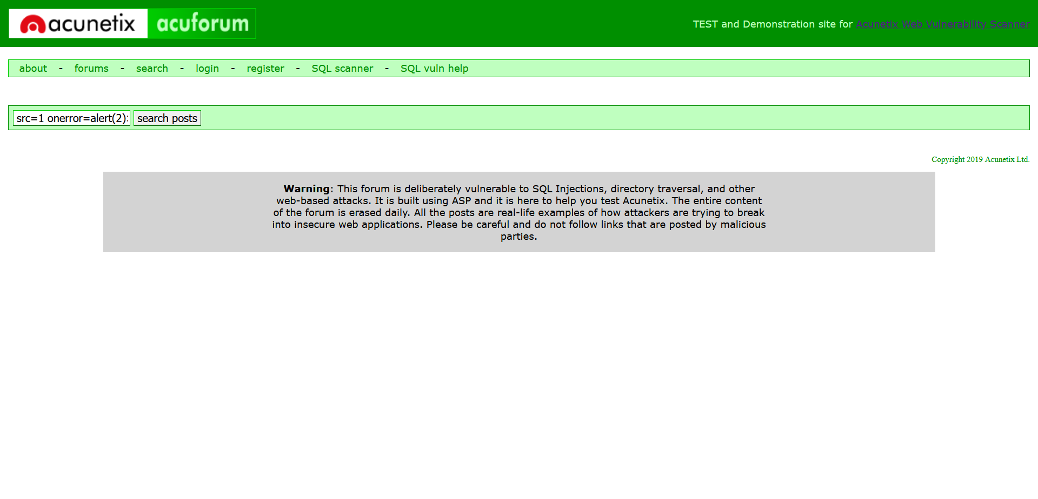
Steps to Reproduce:
To reproduce this, an attacker has to:
Prepare a Javascript payload. In this case, for Proof of Concept purposes, our javascript code show alert on searching the image source.
Code: <img src=1 onerror=alert(2)>

Slide 5
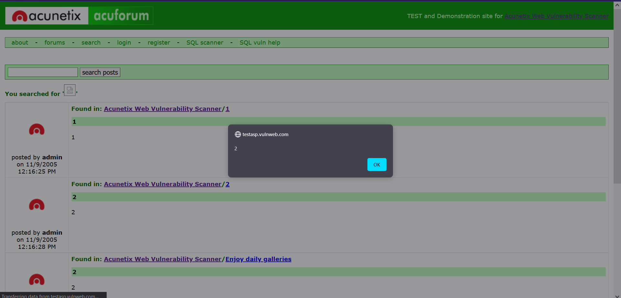
Output of that injected payload: We get the alert after executing above payload on
http://testasp.vulnweb.com/ website.

Slide 6
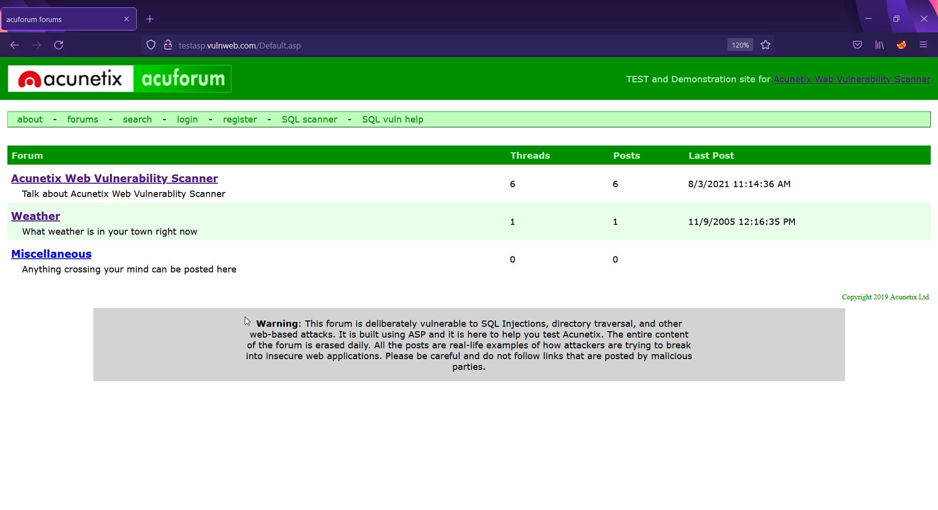
Video Demonstration:

Slide 7
Impacts:
1. View any information that the user is able to view. Modify any information that the user
is able to modify.
2. Initiate interactions with other application users, including malicious attacks,
that will appear to originate from the initial victim user.
3. It can also steal your website cookies using XSS.

