Slide 1
TASK: 1
Portswigger is a website which has so many vulnerable labs which helps you to learn about other vulnerabilities in real life.You can visit Portswigger labs at https://portswigger.net/
So the exact task for you now is there are several XSS labs on this website:
https://portswigger.net/web-security/all-labs. You can just choose any 5 of them and solve it. We are leaving the choice up to you.

Slide 2
LAB 1:
Reflected XSS into HTML context with nothing encoded

Slide 3
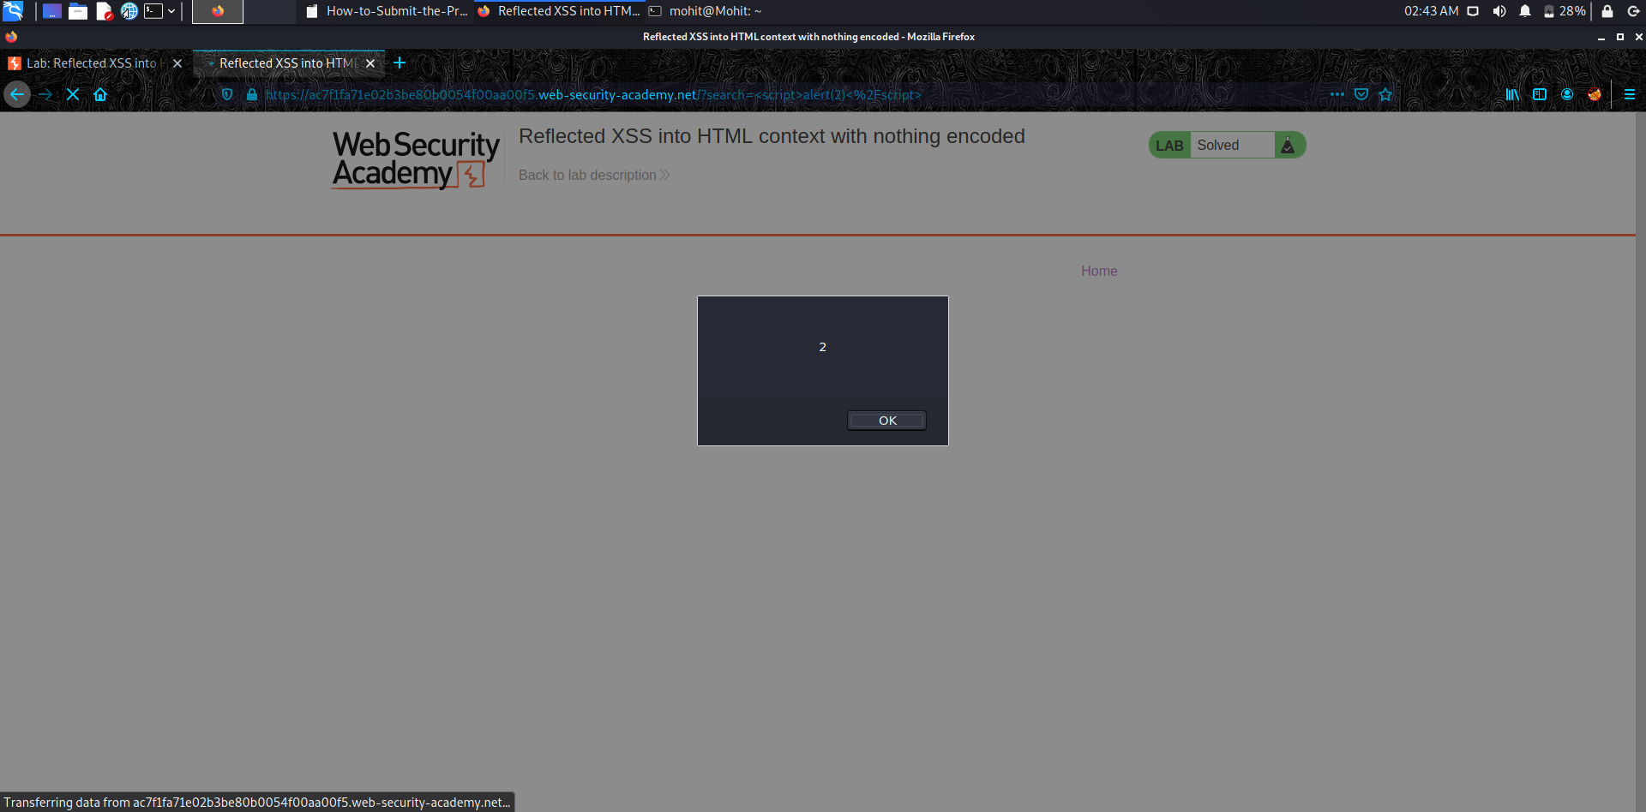

Slide 4
LAB 2:
Reflected XSS into HTML context with most tags and attributes blocked

Slide 5
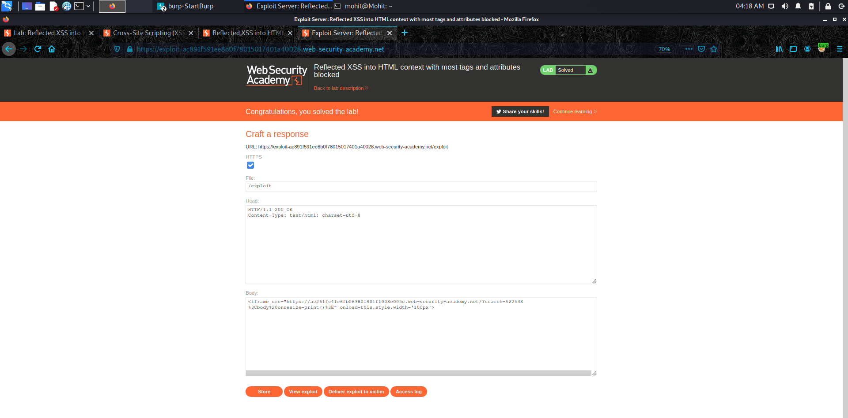

Slide 6
LAB 3:
Reflected XSS into HTML context with all tags blocked except custom ones

Slide 7
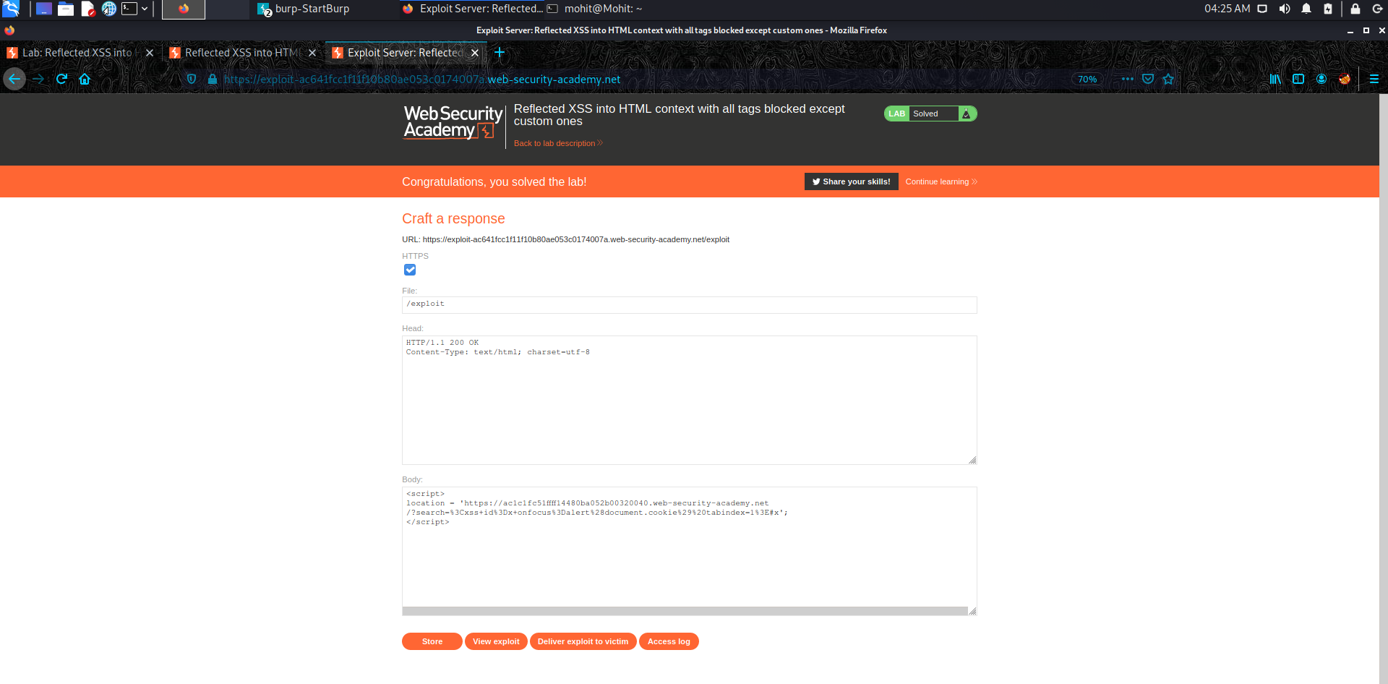

Slide 8
LAB 4:
Reflected XSS with event handlers and href attributes blocked

Slide 9
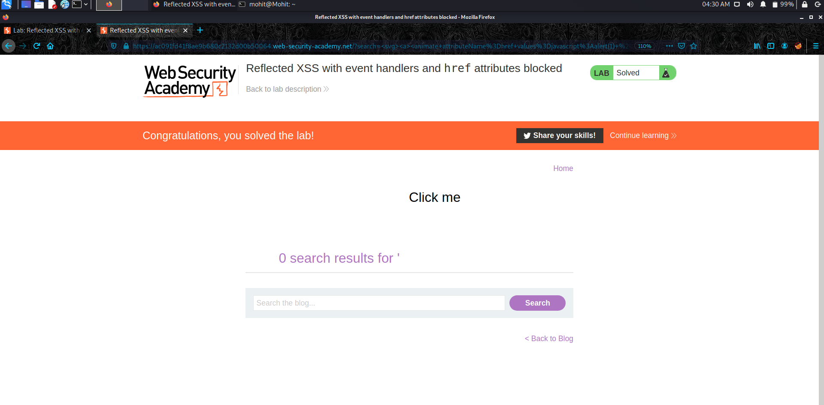

Slide 10
LAB 5:
Reflected XSS with some SVG markup allowed

Slide 11
