Slide 1
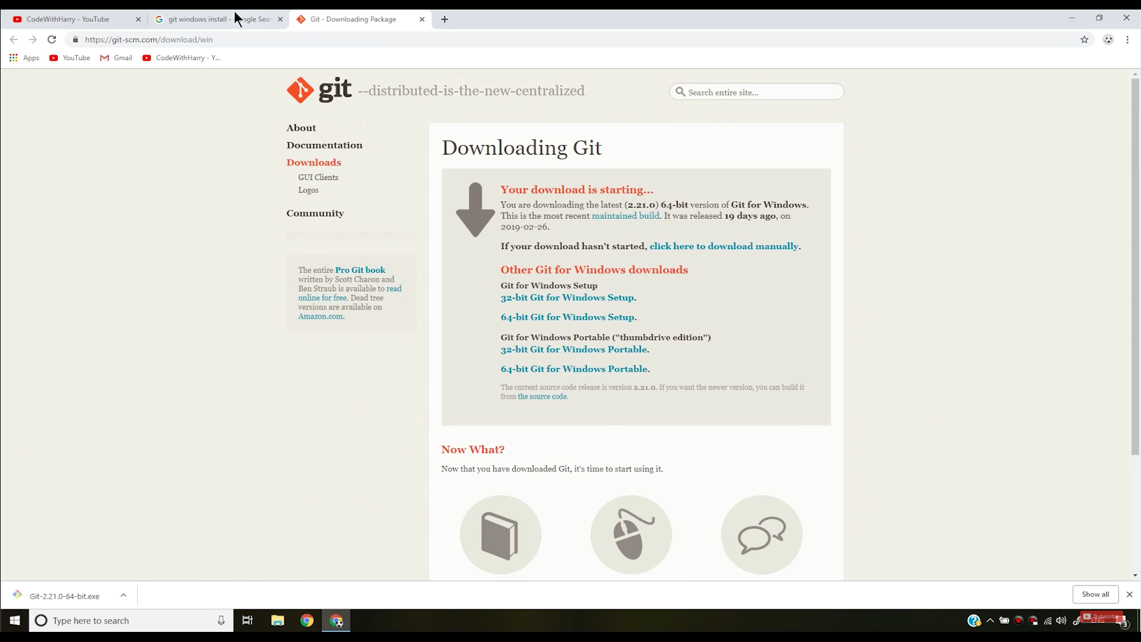

Slide 2
Git Initial configurations
1. Set username
git config --global user.name Mohit
2. Set email
git config --global user.email email@example.com
3. Check username
git config --global user.name
4. Check email
git config --global user.email

Slide 3
Git commands
Open VS code using Git bash
code .
2.

Slide 4
Linux Commands
ls → List all files present in that directory
pwd → Present working directory

