Slide 1
PatentPulse
Research versions and internal review
Advanced Java mini project
Mohit Sharma, Meet, Jay, Nitesh and Mann Jain
Arya College of Engineering and IT, Jaipur
Notes:
Introduce the research-management problem and the five development modules. This deck describes the supplied project archive. It does not claim the final GitHub branch has been freshly tested.

Slide 2
The problem is tracking the reviewed version
Files change
A familiar filename does not identify the exact bytes a reviewer examined.
Feedback becomes detached
Comments and decisions need a stable connection to a particular submission.
Access needs a clear boundary
Owners, assigned reviewers and administrators need different permissions.
02

Slide 3
Five modules share one application
Member | Development responsibility
Mohit | Drafts, uploads, version history and coordination
Meet | Login, registration, sessions and access control
Jay | SHA-256, file comparison and downloads
Nitesh | Assignments, decisions and reviewer feedback
Mann | Administration, audit logs and receipts
03
Notes:
Module ownership follows the team allocation. LedgerService, AppServlet and document.jsp contain shared sections. Read docs/modules/README.md for exact paths.

Slide 4
Servlets connect the browser to services
Browser
SecurityFilter
and Servlets
Services
MySQL via JDBC
Private file storage
Java 17 Servlet/JSP JDBC Maven WAR
04
Notes:
Source: pom.xml, web.xml, AppContext.java and the web/service packages. The WAR uses javax.servlet 4.0 and targets Tomcat 9. H2 and embedded Tomcat are test/demo dependencies.

Slide 5
A research item can contain several versions
Parent record
blueprints stores the owner and current research metadata.
Submitted snapshot
document_versions records version number, metadata, filename, hash and status.
Review records
Assignments and votes belong to a specific version. Audit events record actions.
05
Notes:
Source: src/main/resources/schema.sql. Six tables: users, blueprints, document_versions, review_assignments, review_votes, audit_logs. Receipts are derived views.

Slide 6
Submission preserves a new snapshot
Step | Application action
1 | Validate metadata and the uploaded file
2 | Store bytes under a generated private filename
3 | Calculate the SHA-256 fingerprint
4 | Insert the version and audit event in a transaction
5 | Display the submitted version and its history
A failed database submission triggers attempted file cleanup.
06
Notes:
Source: UploadStore.save, LedgerService.submit and AppServlet POST /submit. Limit is 10,485,760 bytes. File cleanup after SQL failure is attempted, not a distributed transaction.

Slide 7
Two approvals complete an internal review
SUBMITTED
Two approvals
First reviewer assignment
INTERNALLY_REVIEWED
IN_REVIEW
One approval keeps the review open.
Any rejection
NEEDS_REVISION
Revised work starts a separate version with its own review.
07
Notes:
Source: ReviewPolicy.java and LedgerService.assign/vote. Any rejection takes priority. Authors cannot review their own work. A terminal version rejects later votes and assignments.

Slide 8
Verification compares a candidate with a saved hash
Candidate file
The user selects a version and uploads a local file for comparison.
Server calculation
The server hashes the candidate bytes and compares the result with the saved digest.
Result
MATCH or MISMATCH is displayed and recorded in the audit log.
Downloads enforce access permissions without automatic stored-file rehashing.
08
Notes:
Sources: LedgerService.verify and FileServlet.doGet. SHA-256 background: https://doi.org/10.6028/NIST.FIPS.180-4. A hash is not encryption or proof of legal ownership.

Slide 9
Security controls have defined limits
Implemented controls
Deployment gaps
BCrypt password hashes
Session rotation and CSRF tokens
Role and per-version access checks
Prepared SQL and escaped output
Upload limits and private storage
No antivirus scanning
Login delay is session-scoped
Receipts are unsigned
Server timestamps are not independent
Privileged operators remain trusted
09
Notes:
Sources: AuthService.java, AuthServlet.java, SecurityFilter.java, UploadStore.java. Background: https://www.usenix.org/conference/1999-usenix-annual-technical-conference/future-adaptable-password-scheme and https://cheatsheetseries.owasp.org/cheatsheets/File_Upload_Cheat_Sheet.html.

Slide 10
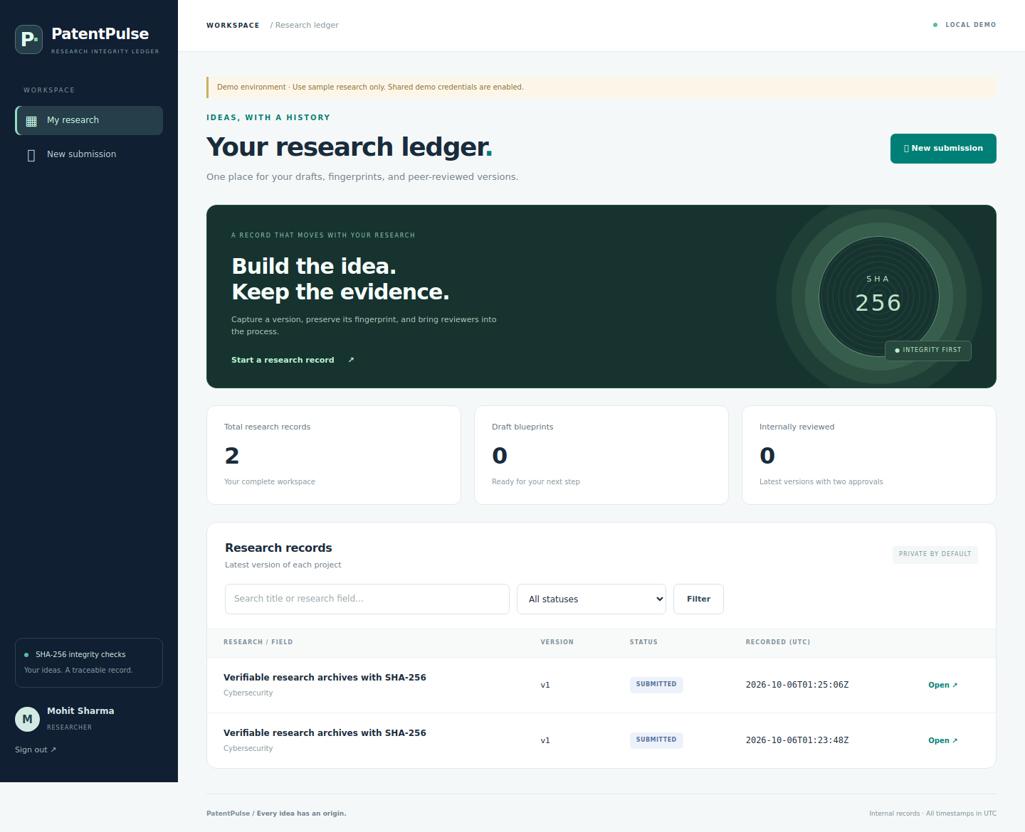
Research dashboard
Listings, search and status filters keep research records together.
Supplied demo screenshot
Synthetic research data
10
Notes:
Supplied synthetic demo screenshot: docs/screenshots/02-dashboard.png. This is an archived UI illustration, not a new capture from the final merged branch.

Slide 11
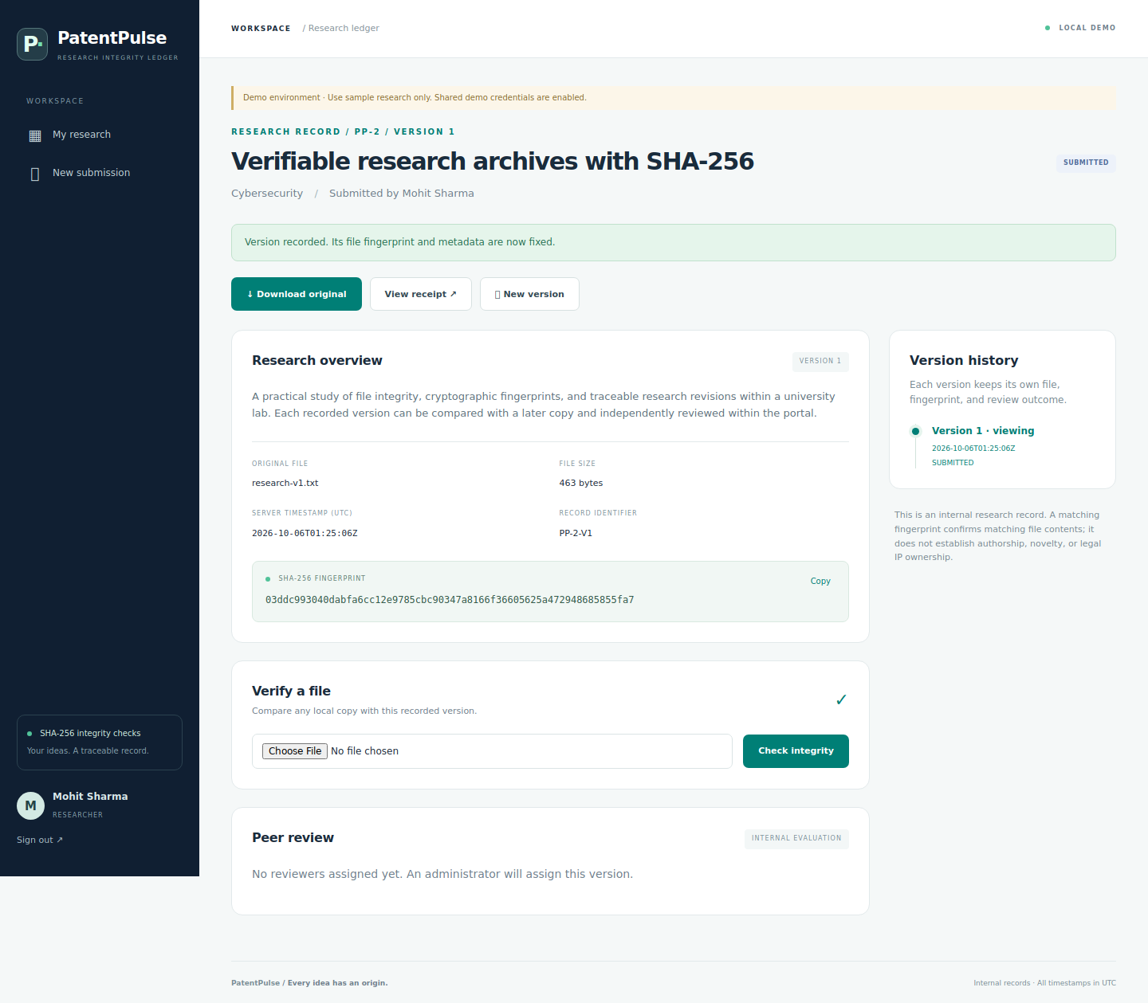
Document details and history
Each version shows its metadata, fingerprint and comparison control.
Supplied demo screenshot
Synthetic research data
11
Notes:
Supplied synthetic demo screenshot: docs/screenshots/03-record.png. This is an archived UI illustration, not a new capture from the final merged branch.

Slide 12
The archive records 11 passing tests
Suite | Tests | Purpose
HashingTest | 4 | Known vectors and byte-stream behaviour
ReviewPolicyTest | 4 | Approval thresholds and terminal states
WorkflowTest | 3 | HTTP, JSP, sessions and connected workflows
Fresh verification still required
Run mvn clean verify on the final branch and test the actual MySQL deployment.
12
Notes:
Source: supplied docs/TEST-REPORT.md, dated 6 October 2026. Source inspection confirms 4 HashingTest methods, 4 ReviewPolicyTest methods and 3 WorkflowTest methods. No new execution occurred during document preparation because Maven was unavailable.

Slide 13
The next step is a verified final demonstration
Demonstrate the complete flow
Draft, submit, compare files, assign reviewers, decide and inspect history.
Complete the evidence
Record the final commit, build output and deployment checks.
Keep claims within scope
Internal review and receipts do not grant patents or prove authorship.
13
Notes:
Sources for scope: https://ipindia.gov.in/pages/patents/learn/basics-of-patents and https://www.wipo.int/en/web/patents/faq_patents. Prototype source: README.md. See docs/DEMO_VIDEO_SCRIPT.md for the recording sequence.

