Slide 1

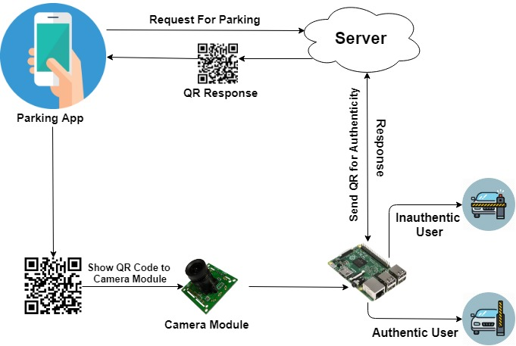
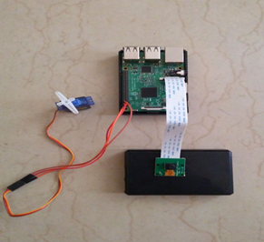
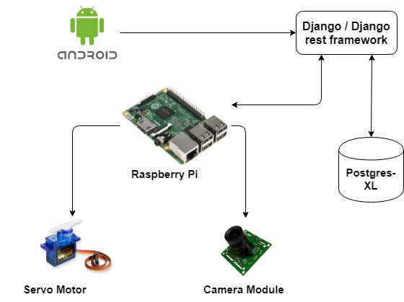
Reservation Based Smart Parking System
Mohit Sharma, Vaibhav Sadhna, Mahi Bansal, Rahul Bhardwaj
Department of Information Technology
ABES Institute Of Technology , Ghaziabad
Introduction
Methodology
Results
It is difficult to find parking space in metropolitan areas, especially in peak rush time. The problem is that the driver does not know the available space at the time. Even if know, most of vehicle may consume limited parking space which leads to traffic congestion and also the time and fuel are wasted in search (blind search) of parking. For this problem, we have designed and developed a prototype of Reservation based Smart Parking System (RSPS), which will allow the users (drivers or owners) to effectively find and reserve the available parking space
In this we have developed a prototype of reservation based smart parking system (RSPS) to optimize the parking facilities and management. We implement parking reservation policy to balance the beneﬁt of service providers and requirements from the users. Furthermore, we have provided the design and implementation of the prototype. Based on the research and evaluation, we conclude that the proposed system (RSPS) has the ability to eliminate the traffic congestion and fuel wastage up to certain level and provide efficient parking system
Objectives
Hardware
Salient Features
The Objective of RBSPS are –
1.More efficient then existing system
2.Easy to find a parking space
3. Allows drivers to effectively find and reserve the vacant parking spaces.
The hardware system is organized by four components i.e. Raspberry pi, camera module, servo motor, user’s communication device.
Some of the major salient features are as
Follows-
Optimized parking
Reduced traffic
Reduced pollution
Enhanced User Experience
Increased Safety
Decreased Management Costs
Technology Stack
(
References
(
www.streetline.com
www.mapsofindia.com
www.slideshare.net
www.justpark.com
www.smartparking.com

