Slide 1
Flipkart
Watch Dataset Analysis

Slide 2
Contents
Mission and vision
Importing Dataset
Dataset Description
Data Preprocessing
Data transformation
Data Visualisation
Dashboard
Result of Analysis
Recommendations

Slide 3
Mission and Vision
Analysis of Flipkart watch dataset
to find suitable brands and suitable price range for a watch shop.
It serves to provide a summarized analysis of watch dataset and get insights from the dataset to make decisions.

Slide 4
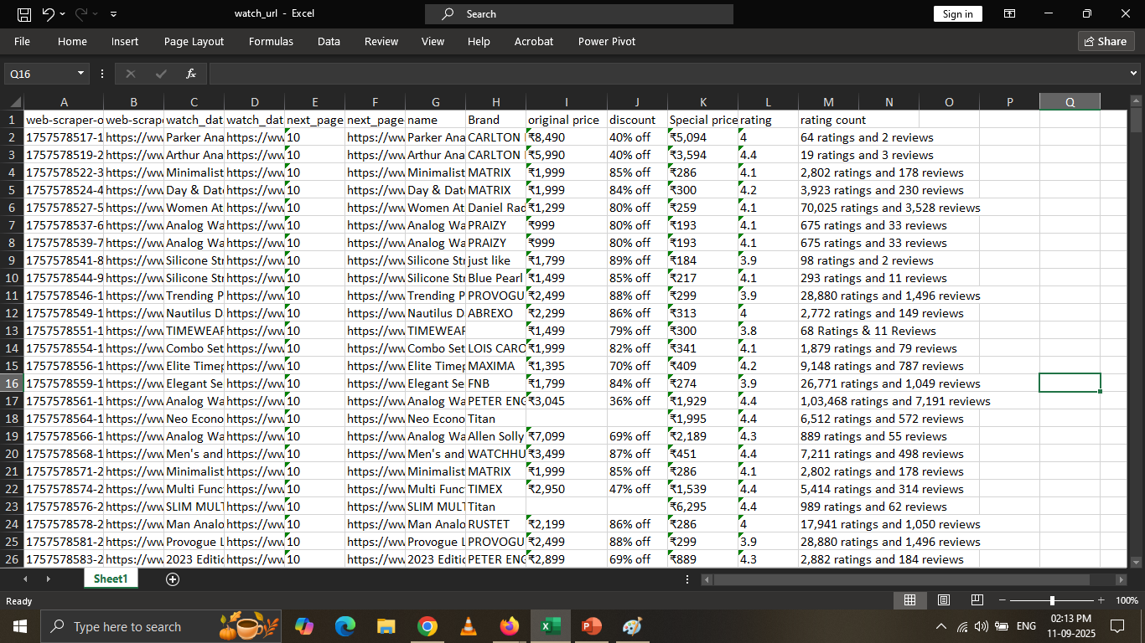
Importing dataset
Scrapped data from flipkart using chrome web scrapper.

Slide 5
Dataset Description
Watch Dataset includes:
Name
Brand
Original Price
Discount
Special Price
Rating
Rating Count

Slide 6
Data Preprocessing
Dropped unnecessary columns like web-scraper-order , web-scraper-start-url , watch_data , watch_data-href ,next_page & next_page-href.

Slide 7
Data Transformation
Removed “off” word from discount column and converted its data type from text to percentage.
Removed “Ratings and Reviews” from rating count column using split column.

Slide 8
Data Visualisation
Which are the top five brands?
Allen Solly(4.35)
MATRIX(4.14)
LOIS CARON(4.04)
PROVOGUE(3.97)
RUSTET(3.95)
Recommendation:
Watches of these brands can be kept
In stock for selling as these watches have highest rating.

Slide 9
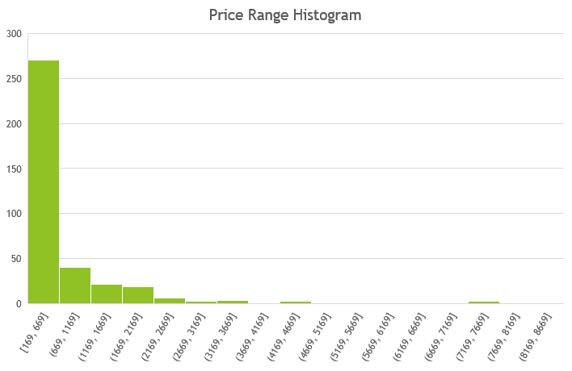
Data Visualisation
What is the most preferred price range for watches?
271 watches falls in the price
Range between 169 and 669.
Recommendation:
You can maintain a stock of
Watches in the price range
Between 150 and 700.

Slide 10
Data Visualisation
Find the highest rated watches?
Name | Average of rating
Analog Watch - For Men Luxury Stainless Steel Mens Sports Business Wrist Watch with Date | 5
Elliot Analog Watch - For Women 14000117 | 4.6
Vyb Diva Analog Watch - For Women FV60060WM01W|FV60060WM01W|FV60060WM01W | 4.6
waterproof kids watches for boys Digital Watch - For Boys & Girls QSIB-72 G SHOCK BLACK_13 | 4.7
Recommendation:
You can maintain a stock of these watches as these can provide good sales.

Slide 11
Data Visualisation
What is the average price of watches across top five brands?
Brand | Average of Special price
Allen Solly | 1397.82
LOIS CARON | 299.06
MATRIX | 294.86
PROVOGUE | 306.54
RUSTET | 387.50

Slide 12
Data Visualisation
What are the lowest rated brands?
Forum(3.2)
SABR(3.6)
RLS(3.6)
Shafs(3.7)
KILLER(3.77)
Recommendation:
We should not consider keeping watches of these brands in stock.

Slide 13
Data Visualisation
Find the top five discounts offered on original price?
Discount(%) | Count of discount
84.00% | 52
86.00% | 44
85.00% | 35
88.00% | 24
82.00% | 22

Slide 14
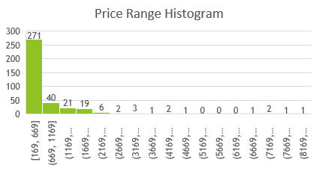
FLIPKART DATA ANALYSIS
TOTAL WATCHES
TOTAL BRANDS
HIGHEST PRICED WATCH
LOWEST PRICED WATCH
371
64
8219
169

Slide 15
Result
On the basis of the analysis of this dataset we can conclude that:
The most popular brands in this dataset are:
1. Allen Solly. 2.MATRIX. 3.LOIS CARON. 4.PROVOGUE. 5.RUSTET.
The suitable price is between 150 and 700.
The highest rated watches are:
Analog Watch - For Men Luxury Stainless Steel Mens Sports Business Wrist Watch with Date.
waterproof kids watches for boys Digital Watch - For Boys & Girls QSIB-72 G SHOCK BLACK_13.
Elliot Analog Watch - For Women 14000117.
Vyb Diva Analog Watch - For Women FV60060WM01W|FV60060WM01W|FV60060WM01W.
The average price(round off) of watches across top five brands are:
1.Allen Solly-1398. 2.MATRIX-295. 3.LOIS CARON-299. 4.PROVOGUE-307. 5.RUSTET-388.
The lowest rated brands are:
1.Forum(3.2). 2.SABR(3.6). 3.RLS(3.6). 4.Shafs(3.7) 5.KILLER(3.77).
The most frequently offered discount range was from 80 to 90 percent on original price.

Slide 16
RECOMMENDATIONS
The watches of top brands can be kept in stock as these can generate good sales.
The suitable price range is between 150 and 700.
Highest rated watches can provide good sales.
Avoid keeping lowest rated brand watches in stock.

Slide 17
THANK YOU

