Slide 1
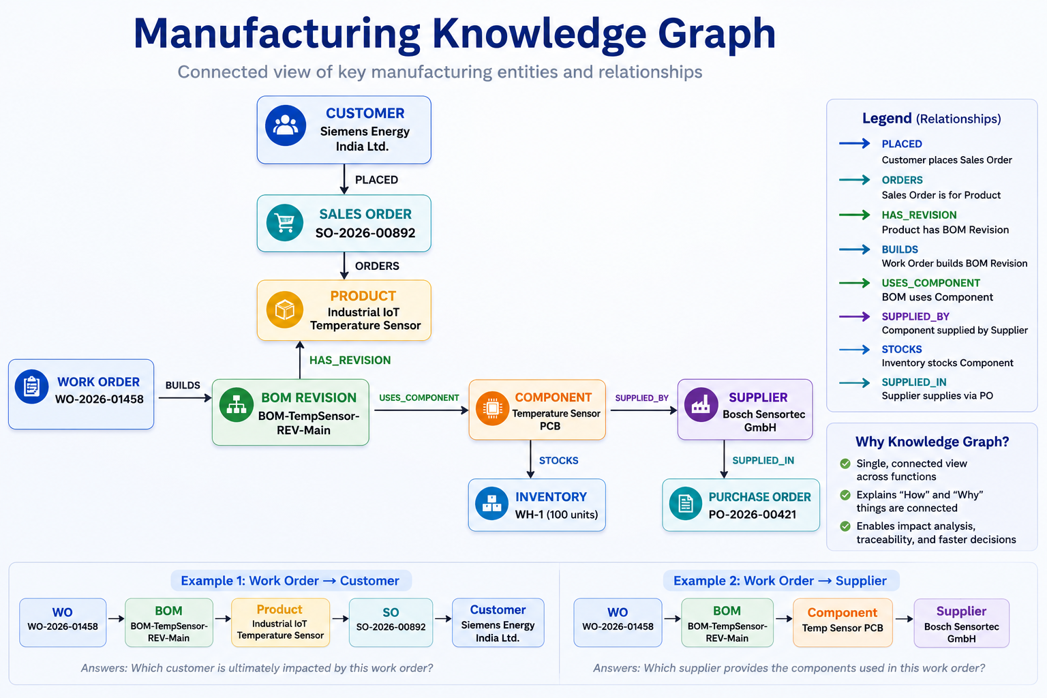
Notes:
"Each box in this diagram represents a business entity from the manufacturing domain, and each arrow represents a business relationship." "For example, a Customer places a Sales Order, the Sales Order orders a Product, and the Product is associated with a specific BOM Revision." "The BOM Revision defines which Components are required to manufacture the product." "Each Component is sourced from one or more Suppliers." "Finally, a Work Order is created to build that specific BOM Revision.“
"Instead of storing these entities in isolated tables, we model them as a connected graph." "This creates a single source of truth for product structure, manufacturing execution, procurement, and customer demand." "Because everything is connected, we can answer business questions simply by traversing the graph."

Slide 2
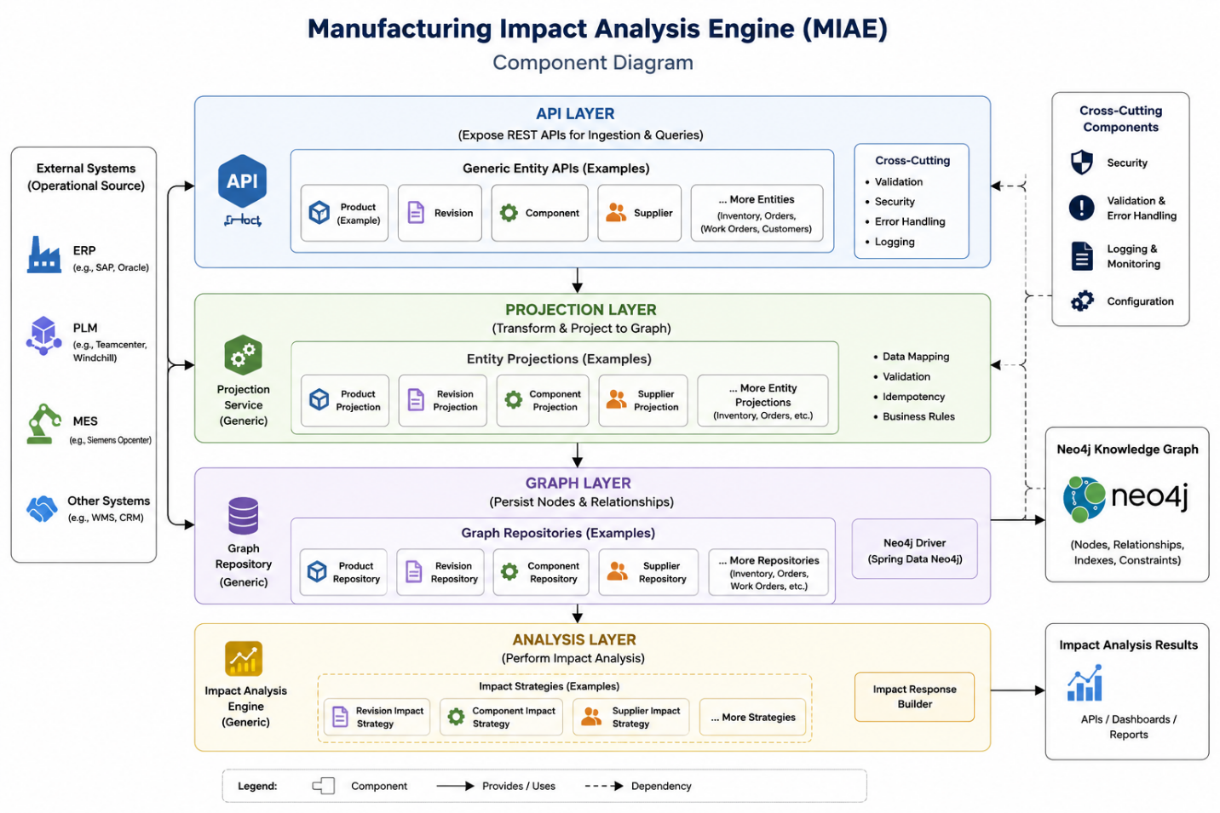
Notes:
REST Controller
"The REST Controller is the entry point into the application."
"It receives the client request, performs basic request validation, and delegates processing to the service layer."
Graph Traversal Service
"The Graph Traversal Service orchestrates the complete traversal workflow."
"It validates business inputs, coordinates repository calls, and transforms graph data into the API response."
"This layer contains the business orchestration but does not execute graph queries itself."
Graph Traversal Repository
"The repository is responsible only for interacting with Neo4j."
"It executes the shortest-path query and returns native graph paths."
"It hides all Cypher query implementation from the rest of the application."
Neo4j Database
"Neo4j stores the manufacturing knowledge graph."
"It discovers the shortest dependency path between any two business entities."
"This allows complex relationship queries to execute efficiently without custom traversal logic in Java."
Response Mapper
"The Response Mapper converts Neo4j graph objects into the API response model."
"It determines traversal direction, calculates hop count, and builds a client-friendly response."
Response DTO
"The final output is a technology-independent response contract."
"Clients receive only business entities and relationships without any Neo4j-specific implementation details."

Slide 3
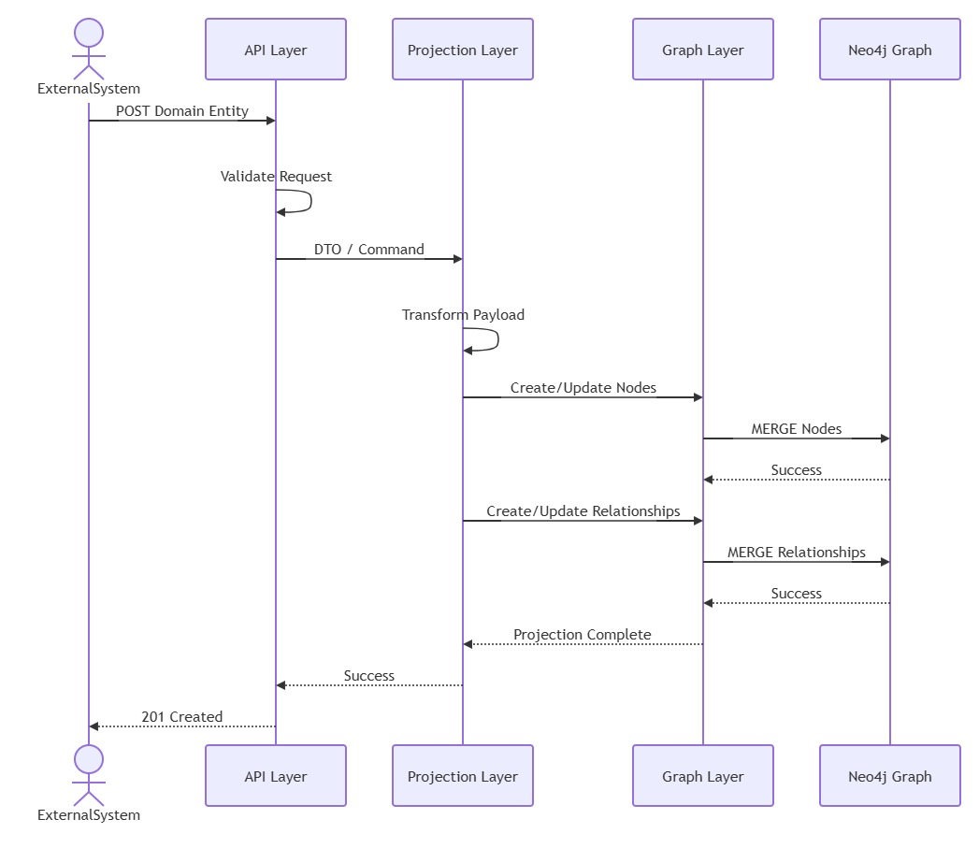

Slide 4
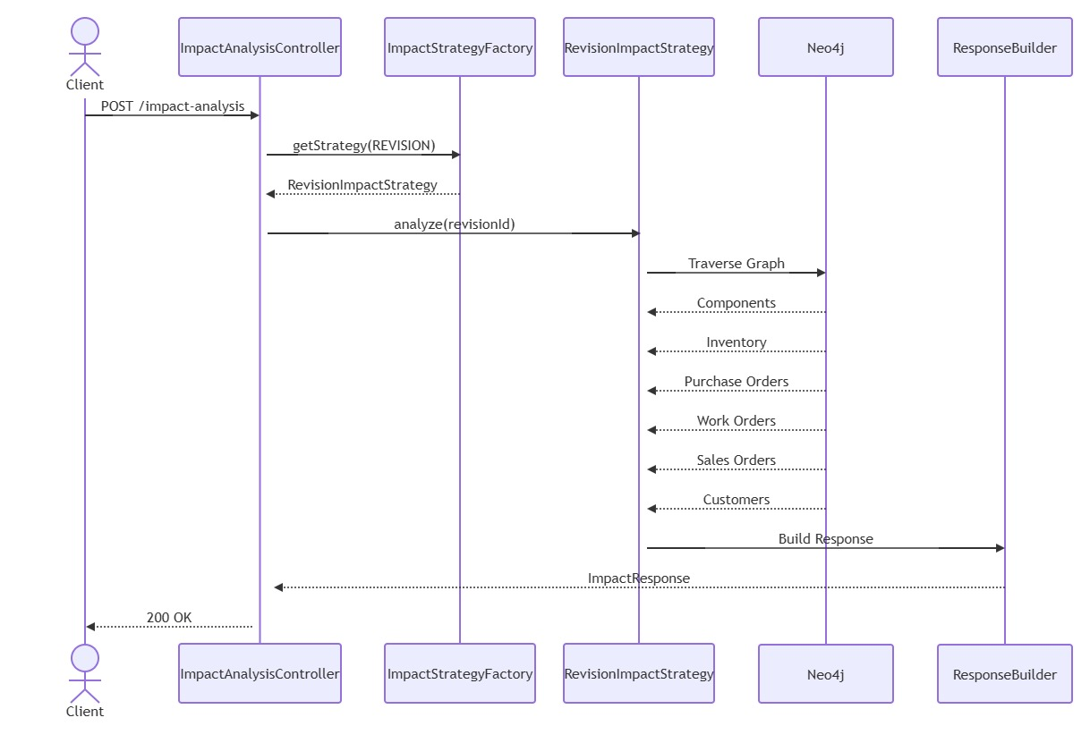

Slide 5
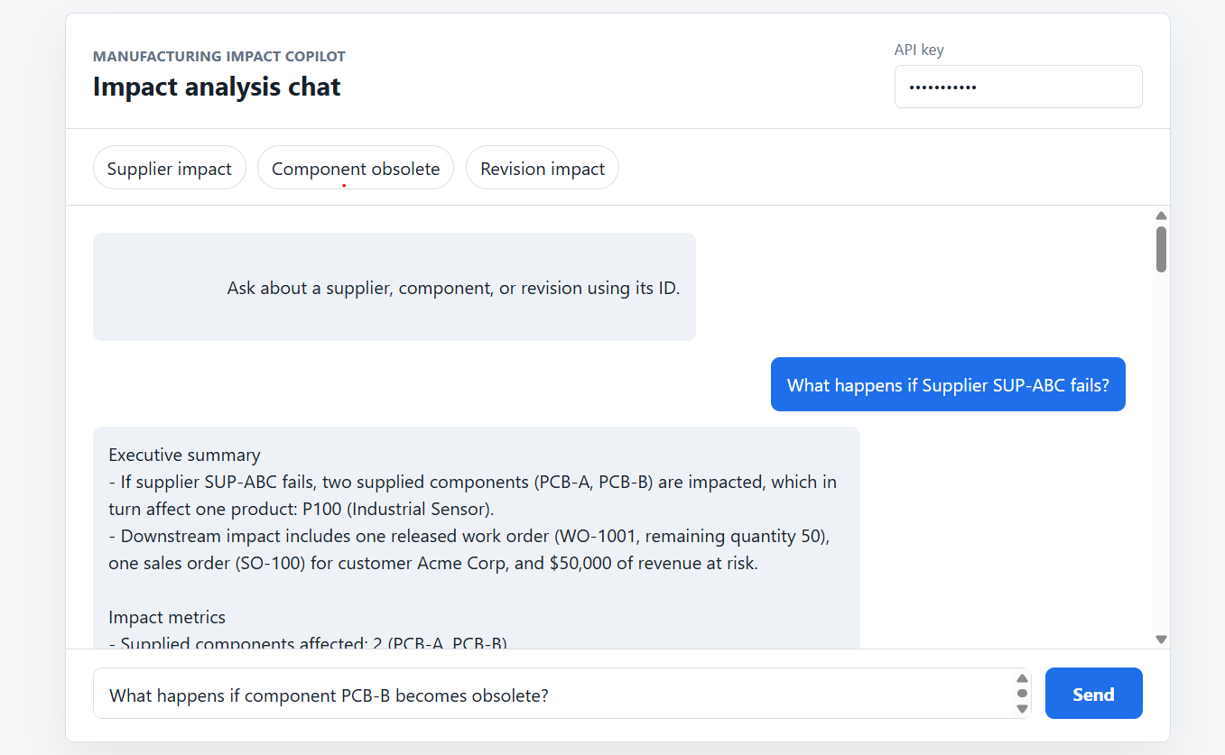

Slide 6
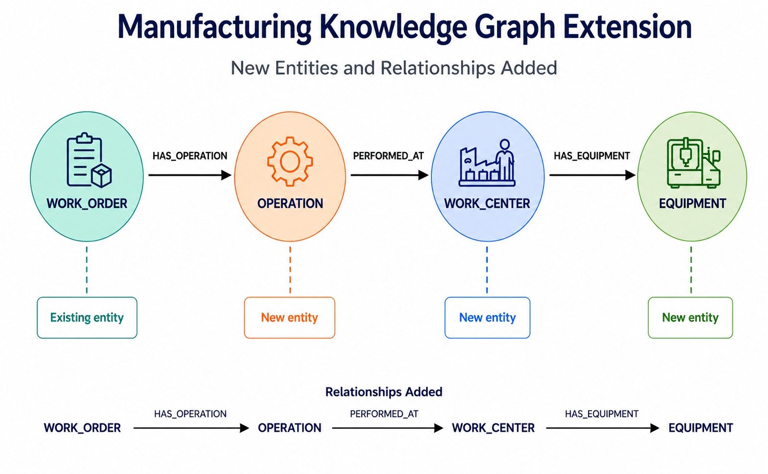
Manufacturing Asset Impact Intelligence

Slide 7
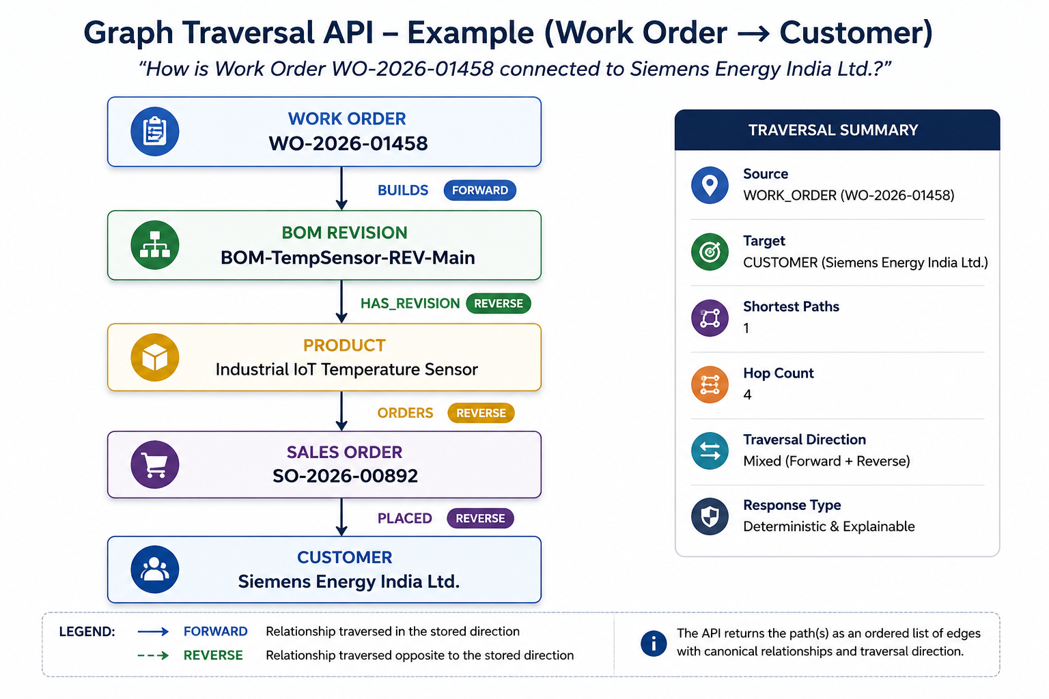
Notes:
"For example, if I start from a Work Order, I can traverse upstream to discover which Supplier provides the required component." "Or I can traverse downstream to identify which Customer ultimately ordered the product being manufactured."

Slide 8
