Slide 1
INDIAN EQUITIES ANALYTICS
Direction Predictor
A reproducible ML pipeline for 5 NSE large-caps: data → features → models → dashboard
RELIANCE.NS · TCS.NS · HDFCBANK.NS · INFY.NS · ICICIBANK.NS
Capstone Presentation • Presented to Ravi Agarwal

Slide 2
01 — THE PROBLEM
Can technical indicators predict tomorrow's move?
Investors constantly ask: will this stock go up or down tomorrow?
We frame that as a supervised binary classification problem for 5 Indian large-cap stocks, using only historical price/volume data.
Build a fully reproducible, single-command pipeline
Compare 3 ML models with sound time-series validation
Report honestly on what does & doesn't work
Indian Equities Analytics & Direction Predictor
2

Slide 3
02 — APPROACH
One command, five stages
Data
Ingestion
→
Feature
Engineering
→
Model
Training
→
Model
Selection
→
Interactive
Dashboard
src/data.py → src/features.py → src/model.py → models/best_model.joblib → app.py
Reproduce everything with:
python run_pipeline.py && streamlit run app.py
Indian Equities Analytics & Direction Predictor
3

Slide 4
03 — DATA
5 years of OHLCV across 5 sectors
Ticker | Company | Sector
RELIANCE.NS | Reliance Industries | Energy / Conglomerate
TCS.NS | Tata Consultancy Services | IT
HDFCBANK.NS | HDFC Bank | Banking
INFY.NS | Infosys | IT
ICICIBANK.NS | ICICI Bank | Banking
Source: Yahoo Finance (yfinance), 5 years daily OHLCV.
Offline-safe: falls back to a deterministic synthetic generator when yfinance/internet is unavailable — the pipeline still runs end-to-end and reproduces every result in this deck.
Indian Equities Analytics & Direction Predictor
4

Slide 5
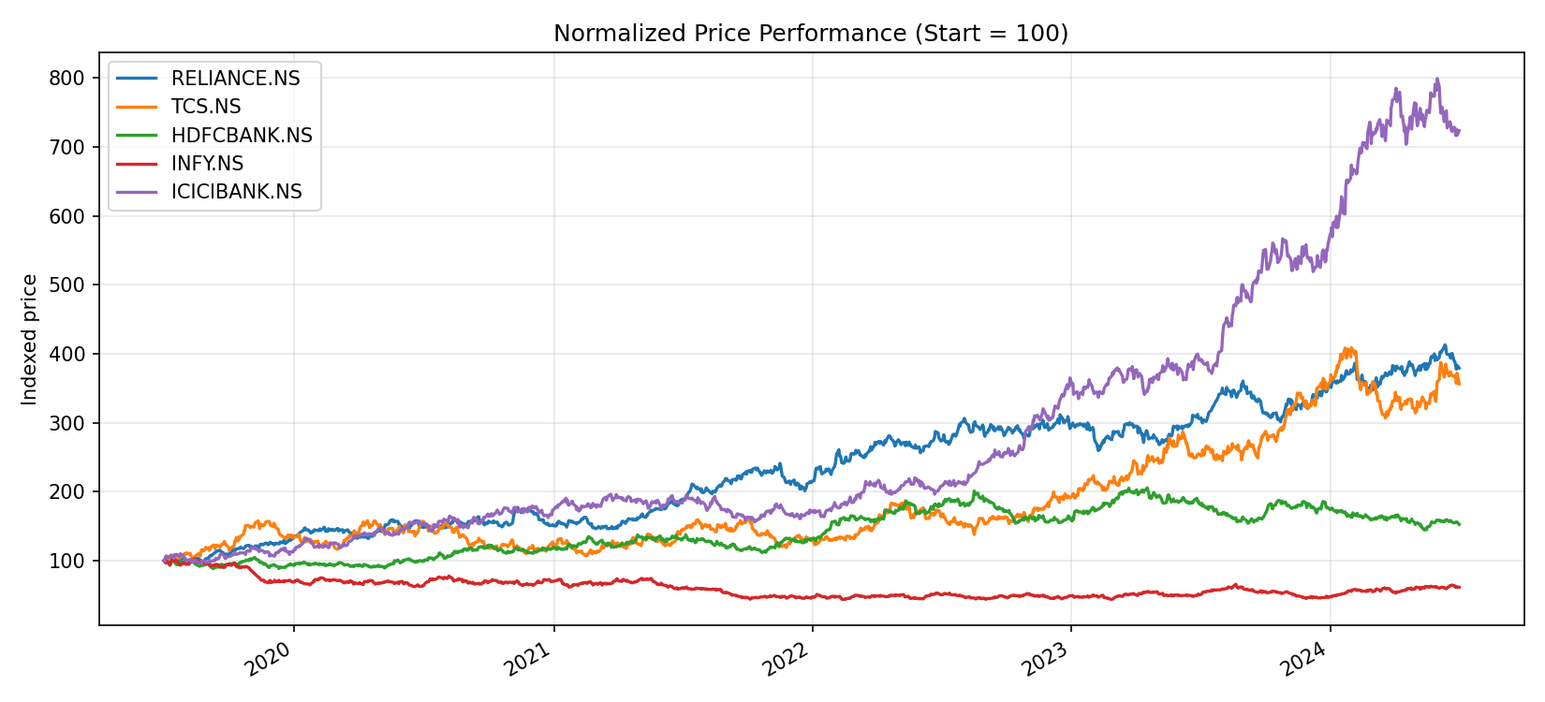
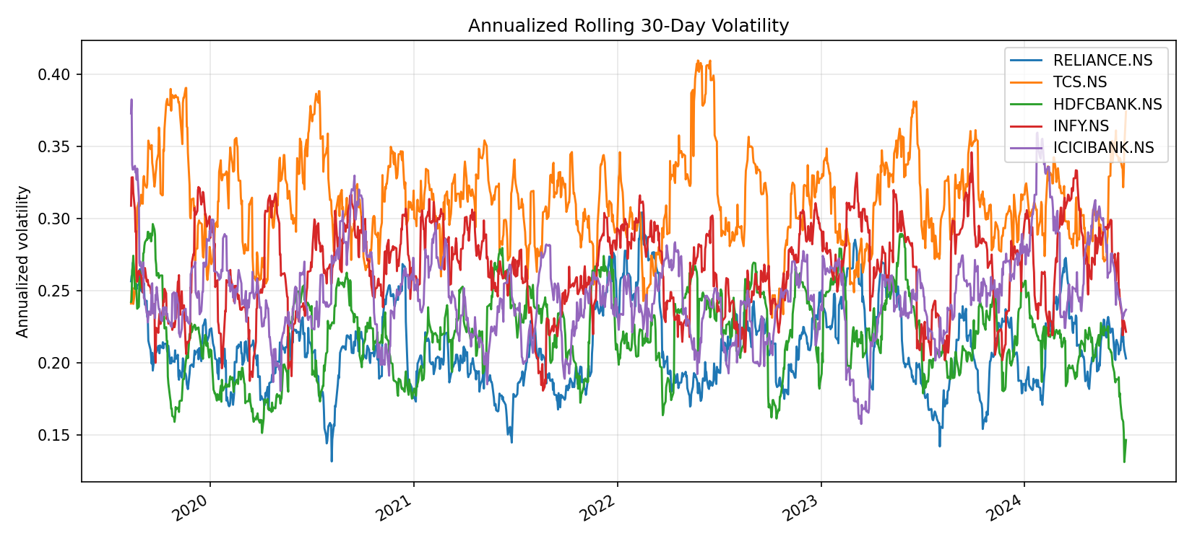
04 — EDA HIGHLIGHTS
Price performance & volatility
All 5 stocks show the fat-tailed, roughly zero-mean daily returns expected of liquid large-caps. Volatility clusters around known macro/earnings events rather than trending steadily.
Indian Equities Analytics & Direction Predictor
5

Slide 6
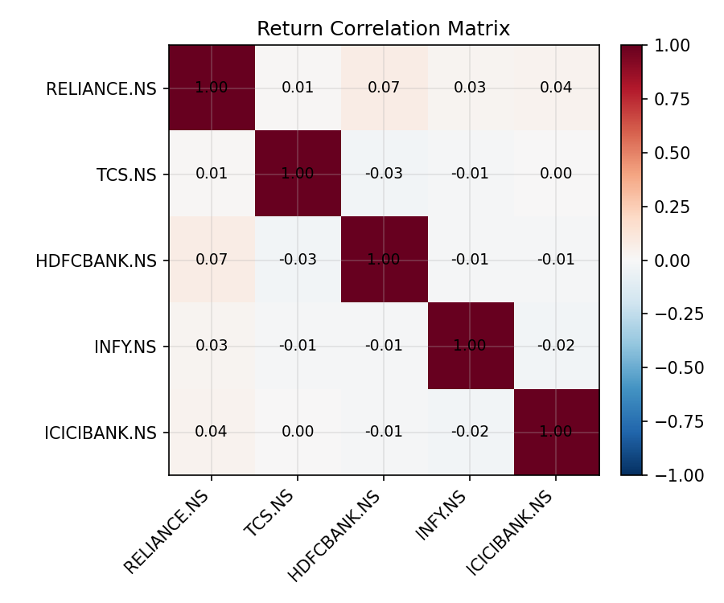
04 — EDA HIGHLIGHTS
Cross-stock return correlation
Correlation is informative context for portfolio construction, but each stock's direction model is trained independently — no cross-stock features are used, avoiding subtle leakage.
Class balance check: ~48-54% up-days per stock — close to balanced, so accuracy near 50% is the honest baseline to beat.
Indian Equities Analytics & Direction Predictor
6

Slide 7
05 — FEATURE ENGINEERING
10 technical indicators, no look-ahead
Momentum
return_1d, log_return_1d
Trend
sma_10_ratio, sma_50_ratio, ema_20_ratio
Oscillators
rsi_14, macd_hist
Volatility
bb_width, volatility_10
Volume
volume_change
Target: 1 if next day's close > today's close, else 0
Indian Equities Analytics & Direction Predictor
7

Slide 8
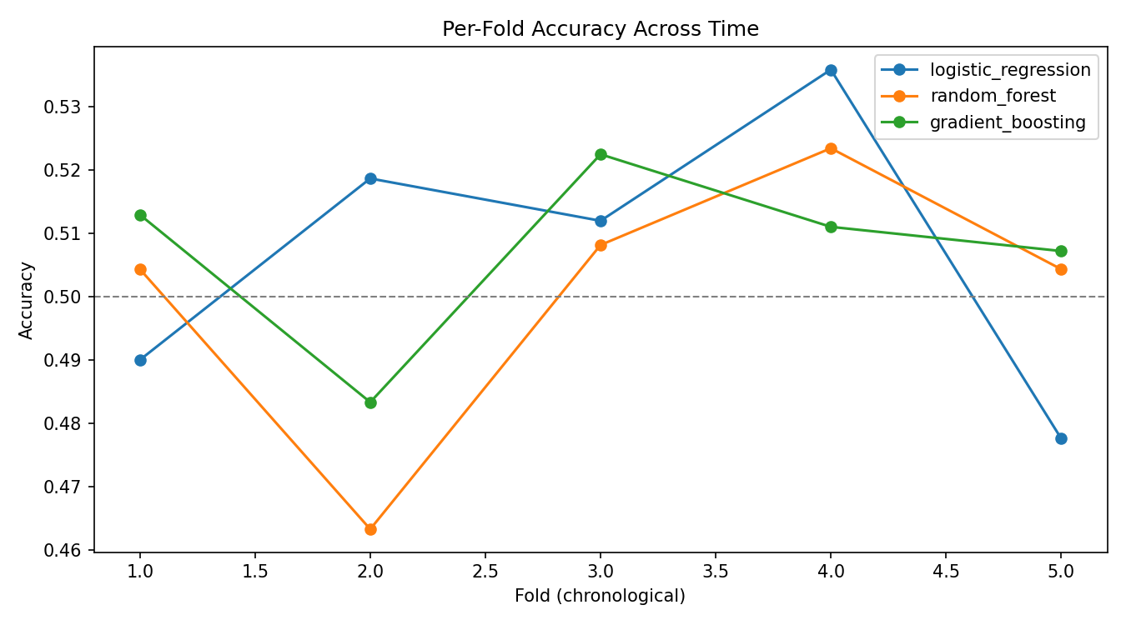
06 — MODELING
3 models, chronological cross-validation
Logistic Regression
Random Forest
Gradient Boosting
Linear baseline, scaled features
300 trees, depth-limited, balanced classes
200 shallow trees — best performer
TimeSeriesSplit (5 folds, chronological, no shuffling) — every fold trains only on the past and tests on the future, avoiding look-ahead leakage that a random K-fold split would introduce on time series.
Indian Equities Analytics & Direction Predictor
8

Slide 9
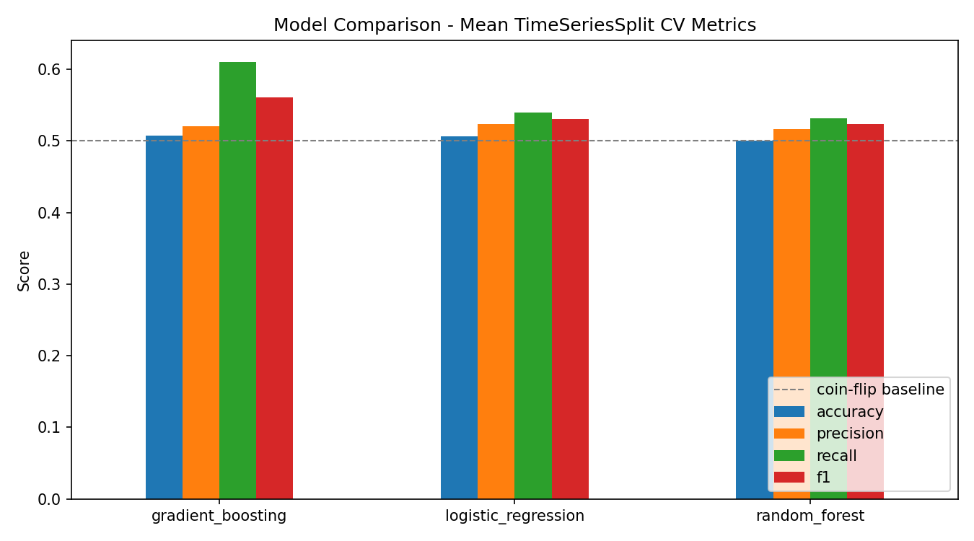
07 — RESULTS
Gradient Boosting selected as best model
Model | Accuracy | Precision | Recall | F1
Logistic Regression | 0.507 | 0.524 | 0.539 | 0.531
Random Forest | 0.501 | 0.517 | 0.531 | 0.523
Gradient Boosting | 0.507 | 0.520 | 0.610 | 0.561
Baseline: a coin flip scores 0.500 accuracy.
Indian Equities Analytics & Direction Predictor
9

Slide 10
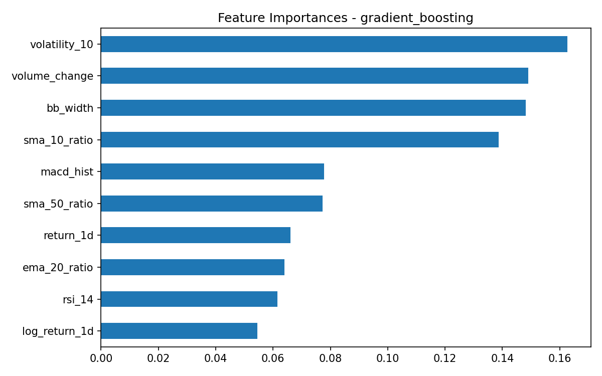
08 — DASHBOARD & INTERPRETABILITY
What drives the prediction?
Streamlit dashboard (app.py):
• Pick any of the 5 stocks
• Candlestick price chart + SMA/EMA overlays
• RSI / MACD / Bollinger-width panels
• Next-day prediction with probability
• Historical CV accuracy table
Indian Equities Analytics & Direction Predictor
10

Slide 11
09 — LIMITATIONS & FUTURE WORK
Honest read of the results
LIMITATIONS
FUTURE WORK
• Accuracy near the random-walk baseline — expected for 1-day direction on liquid large-caps
• Add sentiment, macro (Nifty, USD/INR), and fundamental data
• No fundamental, macro, or sentiment features
• Predict probability/confidence, not just a hard label
• Binary framing loses move magnitude
• Multi-day horizons + walk-forward, cost-aware backtest
• No transaction-cost-aware backtest
• Compare against sequence models (LSTM/Transformer)
Indian Equities Analytics & Direction Predictor
11

Slide 12
Key Takeaways
– A clean, reproducible pipeline matters as much as the model itself
– TimeSeriesSplit is non-negotiable for financial ML — random K-fold silently leaks the future
– Near-50% accuracy is a real, publishable finding — not a failure to hide
– Next step: richer features (sentiment/macro) before chasing fancier models
Thank you
github.com/<https://github.com/mohitsingh200/Ollosoft-ds-internship-mohit->/indian-equities-capstone
Mohit Singh

