Slide 1
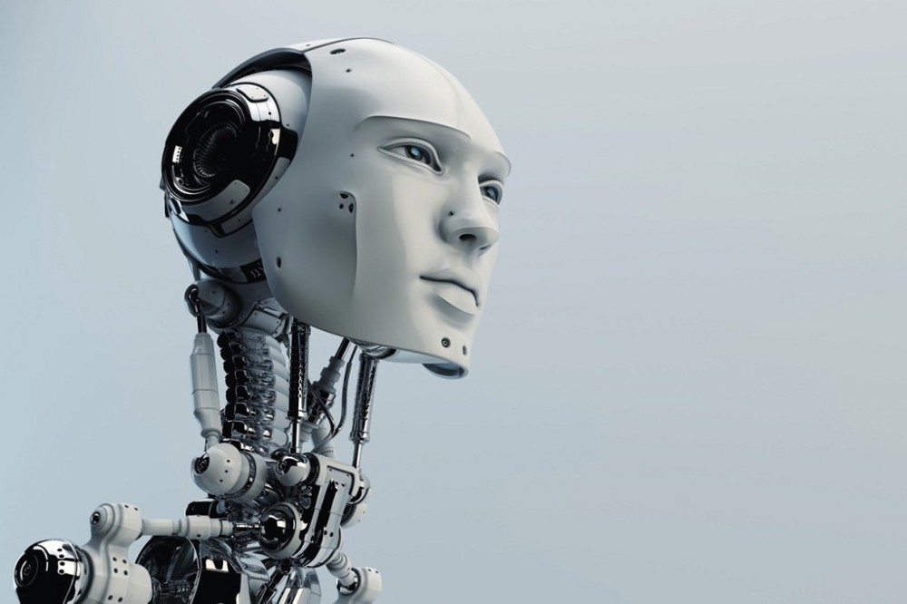
INNOVATION

Slide 2

WHAT IS THIS ALL ABOUT ?
WE ARE GOING TO DETECT THE MOTION OF OUR BODY THROUGH THE MOTION SENSORS →
MAGNETIC MOTION CAPTURE
Active Infrared Sensors
Passive Ultrasonic Detector
Combined Motion Sensors
Wireless Motion Sensor
Motion Sensor Camera

Slide 3
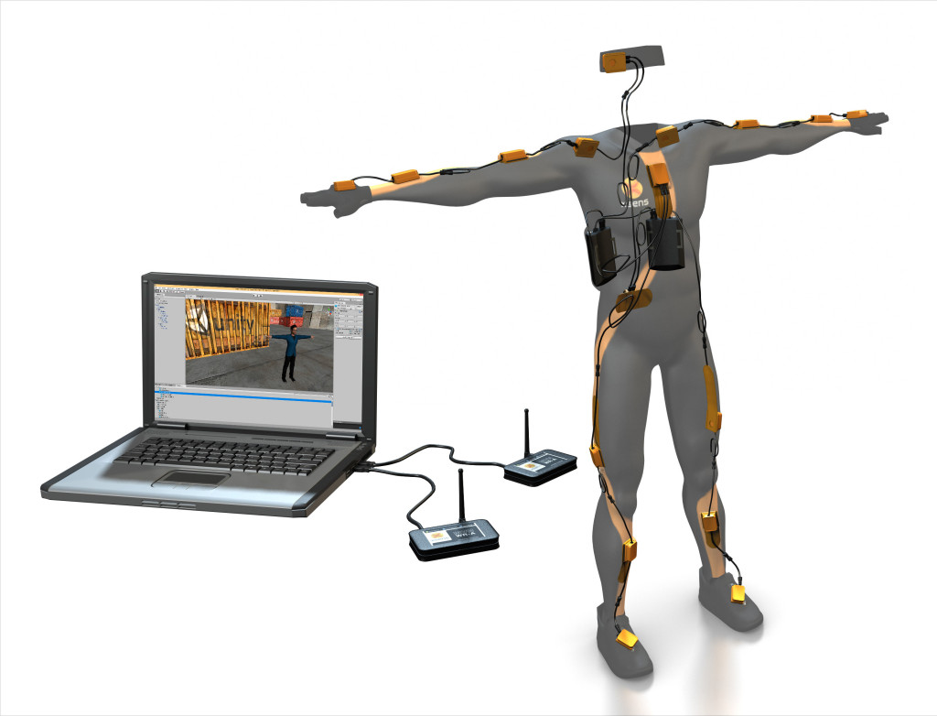
3D MOTION TRACKING

Slide 4

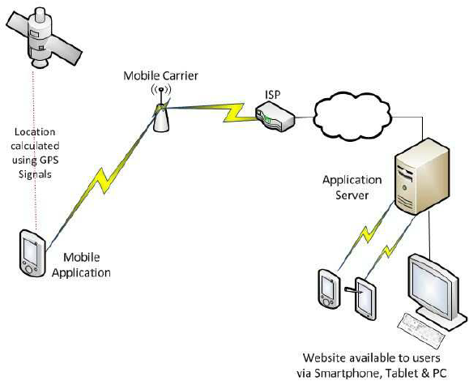
NEXT WE WILL TRANSFER THE DATA THROUGH OUR WIRED OR WIRELESS MEDIUM TO THE DESIRED PROTOTYPE LOCATION

Slide 5

What to do With DATA
ROBOTS
come to play
WE ARE GOING TO USE IT FOR DIFFERENT APPLICATIONs AS IT IS cheaper to use them over humans.
Robots can explore inside gas tanks.
Robots can explore inside volcanoes.

Slide 6
Robots can travel the surface of Mars or other places too dangerous for humans to go where extreme temperatures CLIMATE or WHERE CONTAMINATED environments exist.

Slide 7
comPONENTS OF A ROBOT
COMPONENTS OF A ROBO IS IN GENERAL 3
THESE ARE
SENSORS
MECHANICAL PARTS
CONTROLLER
EITHER WE US Ai
Or we can ourself use it
Or through both instructions and ai

