Slide 1

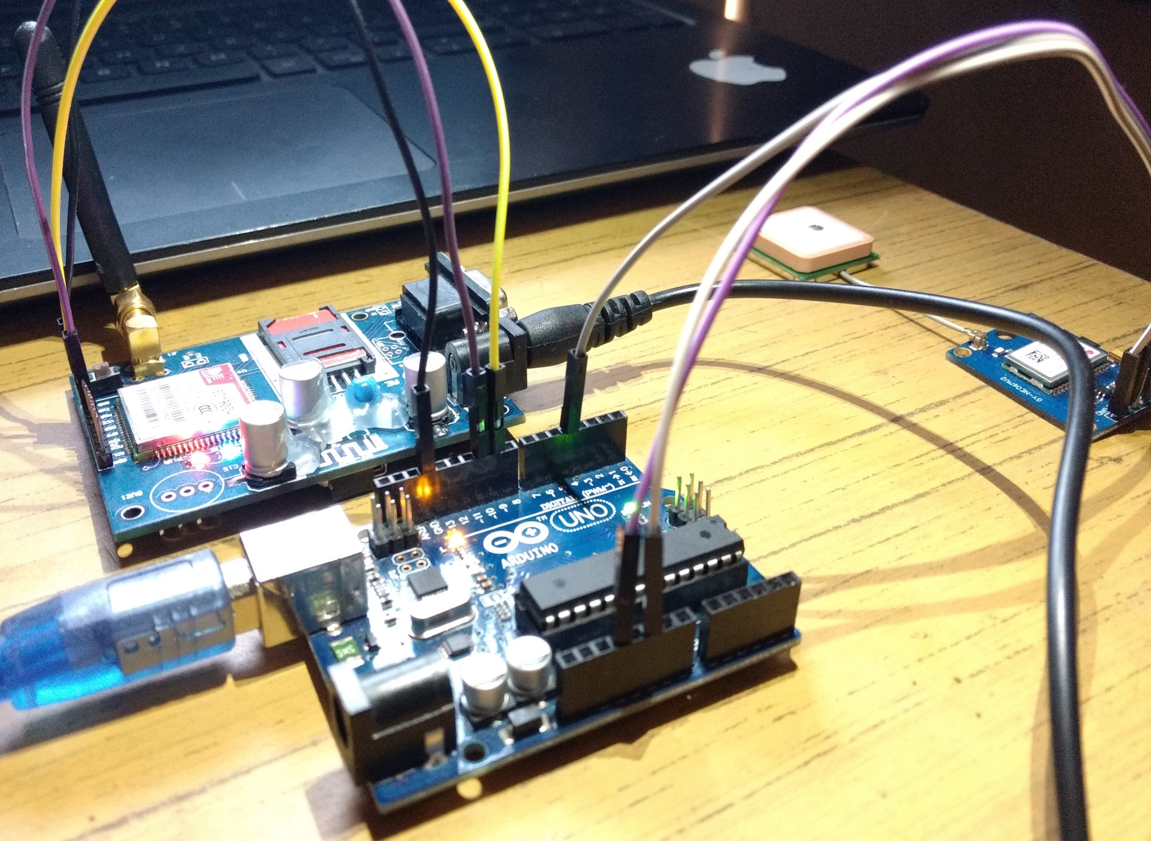
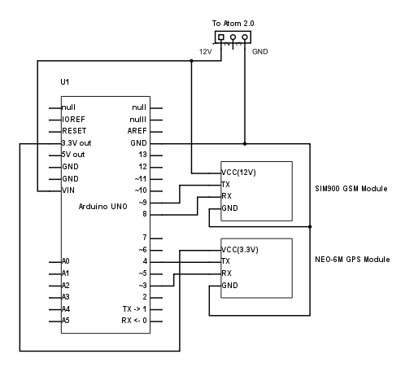
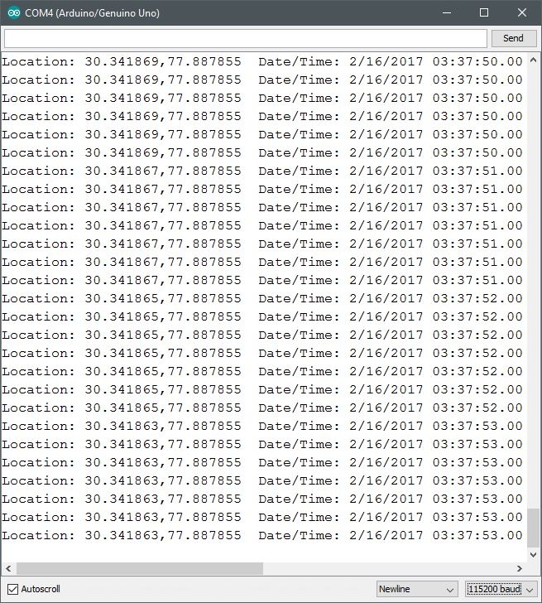
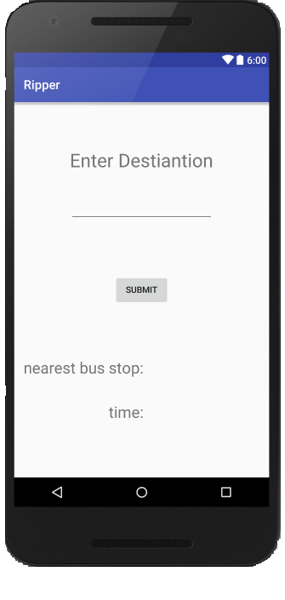
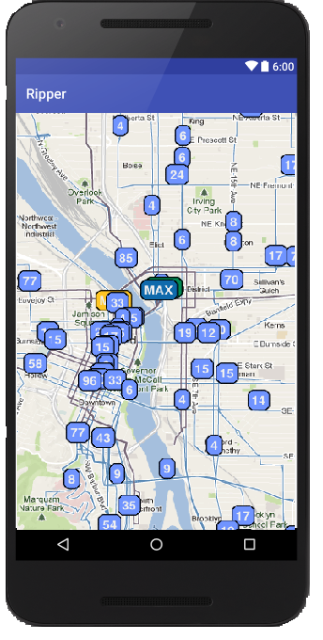
Reducing downtime on public bus system using gps and machine learning
Tula’s Institute
Abhishek Singh(EEE), Mohit Singh(CSE)
Abstract
Construction/Algorithm
The bus transport network of the country faces gridlock on a daily basis, due to this the daily commuter has to faces delays to work and other of his destinations. We have devised a system wherein we use real time tracking and at a later stage machine learning to provide the user back his estimated time of arrival at his preferred bus stop and to the desired destination. Every bus in the network gets a unique ID and our device associated with it. Over time after gathering data about routes and delays on the route, we shall be able to train a linear regression model which will be able to pre-empt the outcomes of the input data by virtue of its sampled data. This will be able to provide best possible estimated time of arrival of busses at bus stop and destinations in an hour in advance.
Prerequisites:
Arduino UNO/Nano/ 10 Pin AVR Microcontroller
Neo 6M GPS Tracking Module 9600 baud
SIM900 GSM/GPRS Signal Receiver
A Server running Ubuntu 14.04 LTS
Node.js as backend
scikitlearn as ML Framework
An Android Smartphone
LM series 12V, 9V and 5V voltage regulators.
9V Batteries x4
Unlocked functional SIM card with GPRS connection
Sockets
Jumper Cables
Introduction
We aim to use real time geo-location data of an entire bus network. The user of the service will be equipped with a smartphone app which will be able to pull data from a central server. The user will set a specific location as his destination or preferred bus stop. The app would then show him the buses nearest to this location along with the estimated time of arrival of all of the relevant buses on his route.
The proposed system shall work in two phases. In the first phase the bus location data will be collected on each operating route throughout the operating hours of the service recording congestion and buffer zones. The GPS data is sent to the arduino in NEMA0183 format. This latitude and longitude data along with the time stamp and bus id will be sent to the server via the GPRS connection provided by the GSM module. The server will compute the speed of the busses by calculating the distance travelled by the bus in the time differences of two successive timestamps.
Results/Application
In the second phase of operation the aspect of machine learning comes into play. All the sampled data collected in phase 1 will be used to train a machine learning classifier. This will enable the service to return ETA(s) back to the user with even better accuracy taking into account the current bus geolocation data.
Shows the user the ETA to his destination and the system improves over time using machine learning.
Underlying Principle
Power: The device will be powered by the internal 12V battery of the vehicle, as the output voltage of the battery will be around 13V voltage regulators have been used. The arduino receives unregulated 12V, GPRS receives regulated 12V and GPS module receives regulated 3.3V.
Connections: The MCU communicates with both the GPS and GPRS modules via asynchronous serial communication with a baud rate of 9600B/S. As we are limited by the number of hardware serial headers, we used the SoftwareSerial library to user digital pins as dedicated serial communications ones. TinyGPS+ library is used for NEMA data formatting.
Conclusion
The server will be running Ubuntu 14.04 with node.js as backend. Scikit learn will be used as the machine learning framework of choice.
The usage of this system will ensure accurate data being transmitted to the smartphone app and the user will be able to correctly gauge his ETA at the destination he desires. This system can also be used by govt. undertakings to conveniently keep track of their vehicles and assets(eg. Post office vehicles etc.)
Operation:
The GPS module receives lock on at least 4 satellites.
GPS Module receives data form satellites. This is then sent serially to the Arduino.
The Arduino manipulates the strings received by the GPS module and sends it to GSM module.
The GSM module registers on network.
The MCU sets the proper APN and GPRS initialization settings.
The GSM module receives this data and is forwarded to the server.
The server calculates distance, speed used to measure congestion. This is then sent to smartphone when user sets a specific bus stop or his destination.
The Android client shows the user the nearest bus stop along with relevant delay data.
References
www.arduino.cc The arduino board reference for power supply and pinout reference.
www.simcom.eu The AT-Command manual for use during serial comm. between MCU and module. http://arduiniana.org/libraries/tinygpsplus/ Library used to use Neo6M GPS module.
http://aprs.gids.nl/nmea/ The specification for the NEMA0183 format.
http://developer.android.com API reference for programming android apps.
Notes:
<number>

