Slide 1
Functions and Recursion

Slide 2
Function is…
In Python, function is a group of related statements that perform a specific task. Functions help break our program into smaller and modular chucks. As our program grows larger and larger, functions make it more organized and manageable. Furthermore, it avoids repetition and makes code reusable.
As you already know, Python gives you many built-in functions like print(), etc. but you can also create your own functions. These functions are called user-defined functions.

Slide 3
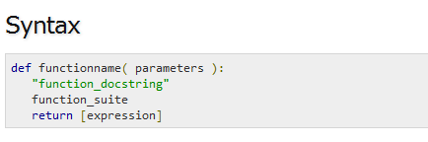
Defining a Function
You can define functions to provide the required functionality. Here are simple rules to define a function in Python.
Function blocks begin with the keyword def followed by the function name and parentheses ( ( ) ).
Any input parameters or arguments should be placed within these parentheses. You can also define parameters inside these parentheses.
The first statement of a function can be an optional statement - the documentation string of the function or docstring.
The code block within every function starts with a colon (:) and is indented.
The statement return [expression] exits a function, optionally passing back an expression to the caller. A return statement with no arguments is the same as return None.

Slide 4
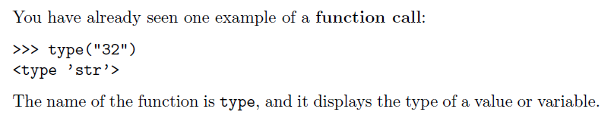
Function calls

Slide 5
>>> type(“32”)
Function Name
Arguments
<type ‘str’>
Return Value
Notes:
So ,Guys how many of you are afraid of programming ???? , who think that coding is the most difficult thing to do ??? Pick one of them and ask him/her the recipe of Maggi or tea …

Slide 6
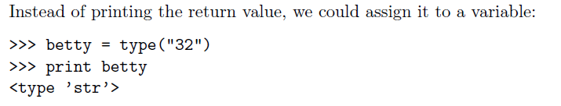

Slide 7
Pass by reference v/s value
All parameters (arguments) in the Python language are passed by reference. It means if you change what a parameter refers to within a function, the change also reflects back in the calling function.

Slide 8
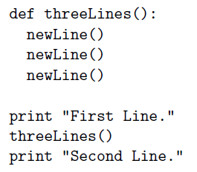
Flow of execution
In order to ensure that a function is defined before its first use, you have to know the order in which statements are executed, which is called the flow of execution.
3
4
5
6
1
Execution Starts
2
7

Slide 9
1.Write a Python function to find the Max of three numbers
2. Write a Python function to sum all the numbers in a list. Sample List : (8, 2, 3, 0, 7) Expected Output : 20
3. Write a Python function to multiply all the numbers in a list.
Sample List : (8, 2, 3, -1, 7) Expected Output : -336

Slide 10
Random Number Generation
import random
print random.randint(0, 5)
randrange ([start,] stop [,step])

Slide 11
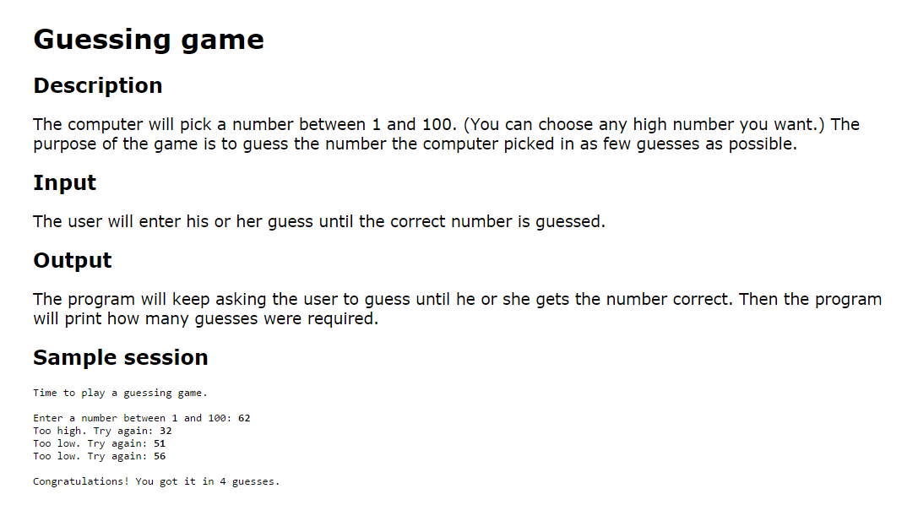

Slide 12
Parameters and arguments
Arguments are the values that control how the function does its job.
For example, if you want to find the sine of a number, you have to indicate what the number is. Thus, sin takes a numeric value as an argument.
Some functions take more than one argument. For example, pow takes two arguments, the base and the exponent. Inside the function, the values that are passed get assigned to variables called parameters.

Slide 13

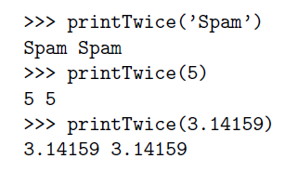
Function Definition
with arguments
Function Call
with arguments of
type String, Integer
and float respectively

Slide 14
Function Arguments
You can call a function by using the following types of formal arguments:
Required arguments
Keyword arguments
Default arguments
Variable-length arguments

Slide 15
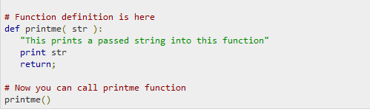
Required arguments
Required arguments are the arguments passed to a function in correct positional order. Here, the number of arguments in the function call should match exactly with the function definition.

Slide 16
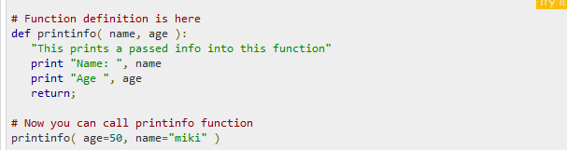
Keyword arguments
Keyword arguments are related to the function calls. When you use keyword arguments in a function call, the caller identifies the arguments by the parameter name.
This allows you to skip arguments or place them out of order because the Python interpreter is able to use the keywords provided to match the values with parameters.

Slide 17
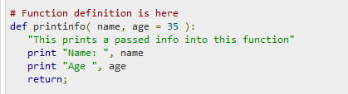
Default arguments
A default argument is an argument that assumes a default value if a value is not provided in the function call for that argument. The following example gives an idea on default arguments, it prints default age if it is not passed −

Slide 18
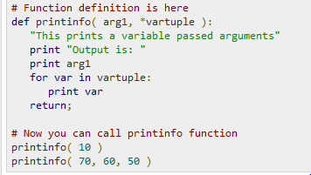
Variable-length arguments
You may need to process a function for more arguments than you specified while defining the function. These arguments are called variable-length arguments and are not named in the function definition, unlike required and default arguments.
An asterisk (*) is placed before the variable name that holds the values of all nonkeyword variable arguments.

Slide 19
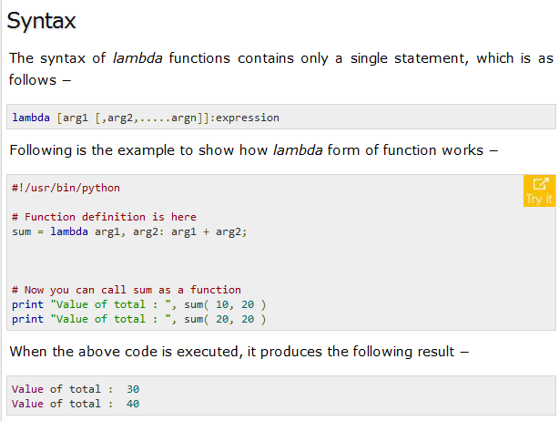
The Anonymous Functions
These functions are called anonymous because they are not declared in the standard manner by using the def keyword. You can use the lambda keyword to create small anonymous functions.
Lambda forms can take any number of arguments but return just one value in the form of an expression. They cannot contain commands or multiple expressions.
An anonymous function cannot be a direct call to print because lambda requires an expression
Lambda functions have their own local namespace and cannot access variables other than those in their parameter list and those in the global namespace.
Although it appears that lambda's are a one-line version of a function, they are not equivalent to inline statements in C or C++, whose purpose is by passing function stack allocation during invocation for performance reasons.

Slide 20
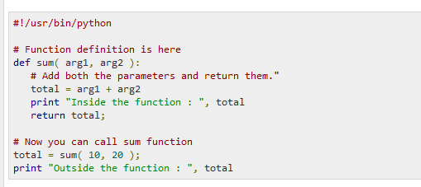
The return Statement
The statement return [expression] exits a function, optionally passing back an expression to the caller. A return statement with no arguments is the same as return None.

Slide 21
Problems
Write a function percent(value, total) that takes in two numbers as arguments, and returns the percentage value as an integer.
Write a function that uses a default value.
Write a function isEquilateral(x, y, z) that accepts the 3 sides of a triangle as arguments. The program should return True if it is an equilateral triangle.

Slide 22
Global vs. Local variables
Variables that are defined inside a function body have a local scope, and those defined outside have a global scope.
This means that local variables can be accessed only inside the function in which they are declared, whereas global variables can be accessed throughout the program body by all functions. When you call a function, the variables declared inside it are brought into scope.

Slide 23
Python Recursion
Recursion is the process of defining something in terms of itself. A physical world example would be to place two parallel mirrors facing each other. Any object in between them would be reflected recursively
**Python Recursive Function
We know that in Python, a function can call other functions. It is even possible for the function to call itself. These type of construct are termed as recursive functions.
Following is an example of recursive function to find the factorial of an integer. Factorial of a number is the product of all the integers from 1 to that number. For example, the factorial of 6 (denoted as 6!) is 1*2*3*4*5*6 = 720.

Slide 24
Advantages of recursion
Recursive functions make the code look clean and elegant.
A complex task can be broken down into simpler sub-problems using recursion.
Sequence generation is easier with recursion than using some nested iteration.
Disadvantages of recursion
Sometimes the logic behind recursion is hard to follow through.
Recursive calls are expensive (inefficient) as they take up a lot of memory and time.
Recursive functions are hard to debug.

Slide 25
Write a recursive function power(x, y) to calculate the value of x raised to the power of y.
Write a recursive function sumOfDigits that takes in an integer and returns the sum of the digit in the integer.
Write a recursive function sumNumbersFromOne(number) that takes in a number and returns the sum of all the numbers from one to the number passed in as argument.
Write a recursive function numbersInbetween(start, end) that takes in two numbers and returns a common-separated string with all the numbers in between the start and end number inclusive of both numbers.

Slide 26
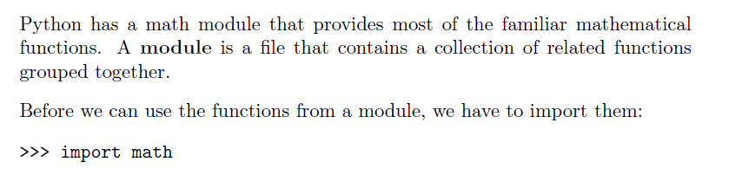
Math Functions
Notes:
Python also provides the power behind the most popular search engine in the world – Google. The programming language can handle the traffic and computing needs of the search engine and its connected apps.

Slide 27
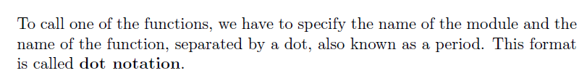
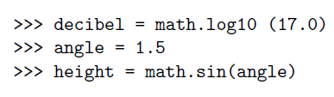
Calling a Math Function
For Example,
Notes:
Quora is the number one place online to ask a question and receive answers from a community of individuals. On their Python website relevant results are answered, edited, and organized by these community members.

Slide 28
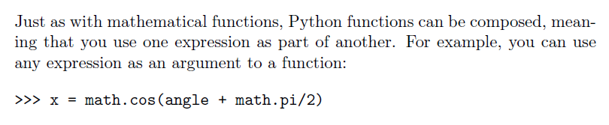
Composition
Notes:
A majority of the code for Bitly URL shortening services and analytics are all built
with Python. Their service can handle hundreds of millions of events per day.

Slide 29
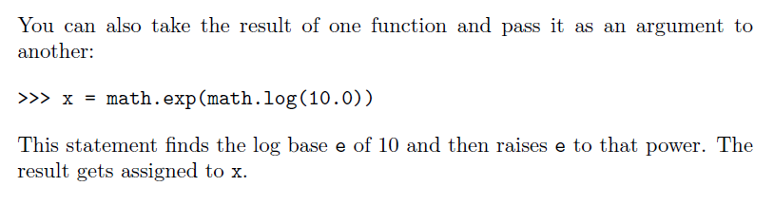
Composition
Notes:
Reddit is known as the front page of the internet. It is the place online to find information or entertainment based on thousands of different categories. Posts and links are user generated and are promoted to the top through votes. Many of Reddit’s capabilities rely on Python for their functionality.

Slide 30
Mathematical Functions
abs(x)
Ceil(x)
cmp (x, y)
exp (x)
Floor(x)
Log(x)
pow (x,y)
sqrt(x )
Max (x1,x2….xn)
Min (x1,x2…xn)

Slide 31
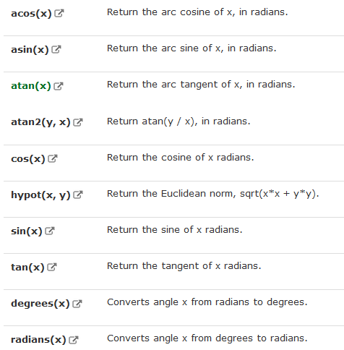
Trigonometric Functions

Slide 32
Stack Diagram for functions
To keep track of which variables can be used where, it is sometimes useful to draw a stack diagram.
Stack diagram is used to represent the state of a program during a function call.
Each function is represented by a frame. A frame is a box with the name of a function beside it and the parameters and variables of the function inside it.

Slide 33
a “Python”
b “Class”
_main_
catTwice
Part1 “Python”
Part2 “Class”
Cat “Python Class”

Slide 34
Functions with results
def sum (x,y):
return x+y
>>> a=sum(8,9)
>>> print a
17

Slide 35

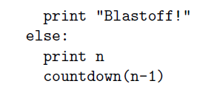
Recursion
It is legal for one function to call another, and you have seen several examples of that.
But it is also legal for a function to call itself.
For example,

Slide 36
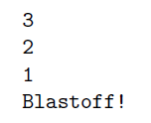
>>> countdown(3)
OUTPUT of this function will be :
Notes:
The execution of countdown begins with n=3, and since n is not 0, it outputs the value 3, and then calls itself...The execution of countdown begins with n=2, and since n is not 0, it outputs the value 2, and then calls itself...
The execution of countdown begins with n=1, and since n
is not 0, it outputs the value 1, and then calls itself...
The execution of countdown begins with n=0, and
since n is 0, it outputs the word, \Blasto!" and
then returns.
The countdown that got n=1 returns.
The countdown that got n=2 returns.
The countdown that got n=3 returns.
And then you're back in main

Slide 37
Stack diagrams for recursive functions
Earlier we used a stack diagram to represent the state of a program during a function call. The same kind of diagram can help interpret a recursive function.
Every time a function gets called, Python creates a new function frame, which contains the function's local variables and parameters. For a recursive function, there might be more than one frame on the stack at the same time.

Slide 38
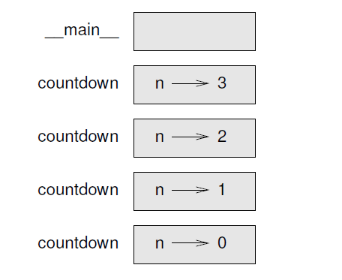
Following figure shows a stack diagram for function countdown (n) called with n = 3:
Notes:
The top of the stack is the frame for __main__ . It is empty because we did not create any variables in main or pass any arguments to it.

Slide 39
Infinite recursion
If a recursion never reaches a base case, it goes on making recursive calls forever, and the program never terminates. This is known as infinite recursion, and it is generally not considered a good idea. Here is a minimal program with an infinite recursion:
def recurse () :
recurse()
Function is calling
itself without any
condition to terminate
The recursive call

Slide 40
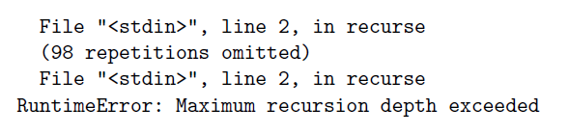
In most programming environments, a program with infinite recursion does not really run forever. Python reports an error message when the maximum recursion depth is reached:

Slide 41
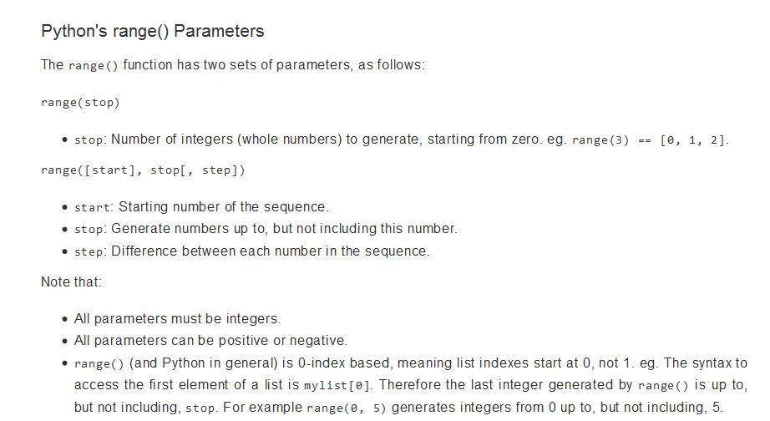

Slide 42
1.Write a Python function to find the Max of three numbers
2. Write a Python function to sum all the numbers in a list. Sample List : (8, 2, 3, 0, 7) Expected Output : 20
3. Write a Python function to multiply all the numbers in a list.
Sample List : (8, 2, 3, -1, 7) Expected Output : -336
4. Write a Python program to reverse a string.
Sample String : "1234abcd" Expected Output : "dcba4321“
5. Write a Python function to calculate the factorial of a number (non-negative integer). The function accept the number as a argument
6. Write a Python function to check whether a number is in a given range.

Slide 43
7. Write a Python function that accepts a string and calculate the number of upper case letters and lower case letters
Sample String : 'The quick Brow Fox' Expected Output : No. of Upper case characters : 3 No. of Lower case Characters : 12
8. Write a Python function that takes a number as a parameter and check the number is prime or not.
Note : A prime number (or a prime) is a natural number greater than 1 and that has no positive divisors other than 1 and itself.
9. Write a Python function that checks whether a passed string is palindrome or not. Note: A palindrome is word, phrase, or sequence that reads the same backward as forward, e.g., madam or nurses run.
Write a Python program that accepts a hyphen separated sequence of words as input and prints the words in a hyphen-separated sequence after sorting them alphabetically.
Sample Items : green-red-yellow-black-white Expected Result : black-green-red-white-yellow

Slide 44
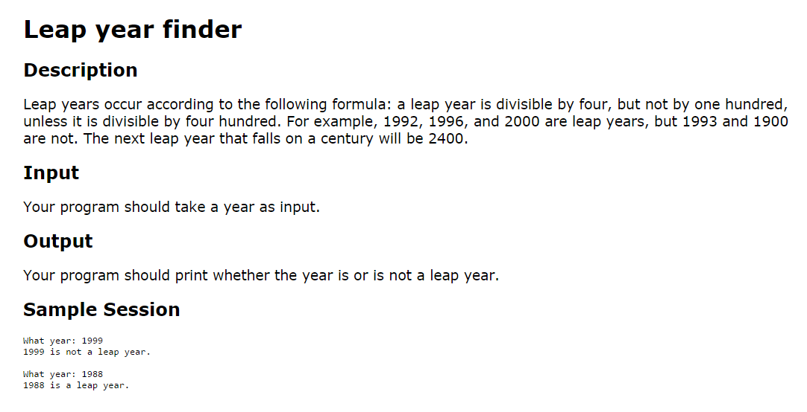

Slide 45
