Slide 1


Slide 2
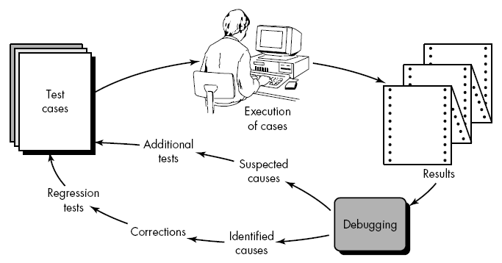
Debugging Process
Debugging occurs as a consequence of successful testing, debugging is the process that results in the removal of the error.

Slide 3
Debugging Process
debugging process begins with the execution of a test case.
Results are assessed and a lack of correspondence between expected and actual performance is encountered.
In many cases the error is being caused by yet another hidden cause, debugging process attempts to match symptom with cause, thereby leading to error correction.
The debugging process will always have one of two outcomes:
the cause will be found and corrected,
the cause will not be found.
In the latter case, the person performing debugging may suspect a cause, design a test case to help validate that suspicion, and work toward error correction in an iterative fashion.
Why is debugging so difficult? The answer is the human psychology.

Slide 4
Debugging Process
There are a few characteristics of bugs provide some clues:
The symptom and the cause may be geographically remote. That is, the symptom may appear in one part of a program, while the cause may actually be located at a site that is far away.
The symptom may disappear (temporarily) when another error is corrected.
The symptom may actually be caused by nonerrors (e.g., round-off inaccuracies).
The symptom may be caused by human error that is not easily traced.
The symptom may be a result of timing problems, rather than processing problems.
It may be difficult to accurately reproduce input conditions (e.g., a real-time application in which input ordering is indeterminate).
The symptom may be intermittent. This is particularly common in embedded systems that couple hardware and software inextricably.
The symptom may be due to causes that are distributed across a number of tasks running on different processors

Slide 5
Debugging Approaches
Regardless of the approach that is taken, debugging has one overriding objective: to find and correct the cause of a software error.
The objective is realized by a combination of systematic evaluation, intuition, and luck.
The basis of debugging is to locate the problem's source [the cause] by binary partitioning, through working hypotheses that predict new values to be examined.
In general, three categories for debugging approaches may be proposed :
Brute force,
Backtracking,
Cause elimination.

Slide 6
Debugging Approaches
1) Brute Force: It is most common and least efficient. We apply brute force debugging methods when all else fails.
Using a "let the computer find the error" philosophy, memory dumps are taken, run-time traces are invoked, and the program is loaded with WRITE statements. It can lead us to a clue that can lead us to the cause of an error.
2) Backtracking: is common and used in small programs, Beginning at the site where a symptom has been uncovered, the source code is traced backward (manually) until the site of the cause is found.
Unfortunately, as the number of source lines increases, the number of potential backward paths may become unmanageably large.
3) Cause Elimination: Introduces the concept of binary partitioning, Data related to the error occurrence are organized to isolate potential causes
A "cause hypothesis" is devised and the aforementioned data are used to prove or disprove the hypothesis.
Alternatively, a list of all possible causes is developed and tests are conducted to eliminate each.

Slide 7
Debugging Approaches
Once a bug has been found, it must be corrected. Van Vleck suggests three simple questions that every software engineer should ask before making the "correction" that removes the cause of a bug.
Is the cause of the bug reproduced in another part of the program?
In many situations, a program defect is caused by an erroneous pattern of logic that may be reproduced elsewhere. Explicit consideration of the logical pattern may result in the discovery of other errors.
2) What "next bug" might be introduced by the fix I'm about to make?
Before the correction is made, the source code (or, better, the design) should be evaluated to assess coupling of logic and data structures. If the correction is to be made in a highly coupled section of the program, special care must be taken when any change is made.
3) What could we have done to prevent this bug in the first place?
This question is the first step toward establishing a statistical software quality assurance approach. If we correct the process as well as the product, the bug will be removed from the current program and may be eliminated from all future programs.

Slide 8
Validation Testing
At the culmination of integration testing, software is completely assembled as a package, interfacing errors have been uncovered and corrected, and a final series of software tests—validation testing—may begin.
validation succeeds when software functions in a manner that can be reasonably expected by the customer. Reasonable expectations are defined in the Software Requirements Specification.
The specification contains a section called Validation Criteria.
Validation Test Criteria:
Software validation is achieved through a series of black-box tests that demonstrate conformity with requirements.
After each validation test case has been conducted, one of two possible conditions exist:
The function or performance characteristics conform to specification and are accepted.
A deviation from specification is uncovered and a deficiency list is created.

Slide 9
Validation Test Criteria
Deviation or error discovered at this stage in a project can rarely be corrected prior to scheduled delivery.
It is often necessary to negotiate with the customer to establish a method for resolving deficiencies.
Configuration Review: An important element of the validation process is a configuration review.
The intent of the review is to ensure that all elements of the software configuration have been properly developed, are catalogued, and have the necessary detail to bolster the support phase of the software life cycle.

Slide 10
Alpha and Beta Testing
It is virtually impossible for a software developer to foresee how the customer will really use a program.
Instructions for use may be misinterpreted;
Strange combinations of data may be regularly used.
output that seemed clear to the tester may be unintelligible to a user in the field.
When custom software is built for one customer, a series of acceptance tests are conducted to enable the customer to validate all requirements.
Tests are conducted by the end user rather than software engineers, an acceptance test can range from an informal "test drive" to a planned and systematically executed series of tests.
Acceptance testing can be conducted over a period of weeks or months, thereby uncovering cumulative errors that might degrade the system over time.

Slide 11
Alpha and Beta Testing
If software is developed as a product to be used by many customers, it is impractical to perform formal acceptance tests with each one.
So Most software product builders use a process called alpha and beta testing to uncover errors that only the end-user seems able to find.
Alpha Testing:
  The alpha test is conducted at the developer's site by a customer.
  The software is used in a natural setting with the developer and recording errors and usage problems.
  Alpha tests are conducted in a controlled environment.

Slide 12
Alpha and Beta Testing
Beta Testing:
  The beta test is conducted at one or more customer sites by the end-user of the software.
  Unlike alpha testing, the developer is generally not present.
  Therefore, the beta test is a "live" application of the software in an environment that cannot be controlled by the developer.
  The customer records all problems (real or imagined) that are encountered during beta testing and reports these to the developer at regular intervals.
  As a result of problems reported during beta tests, software engineers make modifications and then prepare for release of the software product to the entire customer base.

Slide 13
Alpha Vs. Beta Testing
Alpha Testing: Testing a software product which is not the final version. This software does not have to necessarily contain the full functionality required for an application however core functionality to accept input an generate output is required. Alpha testing is done by client side people in development environment. In Alpha testing client comes to testing environment and will do testing while 80 of the application has been developed and tested | Beta Testing: Beta Testing is last stage of testing where a product is sent outside the company or offer the product for free trial download. testing is done by client side people in real time environment. In Beta testing complete application package will be installed in client environment (ie) Real time environment and will do testing in the application which is completed (100 ) development and testing

