Slide 2
Decision Table Testing
From the beginning of software development testing has always been incorporated into the final stages.
Over the years the technicality of software has increased dramatically.
As this complexity increases, programmers realise that testing is just as important as the development stages.
Nowadays there are two main types of stages, White box testing and Black box testing
Grey box testing is another type, but it’s not so well known and is sometimes used with Decision Table-Based Testing:

Slide 3
Decision Table Testing
White box – testing concerned with the internal structure of the program.
Black box – testing concerned with input/output of the program.
Grey box – using the logical relationships to analyse the input/output of the program.
Decision Table-Based Testing which is a Functional Testing method, also known as Black box testing.

Slide 4
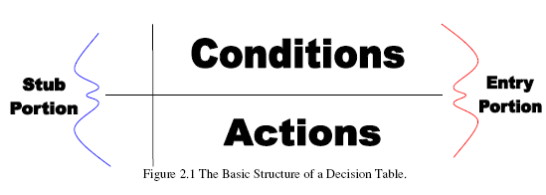
Decision Table Testing
Decision Table-Based Testing has been around since the early 1960’s.
It is used to depict complex logical relationships between input data. There are two closely related methods of Functional Testing.
  The Cause-Effect Graphing (Elmendorf, 1973; Myers, 1979), and
  The Decision Tableau Method (Mosley, 1993).
A Decision Table is the method used to build a complete set of test cases without using the internal structure of the program in question.
In order to create test cases we use a table to contain the input and output values of a program. Such a table is split up into four sections as shown below:

Slide 5
Decision Table Testing
In fig there are two lines which divide the table into its main structure. The solid vertical line separates the Stub and Entry portions of the table, and the solid horizontal line is the boundary between the Conditions and Actions.
So these lines separate the table into four portions, Condition Stub, Action Stub, Condition Entries and Action Entries.
A column in the entry portion of the table is known as a rule.
Values which are in the condition entry columns are known as inputs.
Values inside the action entry portions are known as outputs.
Outputs are calculated depending on the inputs and specification of the program.

Slide 6
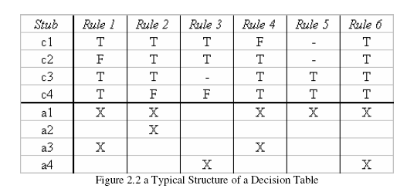
Decision Table Testing
There is an example of a typical Decision Table. The inputs in this given table derive the outputs depending on what conditions these inputs meet. Notice the use of “-“in the table below, these are known as don’t care entries. Don’t care entries are normally viewed as being false values which don’t require the value to define the output.
Figure shows its values from the inputs as true(T) or false(F) values which are binary conditions, tables which use binary conditions are known as limited entry decision tables. Tables which use multiple conditions are known as extended entry decision tables. One important aspect to notice about decision tables is that they aren’t imperative as that they don’t apply any particular order over the conditions or actions.

Slide 7

Decision table is based on logical relationships just as the truth table.
It is a tool that helps us look at the “complete” combination of conditions

Slide 8

rules
R1 R2 R3 R4 R5 R6 R7 R8
C1
C2
C3
T T T T F F F F
conditions
T T F F T T F F
values of conditions
T F T F T F T F
a1
a2
a3
a4
a5
x x x x
x x
actions taken
actions
x x
x x x x
x x
Read a Decision Table by columns of rules : R1 says when all conditions
are T, then actions a1, a2, and a5 occur

Slide 9
Conditions in Decision Table
The conditions in the decision table may take on any number of values. When it is binary, then the decision table conditions are just like a truth table set of conditions. (Note that the conditions do not have to be binary --- table gets “big” then.)
The decision table allows the iteration of all the combinations of values of the condition, thus it provides a “completeness check.”
The conditions in the decision table may be interpreted as the inputs, and the actions may be thought of as outputs. OR conditions needs to be thought as inputs needed set the conditions, and actions can be processing

Slide 10
Triangle Problem Example
Consider a program statement that, given the length of 3 sides, determines whether the 3 sides can (i) form a triangle and (ii) what type of triangle (equilateral, isosceles, or scalene).
  The inputs are a, b, c sides (each between 1 and 200)
  Then the inputs must satisfy certain conditions:
    a < b + c
    b < a + c
    c < a + b
Assume that we have performed the boundary value tests of the sides
and that all passed. Then ---- next we use decision table to help.

Slide 11
Assume a, b and c are
all between 1 and 200
Pick input <a, b, c> for each of the columns
a < b + c
b < a + c
c < a + b
a = b
a = c
b = c
F T T T T T T T T T T
- F T T T T T T T T T
- - F T T T T T T T T
- - - T T T T F F F F
- - - T T F F T T F F
- - - T F T F T F T F
Not triangle
Scalene
Isosceles
Equilateral
“impossible”
X X X
X
X X X
X
X X X
Note the
Impossible cases

Slide 12
How Many Test Cases for Triangle Problem?
There is the “invalid situation” --- not a triangle:
  There are 3 test conditions in the Decision table
  Note the “-” entries, which represents “don’t care,” when it is determined that the input sides <a, b, c> do not form a triangle
There is the “valid” triangle situation:
  There are 3 types of valid; so there are 2³ = 8 potential conditions
  But there are 3 “impossible” situations
  So there are only 8 – 3 = 5 conditions
So, for valid values of a, b, and c, we need to come up with 8 sets of <a, b, c> to test the 8 “Rules”.

Slide 13
Advantages/Disadvantages of Decision Table
Advantages:
  Allow us to start with a “complete” view, with no consideration of dependence
  Allow us to look at and consider “dependence,” “impossible,” and “not relevant” situations and eliminate some test cases.
  Allow us to detect potential error in our specifications
Disadvantages:
  Need to decide (or know) what conditions are relevant for testing
  Scaling up can be massive: 2^{n} for n conditions.

Slide 14
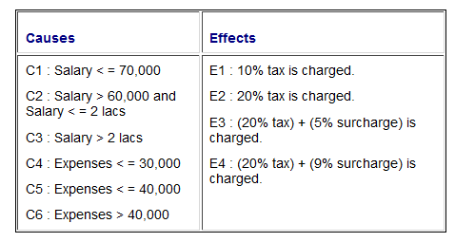
Example
Consider the payroll system of a person
(a) If the salary of a person is less than equal to Rs. 70,000 and expenses do not exceed Rs. 30,000 then 10% tax is charged by IT department.
(b) If the salary is greater than Rs.60,000 and less than equal to Rs 2lakhs and expenses don't exceed Rs. 40,000 than 20% tax is charged by IT department.
(c) For salary greater than Rs 2 lakhs, 5% additional surcharge is also charged.
(d) If expenses are greater than Rs. 40,000 surcharge is 9%.
  Step 1: First of all we need to identify the causes and its effects.

Slide 15
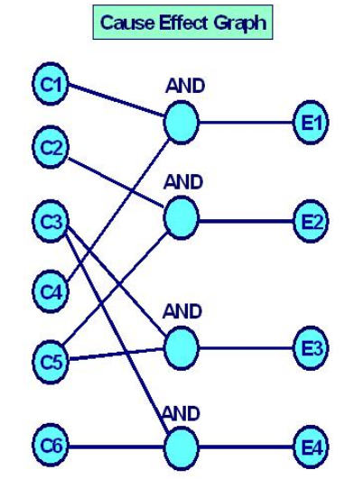
Example
  Step 2:

Slide 16
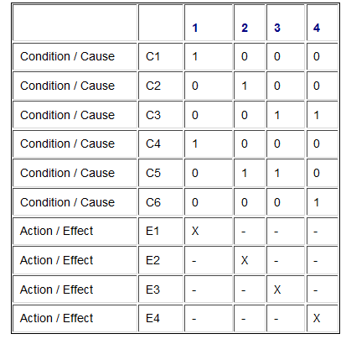
Step 3: Transform cause-effect graph into the following decision table. It may be noted that these 'causes' and 'effects' are nothing else but 'conditions' and 'actions' of our decision table.
That is, if C1 and C4 are 1 (or true) then the effect (or action) is E1. Similarly, if C2 and C5 is 1 (or true), action to be taken is E2 and so on.

Slide 17
Step 4. Since there are 4 rules in our decision table above, so we must have at least 4 test cases to test this system using this technique.
These test cases can be
1. Salary = 20,000, Expenses = 2000.
2. Salary = 1,00,000, Expenses = 10,000
3. Salary = 3,00,000, Expenses = 20,000
4. Salary = 3,00,000, Expenses = 50,000.
Thus we can say that a decision table is used to derive the test cases which can also take into account the boundary values.

