Slide 1
Function-oriented design
Design with functional units which transform inputs to outputs

Slide 2
Objectives
To explain how a software design may be represented as a set of functions which share state
To introduce notations for function-oriented design
To illustrate the function-oriented design process by example
To compare sequential, concurrent and object-oriented design strategies

Slide 3
Topics covered
data-flow design
Structural decomposition
Detailed design
A comparison of design strategies

Slide 4
Function-oriented design
Practiced informally since programming began
Thousands of systems have been developed
using this approach
Supported directly by most programming
languages
Most design methods are functional in their
approach
CASE tools are available for design support

Slide 5
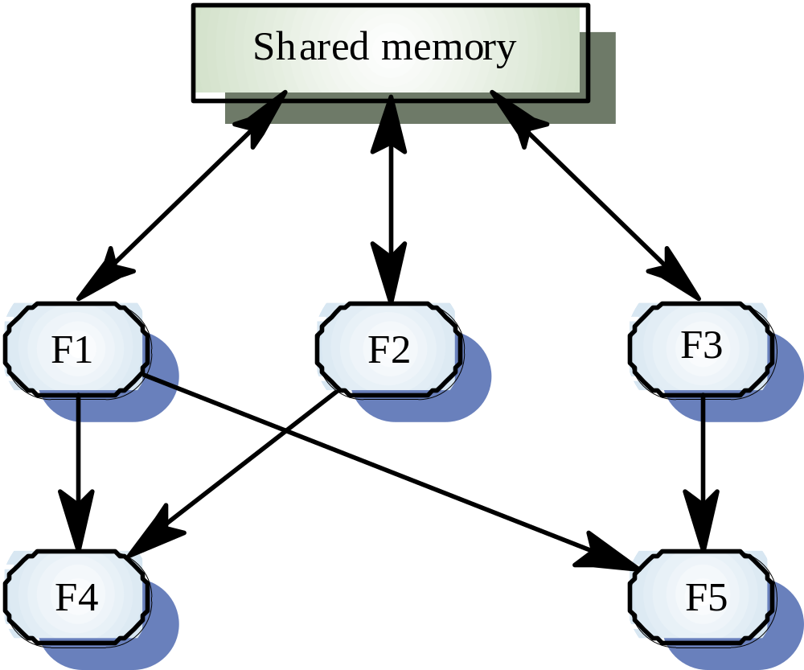
A function-oriented view of design

Slide 6
Natural functional systems
Some systems are naturally function-oriented
Systems which maintain minimal state
information i.e. where the system is concerned
with processing independent actions whose
outcomes are not affected by previous actions
Information sharing through parameter lists
Transaction processing systems fall into this category. Each transaction is independent

Slide 7
ATM software design
loop
loop
Print_input_message (” Welcome - Please enter your card”) ;
exit when Card_input ;
end loop ;
Account_number := Read_card ;
Get_account_details (PIN, Account_balance, Cash_available) ;
if Validate_card (PIN) then
loop
Print_operation_select_message ;
case Get_button is
when Cash_only =>
Dispense_cash (Cash_available, Amount_dispensed) ;
when Print_balance =>
Print_customer_balance (Account_balance) ;
when Statement =>
Order_statement (Account_number) ;
when Check_book =>
Order_checkbook (Account_number) ;
end case ;
Eject_card ;
Print (“Please take your card or press CONTINUE”) ;
exit when Card_removed ;
end loop ;
Update_account_information (Account_number, Amount_dispensed) ;
else
Retain_card ;
end if ;
end loop ;
©Ian Sommerville 1995 Software Engineering, 5th edition. Chapter 15 Slide 7

Slide 8
Functional and object-oriented design
For many types of application, object-oriented
design is likely to lead to a more reliable and
maintainable system
Some applications maintain little state - function-oriented design is appropriate
Standards, methods and CASE tools for functional design are well-established
Existing systems must be maintained -
function-oriented design will be practiced well
into the 21st century

Slide 9
Functional design process
Data-flow design
  Model the data processing in the system using data-flow diagrams
Structural decomposition
  Model how functions are decomposed to sub-functions using graphical structure charts
Detailed design
  The entities in the design and their interfaces are described in detail. These may be recorded in a data dictionary and the design expressed using a PDL

Slide 10
Data flow diagrams
Show how an input data item is functionally
transformed by a system into an output data
item
Are an integral part of many design methods
and are supported by many CASE systems
May be translated into either a sequential or
parallel design. In a sequential design,
processing elements are functions or
procedures; in a parallel design, processing
elements are tasks or processes

Slide 11
DFD notation
Rounded rectangle - function or transform
Rectangle - data store
Circles - user interactions with the system
Arrows - show direction of data flow
keywords and/ or. Used to link data flows

Slide 12
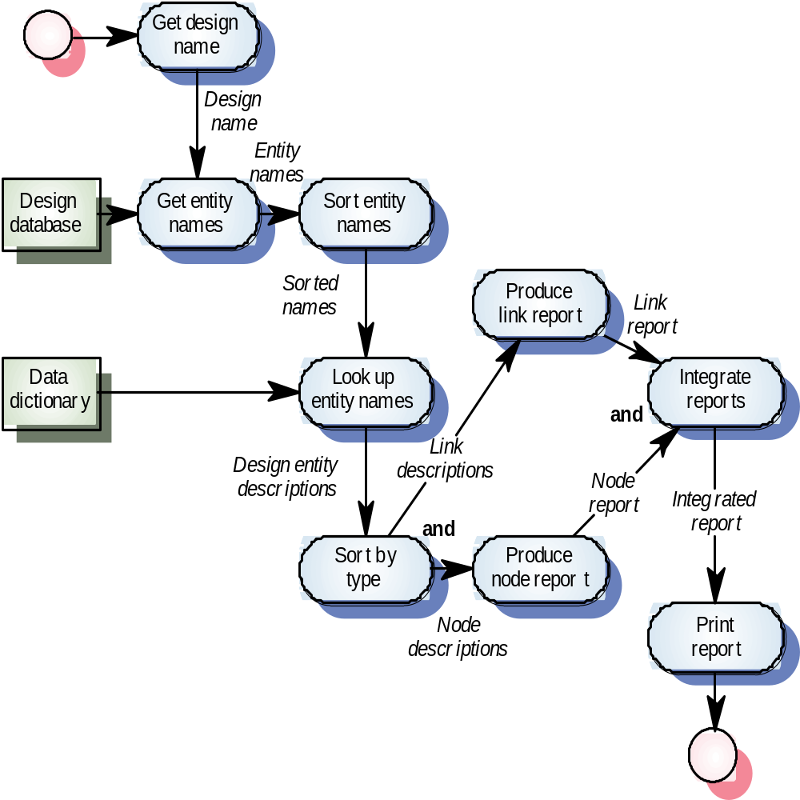
Design report generator

Slide 13
Structural decomposition
Structural decomposition is concerned with developing a model of the design which shows the dynamic structure i.e. function calls
This is not the same as the static composition structure
The aim of the designer should be to derive
design units which are highly cohesive and
loosely coupled
In essence, a data flow diagram is converted to a structure chart

Slide 14
Decomposition guidelines
For business applications, the top-level structure chart may have four functions namely input, process, master-file-update and output
Data validation functions should be subordinate to an input function
Coordination and control should be the responsibility of functions near the top of the hierarchy

Slide 15
Decomposition guidelines
The aim of the design process is to identify loosely coupled, highly cohesive functions. Each function should therefore do one thing and one thing only
Each node in the structure chart should have between two and seven subordinates

Slide 16
Process steps
Identify system processing transformations
  Transformations in the DFD which are concerned with processing rather than input/output activities. Group under a single function in the structure chart
Identify input transformations
  Transformations concerned with reading, validating and formatting inputs. Group under the input function
Identify output transformations
  Transformations concerned with formatting and writing output. Group under the output function

Slide 17
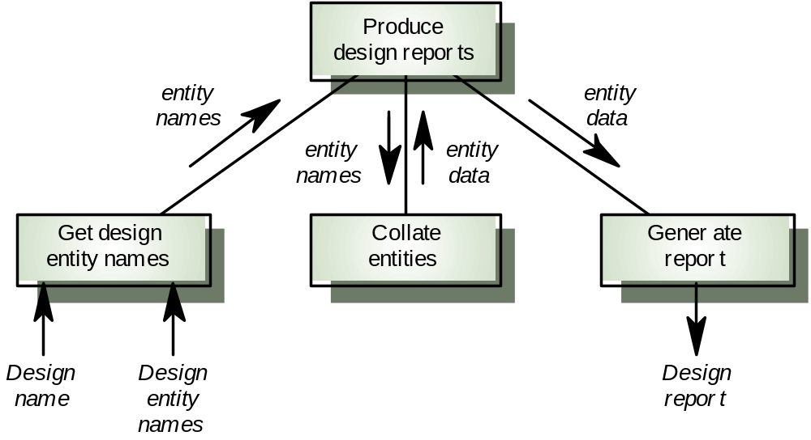
Initial structure chart

Slide 18
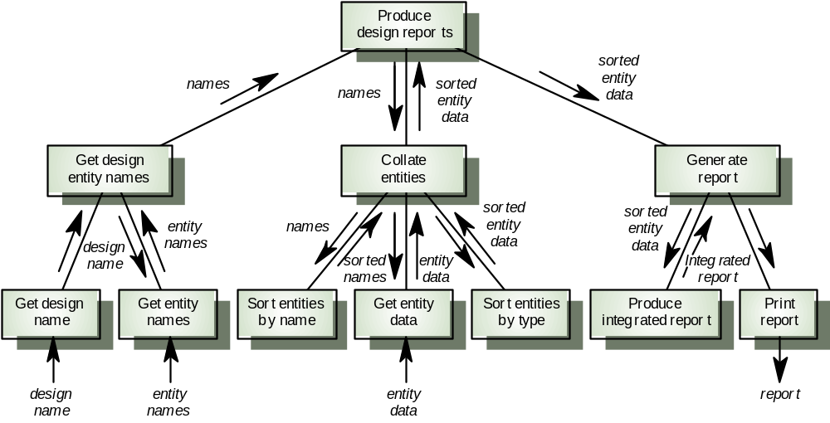
Expanded structure chart

Slide 19
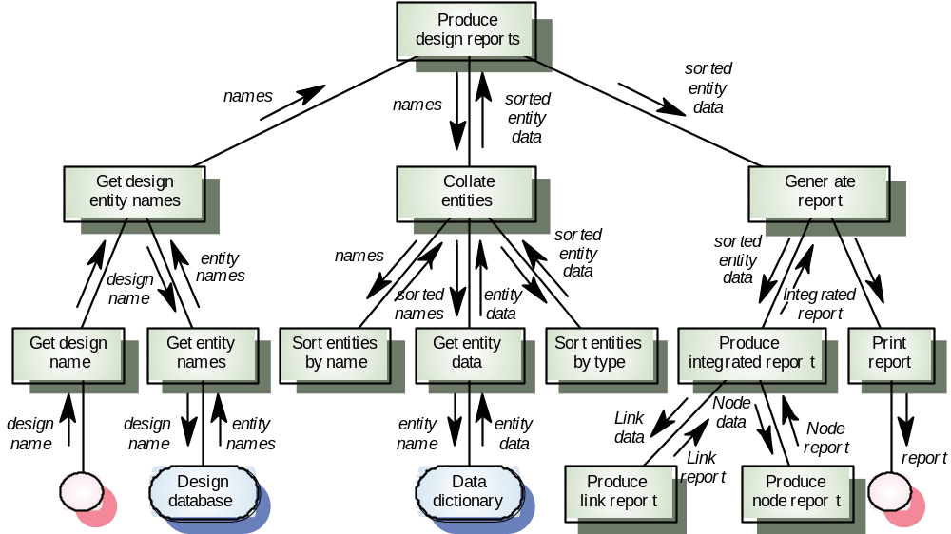
Final structure chart

Slide 20
Detailed design
Concerned with producing a short design specification (mini-spec) of each function. This should describe the processing, inputs and outputs
These descriptions should be managed in a data dictionary
From these descriptions, detailed design descriptions, expressed in a PDL or programming language, can be produced

Slide 21
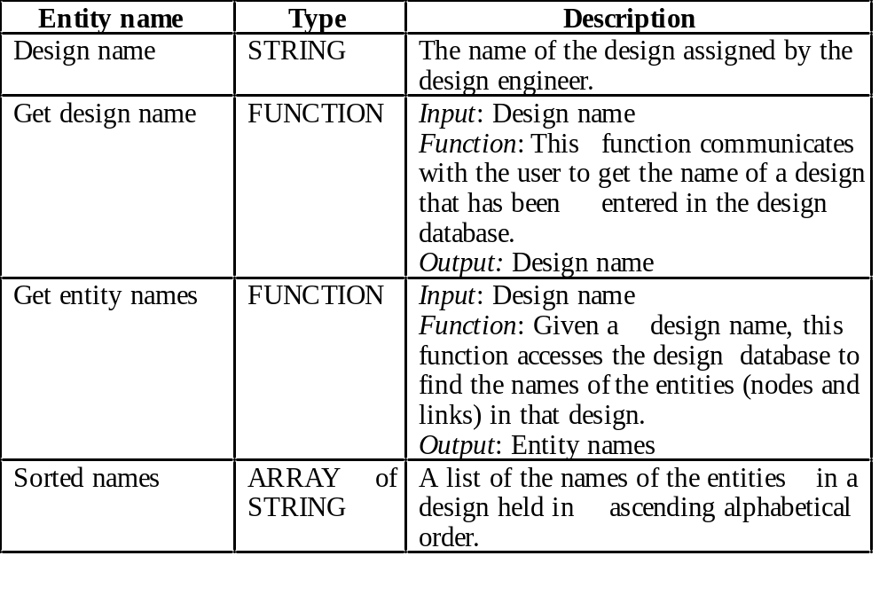
Data dictionary entries

Slide 22
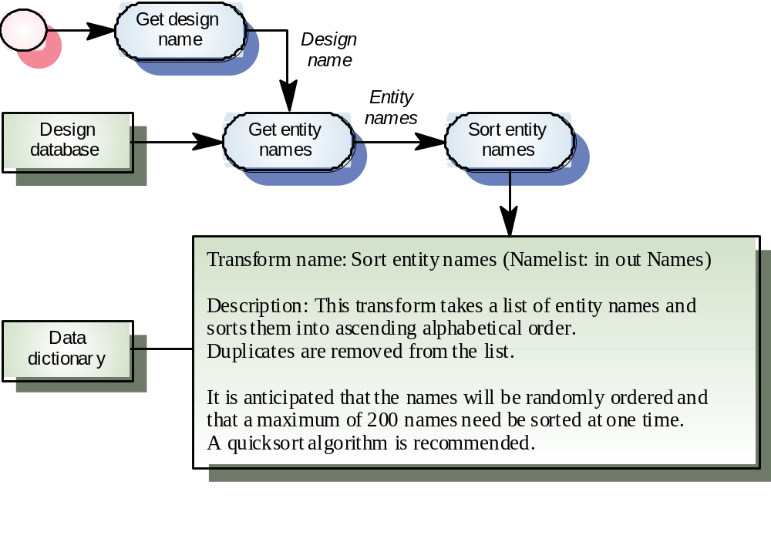
Design entity information

Slide 23
A comparison of design strategies
An example of an office information retrieval system (OIRS) is used to compare different design strategies
Functional design, concurrent systems design and object-oriented design are compared
The OIRS is an office system for document management. Users can file, maintain and retrieve documents using it

Slide 24
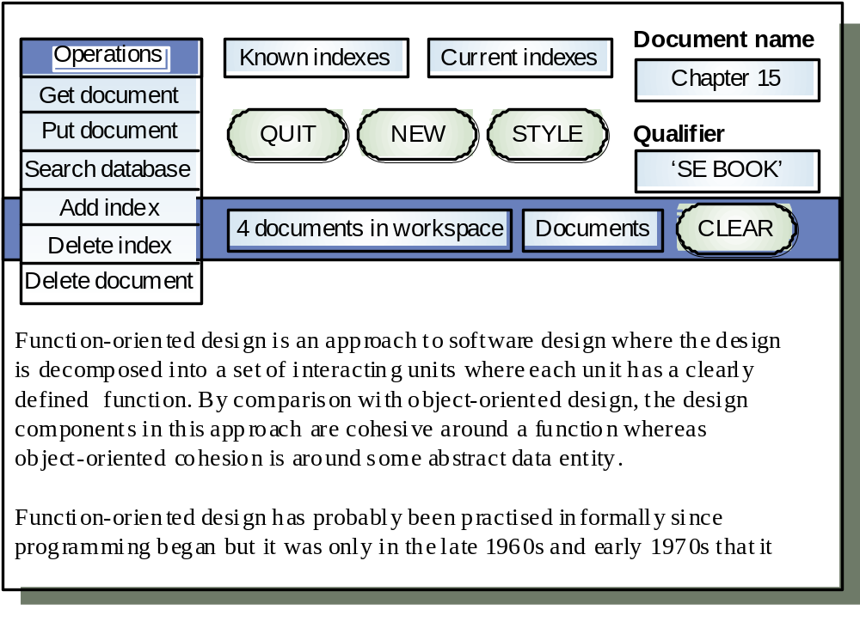
OIRS user interface

Slide 25
Interface description
Operation field.
  Pull-down menu allowing an operation to be selected.
Known and current indexes fields
  Pull-down menus of indexes
Document name.
  Name under which the document is to be filed.
Qualifier field
  Pattern used in retrieval.
Current workspace
  Contains the documents currently being used. May be edited with word processor

Slide 26
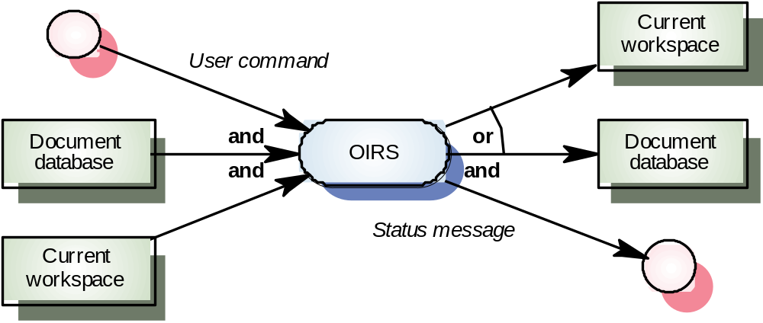
OIRS inputs and outputs

Slide 27
Fetch-execute model
procedure Interactive_system is
begin
loop
Command := Get_command;
if Command = “quit” then
-- Make sure files etc. are closed properly
Close_down_system ;
exit ;
else
Input_data := Get_input_data ;
Execute_command (Command, Input_data, Output_data) ;
end if ;
end loop ;
end Interactive_system ;

Slide 28
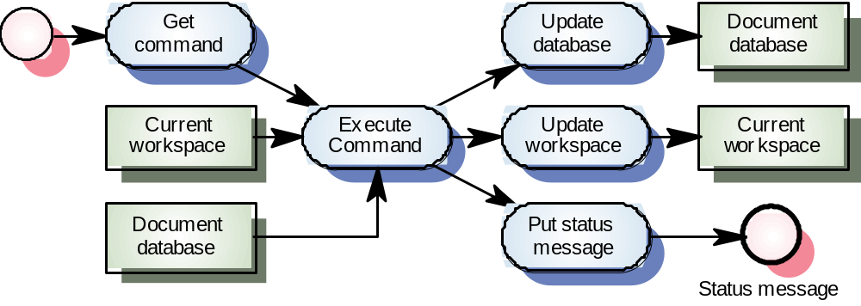
Top-level OIRS DFD

Slide 29
Design decisions
What strategy should be adopted in
decomposing Execute command?
Are the input and output data flows processed
independently or are they inter-dependent. If
independent, there should be a central
transform for each processing unit
Is the central transform a series of transforms?
If so, each logical element in the series should
be a single transformation

Slide 30
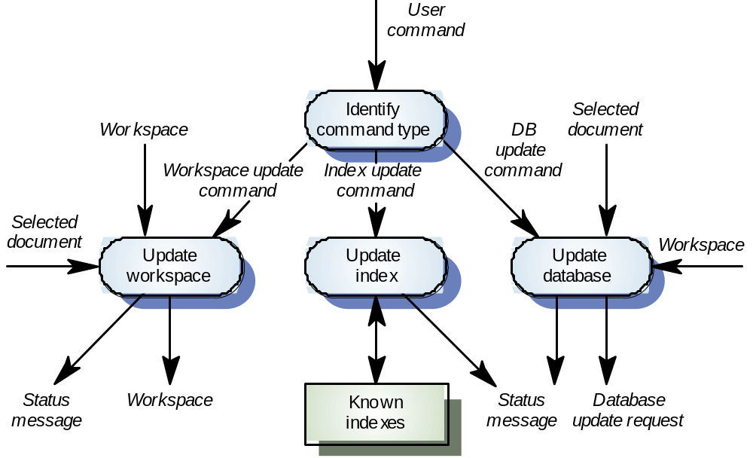
Execute command DFD

Slide 31
OIRS design description
procedure OIRS is
begin
User := Login_user ;
Workspace := Create_user_workspace (User) ;
-- Get the users own document database using the user id
DB_id := Open_document_database (User) ;
-- get the user’s personal index list;
Known_indexes := Get_document_indexes (User) ;
Current_indexes := NULL ;
-- command fetch and execute loop
loop
Command := Get_command ;
exit when Command = Quit ;
Execute_command ( DB_id, Workspace, Command, Status) ;
if Status = Successful then
Write_success_message ;
else
Write_error_message (Command, Status) ;
end if ;
end loop ;
Close_database (DB_id) ;
Logout (User) ;
end OIRS ;

Slide 32
Concurrent systems design
Data flow diagrams explicitly exclude control
information. They can be implemented directly
as concurrent processes.
Logical groups of transformations can also be
implemented as concurrent processes e.g.
input data collection and checking
The OIRS system can be implemented as a
concurrent system with command input,
execution and status reporting implemented as
separate tasks

Slide 33
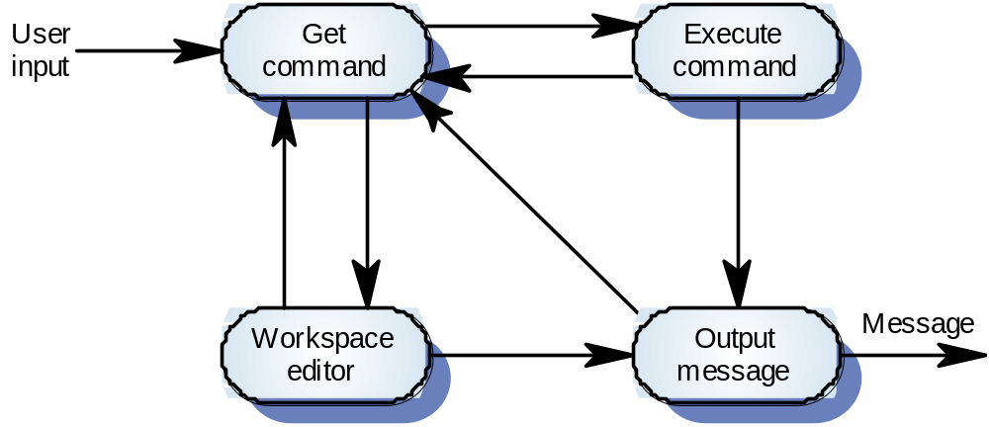
OIRS process decomposition

Slide 34
Detailed process design
procedure Office_system is
task Get_command ;
task Process_command is
entry Command_menu ;
entry Display_indexes ;
entry Edit_qualifier ;
-- Additional entries here. One for each command
end Process_commands ;
task Output_message is
entry Message_available ;
end Output_message ;
task Workspace_editor is
entry Enter ;
entry Leave ;
end Workspace_editor ;

Slide 35
Detailed process design
task body Get_command is
begin
-- Fetch/execute loop
loop
loop
Cursor_position := Get_cursor_position ;
exit when cursor positioned in workspace or
(cursor positioned over menu and button pressed)
Display_cursor_position ;
end loop ;
if In_workspace (Cursor_position) then
Workspace_editor.Enter ;
elsif In_command_menu (Cursor_position) then
Process_command.Command_menu ;
elsif In_Known_indexes (Cursor_position) then
Process_command.Display_indexes ;
elsif In_Current_indexes (Cursor_position) then
...
Other commands here
...
end loop ; -- Fetch/execute
end Get_command ;
-- other task implementations here
end Office_system ;

Slide 36
Key points
Function-oriented design relies on identifying functions which transform inputs to outputs
Many business systems are transaction processing systems which are naturally functional
The functional design process involves identifying data transformations, decomposing functions into sub-functions and describing these in detail
35

Slide 37
Key points
Data-flow diagrams are a means of documenting end-to-end data flow. Structure charts represent the dynamic hierarchy of function calls
Data flow diagrams can be implemented directly as cooperating sequential processes
Functional and object-oriented design result in different system decompositions. However, a heterogeneous approach to design is often necessary

