Slide 1


Slide 2
Integration testing
Tests complete systems or subsystems composed of integrated components
Integration testing should be black-box testing with tests derived from the specification
Main difficulty is localising errors
Incremental integration testing reduces this problem

Slide 3
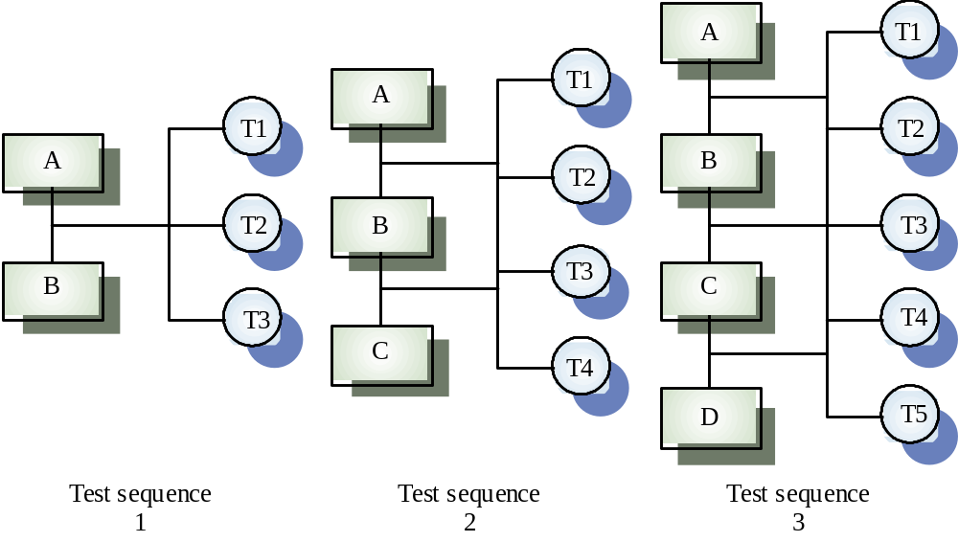
Incremental integration testing

Slide 4
Approaches to integration testing
Top-down testing
  Start with high-level system and integrate from the top-down replacing individual components by stubs where appropriate.
Bottom-up testing
  Integrate individual components in levels until the complete system is created.
In practice, most integration involves a combination of these strategies

Slide 5
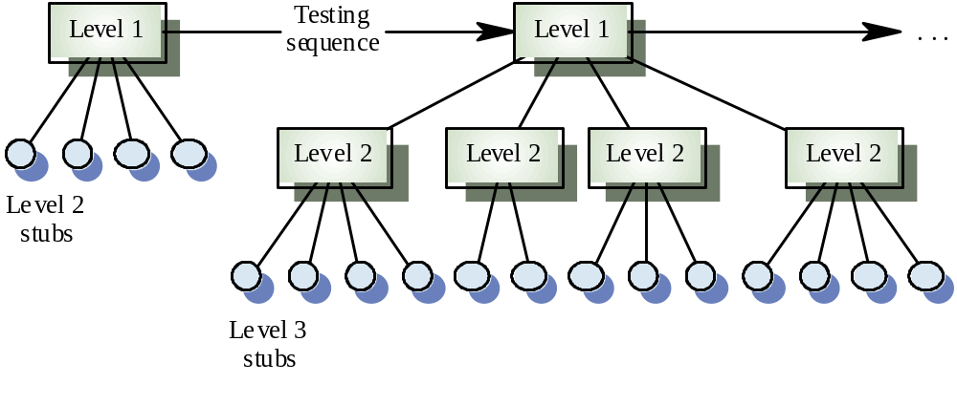
Top-down testing

Slide 6
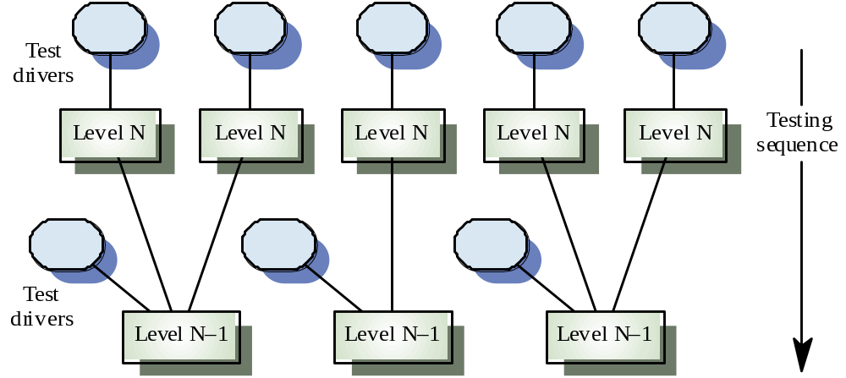
Bottom-up testing

Slide 7
Testing approaches
Architectural validation
  Top-down integration testing is better at discovering errors in the system architecture
System demonstration
  Top-down integration testing allows a limited demonstration at an early stage in the development
Test implementation
  Often easier with bottom-up integration testing
Test observation
  Problems with both approaches. Extra code may be required to observe tests

Slide 8
Regression Testing
Each time a new module is added as part of integration testing, the software changes.
New data flow paths are established, new I/O may occur, and new control logic is invoked.
regression testing is the re-execution of some subset of tests that have already been conducted to ensure that changes have not propagated unintended side effects.
Regression testing may be conducted manually, by re-executing a subset of all test cases or using automated capture/playback tools

Slide 9
Smoke Testing
Smoke testing is an integration testing approach that is commonly used when “shrinkwrapped” software products are being developed. the smoke testing approach encompasses the following activities:
1. Software components that have been translated into code are integrated into a “build.” A build includes all data files, libraries, reusable modules, and engineered components that are required to implement one or more product functions.
2. A series of tests is designed to expose errors that will keep the build from properly performing its function. The intent should be to uncover “show stopper” errors that have the highest likelihood of throwing the software project behind schedule.
3. The build is integrated with other builds and the entire product (in its current form) is smoke tested daily. The integration approach may be top down or bottom up.

Slide 10
Smoke Testing
Smoke testing provides a number of benefits when it is applied on complex, time critical software engineering projects:
Integration risk is minimized. Because smoke tests are conducted daily.
The quality of the end-product is improved. Because the approach is construction (integration) oriented, smoke testing is likely to uncover both functional errors and architectural and component-level design defects.
Progress is easier to assess. With each passing day, more of the software has been integrated and more has been demonstrated to work.

