Slide 1
Quality Management Systems
Software Testing
Karl Heinrich Möller
Gaertnerstr. 29
D-82194 Groebenzell
Tel: +49(8142)570144
Fax: +49(8142)570145
Email: Karl-Heinrich.Moeller@t-online.de

Slide 2
Overview of Test Techniques
Unit/Component Testing - The Foundation
Path Testing, Sensitizing, Coverage
Test Techniques
  Syntax Testing
  Transaction Flow Testing
  State Testing
  Domain Testing
  Data Flow Testing

Slide 3
Motivation
Path Testing: Most basic, illustrates issues, coverage, reappears in many different guises
Unit/Component Testing: Reiterated at all levels
Other Techniques: Testing is science not art
Automation: Focus on automation; presupposes knowledge of techniques

Slide 4
Strong or Weak Tests
How do we know if the code is good or if the tests are just weak - e.g. non-revealing tests?
  Coverage metrics are basic to the answer
How many tests we need depends on code size and complexity
  Lines of code (LOC) is weakest metric
  Today, testing is metrics driven
  Useful metrics are an automated by-product of testing

Slide 5
Target the Tests
Every test must be targeted against specific expected bugs
Effort (number of tests) is guided by bug type frequencies
Gather bug statistics - Use any list of categories for starting point
Risk impact - Pick the tests that best minimize the perceived risk

Slide 6
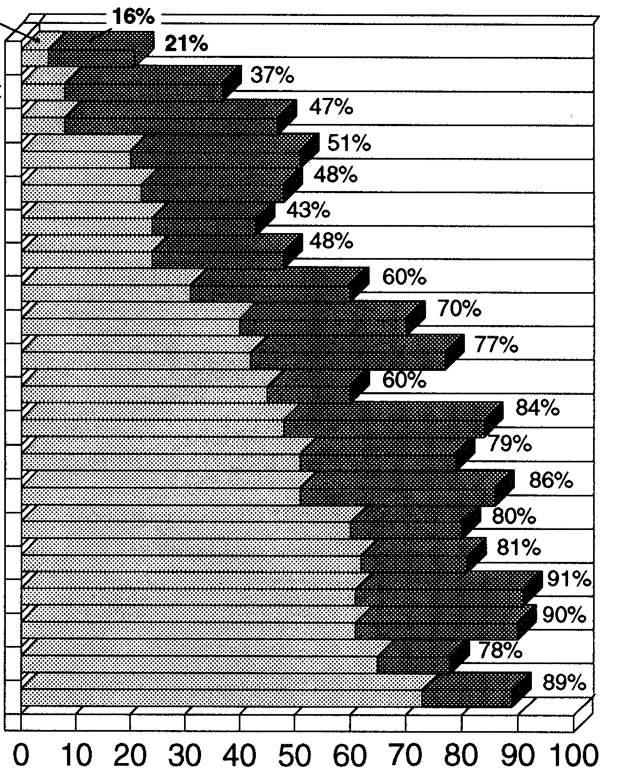
Target the Tests by Gelprin, Hetzel 88
measure coverage
test cases before coding of product
user take part in testing
Inspection of test cases
Training in testing
cost of testing are measured
Integration testing by professionals
test are inspected
test time is measured
protocols of test results
standardised tests
test specification is documented
tests are stored
tests are repeated when software is changed
development and test are different organisations
system test professionals
test is systematic activity
test plans exist
test representative is nominated
Faults are registered
sometimes
always

Slide 7
Definitions (1)
Unit testing: Aimed at exposing bugs in the smallest component, the unit
Component testing: Aimed at exposing bugs in integrated components of one or more units
Integration testing: Aimed at exposing interface and interaction bugs between otherwise correct and component tested components
Feature testing: Aimed at exposing functional bugs in the features of an integration-tested system

Slide 8
Definitions (2)
System testing: Tests aimed at exposing bugs and conditions usually not covered by specifications, such as security, robustness, recovery, resource loss
Structural testing: Test strategies based on a programs structure - e.g. the code. Also called “White Box” and “Glass Box” testing
Behavioural testing: Test strategies based on a programs required behaviour - e.g. specifications. Also called “Functional Testing” or “Black Box Testing”
Testing: The act of specifying, designing, testing and executing tests in order to get confidence that the program fulfils the requirements and expectations

Slide 9
Clean versus Dirty Tests
Clean Tests: Tests aimed at showing that the
component satisfies requirements. Also called “Positive Tests”
Dirty Tests: Tests aimed at breaking the
software.
Also called “Negative Tests”
Immature Process: Clean to Dirty = 5:1
Mature Process: Clean to Dirty = 1:5
Obtained by increasing the number of dirty tests

Slide 10
Tests, Subtests, Suites, etc.
Subtest : Smallest unit of testing - one input, one outcome
Test: Sequence of one or more subtests that must be run as a group because the outcome of a subtest is the initial condition or input to the next subtest
Test Suite: A set of one or more related tests for one software product with common data base and environment
Test step: The most detailed, microscopic specification of the actions in a subtest. For example, individual statements in a scripting language

Slide 11
Test Scripts and Test Plans
Test Script: Collections of steps corresponding to test or subtests - statements in a scripting language
Scripting Language: A high-order programming language optimized for writing scripts
Test Plan: An informal (not a program), high level test design document that includes who, what, when, how, resources, people, responsibilities, etc.
Test Procedure: Test scripts for manual testing (usually)

Slide 12
Behavioural vs. Structural Testing
Structural Testing: Confirm that the actual structure (e.g. code) matches the intended structure
Behavioural Testing: Confirm that the program’s behaviour matches the intended behaviour (e.g. requirements)
  Input --> Response

Slide 13
Behaviour versus Structure
Behaviour versus structure is a fundamental Distinction of computer science
Our objective is to produce a structure (i.e. software) that exhibits desirable behaviour (i.e. meets requirements)
The two points of view are not contradictory but complementary

Slide 14
Structural Testing
Advantages
  Efficient
  Theoretically complete
  Can be mechanized (theoretically)
  Inherently methodical
Disadvantages
  Inherently biased by design
  may not be meaningful or useful
  Can’t catch many important bugs
  Far removed from user
Effectiveness
  Catches 50-75% of bugs that can be caught in unit testing (25-50% of total), but they are the easiest ones to catch, at most 50% of test labour content

Slide 15
Behavioural Testing
Advantages
  Inherently unbiased
  Always meaningful and useful
  Catches the bugs the users see
  Less analysis required
Disadvantages
  Inefficient - too many blank shots
  Theoretically incomplete
  Cannot be fully automated
  Intuitive rather than formal
Effectiveness
  Catches 10-30% of bugs that can be caught in unit testing (5-15% of total), - 50-75% of bugs that can be caught in system testing, - catches though, embarrassing bugs, - about 50% of test labour content

Slide 16
Goals of Unit Testing
Objective Goals
  Prove that there are bugs
  Demonstrate self-consistency
  Show correspondence to specifications
Subjective Goals
  Personal confidence in the unit
  Public trust in the unit
of the two, the subjective goals are the more important

Slide 17
Prerequisites to Unit Testing
Builder’s confidence
A testable component
Inspections
Thorough private testing
A designed, documented unit test plan
Time, prerequisites, tools, resources

Slide 18
Coverage Concepts
“Coverage” is a measure of testing completeness with respect to a particular testing strategy
“100% Coverage” never means “Complete Testing”, but only completeness with respect to a specific strategy
It follows that every strategy and therefore every associated test technique will have an associated coverage concept
An infinite number of strategies
  An infinite number of associated techniques
    An infinite number of coverage metrics
None is best, but some are better than others

Slide 19
Component Testing
A component is an object under test (unit, module, program or system)
It can, with a suitable test driver , be tested by itself
It has defined inputs which when applied will yield predictable outcomes
Complete component level structure tests
Upward interface tests (integration) with every component that calls it
Downward interface tests (integration) with every component it calls
Integration with local and global data structures
Behavioural testing to a written specification

Slide 20
Control Flow (Path) Testing
Fundamental Technique that illustrates aspects of other test techniques
Paths exist and they’re important even if you don’t do path testing
Developers testing: Designers often use path testing methods in unit testing. You must understand their tests
Domain testing: If used as a behavioural test method requires an understanding of the underlying program paths
Transaction flow testing: A behavioural test method used in system testing, it is almost identical to path testing
Data flow testing: In either behavioural or structural form presupposes knowledge of path testing methods

Slide 21
Control Flow (Path) Testing
It is the primary unit test technique
It is the minimum mandatory testing
It is the cornerstone of testing
But it is not the end - only the beginning
  Three parts of path test design
Select the covering paths in accordance to the chosen strategy
Sensitize the paths: Find input values that force the selected paths
Instrument the paths: Confirm that you actually went along the chosen path

Slide 22
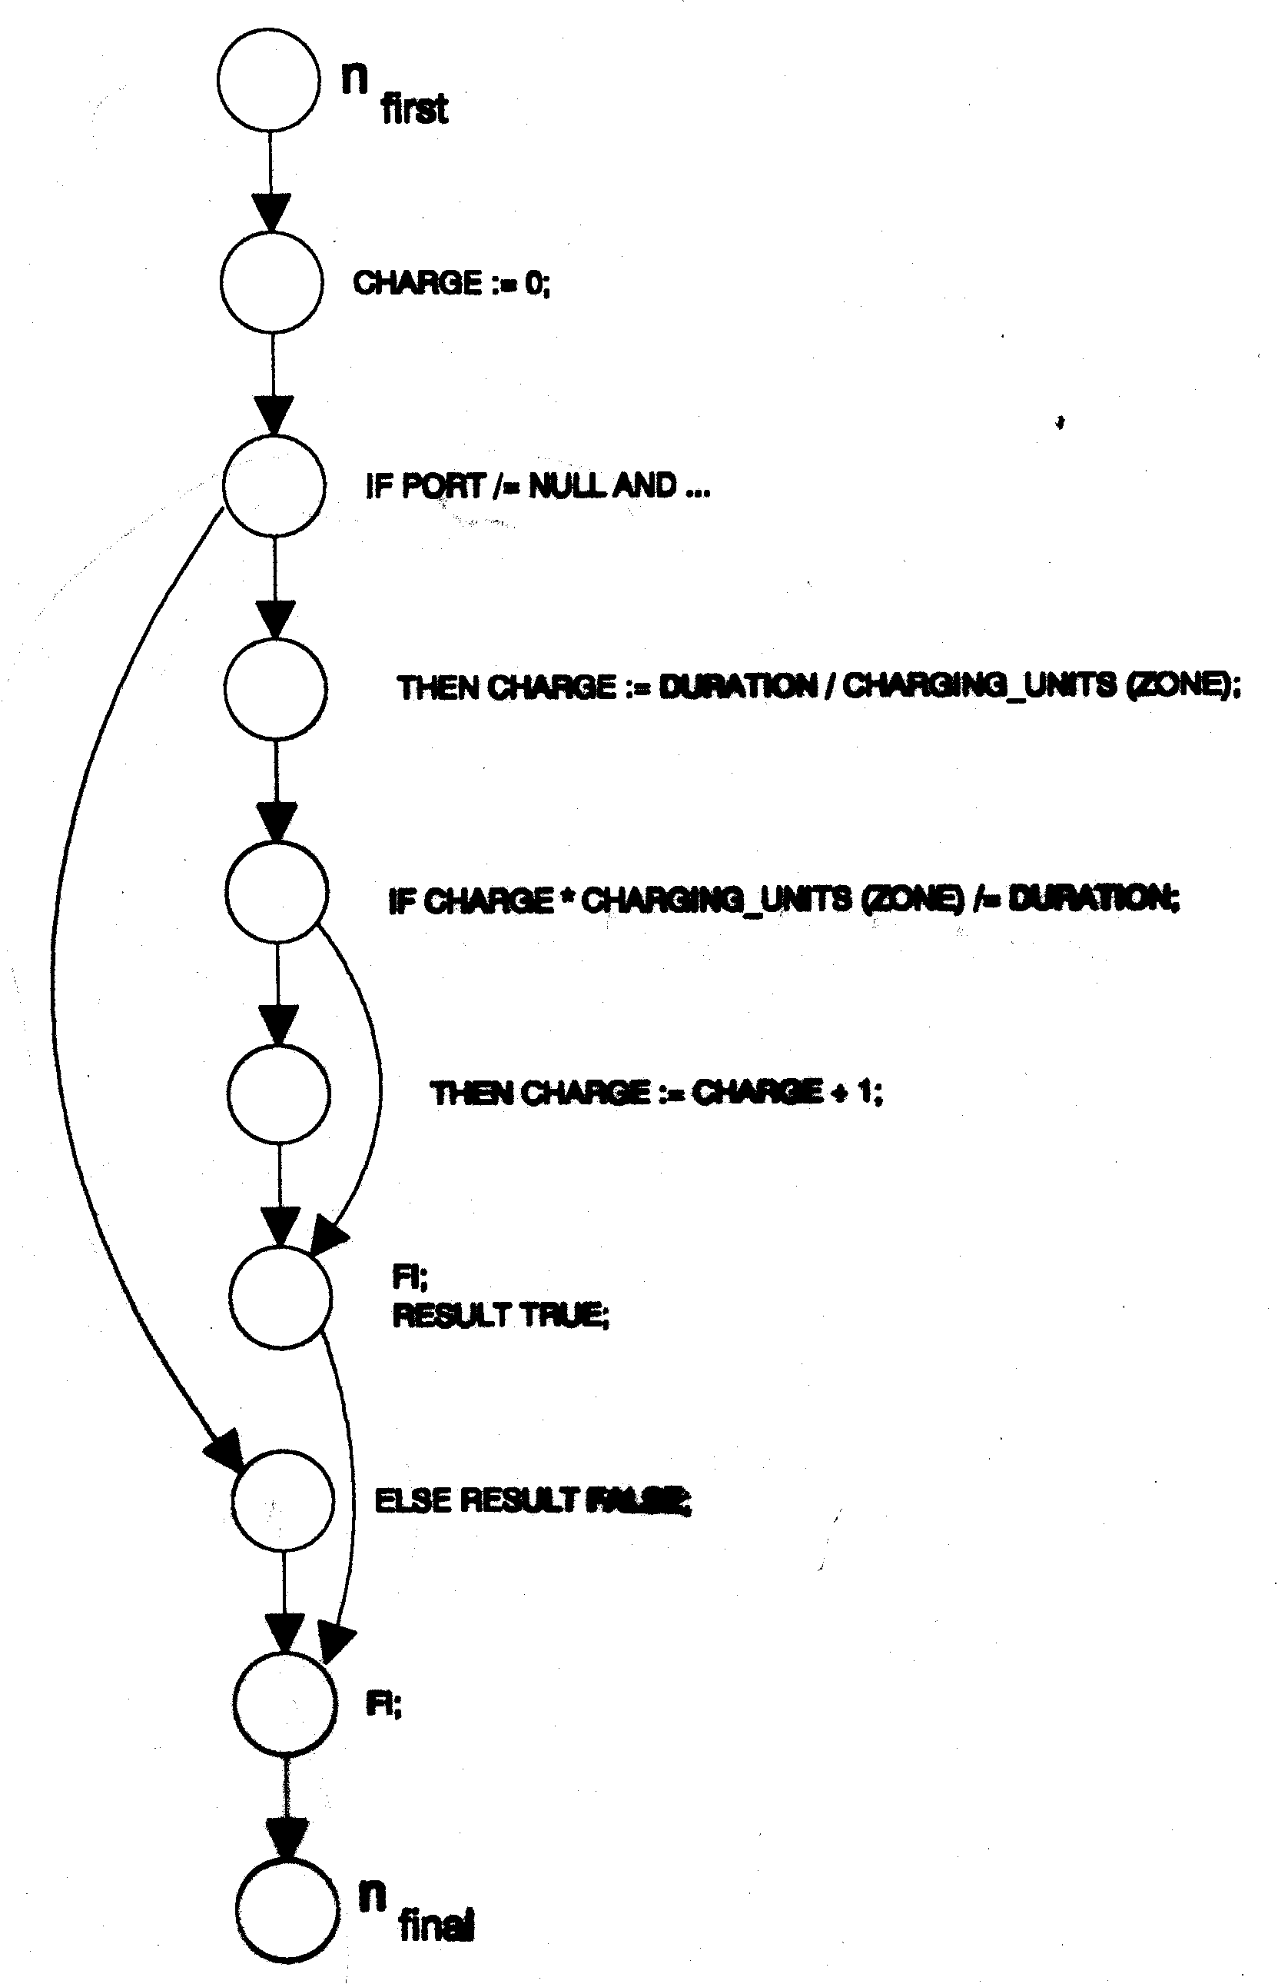
Control Flow (Path) Testing
Example
# of edges - # of knots + 2 = # of paths
11- 10 + 2 = 3

Slide 23
Transaction Flow Testing
A behavioural test technique based on a structural model
  Design steps
Find and define a covering set of transaction flows
Select the test paths
Sensitize the paths:
  Prepare inputs
  Predict outcomes
Instrument the paths
Debug and run the tests

Slide 24
Transaction Flow Testing
Most of the benefits (50-75%) are in the first step. Getting and documenting a covering set of transaction flows
This activity is a highly structured review of what the system is supposed to do
It always catches nasty behavioural bugs very early in the game
Programmers usually change their designs
Transaction flow testing can be the cornerstone of system testing

Slide 25
Transaction Flows and inspections
Make transaction flows (a covering set) an inspection agenda item
Validate
  Conformance to formal description standards
  Cross reference to requirements
  100% link coverage
  Cross reference to test plans
Inspect and confirm the correct functionality of all transactions

Slide 26
Domain Testing
Behavioural, structural or hybrid test technique
Focus on input variable values treated as numbers
Effective as a test of input error tolerance
Basis for tools
Essential ingredient for integration testing

Slide 27
Data Flow Testing
Data Flow Test Criteria (structural)
  More general than path testing family
  Stronger than branch but weaker than all paths
  Must be done separately for each data object
  Based on control flowgraph annotated with data flow relations
Data Flow Test Criteria (behavioural)
  Heuristic but sensible and effective
  Transaction flow testing is a kind of data flow testing
  Must be done separately for each data object in your data model
  Based on data flowgraphs used in many design methodologies

Slide 28
Syntax Testing
Functional test technique
  Focus on data and command input structures
  Test of input error tolerance
  Significant use in integration testing
Targets for syntax testing
  Operator and user interfaces
  Communication protocols
  Device drivers subroutine Call/Return sequences
  Hidden languages
  All other internal interfaces

Slide 29
Syntax Testing Overview
Step 1: Identify components suitable to syntax testing
Step 2: Formal Definition of syntax
Step 3: Cover the syntax graph (Clean Tests)
Step 4: Mess up the syntax graph (Dirty Tests)

Slide 30
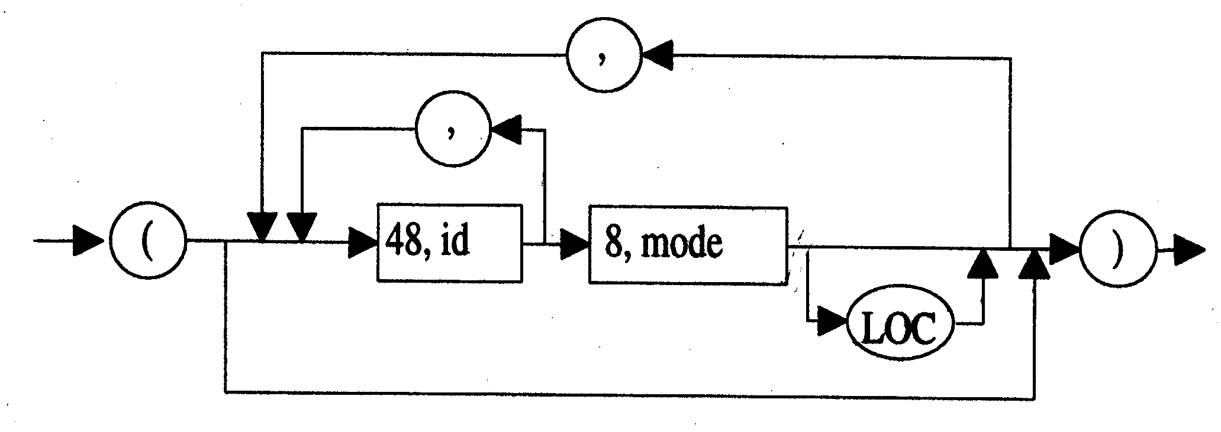
Syntax Testing
Test case 1: ( )
Test case 2: (id, id mode, id mode LOC)

Slide 31
State Transition Testing
Does actual behaviour match the intended?
Very old - Basic to hardware design
A functional test technique, based on Software behaviour (Black Box)
The fundamental model of computer science
Applications overview
Device drivers, communications and other protocol handlers, system controls, resource managers
System and configuration testing
Recovery and security processing
Menu-driven Software

Slide 32
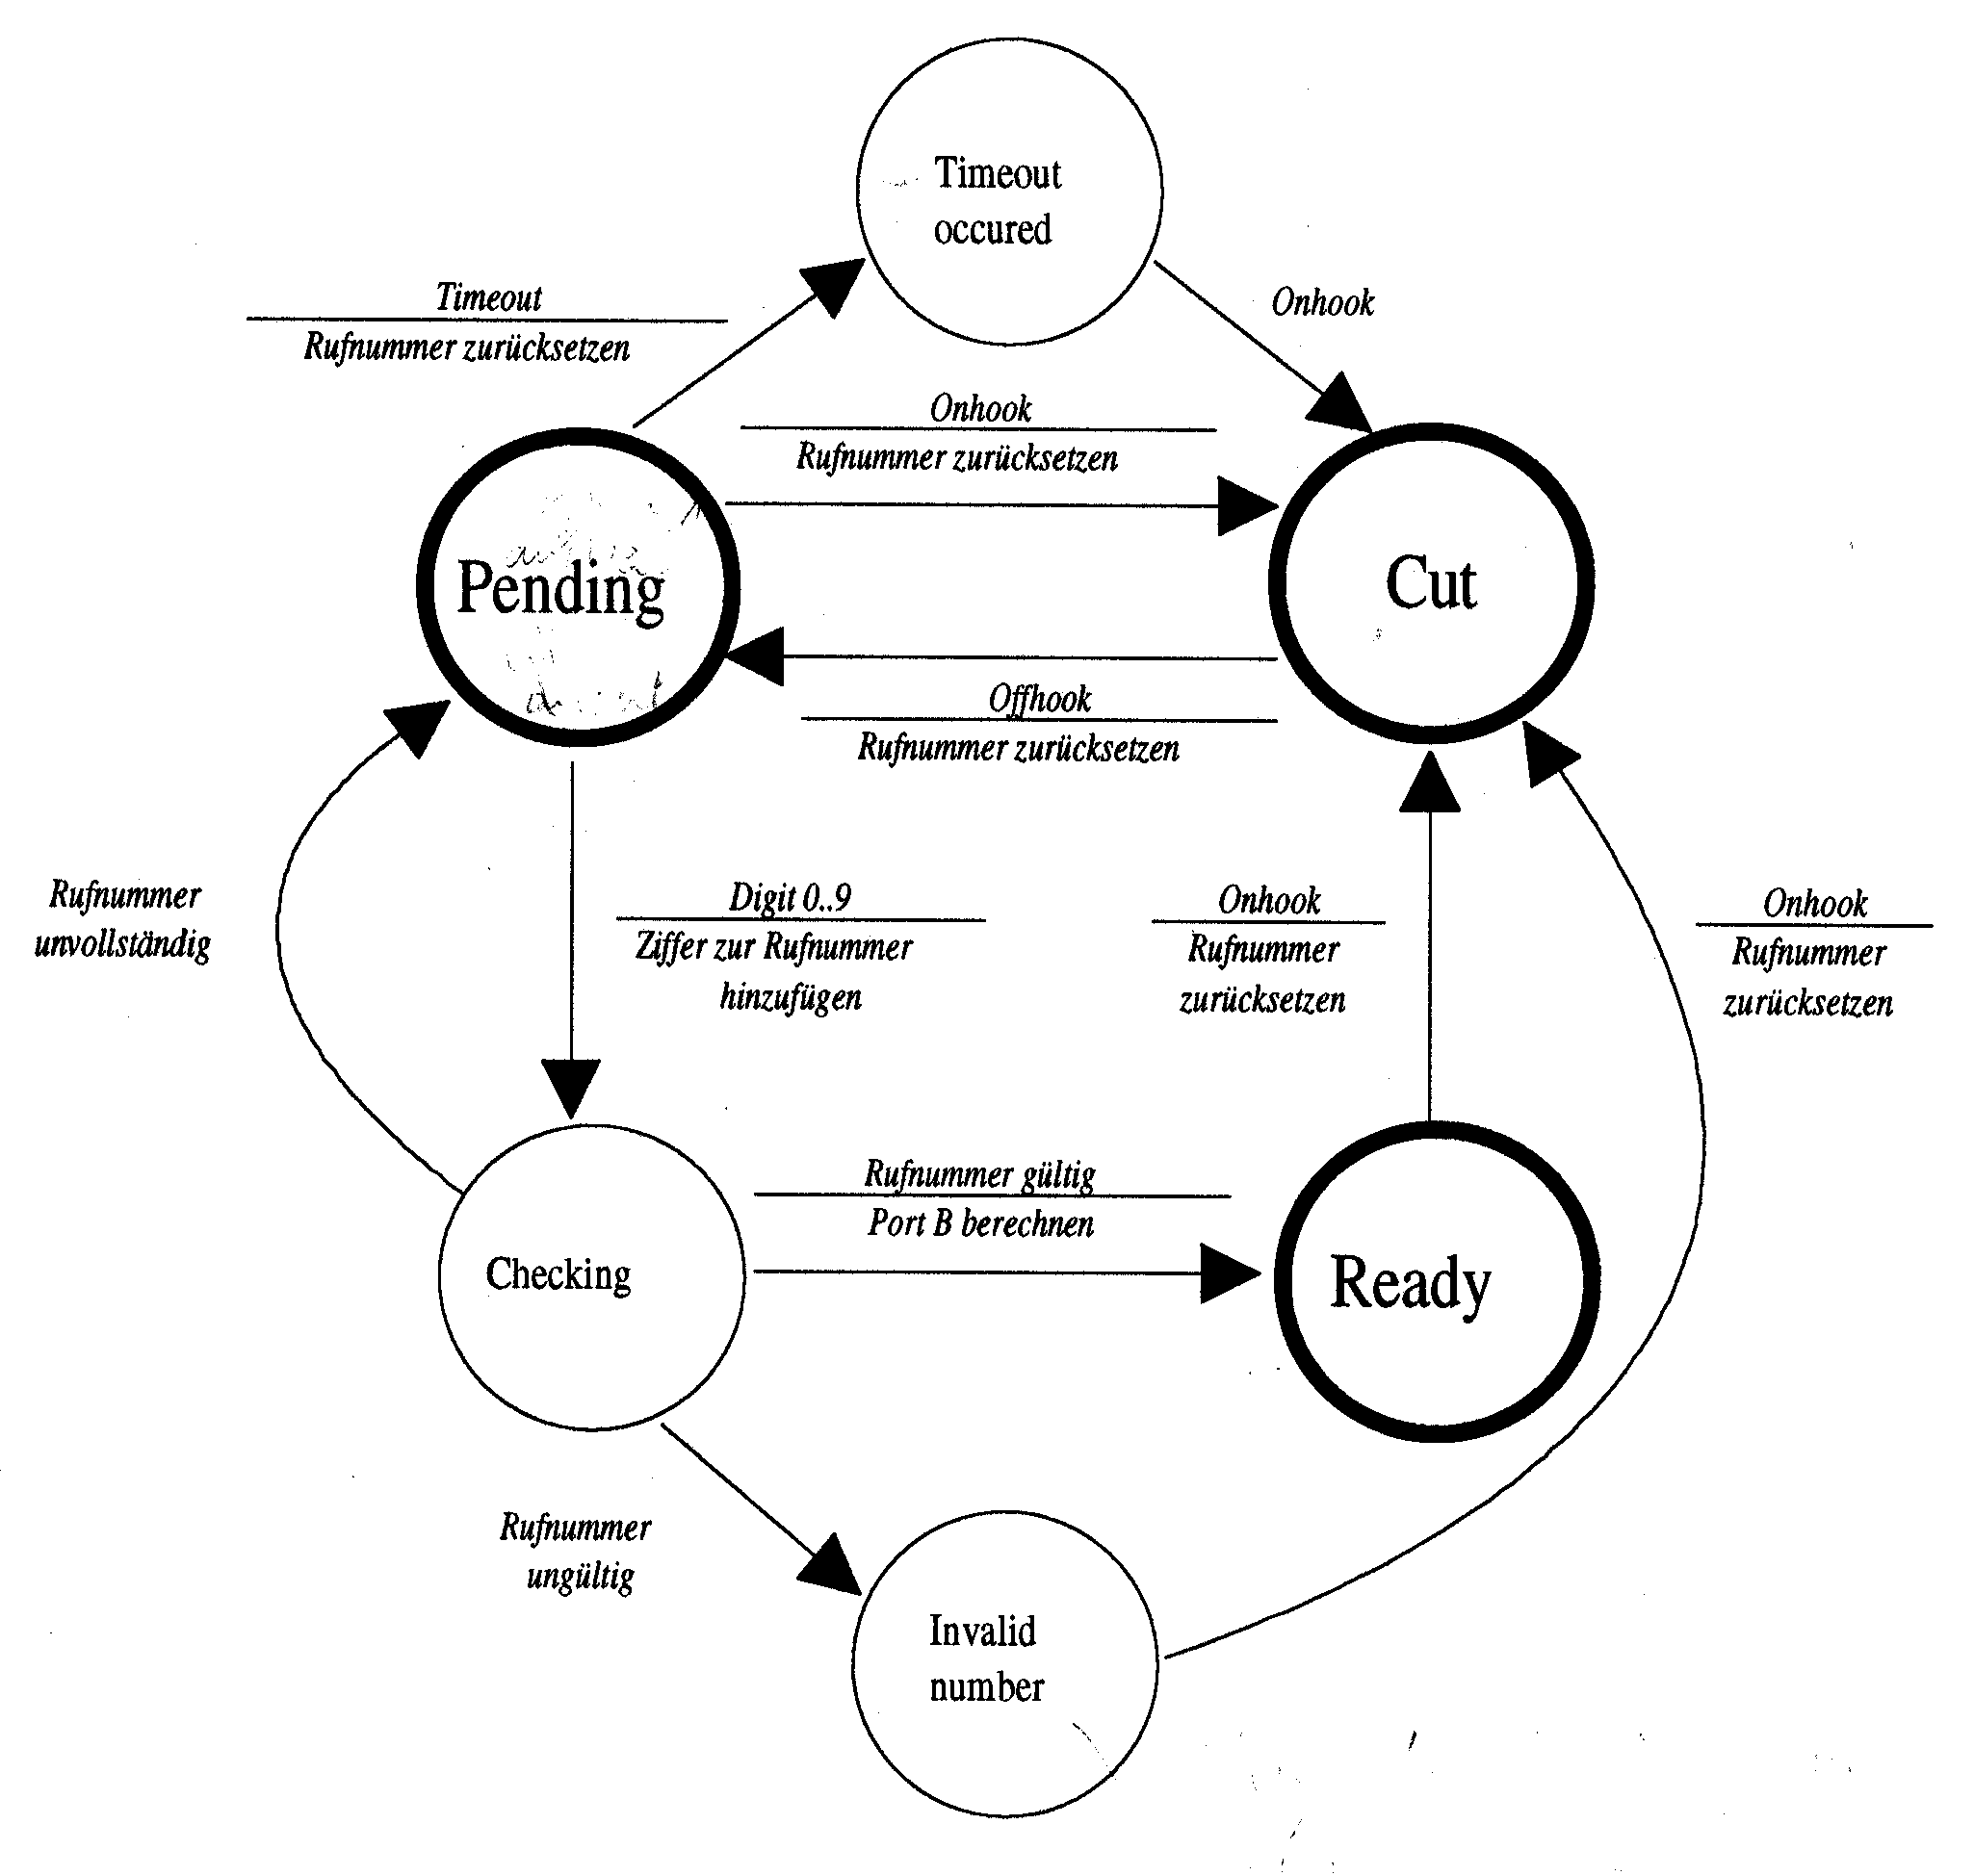
State Transition Testing
Transaction Flow
A minimal test strategies is the coverage of al states
A better strategy is to cover all state transitions
Cut, Off hook = Pending, Timeout occurred = Cut
Cut, Off hook = Pending, Digits 0..9 = Checking, = Number incomplete Pending, Digits 0..9 = Checking, … ,Number valid = Ready, On hook = Cut
Cut, Off hook = Pending, Digits 0..9 = Checking, = Number incomplete Pending, Digits 0..9 = Checking, … ,Number invalid = Invalid number, On hook = Cut
Cut, Off hook = Pending, On hook = Cut
Cut, Off hook = Pending, Time out = Time out occurred, On hook = Cut

Slide 33
The three parts of Testing
Unit/Component testing
  Test of component correctness and integrity
Integration testing
  Tests of inter-component consistency
System testing
  Tests of system-wide issues

Slide 34
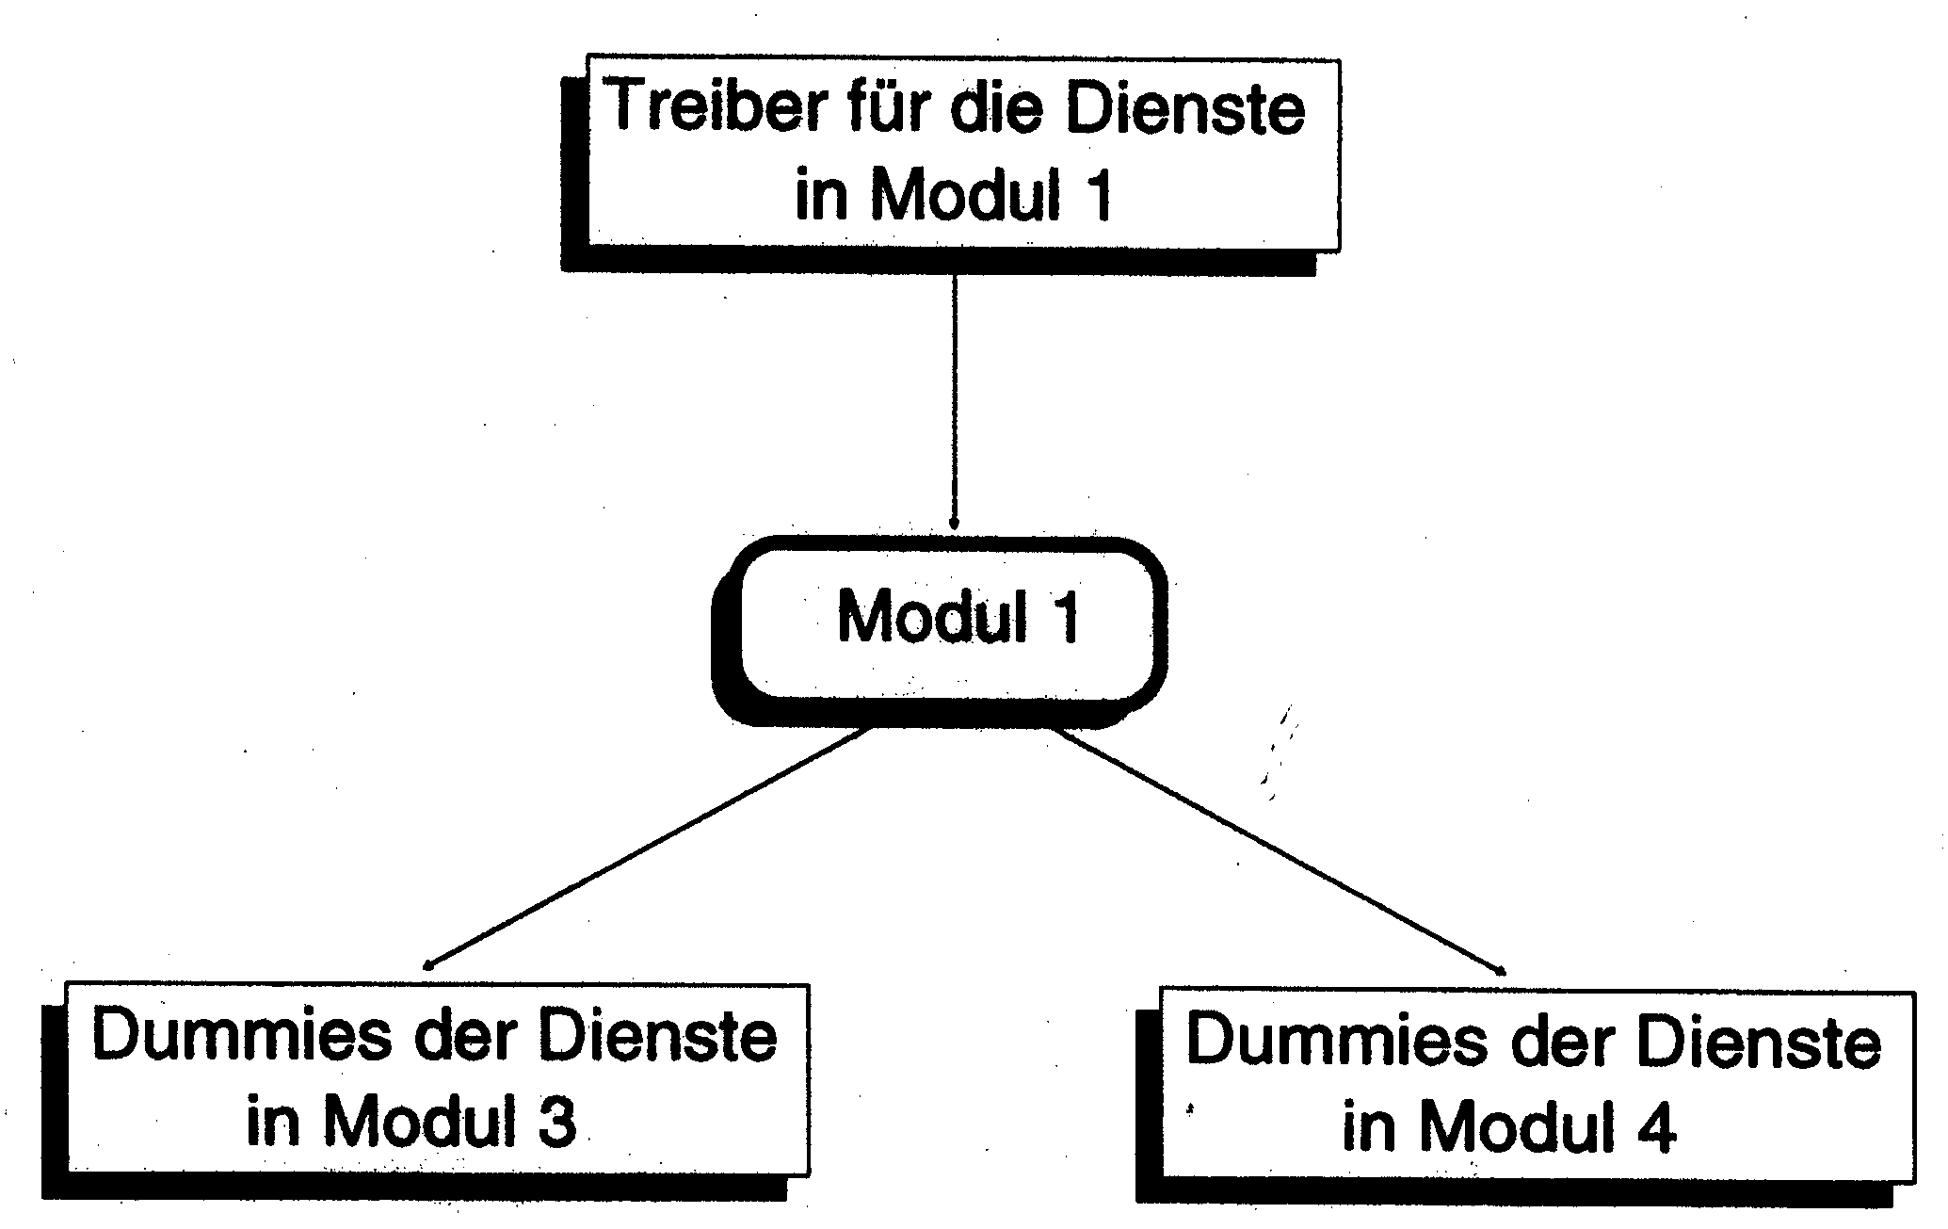
Unit/Component Testing
dummy for services
in module 1
Unit/Component testing
  Test of component correctness and integrity
driver for services
in module 3
driver for services
in module 4

Slide 35
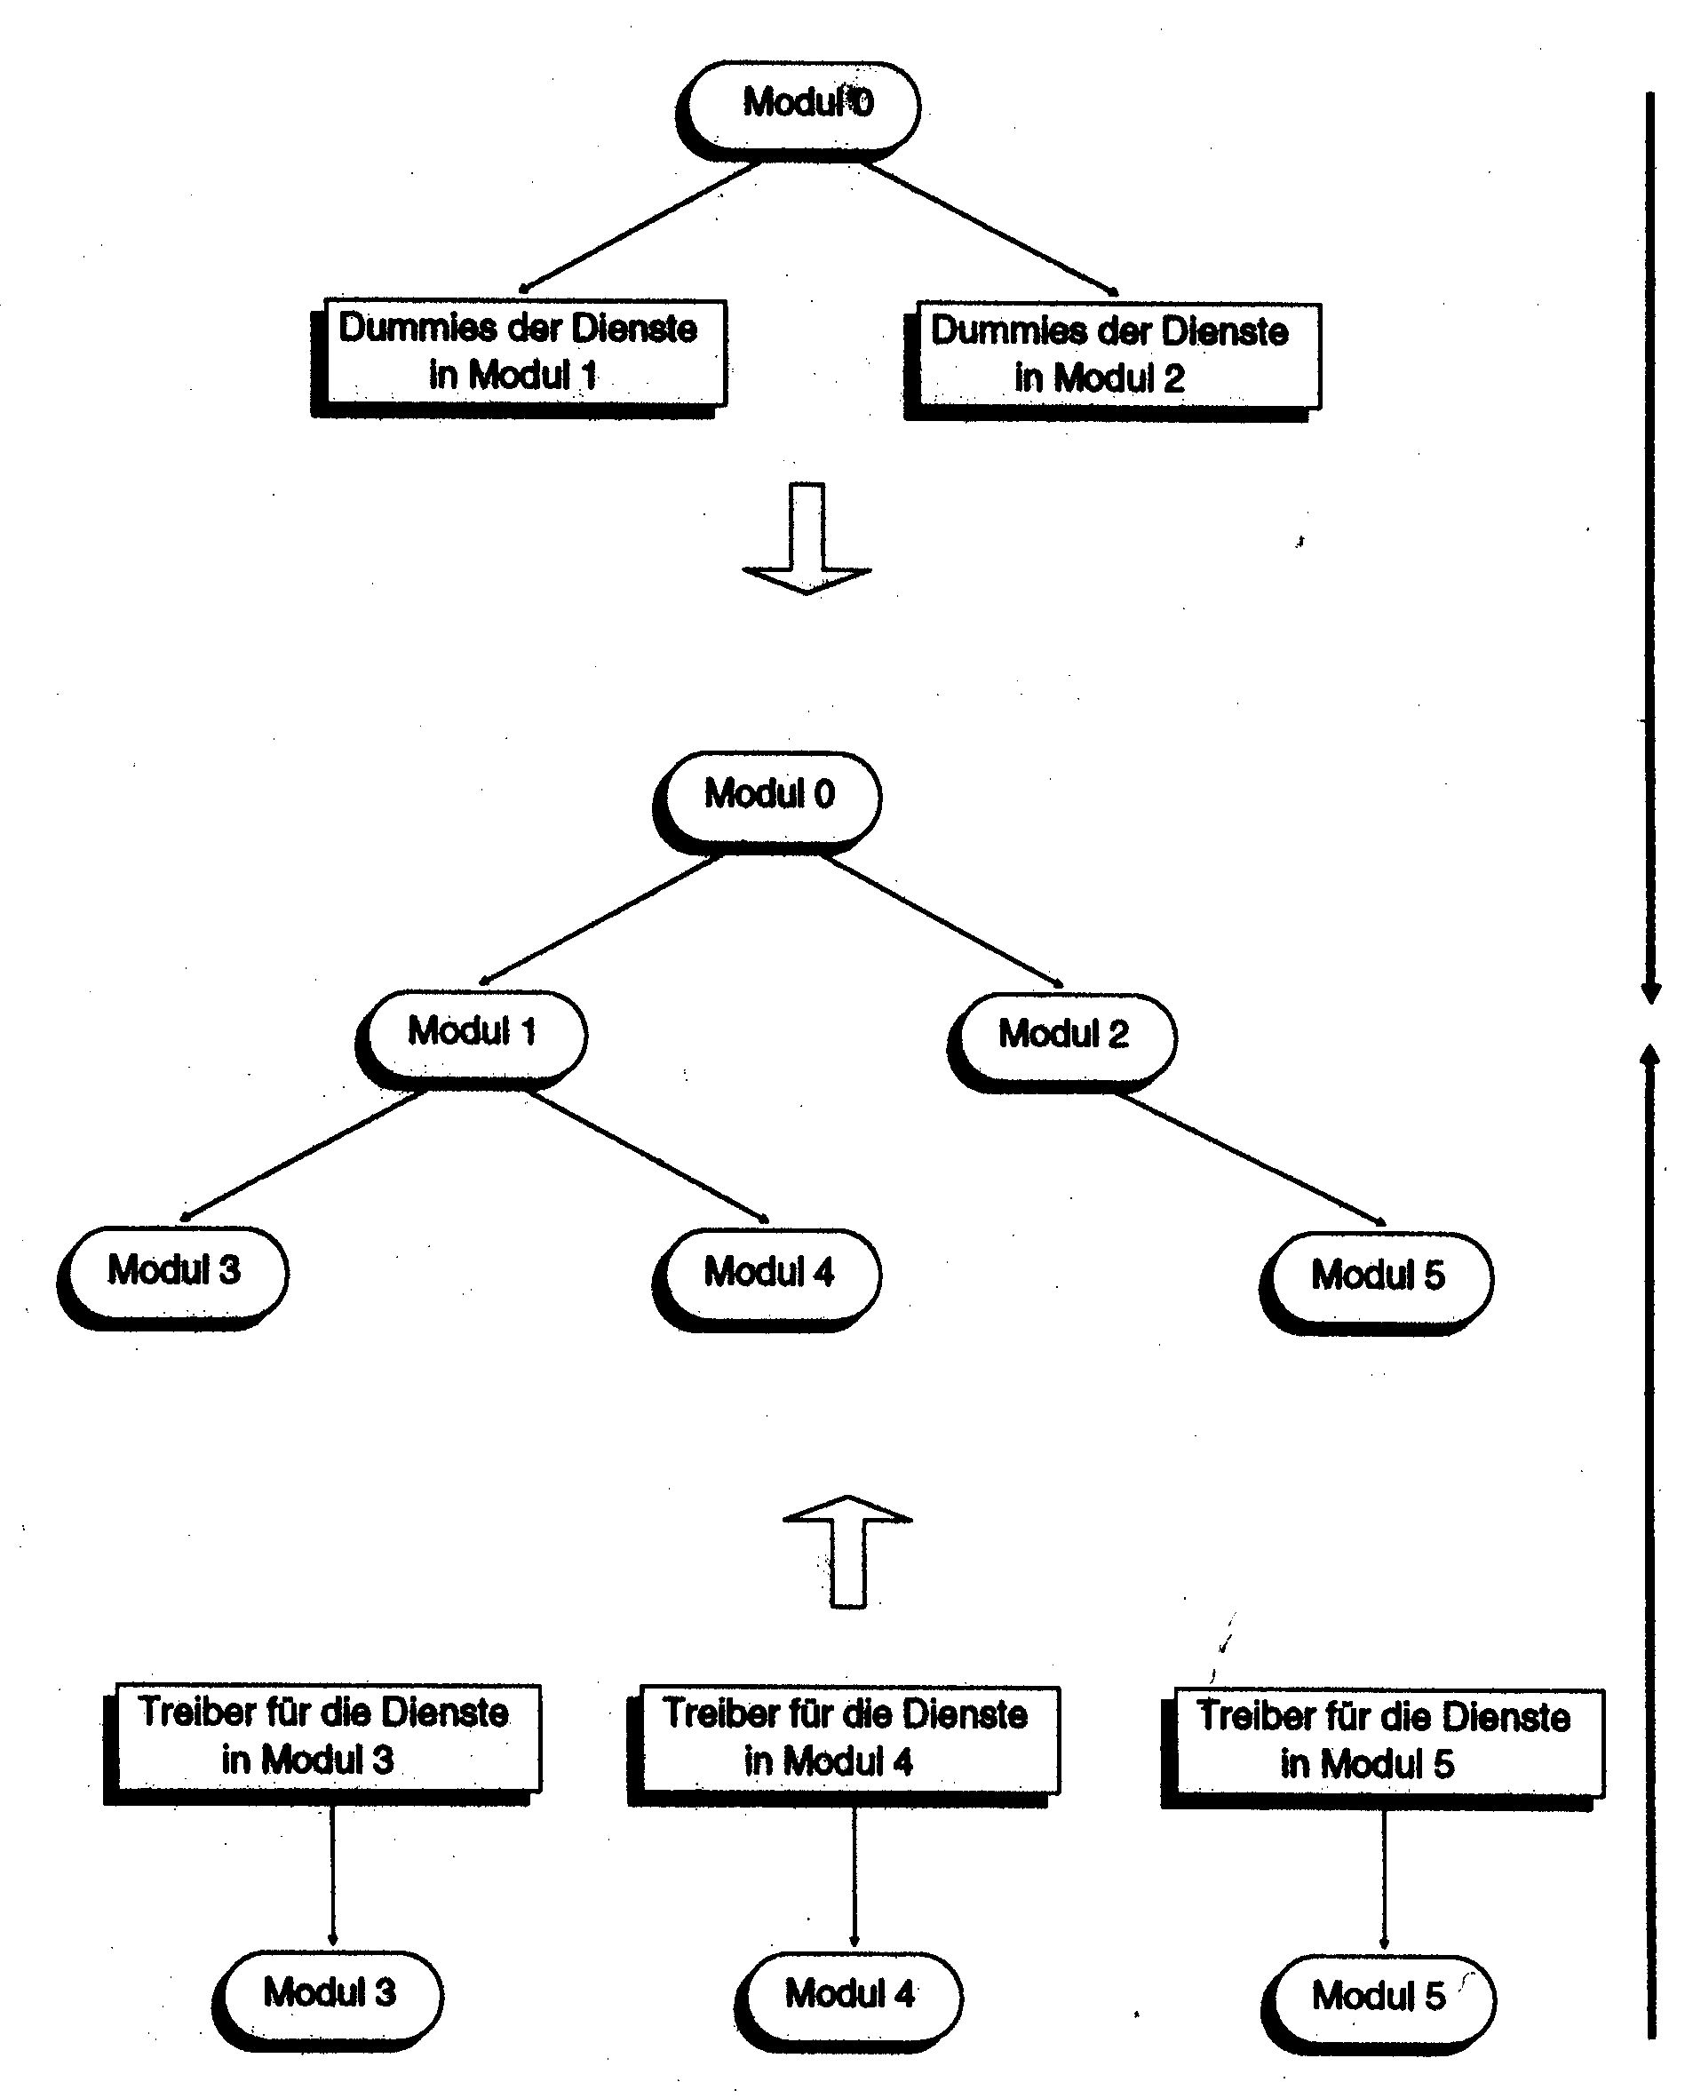
Integration Test
Integration testing is
  test of inter-component consistency
dummy for services
in module 1
dummy for services
in module 2
time
time
driver for services
in module 3
driver for services
in module 5

Slide 36
Integration Testing
Integration is not an event, it is a process,
a process that begins when there are two or more tested components
and ends when there is an adequately tested system
Objective Goals
  Demonstrate that software components are consistent with one another
  Build a hierarchy of working components
Subjective Goals
  Build a hierarchy of trust

Slide 37
Prerequisites to Integration Testing
Trusted subcomponents
Interface standards
Configuration control
Data dictionary
An integration plan
Time, tools, resources

Slide 38
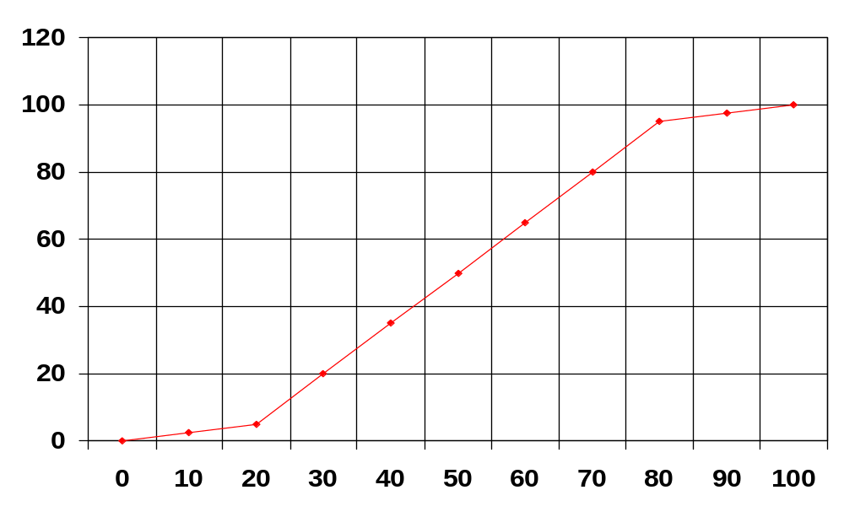
Phases of Testing
% of scheduled tests completed
Phase 3
Phase 2
Phase 1
% of project schedule

Slide 39
The Three Phases of Testing
Phase 1
Many bad but easy bugs
Bugs must be fixed for testing to continue
Small test crew
Set-up problems
Cockpit errors
Incomplete system
Inadequate test tools
Result: Slow test progress

Slide 40
The Three Phases of Testing
Phase 2
Many trivial, easy bugs
Most bugs don’t cause testing to stop
Big test crew
Set-up now automatic
No cockpit errors
Complete system
Adequate test tools
Result: Fast test progress

Slide 41
The Three Phases of Testing
Phase 3
A few, very nasty bugs
Small test crew again
Junior test crew - inexperienced
Diagnosis problems
Intermittent symptoms
Complicated tests
Tools don’t help
Result: Slow test progress

Slide 42
How to Control the Phases of Testing ?
Phase 1 is slow because you don’t have a mature test engine. Backbone integration helps create that engine and reduces phase 2
Increase Phase 2 slope by automation and organising test suites according to generator methods and drivers
Phase 3 is slow because the most junior people are left to deal with the most difficult system bugs. Early stress testing and matching test sequence, bugs and personnel reduces or eliminates phase 3

Slide 43
Regression Testing
Regression testing
Rerun of test suite after any change/correction of software, requirements, tests, configuration, hardware to establish a correctable baseline and to avoid a runaway process
Equivalence testing
Regression test of old (unchanged) features on a new version to confirm that they work exactly as before
Progressive testing
Functional testing of new or changed features on a new version

Slide 44
Why do Regression Testing ?
How else will you know that something was really fixed?
What makes modified software any less buggy than the original - If anything, considering the usual debugging pressures, it’s probably worse
For good systems, bugs decrease with fixes, but debugging induced bugs becomes an increasing part of effort
Regression testing problems is an early warning sign of a project in trouble
There’s too much going on simultaneously during debugging to really keep track of what was fixed, when, by whom - only a full regression test provides the insurance

Slide 45
Regression Tests - Hard or Easy
Hard
  All private tests
  No automatic test drivers
  Manual regression testing
  Tests not configuration controlled
Easy
  All tests configuration controlled
  Centralised database management
  Good automatic tools
  Stress testing done
  Plan, budget, policy that demand regression tests

Slide 46
Performance Testing
Definition
  Performance bugs do not affect transaction fidelity, accountability or processing correctness, but which are manifested only in terms of abusive resource utilization and/or poor performance
Performance behaviour laws
  Real algorithms have simply behaviour which are known and understood -linear, nlogn, etc.
  Real (good) algorithms are monotonic increasing with increased load, tasks, etc.
  Buggy algorithms jump up and down, are discontinuous and exhibit other forms of exotic behaviour
Lesson: The measured behaviour’s departure from simple behavioural laws predicted by theory is the clue to the discovery of performance bugs

Slide 47
Test Tools Overview
Fundamental tools
Compilers, symbolic debugger, development tools, hardware, human environment
Analytical tools
That tell us something about the software: Flowchart generators, call-tree generators
Test execution automation tools
Test design automation tools
CAST: Computer Aided Software Testing

Slide 48
Computers or Stone Axes
The strangest sight in the world is a programmer or tester who while surrounded by computers uses manual testing methods
Even stranger are managers who think that that’s okay
Don’t justify automation. What must be justified is continued use of manual methods (stone axes)

Slide 49
Limitations of manual testing
Not reproducible
Testing and tester errors
Initialization bugs
  Database and configuration bugs
  Input bugs
  Verification and comparison bugs
  Input “corrections”
Variable reports, no support for metrics, poor tracking
Very labour intensive: Testers should design tests, not pound keys

Slide 50
Why automated testing is mandatory ?
Manual test execution error rates are much higher than the software reliabilities the user demand
Most cost-benefits analyses that claim to show that manual testing is cheaper assume no testing bugs - silly assumption
Regression testing without automation is limited

Slide 51
The obvious toolkit
Test bed access
Adequate consumable supplies
Project library and librarian
Reference books
Communication & e-mail
Support technicians
Adequate workstations
Good working conditions

Slide 52
The basic toolkit
Capture/Playback (Behavioural tool)
Unit coverage analyzer & driver (Structural tool)
Requirements based tool (Behavioural test tool)

Slide 53
Side Benefits of Coverage Tools
Programmers (especially) have inflated views of the coverage they achieve in testing
They think that it is 95% but in fact it’s closer to 50%
Fundamental risk assessment data
Quantification - a metric of completion

Slide 54
Use of Software Performance Tools
Statistical software performance tool samples the top of the current stack to support execution time measurement
Can also be used to do block coverage analysis
Very low artefact, useful at all test levels
This is an operating system kernel tool

Slide 55
Metrics as a Compiler/Linker by-product
Most of the interesting metrics can be obtained as a by-product of compilation, especially for optimizing compilers
The needed data are calculated, used and then discarded by the typical compiler
Including: Cyclomatic complexity (branch count), Halstead’s metric (Token count) and others
Get your compiler supplier to stop throwing away important data

Slide 56
Test Drivers
What
Tools that automate the setup, initialization, execution,outcome recording and confirmation of tests, especially for unit testing
Why
Elimination of test execution errors simplifies test debugging and makes regression testing possible
Prerequisites
Formal, designed tests under configuration control

Slide 57
Capture/Playback Tool
Inserted between interfaces, captures inputs (e.g. keystrokes) and system responses, compares outcomes to previously recorded outcomes, reports by exception
Easiest way to transition from manual to automated testing
Huge payoff in regression testing
Test is first executed in normal (manual) mode
Manual verification of outcomes is essential the first time
Subsequent executions are fully automated
Editor is used to build variations
The single most popular test tool

Slide 58
Test Design Automation Status
Weak execution automation support
Un-integrated commercial tools
Big gap between labs and practice
Heavy training investment
Poor integration with CASE

Slide 59
The Comprehensive Test Environment
Test bed management
Test execution and verification
Test design automation support
Incident tracking
Configuration control
Metrics support
Common functions, e.g. report generator

Slide 60
Perspective on Testing
All advanced test techniques are tool intensive
Importance of tools and test automation
Tool building versus tool buying
Realistic payoff projections
Tool penetration - reality vs. aspirations
Solution to the tool penetration problem

