Slide 1



Slide 2
Testing Process
The final aim of S/w engg. Is to give error free software, hence review and verification is done after every phase. However it cannot detect all the errors, hence as testing is the last activity before the final software is delivered, it has the enormous responsibility of detecting any type of error that may be in the software.
After delivery of the software, regression testing is done, for validation. In regression testing, old test cases are executed with the expectation that the same old results will be produced. It makes old testing more important.
It is very costly activity So it is to be done very carefully.
The testing process focuses on how testing should proceed for a particular project.

Slide 3
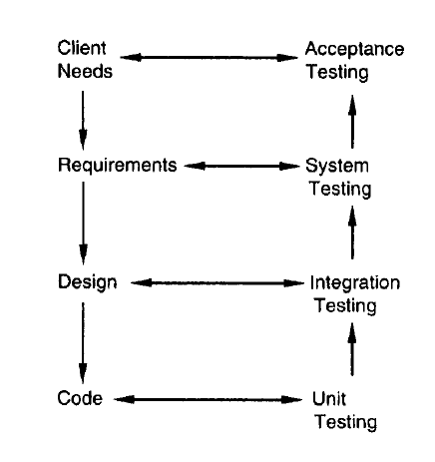
Levels of Software Testing
Each level of testing aims to test different aspects of the system. We are to check the errors apart from the coding also.

Slide 4
Levels of Software Testing
The basic levels are
(1) unit testing
(2) integration testing
(3) System testing
(4) Acceptance testing
These different levels of testing attempt to detect different types of faults.
Unit Testing: Here different modules are tested against the specifications produced during design for the modules. It is essential for verification of code.
Integration Testing: Here many unit tested modules are combined into subsystems, which are then tested. Hence, the emphasis is on testing interfaces between modules.
System testing: Here the entire software system is tested. The reference document for this process is the requirements document, and the goal is to see if the software meets its requirements. Mainly for Validation.
Acceptance testing: is sometimes performed with realistic data of the client to demonstrate that the software is working satisfactorily. Here external behaviour of the system is seen not internal logic.

Slide 5
Regression Testing
Regression Testing: is performed when some changes are made to an existing system. The modified software needs to be tested to make sure that the new features to be added do indeed work. Testing also has to be done to make sure that the modification has not had any undesired side effect of making some of the earlier services faulty. Here some test cases are recorded and maintained to check the system’s functionality again and again.
A regression testing script executes a suite of test cases. For each test case, it sets the system state for testing, executes the test case, determines the output or some aspect of system state after executing the test case, and checks the system state or output against expected values. These scripts are typically produced during system testing, as regression testing is generally done only for complete systems.

Slide 6
Test Plan
Testing commences with a test plan and terminates with acceptance testing.
The test planning can be done well before the actual testing commences and can be done in parallel with the coding and design activities.
The inputs for forming the test plan are: (1) project plan, (2) requirements document, and (3) system design document.
Test Plan should contain the following:
  Test unit specification
  Features to be tested
  Approach for testing
  Test deliverables
  Schedule and task allocation
A test unit is a set of one or more modules, together with associated data, that are from a single computer program and that are the object of testing.
Test unit may be a module, a few modules, or a complete system.
The identification of test units establishes the different levels of testing that will be performed in the project.

Slide 7
Test Plan
Modules are first individually tested, it is as test units. Then the higher level units are specified, which may be a combination of already tested units or may combine some already tested units with some untested modules.
It is to make sure that testing is being performed incrementally.
Testability: means a module should be easily tested.
Features to be Tested: software feature is a software characteristic specified or implied by the requirements or design documents, It include functionality, performance, design constraints, and attributes.
Approach for testing: This is sometimes called the testing criterion or the criterion for evaluating the set of test cases used in testing.
Test Deliverables could be a list of test cases that were used, detailed results of testing including the list of defects found, test summary report, and data about the code coverage, i.e. a test case specification report, test summary report, and a list of defects should always be specified as deliverables.

Slide 8
Test Cases
There are many methods that are used to design the test cases.
These methods provide the developer with a systematic approach to testing. More important, methods provide a mechanism that can help to ensure the completeness of tests and provide the highest likelihood for uncovering errors in software. Any engineered product can be tested in two ways:
(1) Knowing the specified function that a product has been designed to perform, tests can be conducted that demonstrate each function is fully operational while at the same time searching for errors in each function. (BALCK BOX )
(2) Knowing the internal workings of a product, tests can be conducted to ensure that "all gears mesh," that is, internal operations are performed according to specifications and all internal components have been adequately exercised. (WHITE BOX TESTING)

Slide 9
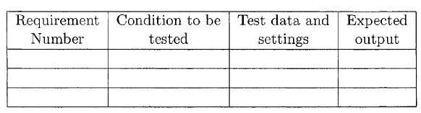
Test Case Specifications
Test Plan focuses on the process of testing, what activities are to be performed at various stages of testing, but does not tell the details of Testing Unit.
Test case specification has to be done separately for each unit.
Which features of unit are to be checked, which plan is to be followed to test.
Test case specification gives, for each unit to be tested, all test cases, inputs to be used in the test cases, conditions being tested by the test case, and outputs expected for those test cases.
Test case specifications contain not only the test cases, but also the rationale of selecting each test case (such as what condition it is testing) and the expected output for the test case.

Slide 10
Test Case Specifications
Reasons for test cases are specified before they are used for testing:
1) Effectiveness of testing depends very heavily on the exact nature of the test cases. Constructing "good" test cases that will reveal errors in programs.
  evaluation of quality of test cases is done through "test case review.“
  The test case specification document is reviewed, using a formal review process, to make sure that the test cases are consistent with the policy specified in the plan, satisfy the chosen criterion, and in general cover the various aspects of the unit to be tested.
  By looking at the conditions being tested by the test cases, the reviewers can check if all the important conditions are being tested.
  By considering the expected outputs of the test cases, it can also be determined if the production of all the different types of outputs the unit is supposed to produce are being tested.
2) specifying all the test cases will help the tester in selecting a good set of test cases.
3) the specifications can be used as "scripts" during regression testing.

Slide 11
Test Case Execution and Analysis
After Defining the test cases next step in Testing process is to execute them.
Specification only defines the test cases: But executing it may require construction of driver modules
It also require modules to set up the environment. Then only the test cases can be executed.
Sometimes it is specified in a separate document test procedure specification.
It tells the special requirements for test environment , methods and formats for reporting the results of testing.
Various outputs are received for unit tested and checked to see the testing was satisfactory.
The most common outputs are the test summary report, and the error report.
The summary gives the total number of test cases executed, the number and nature of errors found, and a summary of the metrics data collected.
The error report is the details of the errors found during testing.

Slide 12
Test Case Execution and Analysis
Testing effort :is the total effort actually spent by the team in testing activities, and is an indicator of whether or not sufficient testing is being performed.
It is to be estimated and then monitored, The estimated effort is used for monitoring. Such monitoring can catch the "miracle finish" cases, where the project "finishes" suddenly, soon after the coding is done.
Computer time consumed during testing is another measure :that can give valuable information to project management. In the initial stage of development it is low and then go on increasing. And then Thereafter it is reduced as the project reaches its completion. Maximum time is used in coding and testing.
By monitoring the computer time consumed, one can get an idea about how thorough the testing has been.
The error report gives the list of all the defects found categorized in the categories.

Slide 13
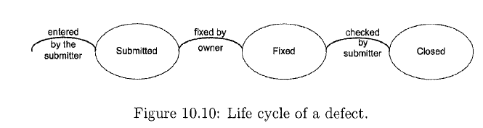
Defect Logging and Tracking
A large software project may include thousands of defects that are found by different people at different stages of the project.
Generally the person who fixes the defect is different from who reports.
So the informal methods will not work. Hence these defects may be forgotten.
Hence, defects found must be properly logged in a system and their closure tracked.
Life cycle of a defect:
  When a defect is found, it is logged in a defect control system, along with sufficient information about the defect. Now it is in the state “Submitted”.
  The job of fixing the defect is then assigned to some person, who is generally the author of the document or code in which the defect is found. Now it is in state “Fixed”.
  Then the verification may be done by another person or by a test team, and typically involves running some tests. Now it is the state “Closed”.

Slide 14
Defect Logging and Tracking
the life cycle can be expanded or contracted to suit the purposes of the project or the organization.
When logging a defect, sufficient information has to be recorded so that the effects can be recreated and debugging and fixing can be done, this may help in the analysis of defect data and can also be very useful for improving the quality.
Defects are categorized as:
  classified in many different ways, and many schemes have been proposed. The orthogonal defect classification scheme , for example, classifies defects in categories that include functional, interface, assignment, timing, documentation, and algorithm.
  Some of the defect types used in a commercial organization are: Logic, Standards, User Interface, Component Interface, Performance, and Documentation.
The impact of Defect is also categorized: such as Catastrophic (High , Requires urgent attention) Minor (Low, Requires No urgent attention)

Slide 15
Defect Logging and Tracking
One such classification is:
1) Critical. Show stopper; aflFects a lot of users; can delay project.
2) Major. Has a large impact but workaround exists; considerable amount
of work needed to fix it, though schedule impact is less.
3) Minor. An isolated defect that manifests rarely and with little impact.
4) Cosmetic. Small mistakes that don't impact the correct working.
At the end of the project, ideally no open defects should remain. Generally it is not practical. A project may have release criteria like "software can be released only if there are no critical and major bugs, and minor bugs are less than x per feature.“
The defect data can be analyzed in other ways to improve project monitoring and control.
Analysis can be done on almost all long lasting projects is to plot and observe the defect arrival and closure trend.

Slide 16
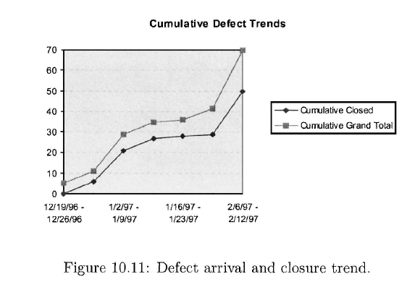
Defect Logging and Tracking
Plotting both the arrival and removal can at a glance provide a view of the state of the quality control tasks in the project.
Here in this diagram the gap between the total defects and the total closed defects is gradually increasing, although the increase is not too alarming.

Slide 17
Defect Logging and Tracking
In addition to plotting the arrival and fixing, the volume of open defects can also be plotted.
This gives a direct plot of how many defects are still not closed. This plot, generally increases with time first, and then starts decreasing. Towards project completion this plot should reach towards zero.
If at some point during the project, all defects have been closed. Of course, this does not mean that there are no defects in the software after reaching the zero open defect, further testing (and adding of code) may reveal defects.
In other words, this plot is not monotonically decreasing, though it is expected that for most controlled projects its general trend will be downwards.
The defect data can also be analyzed for improving the process. One specific technique for doing this is defect prevention

