Slide 1
Software Configuration Management
Presented by: Susan Sekira
Software Process Improvement (SPI) Project

Slide 2
Agenda
Configuration Management (CM) Background
  CM Concepts
  CM Benefits
  Process Overview
Configuration Management Implementation
  Planning and Startup Tasks
  Execution Tasks
CM Support Information
Software Configuration Management, March 2008

Slide 3
Purpose and Objectives
Purpose: Describe CM Concepts and the implementation approach
Objective: After this session you should understand:
  Four key functions of CM
  How to apply CM to your project
  Which CM records to maintain
  Where to find additional information on CM processes and tools
Software Configuration Management, March 2008

Slide 4
Configuration Management Overview
The purpose of Software Configuration Management (CM) is to establish and maintain the integrity of products throughout the software life cycle
Software CM involves four key functions:
  identification of work products and baselines that are subject to configuration control
  control (i.e., approval/rejection) of proposed changes to configuration items
  status accounting of configuration data and changes
  audits to maintain the integrity of the configuration baselines
Software Configuration Management, March 2008

Slide 5

CM Benefits
Improves
  Product protection
  Product visibility
  Product control
  Team communication
  Customer Confidence
Decreases
  Rework
  Confusion
  Project Risk
Software Configuration Management, March 2008

Slide 6
Key Definitions
Configuration Item (CI) - an aggregation of work products (e.g., hardware, software, firmware, or documentation) that is designated for configuration management and treated as a single entity in the configuration management process
Baseline – a set of specifications or work products that has been formally reviewed and agreed on, which thereafter serves as the basis for further development, and which can be changed only through change control procedures. Typically defined for each project life-cycle phase
Software Configuration Management, March 2008
Notes:
Top priority – Most of CMMI maturity level 2 processes plus risk management.

Slide 7
Configuration Management Roles and Responsibilities
Product Development Lead (PDL) - Responsible for CM planning and overall control and approval of CM activities and tools. Develops and maintains the project’s CM Plan
Configuration Management Officer (CMO) – Implements and maintains the CM system according to the project’s CM Plan. Coordinates, supports, and performs CM activities and reports those activities to the PDL
Control Board – composed of technical and administrative representatives who recommend approval/disapproval of changes to a CI or baseline (e.g., Configuration Control Board (CCB), Internal Review Board (IRB))
Software Configuration Management, March 2008
Notes:
Top priority – Most of CMMI maturity level 2 processes plus risk management.

Slide 8
Configuration Management Process
Overview
Configuration Management Process
Planning Data
Project Management Processes
Project Formulation
Project Planning
CM Plan
Status reports; audit results
Project Monitoring & Control
Project Startup
Work products; change requests
Controlled work products; approved change requests
Project Closeout
Product Development Processes
Systems Engineering
Requirements Engineering
Design
Implementation
Sustaining Engineering & Maintenance
Product Release
Testing
Software Configuration Management, March 2008
Notes:
Uses
Configuration Identification
Configuration control
Status acting
Configuration Audits

Slide 9
Configuration Management Tasks
CM planning and startup tasks
Define levels of control and responsibilities
Identify configuration items
Define CM procedures
Prepare the CM Plan
Establish the software project CCB
Setup CM tools and libraries
CM execution tasks
Identify work products/baselines
Perform configuration control
Perform configuration status accounting
Perform configuration audits
NOTE: See the ISD Software Configuration Management Asset, 3.1, for complete task descriptions
Software Configuration Management, March 2008
Notes:
Define controls:
recording records
approving & changing baselines
process for baseline authorization and change
Identify Configuration Items:
What will be under CM control
what’s in each baseline
name/label conventions
Define CM procedures:
establish
control
deliver
update and maintain

Slide 10
CM Planning and Startup Tasks
Define levels of control and responsibilities
Identify configuration items
Define CM procedures
Prepare the CM Plan
Establish the software project CCB
Setup CM tools and libraries

Slide 11
CM Planning/Startup Tasks (1 of 2)
Identify the CIs (e.g., deliverable products, interim products, requirements, software) and define the naming conventions
Identify the levels of control for each CI
List the identified items in the data management list (DML)
Determine when each item will be placed under configuration control (i.e., Baselined)
Select a role that is responsible for maintaining the integrity of items under CM
Establish a CCB or IRB to manage, assess, and control changes to configured items
Software Configuration Management, March 2008

Slide 12
CM Planning/Startup Tasks (2 of 2)
Define the mechanism used to control changes
  Change requests (e.g., What forms / tools will be used?)
  CCB / IRB (e.g., What meetings (if any) will be held? How will changes be dispositioned, logged, and tracked?)
  Audits to confirm the approved changes and ensure the integrity of the configuration baselines
Identify tools used to support CM and how they will be used (e.g., MKS, CVS, ClearCase)
Document approaches, procedures, and tools in a separate CM Plan or as part of your SMP/PP
Software Configuration Management, March 2008

Slide 13
CM Execution Tasks
Identify work products/baselines
Perform configuration control
Perform configuration status accounting
Perform configuration audits

Slide 14
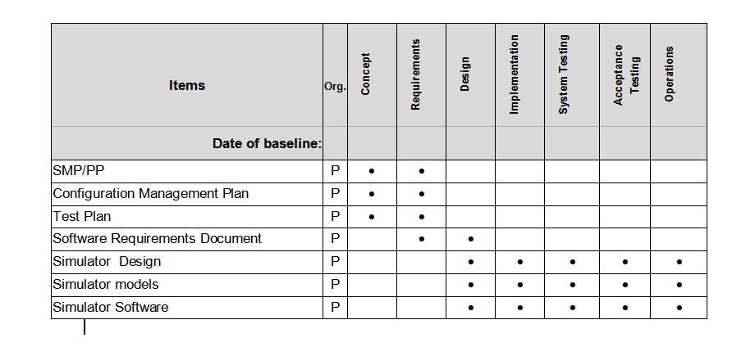
1 - Configuration Identification
Identify Work Products and Baselines
Document the baseline items in the “Baselines Table” in the SMP/PP
Identify by phase (per your life cycle model) the CIs that will be baselined or re-baselined
….
Go to http://software.gsfc.nasa.gov/tools.cfm and look for “CM Baselines Template”
Software Configuration Management, March 2008
Notes:
Tools:
CM Baselines Template
CM Plan Template
PP Boilerplate

Slide 15
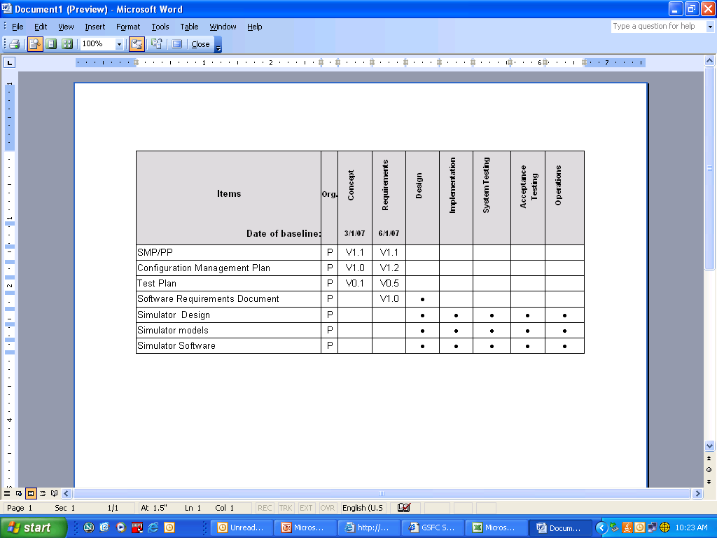
Recording the Baselines
Update the “Baselines Table” at the conclusion of each phase to record the baseline date and the baseline versions for each configured item
Save your updated “Baselines Table” as specified in your DML
….
Software Configuration Management, March 2008

Slide 16
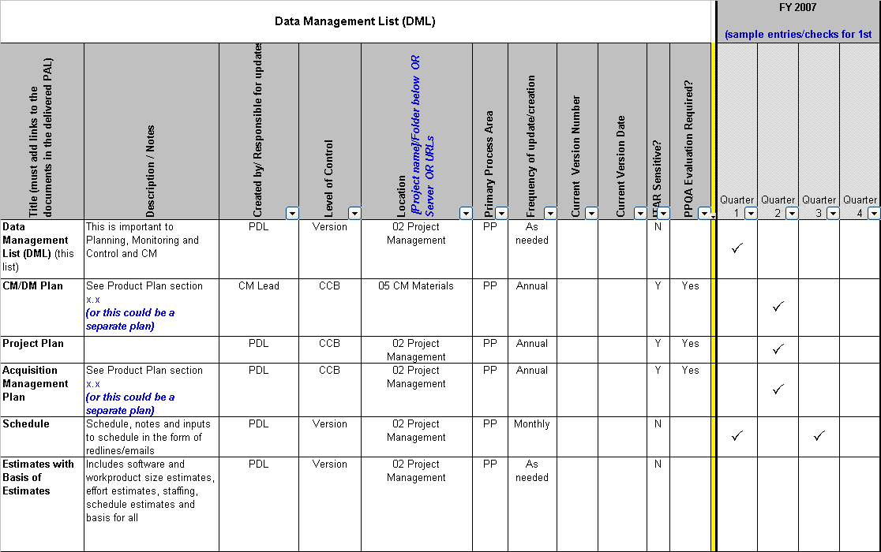
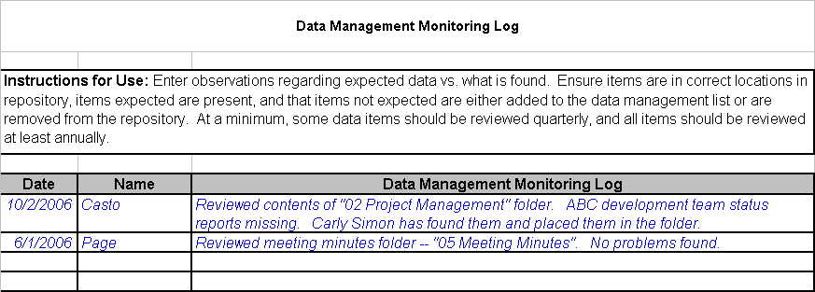
Document CIs in Data Management List (DML)
Go to http://software.gsfc.nasa.gov/tools.cfm and look for “Data Management List”
Software Configuration Management, March 2008

Slide 17
2 - Configuration Control
Identify and record desired changes to a baselined item
Define the need / problem rather than the desired resolution
Document the analysis of change
  Impact analysis, costs, urgency…
Review and disposition each change request
Use a tool* to record and track the status of all change requests
*Go to http://software.gsfc.nasa.gov/tools.cfm and look for “Change Request Form” and “Change Request Log Template”
Software Configuration Management, March 2008

Slide 18
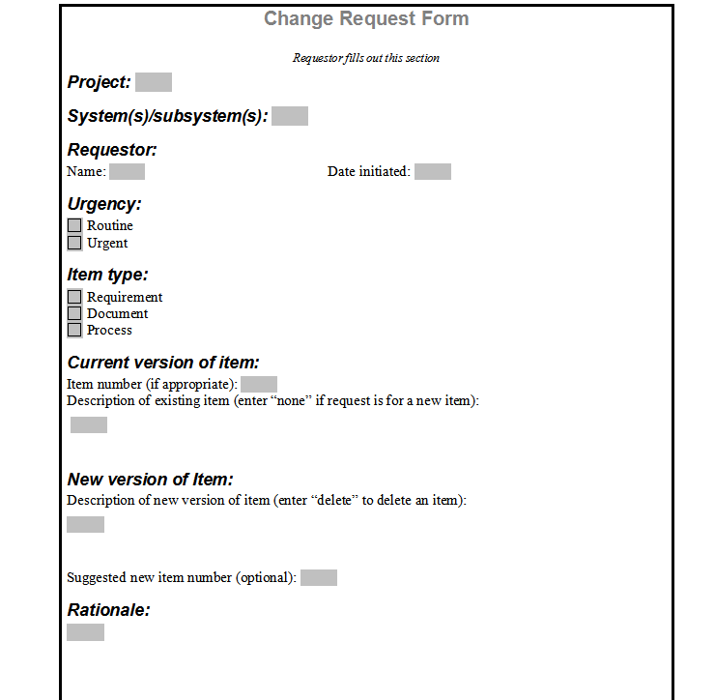
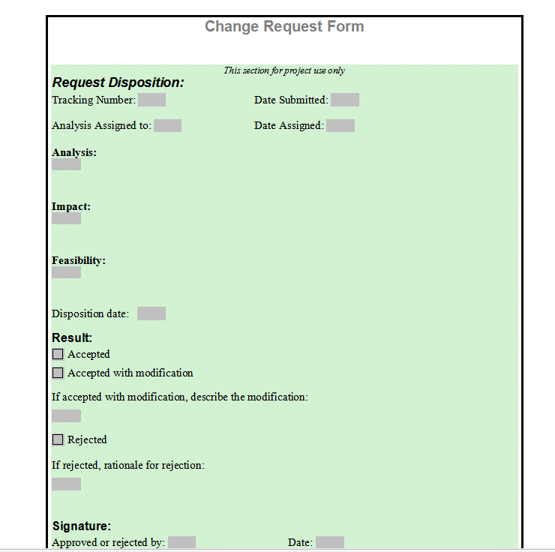
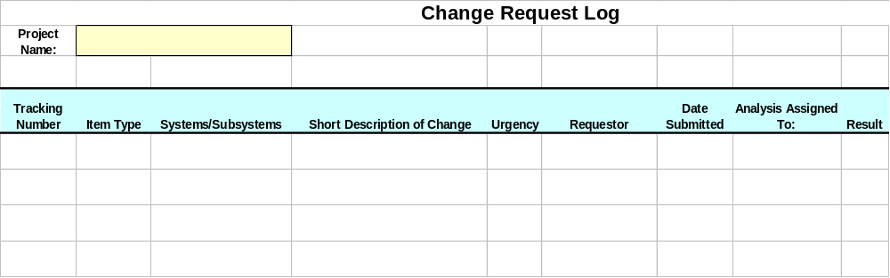
Change Request Form and Log
Thoroughly analyzing the change
Describing the desired change
Decision and formal approval
Keeping track of all the desired changes
Software Configuration Management, March 2008
Notes:
OR this could all be done in a tool like MKS

Slide 19
3 – Configuration Status Accounting
Maintain records of the CIs throughout the project’s life cycle
Record and monitor all changes to CIs
Document the contents of versions, builds, and baselines
Generate periodic status reports – your CM tool may provide the reporting for you!
Software Configuration Management, March 2008

Slide 20
4 – Configuration Audits
Conduct audits to maintain the integrity of the configuration baselines
Three types of CM Audits are required:
  Baseline Audit
  Functional Configuration Audit (FCA)
  Physical Configuration Audit (PCA)
Audits correspond to major milestones and must be planned and on your schedule
Software Configuration Management, March 2008

Slide 21
Baseline Audit
Conducted at the end of each life cycle phase or at each major delivery
Conducted by the team’s CMO or designated team personnel; reviewed by the team’s Software Quality Engineer (SQE)
Baseline Audit -- verifies the content of the baseline
  Correct versions of CIs were used to build the baseline
  Correct version of documentation are included in the baseline
Software Configuration Management, March 2008

Slide 22
FCA and PCA
Functional Configuration Audit (FCA) -- Verifies functionality of baseline after final testing
  Ensures that CIs achieve the performance and functional requirements
  Ensures that operational and support documents are complete and satisfactory
Physical Configuration Audit (PCA) -- Verifies content of baseline for major builds or deliveries
  Ensures that baseline items of a delivery match the documentation that defines it (e.g., Version Description Document (VDD), design documents)
Both conducted by the team’s CMO or designated team personnel; verified by the team’s SQE
Software Configuration Management, March 2008

Slide 23
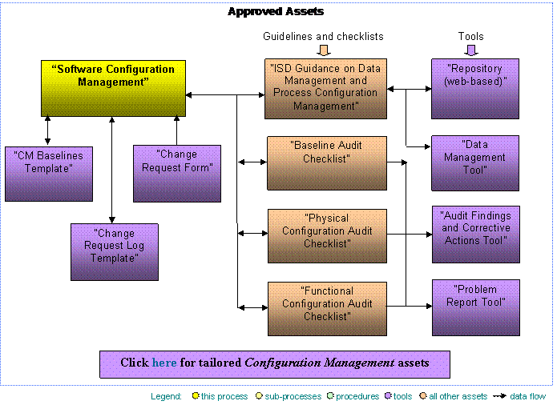
CM Assets
Procedures, Guidelines, and Tools
Software Configuration Management, March 2008
Go to http://software.gsfc.nasa.gov/process.cfm and look under “Organizational Support”

Slide 24
CM Records
CM Plan (including responsibilities, approach, baselines, and CI naming conventions)
Schedule of CM activities
Evidence of Change Request (CR) handling, assignment, and tracking – following the full thread thru the CM process
CCB agendas and meeting minutes
VDDs and/or Delivery Letters
CM audit results
Emails communicating audit results, configuration problems, distribution of the Plan, CRs emailed for analysis, summary of open CRs…
Software Configuration Management, March 2008

Slide 25
Summary
Software Configuration Management establishes and maintains the integrity of products throughout the software life cycle
CM planning and implementation support include:
  Configuration Identification
  Configuration Control
  Configuration Status Accounting
  Configuration Audits
CM records must be organized and maintained
Software Configuration Management, March 2008

Slide 26
Questions?
Software Configuration Management, March 2008

Slide 27
Acronyms
CCB Configuration Control Board
CI Configuration Item
CM Configuration Management
CMO Configuration Management Officer
CR Change Request
DML Data Management List
FCA Functional Configuration Audit
IRB Internal Review Board
ISD Information Systems Division
PCA Physical Configuration Audit
PDL Product Development Lead
SMP/PP Software Management Plan/Product Plan
SPI Software Process Improvement
SQE Software Quality Engineer
VDD Version Description Document
Software Configuration Management, March 2008

