Slide 1


Slide 2
Structural Testing (White Box Testing)
Black-box testing is concerned with functionality rather than implementation of the program. White-box testing, on the other hand is concerned with testing the implementation of the program.
The idea is not to exercise all the different I/O conditions but to exercise the different programming structures and data structures used in the program.
Structural testing aims to achieve test cases that will force the desired coverage of different structures. The criteria for structural testing are generally quite precise as they are based on program structures.
White-box testing, sometimes called glass-box testing.

Slide 3
Structural Testing (White Box Testing)
Using white-box testing methods we can derive test cases that
Guarantee that all independent paths within a module have been exercised at least once.
Exercise all logical decisions on their true and false sides.
Execute all loops at their boundaries and within their operational bounds.
Exercise internal data structures to ensure their validity.
There are three different approaches to structural testing:
control flow-based testing
Data flow-based testing
Mutation testing

Slide 4
Types of control flow-based testing
Statement coverage -
  Test cases which will execute every statement at least once.
  Tools exist for help
  No guarantee that all branches are properly tested. Loop exit?
Branch coverage
  All branches are tested once
Path coverage - Restriction of type of paths:
  Linear code sequences
  Definition/Use checking (all definition/use paths)
  Can locate dead code

Slide 5
Control Flow-Based Criteria
Here the control flow graph of a program is considered and coverage of various aspects of the graph are specified as criteria.
Let the control flow graph or flow graph of a program P be G.
Node in this graph represents a block of statements that is always executed together.
An edge (i, j) (from node i to node j) represents a possible transfer of control after executing the last statement of the block represented by node i to the first statement of the block represented by node j .
Start Node is that whose first statement is the start statement of P, Similarly there is exit node with the last statement of P.
A path is a finite sequence of nodes (n₁,n₂, ...,n_{k}),k > 1, such that there is an edge (n_{i},n_{i+1} )for all nodes n_{i} in the sequence (except the last node n_{k}).
A complete path is a path whose first node is the start node and the last node is an exit node.

Slide 6
Control Flow-Based Criteria
Simplest coverage criteria is statement coverage, Here each statement of the program be executed at least once during testing.
i.e. It requires that the paths executed during testing include all the nodes in the graph. This is also called the all-nodes criterion.
This method is not very strong as it leave errors e.g.
if there is an if statement in the program without having an else clause, the statement coverage criterion for this statement will be satisfied by a test case that evaluates the condition to true. No test case is needed that ensures that the condition in the if statement evaluates to false.
Criterion is branch coverage, which requires that each edge in the control flow graph be traversed at least once during testing. i.e. each decision in the program be evaluated to true and false values at least once during testing, often called branch testing.

Slide 7
Control Flow-Based Criteria
The problem in branch testing is, if a decision has many conditions in it (consisting of a Boolean expression with Boolean operators and &or). In such situations, a decision can evaluate to true and false without actually exercising all the conditions.
Studies have indicated that there are many errors whose presence is not detected by branch testing because some errors are related to some combinations of branches and their presence is revealed by an execution that follows the path that includes those branches.
Another Criteria requires all possible paths in the control flow graph be executed during testing. This is called the path coverage criterion or the all-paths criterion, and the testing based on this criterion is often called path testing.

Slide 8
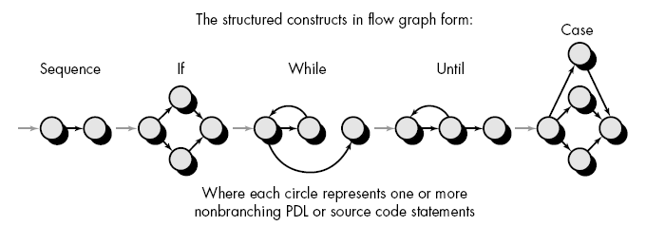
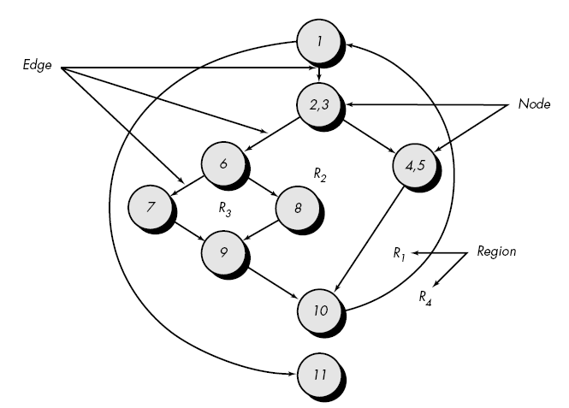
Control Flow-Based Criteria

Slide 9
Control Flow-Based Criteria
The problem here is that programs that contain loops can have an infinite number of possible paths. Furthermore, not all paths in a graph may be "feasible" in the sense that there may not be any inputs for which the path can be executed.
Here main aim is to select a set of paths that ensure branch coverage criterion and try some other paths that may help reveal errors.
One method to decrease the no. of paths is consider two paths same if they are in same loop.
Another approach is based on cyclometic complexity .
cyclomatic complexity V of a module is the number of independent paths in the flow graph of a module.

Slide 10
Control Flow-Based Criteria
The test criterion is that if the cyclomatic complexity of a module is V, then at least V distinct paths must be executed during testing.
As these paths are independent others are dependant , and these basic paths are finite.

Slide 11
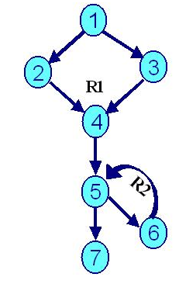
Basis Path Testing – Estimation of Complexity Measure V(G)
This value of V(G), defines the maximum number of test cases to be designed by identifying basis set of execution paths to ensure that all statements are executed at least once. To draw a Flow Graph, find its Cyclomatic Complexity, V(G) and the independent paths for the following piece of code.
void foo (float y, float a *, int n)
{
float x = sin (y) ;
if (x > 0.01)
z = tan (x) ;
else
z = cos (x) ;
for (int i = 0 ; i < x ; + + i) {
a[i] = a[i] * z ;
Cout < < a [i] ;
}
Cout < < a [i] ;
}

Slide 12
Basis Path Testing – Estimation of Complexity Measure V(G)
Piece of code being covered under Node –1
void foo (float y, float a *, int n)
{float x = sin (y) ;
if (x > 0.01)
Piece of code being covered under Node –2
z = tan (x) ;
else
Piece of code being covered under Node –3
z = cos (x) ;
Piece of code being covered under Node –4
for (int i = 0 ; i < x ; + + i)
Piece of code being covered under Node –5
{
Piece of code being covered under Node –6
a[i] = a[i] * z ;
Cout < < a [i] ;
}
Piece of code being covered under Node –7
Cout < < a [i] ;
}
Calculation of V(G) by three methods : V(G) = e – n + 2 ( Where “e” are edges & “n” are nodes)
V(G) = 8 – 7 + 2=3

Slide 13
Path testing (Revision)
The objective of path testing is to ensure that the set of test cases is such that each path through the program is executed at least once
The starting point for path testing is a program flow graph that shows nodes representing program decisions and arcs representing the flow of control
Statements with conditions are therefore nodes in the flow graph

Slide 14
Program flow graphs
Describes the program control flow. Each branch is shown as a separate path and loops are shown by arrows looping back to the loop condition node
Used as a basis for computing the cyclomatic
complexity
Cyclomatic complexity = Number of edges - Number of nodes +2

Slide 15
Cyclomatic complexity
The number of tests to test all control
statements equals the cyclomatic complexity
Cyclomatic complexity equals number of conditions in a program
Useful if used with care. Does not imply
adequacy of testing.
Although all paths are executed, all combinations of paths are not executed

Slide 16
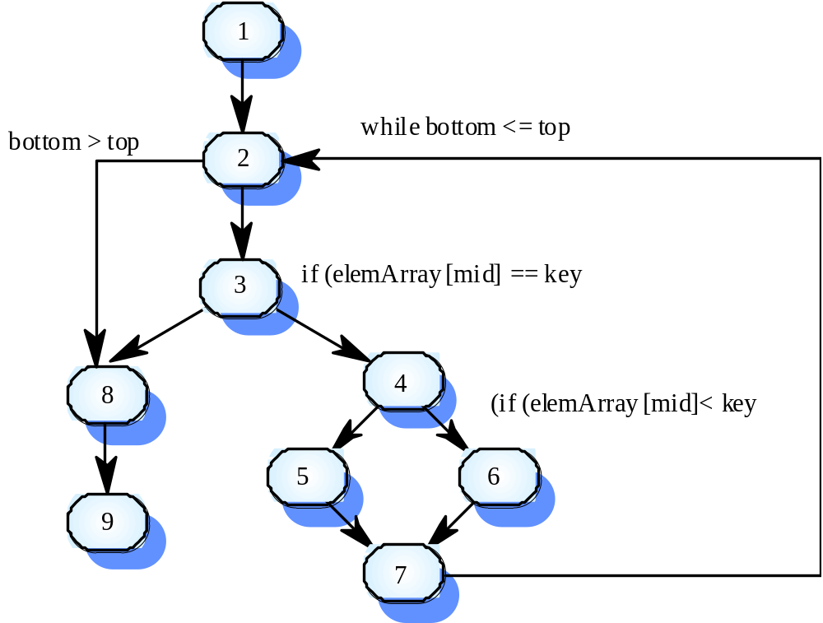
Binary search flow graph

Slide 17
Independent paths
1, 2, 3, 8, 9
1, 2, 3, 4, 6, 7, 2
1, 2, 3, 4, 5, 7, 2
1, 2, 3, 4, 6, 7, 2, 8, 9
Test cases should be derived so that all of these paths are executed
A dynamic program analyser may be used to check that paths have been executed
None of these criteria is sufficient to detect all kind of errors in programs. For example, if a program is missing some control flow paths that are needed to check for a special value (like pointer equals nil and divisor equals zero), then even executing all the paths will not necessarily detect the error.
Hence, even the path coverage criterion, which is the strongest of the criteria we have discussed, is not strong enough to guarantee detection of all the errors.

Slide 18
Data Flow Testing
The data flow testing method selects test paths of a program according to the locations of definitions and uses of variables in the program.
E.g. suppose that each statement in a program is assigned a unique statement number and that each function does not modify its parameters or global variables. For a statement with S as its statement number,
DEF(S) = {X | statement S contains a definition of X}
USE(S) = {X | statement S contains a use of X}
If statement S is an if or loop statement, its DEF set is empty and its USE set is based on the condition of statement S.
The definition of variable X at statement S is said to be live at statement S' if there exists a path from statement S to statement S' that contains no other definition of X.

Slide 19
Data Flow Testing
A definition-use (DU) chain of variable X is of the form [X, S, S'], where S and S' are statement numbers, X is in DEF(S) and USE(S'), and the definition of X in statement S is live at statement S'.
One simple data flow testing strategy is to require that every DU chain be covered at least once, called a DU testing strategy.

