Slide 1


Slide 2
In the early days…
Software engineering tools consisted solely of translators, compilers, assemblers, linkers, loaders, etc. – the software NEEDED to build code.
Computers weren’t powerful enough or advanced yet to support higher-level functioning

Slide 3
But now…
Software engineering often follows specific standardized methods
There are lots of diagrams and documentation involved
So now computers can be used to deal with the higher-level aspects of software engineering

Slide 4
Computer Aided Software Engineering
What is a CASE Environment?
  CASE is the use of computer-based support in the software development process.
What is a CASE Tool?
  A CASE tool is a computer-based product aimed at supporting one or more software engineering activities within a software development process.

Slide 5
Goal of using CASE tools
Supply basic functionality, do routine tasks automatically
  Be able to support editing of code in the particular programming language, supply refactoring tools
Enhance productivity
  Generate code pieces automatically
Increase software quality
Intuitive use
Integration with other tools
  For example, code editor works with code repository

Slide 6
What could be called a CASE tool?
Project management software
System design tools
Code storage
Compilers
Translation tools
Test software

Slide 7
But generally…
Code generation tools (Visual Studio .NET)
Code analysis (Borland Audits)
Development of data models (UML editors)
Cleaning up code (refactoring tools)
Bug tracker
Version control (CVS, etc.)

Slide 8
They do THAT?
CASE tools do more than just output code
Can be used to generate SE documents
  Database schema
  Data flow diagrams
  Entity relationship diagrams
  Program specifications
  User documentation

Slide 9

Introduction
CASE tools: Software tools designed to help system analyst complete development tasks.
The CASE tool contains a database of information called a “repository”
  Information about models
  Descriptions
  Data definitions
  References that link models together
Case tools can check the models to make sure they are complete and follow diagramming rules
Also can check if the models are consistent
Adds a number of capabilities around the repository

Slide 10
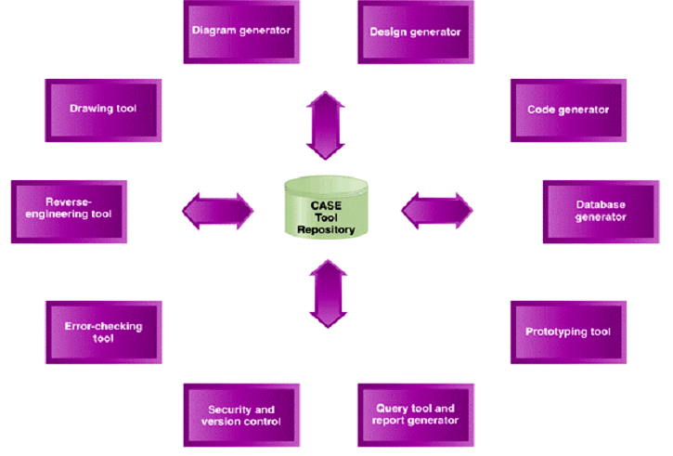
FIGURE 4-10 A CASE tool repository contains all information about the system.
Lecture 4

Slide 11
Types of CASE tools
Upper CASE tools
  Support analyst during the analysis and design phases
Lower CASE tools
  Support for implementation – e.g. generating programs
Tools may be general, or designed for specific methodology (like for information engineering – TIs’ IEF, CoolTools)
Examples of CASE tools
  Visual Analyst for creating traditional models
    Called “integrated application development tool”
  Rational Rose for object-oriented modeling
    Based on UML standard for object orientation
    Allows for reverse-engineering and code generation (can be integrated with other tools like Visual C++ etc.)
“Round trip engineering” – synchronized updating

Slide 12
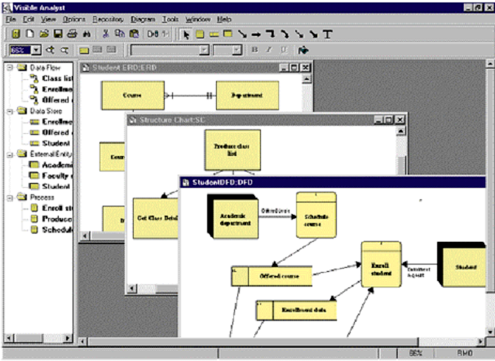
Types of CASE tools (cont.)

Slide 13
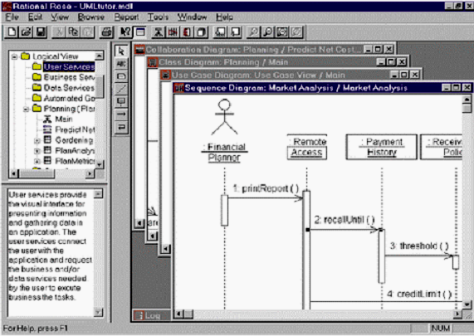
Types of CASE tools (cont.)

Slide 14
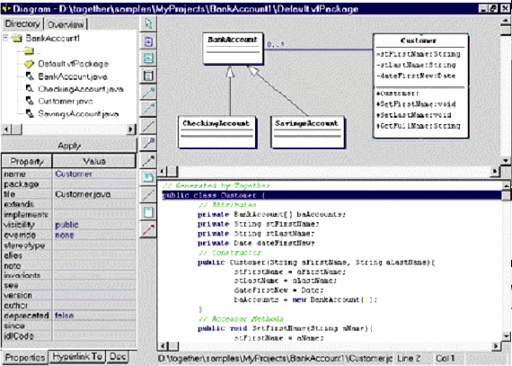
Types of CASE tools (cont.)

Slide 15
Testing Tools
Software testing tools, Software Quality Engineering [SQE95] defines the following testing tools categories:
Data acquisition—tools that acquire data to be used during testing.
Static measurement—tools that analyze source code without executing test cases.
Dynamic measurement—tools that analyze source code during execution.
Simulation—tools that simulate function of hardware or other externals.
Test management—tools that assist in the planning, development, and control of testing.
Cross-functional tools—tools that cross the bounds of the preceding categories.
It should be noted that many testing tools have features that span two or more of the categories.

Slide 16
Regression Testing – What to Test?

Slide 17
Regression Testing – How to Test?

Slide 18
Types of Regression

Slide 19
The Selective Strategy

Slide 20
Selective Regression Testing Techniques

