Slide 1
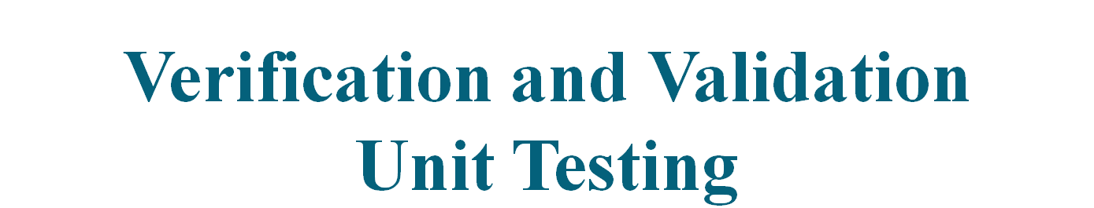

Slide 2
SOFTWARE TESTING STRATEGIES
Any testing strategy must incorporate test planning, test case design, test execution, and resultant data collection and evaluation.
Testing is an individualistic process, and the number of different types of tests varies as much as the different development approaches.
A strategy for software testing must accommodate low-level tests that are necessary to verify that a small source code segment has been correctly implemented as well as high-level tests that validate major system functions against customer requirements.
Software testing is one element of a broader topic that is often referred to as verification and validation (V&V).

Slide 3
SOFTWARE TESTING STRATEGIES
Verification refers to the set of activities that ensure that software correctly implements a specific function.
Validation refers to a different set of activities that ensure that the software that has been built is traceable to customer requirements.
Verification: "Are we building the product right?"
Validation: "Are we building the right product?“
V&V encompasses various activities that is called SQA, that include:
formal technical reviews
quality and configuration audits
performance monitoring,
simulation,
feasibility study,
documentation review,
database review,
algorithm analysis,
development testing,
qualification testing,
installation testing

Slide 4
SOFTWARE TESTING STRATEGIES
V & V doesn't mean only testing, it cover many other activities also.
Testing does provide the last bastion from which quality can be assessed and, more pragmatically, errors can be uncovered.
But testing should not be viewed as a safety net. As they say, "You can't test in quality. If it's not there before you begin testing, it won't be there when you're finished testing.“
Quality is incorporated into software throughout the process of software engineering. Proper application of methods and tools, effective formal technical reviews, and solid management and measurement all lead to quality that is confirmed during testing.

Slide 5
Verification and Validation
Assuring that a software system meets a user's needs

Slide 6
Verification vs validation
Verification:
"Are we building the product right"
The software should conform to its specification
Validation:
"Are we building the right product"
The software should do what the user really requires

Slide 7
The V & V process
Is a whole life-cycle process - V & V must be
applied at each stage in the software process.
Has two principal objectives
  The discovery of defects in a system
  The assessment of whether or not the system is usable in
  an operational situation.

Slide 8
Static and dynamic verification
Software inspections Concerned with analysis of
the static system representation to discover problems (static verification)
  May be supplement by tool-based document and code analysis
Software testing Concerned with exercising and
observing product behaviour (dynamic verification)
  The system is executed with test data and its operational behaviour is observed

Slide 9
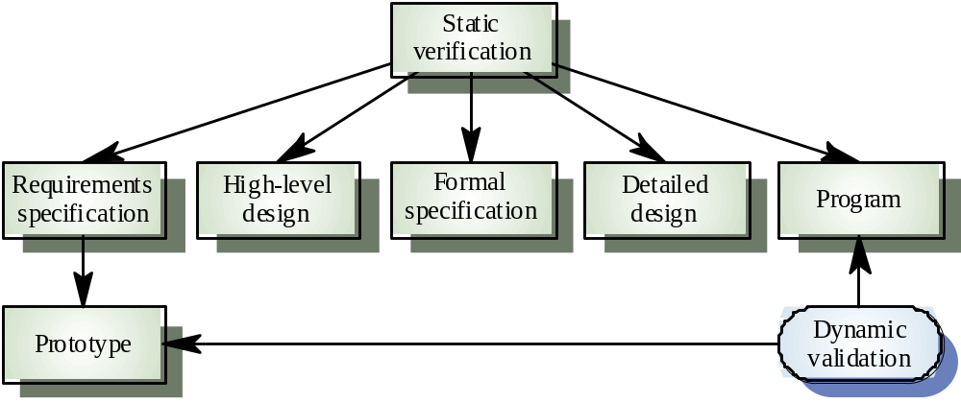
Static and dynamic V&V

Slide 10
V& V goals
Verification and validation should establish confidence that the software is fit for purpose
This does NOT mean completely free of defects
Rather, it must be good enough for its intended use and the type of use will determine the degree of confidence that is needed

Slide 11
V & V confidence
Depends on system’s purpose, user expectations and marketing environment
  Software function
    The level of confidence depends on how critical the software is to an organisation
  User expectations
    Users may have low expectations of certain kinds of software
  Marketing environment
    Getting a product to market early may be more important than finding defects in the program

Slide 12
Testing and debugging
Defect testing and debugging are distinct
processes
Verification and validation is concerned with establishing the existence of defects in a program
Debugging is concerned with locating and
repairing these errors
Debugging involves formulating a hypothesis
about program behaviour then testing these
hypotheses to find the system error

Slide 13
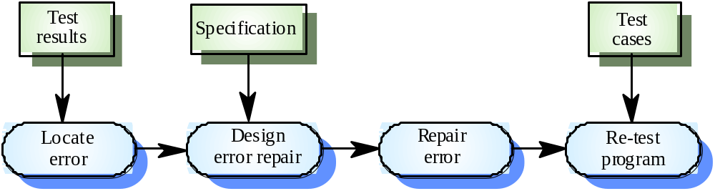
The debugging process

Slide 14
V & V planning
Careful planning is required to get the most out of testing and inspection processes
Planning should start early in the development process
The plan should identify the balance between static verification and testing
Test planning is about defining standards for the testing process rather than describing product tests

Slide 15
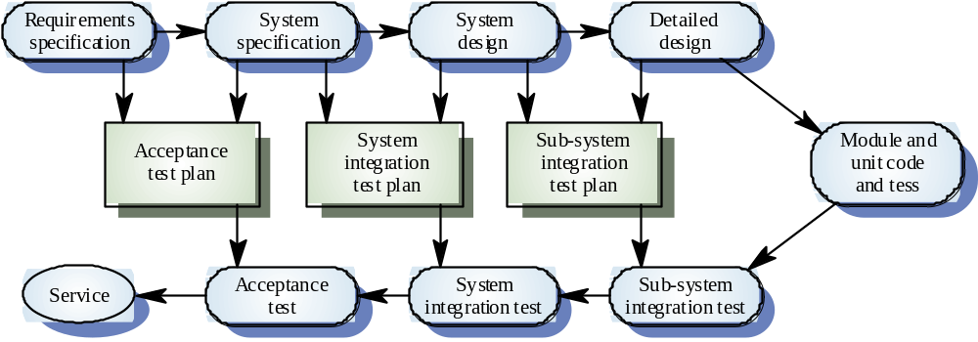
The V-model of development

Slide 16
Key points
Verification and validation are not the same thing. Verification shows conformance with specification; validation shows that the program meets the customer’s needs
Test plans should be drawn up to guide the testing process.
Static verification techniques involve examination and analysis of the program for error detection

Slide 17
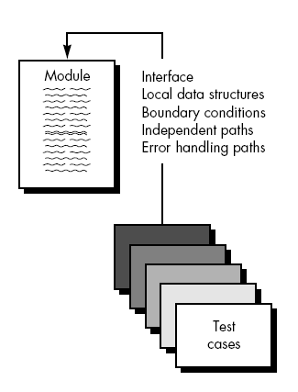
Unit testing
Unit testing focuses verification effort on the smallest unit of software design.
The unit test is white-box oriented, and the step can be conducted in parallel for multiple components

Slide 18
Unit testing
The module interface is tested to ensure that information properly flows into and out of the program unit under test
The local data structure is examined to ensure that data stored temporarily maintains its integrity during all steps in an algorithm's execution.
Boundary conditions are tested to ensure that the module operates properly at boundaries established to limit or restrict processing.
All independent paths (basis paths) through the control structure are exercised to ensure that all statements in a module have been executed at least once. And finally, all error handling paths are tested.
Tests of data flow across a module interface are required before any other test is initiated.
Selective testing of execution paths is an essential task during the unit test

Slide 19
Unit testing
Test cases should be designed to uncover errors due to erroneous computations, incorrect comparisons, or improper control flow. Basis path and loop testing are effective techniques for uncovering a broad array of path errors.
Among the more common errors in computation are
(1) misunderstood or incorrect arithmetic precedence,
(2) mixed mode operations,
(3) incorrect initialization,
(4) precision inaccuracy,
(5) incorrect symbolic representation of an expression.
Comparison and control flow are closely coupled to one another (i.e., change of flow frequently occurs after a comparison).

Slide 20
Unit testing
Test cases should uncover errors such as
(1) comparison of different data types,
(2) incorrect logical operators or precedence,\
(3) expectation of equality when precision error makes equality unlikely,
(4) incorrect comparison of variables,
(5) improper or nonexistent loop termination,
(6) failure to exit when divergent iteration is encountered, and
(7) improperly modified loop variables.
Unit testing is normally considered as an adjunct to the coding step.

Slide 21
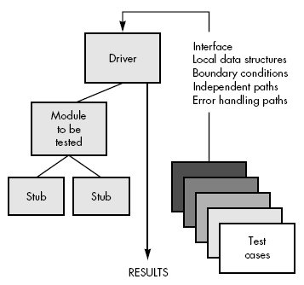
Unit testing
The unit test environment is illustrated:
In most applications a driver is nothing more
than a "main program" that accepts test case
data, passes such data to the component
(to be tested), and prints relevant results.
Stubs serve to replace modules that are
subordinate (called by) the component to be
tested. A stub or "dummy subprogram" uses
the subordinate module's interface, may
do minimal data manipulation, prints verification
of entry, and returns control to the module undergoing testing

