Slide 1



Slide 2
Reasons to Failures
Software faults and failures:
What does it mean that the software has failed?
The software does not do what the requirements describe
Reasons to the failures
1) Requirements incomplete, inconsistent, impossible to implement
2) Wrong interpretation of the requirements
3) The system design may contain a fault (misunderstanding, requirements,
wrong architecture, incomplete design)
4) Program design may contain a fault - wrong algorithm
5) The program code may be wrong - improper, incomplete, inconsistent
implementation
6) Documentation can be wrong - can describe incorrectly the behaviour of the
system

Slide 3
Reasons to Failures
Integration problems:
The components integrated into a systems are not compatible
(wrong components, wrong component versions)
  The performance of the entire system does not correspond to the requirements (expectations)
  The system requires too much resources
Not failures but still unsuccessful
  Bad Graphical User Interface
  Complicated process
  Missed points with requirements (users actually wanted something else)

Slide 4
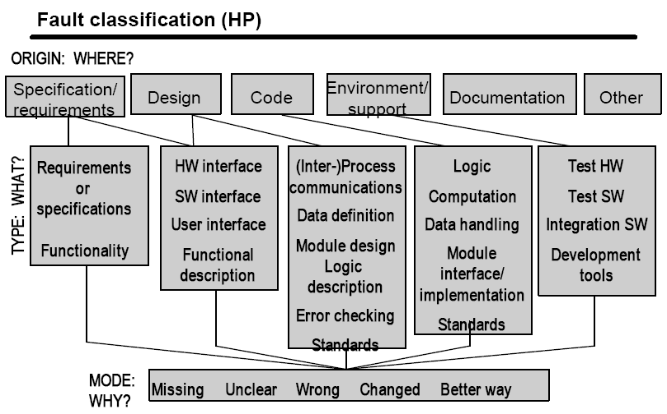
Faults Classification

Slide 5
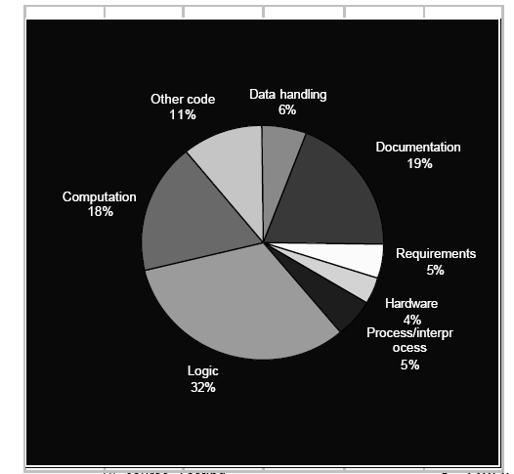
Reliability Metrics
  What are the most frequent faults:

Slide 6
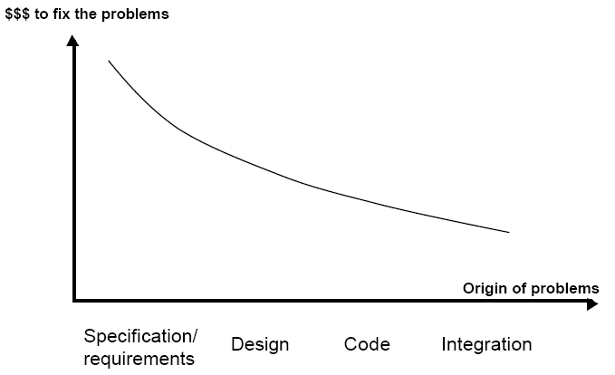
Cost to Repair Failures
How to avoid a late detection of the faults?
1) Use the development process that suits the best
2) Do proper planning
3) Ensure the quality in each process step
4) perform reviews
5) perform tests

