Slide 1

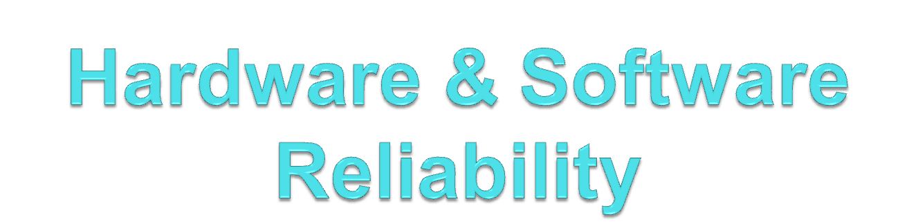

Slide 2

Introduction
Reliability : The probability that software will contribute to failure-free system performance for a specified time under specified conditions. The probability depends on information input into the system, system use, and the existence of software faults encountered during input
Availability :Availability of the module is the percentage of time when system is operational. Availability of a hardware/software module can be obtained by the formula given below.
MTTR : Mean Time To Repair (MTTR), is the time taken to repair a failed hardware module. In an operational system, repair generally means replacing the hardware module.
MTBF: Mean Time Between Failures (MTBF), as the name suggests, is the average time between failure of hardware modules. It is the average time a manufacturer estimates before a failure occurs in a hardware module.
MEAN: the expected value of a random variable, which is also called the population mean.

Slide 3
System Reliability Specification
Hardware reliability
  probability a hardware component fails
Software reliability
  probability a software component will produce an incorrect output
  software does not wear out
  software can continue to operate after a bad result
Operator reliability
  probability system user makes an error

Slide 4
Faults and Failures
Failure Probabilities: If there are two independent components in a system and the operation of the system depends on them both then
    P(S) = P(A) + P(B)
If the components are replicated then the probability of failure is
    P(S) = P(A)^{n}
  meaning that all components fail at once.
  Failure & Faults:
A failure corresponds to unexpected run-time behaviour observed by a user of the software
A fault is a static software characteristic which causes a failure to occur.
Faults need not necessarily cause failures. They only do so if the faulty part of the software is used
If a user does not notice a failure, is it a failure? Remember most users don’t know the software specification.

Slide 5
Reliability Metrics
  Hardware Reliability Metrics:
Hardware metrics are not suitable for software since its metrics are based on notion of component failure.
Software failures are often design failures.
Often the system is available after the Software failure has occurred.
Hardware components can wear out.
  Software Reliability Metrics:
1. Reliability metrics are units of measure for system reliability
2. System reliability is measured by counting the number of operational failures and relating these to demands made on the system at the time of failure
3. A long-term measurement program is required to assess the reliability of critical systems

Slide 6
Reliability improvement
Reliability is improved when software faults which occur in the most frequently used parts of the software are removed.
Removing x% of software faults will not necessarily lead to an x% reliability improvement.
Removing faults with serious consequences is the most important objective.
The use of formal methods of development may lead to more reliable systems as it can be proved that the system conforms to its specification
The development of a formal specification forces a detailed analysis of the system which discovers anomalies and omissions in the specification
However, formal methods may not actually improve reliability.

Slide 7
Reliability and efficiency
As reliability increases system efficiency tends to decrease
To make a system more reliable, redundant code must be includes to carry out run-time checks, etc. This tends to slow it down.
Reliability is usually more important than efficiency.
No need to utilise hardware to fullest extent as computers are cheap and fast.
Unreliable software isn't used.
Hard to improve unreliable systems.
Software failure costs often far exceed system costs.
Costs of data loss are very high.

Slide 8
Reliability Metrics
Hardware metrics not really suitable for software as they are based on component failures and the need to repair or replace a component once it has failed. The design is assumed to be correct.
Software failures are always design failures. Often the system continues to be available in spite of the fact that a failure has occurred.
Some of the Important Software Reliability Metrics are:
Probability of failure on demand
  This is a measure of the likelihood that the system will fail when a service request is made
  POFOD = 0.001 means 1 out of 1000 service requests result in failure
  Relevant for safety-critical or non-stop systems

Slide 9
Reliability Metrics Contd..
2. Rate of fault occurrence (ROCOF)
  Frequency of occurrence of unexpected behaviour
  ROCOF of 0.02 means 2 failures are likely in each 100 operational time units
  Relevant for operating systems, transaction processing systems
3. Mean time to failure
  Measure of the time between observed failures
  MTTF of 500 means that the time between failures is 500 time units
  Relevant for systems with long transactions e.g. CAD systems
4. Availability
  Measure of how likely the system is available for use. Takes repair/restart time into account
  Availability of 0.998 means software is available for 998 out of 1000 time units
  Relevant for continuously running systems e.g. telephone switching systems

Slide 10
Reliability measurement
Measure the number of system failures for a given number of system inputs
    Used to compute POFOD
Measure the time (or number of transactions) between system failures
    Used to compute ROCOF and MTTF
Measure the time to restart after failure
    Used to compute AVAILABILITY
Time units
Time units in reliability measurement must be carefully selected. Not the same for
all systems
Raw execution time (for non-stop systems)
Calendar time (for systems which have a regular usage pattern e.g. systems which are always run once per day)
Number of transactions (for systems which are used on demand)

Slide 11
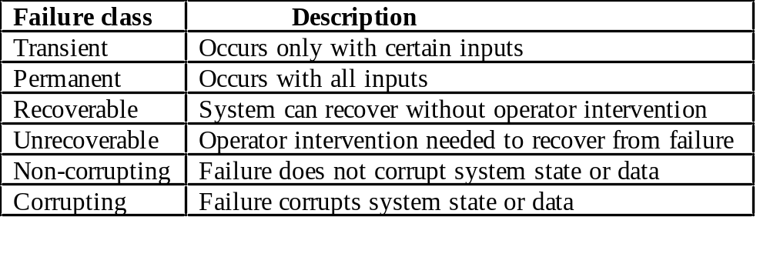
Reliability specification
Reliability requirements are only rarely expressed in a quantitative, verifiable way.
To verify reliability metrics, an operational profile must be specified as part of the test plan.
Reliability is dynamic - reliability specifications related to the source code are meaningless.
  No more than N faults/1000 lines.
  This is only useful for a post-delivery process analysis.
Failure classification:

Slide 12
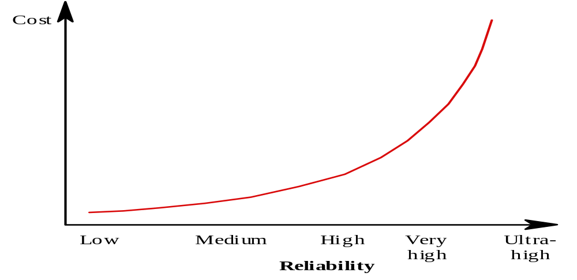
Steps to a reliability specification
For each sub-system, analyse the consequences of possible system failures.
From the system failure analysis, partition failures into appropriate classes.
For each failure class identified, set out the reliability using an appropriate metric. Different metrics may be used for different reliability requirements.
Reliability economics: Because of very high costs of reliability achievement, it may be more cost effective to accept unreliability and pay for failure costs
However, this depends on social and political factors. A reputation for unreliable products may lose future business
Depends on system type - for business systems in particular, modest reliability may be adequate

