Slide 1
AVL Trees

Slide 2
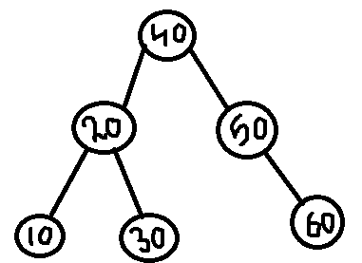
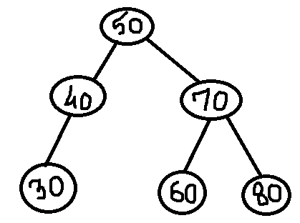
Draw a BST with the following nodes and count the number of comparisons for finding an element:
10 20 30 40 50 60. find:60
80 70 60 50 40 30. find:30
Compare the comparisons for the above two trees with the trees given below:

Slide 3
For skewed/unbalanced BST, Max{number of comparisons} = no of nodes [O(n)]
For balanced BST, Max{number of comparisons} = Height of tree [O(log n)]
Therefore, its is necessary to maintain the BST to be balanced height, so that it is possible to do search option with time complexity of O(log n) in worst case.
Hence, a popular balanced tree was introduced by Adelson-Velskii and Landis (AVL), known as AVL trees.
Note -> If a tree is not balanced , it can be a BST but not AVL.

Slide 4
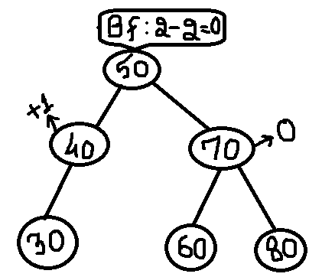
AVL Tree
An empty binary tree will always be an AVL tree
A non-empty binary tree T is an AVL iff the balance factor of all the nodes in tree <= 1 and >= -1 (i.e. it is either -1 , 0 or 1)
BALANCE FACTOR , BF = H(left subtree) – H(right subtree)
  H(left subtree) : height of left subtree
Searching in AVL is similar to that in
BST

Slide 5
Insertion in AVL Tree
Insertion in AVL is done with the help of technique called rotations.
If after insertion of the element, the BF of any node in tree is affected s.t. it renders the BST unbalanced, we apply this technique “rotations” to restore the balance of the search tree.
Rule for performing rotation :
To perform rotation , first, identify a specific node A whose BF is : 0, 1 or -1 and which is nearest ancestor to the inserted node.
Types of rotation:
LL rotation: inserted node is in the left subtree of left subtree of node A.
RR rotation: inserted node is in the right subtree of right subtree of node A.
LR rotation: inserted node is in the right subtree of left subtree of node A.
RL rotation: inserted node is in the left subtree of right subtree of node A.

Slide 6
Example – LL rotation
BF: 2
A
50
50
Insert 30
BF: 1
40
40
30

Slide 7
Example – RR rotation
A
50
BF: -2
50
Insert 70
BF: -1
60
60
70

Slide 8
Example – LR rotation
BF: 2
A
70
70
Insert 60
BF: 1
50
50
60

Slide 9
Example – RL rotation
A
60
BF: -2
60
Insert 70
BF: -1
90
90
70

Slide 10
Find node A and the type of rotation
50
insert 80
40
60
70

Slide 11
Rule for applying rotation
LL and RR rotation: identify A and B then make A as a child of B.
LR and RL rotation: identify A, B and C then make A and B child of C
LR and RL are also known as double rotation because
  LR – combination of RR followed by LL rotation
  RL - combination of LL followed by RR rotation

Slide 12
Example – LL rotation
BF: 2
BF: 0
50
A
40
50
Insert 30
BF: 1
40
40
30
50
B
30

Slide 13
Example – RR rotation
BF: -2
A
50
60
50
Insert 70
B
60
BF: -1
50
70
60
70

Slide 14
Example – LR rotation
A
BF: -2
70
70
60
Insert 60
BF: -1
50
B
50
50
70
C
60

Slide 15
Example – RL rotation
BF: -2
60
A
60
70
BF: -1
Insert 70
90
B
90
C
60
90
70

Slide 16
Find node A and the type of rotation
50
insert 80
40
60
70

Slide 17
Examples:
Insert the following into a balanced AVL tree :
  12 5 15 14 16 17
  60 25 75 20 50 66 33 44
  5 7 19 12 10 15 18 20 25 23

Slide 18
Deletion in AVL Trees
Rules:
Find node A after deletion
If deletion is done on right subtree of A, identify root of left subtree of A and calculate bf of root
  if bf = 0 or 1, go for LL rotation else for LR rotation(bf=-1)
If deletion is done on left subtree of A, identify root of right subtree of A and calculate bf of root
  if bf = 0 or -1, go for RR rotation else for RL rotation(bf=1)
Names of rotation with respect to deletion and balance factor:
bf of root Deletion | 0 | 1 | -1
Right subtree | R0 (LL) | R1 (LL) | R-1 (LR)
Left subtree | L0 (RR) | L1 (RL) | L-1 (RR)

Slide 19
Example 1:
5
5
Node A
3
8
Delete 4
3
8
Del in right subtree
Root Node bf: 1
7
10
LL
7
10
2
4
2
1
6
9
11
1
6
9
11

Slide 20
Tree after Rotation
5
2
8
1
3
7
10
6
9
11

