Slide 1
Complexity Analysis

Slide 2
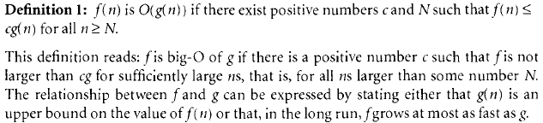
Big – O notation
It is most commonly used notation for specifying asymptotic complexity i.e rate of function growth.
It refers to upper bound of functions.
For example:
lim n->∞ f(n) / g(n) = c //`c closer to 0`

Slide 3
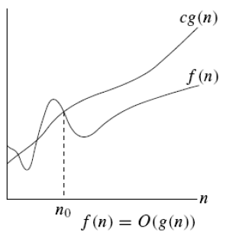
Graph for O Notation

Slide 4
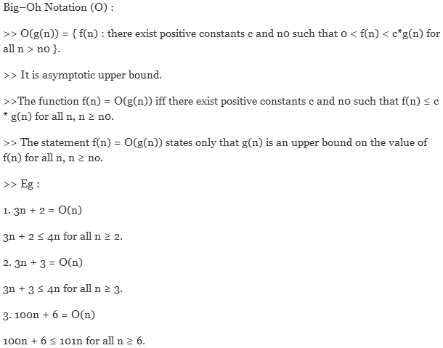

Slide 5
Basic rules for finding Big - O
1. Nested loops are multiplied together. 2. Sequential loops are added. 3. Only the largest term is kept, all others are dropped. 4. Constants are dropped. 5. Conditional checks are constant (i.e. 1).

Slide 6
Example 1
//linear
for(int i = 0; i < n; i++) {
cout << i << endl;
}

Slide 7
Ans: O(n)

Slide 8
Example 2
//quadratic
for(int i = 0; i < n; i++) {
for(int j = 0; j < n; j++){
//do swap stuff, constant time
}
}

Slide 9
Ans O(n^2)

Slide 10
Example 3
//quadratic
for(int i = 0; i < n; i++) {
for(int j = 0; j < i; j++){
//do swap stuff, constant time
}
}

Slide 11
Ans: (n(n+1)/2). This is still in the bound of O(n^2)

Slide 12
Example 4
for(int i = 0; i < 2*n; i++) {
cout << i << endl;
}

Slide 13
At first you might say that the upper bound is O(2n); however, we drop constants so it becomes O(n)

Slide 14
Example 5
//linear
for(int i = 0; i < n; i++) {
cout << i << endl;
}
//quadratic
for(int i = 0; i < n; i++) {
for(int j = 0; j < i; j++){
//do constant time stuff
}
}

Slide 15
Ans : In this case we add each loop's Big O, in this case n+n^2. O(n^2+n) is not an acceptable answer since we must drop the lowest term. The upper bound is O(n^2). Why? Because it has the largest growth rate

Slide 16
Example 6
for(int i = 0; i < n; i++) {
for(int j = 0; j < 2; j++){
//do stuff
}
}

Slide 17
Ans: Outer loop is 'n', inner loop is 2, this we have 2n, dropped constant gives up O(n)

Slide 18
Example 7
for(int i = 1; i < n; i *= 2) {
cout << i << endl;
}

Slide 19
There are n iterations, however, instead of simply incrementing, 'i' is increased by 2*itself each run. Thus the loop is log(n).

Slide 20
Example 8
for(int i = 0; i < n; i++) { //linear
for(int j = 1; j < n; j *= 2){ // log (n)
//do constant time stuff
}
}

Slide 21
Ans: n*log(n)

Slide 22
Examples
3 * n² + n/2 + 12 ∈ O(n²)
4*n*log₂(3*n+1) + 2*n-1 ∈ O(n * log n)

Slide 23
Typical Complexities
Complexity | Notation | Description
constant | O(1) | Constant number of operations, not depending on the input data size, e.g. n = 1 000 000 → 1-2 operations
logarithmic | O(log n) | Number of operations propor-tional of log₂(n) where n is the size of the input data, e.g. n = 1 000 000 000 → 30 operations
linear | O(n) | Number of operations proportional to the input data size, e.g. n = 10 000 → 5 000 operations

Slide 24
Typical Complexities
Complexity | Notation | Description
quadratic | O(n²) | Number of operations proportional to the square of the size of the input data, e.g. n = 500 → 250 000 operations
cubic | O(n³) | Number of operations propor-tional to the cube of the size of the input data, e.g. n = 200 → 8 000 000 operations
exponential | O(2^{n}), O(k^{n}), O(n!) | Exponential number of operations, fast growing, e.g. n = 20 → 1 048 576 operations

Slide 25
Time Complexity and Speed
Complexity | 10 | 20 | 50 | 100 | 1 000 | 10 000 | 100 000
O(1) | < 1 s | < 1 s | < 1 s | < 1 s | < 1 s | < 1 s | < 1 s
O(log(n)) | < 1 s | < 1 s | < 1 s | < 1 s | < 1 s | < 1 s | < 1 s
O(n) | < 1 s | < 1 s | < 1 s | < 1 s | < 1 s | < 1 s | < 1 s
O(n*log(n)) | < 1 s | < 1 s | < 1 s | < 1 s | < 1 s | < 1 s | < 1 s
O(n²) | < 1 s | < 1 s | < 1 s | < 1 s | < 1 s | 2 s | 3-4 min
O(n³) | < 1 s | < 1 s | < 1 s | < 1 s | 20 s | 5 hours | 231 days
O(2^{n}) | < 1 s | < 1 s | 260 days | hangs | hangs | hangs | hangs
O(n!) | < 1 s | hangs | hangs | hangs | hangs | hangs | hangs
O(n^{n}) | 3-4 min | hangs | hangs | hangs | hangs | hangs | hangs

Slide 26
Practical Examples
O(n): printing a list of n items to the screen, looking at each item once.
O(log n): taking a list of items, cutting it in half repeatedly until there's only one item left.
O(n^2): taking a list of n items, and comparing every item to every other item.

Slide 27
How to determine Complexities Example 1
Sequence of statements
statement 1;
statement 2;
...
statement k;
total time = time(statement 1) + time(statement 2) + ... + time(statement k)
If each statement is "simple" (only involves basic operations) then the time for each statement is constant and the total time is also constant: O(1).

Slide 28
Example 2
if-then-else statements
if (condition)
{
sequence of statements 1
}
else
{
sequence of statements 2
}
Here, either sequence 1 will execute, or sequence 2 will execute.
Therefore, the worst-case time is the slowest of the two possibilities: max(time(sequence 1), time(sequence 2)).
For example, if sequence 1 is O(N) and sequence 2 is O(1) the worst-case time for the whole if-then-else statement would be O(N).

Slide 29
Example 3
for loops
for (i = 0; i < N; i++)
{
sequence of statements
}
The loop executes N times, so the sequence of statements also executes N times.
Since we assume the statements are O(1), the total time for the for loop is N * O(1), which is O(N) overall.

Slide 30
Example 4
for (i = 0; i < N; i++)
{
for (j = 0; j < M; j++)
{
sequence of statements ;
}
}
The outer loop executes N times. Every time the outer loop executes, the inner loop executes M times. As a result, the statements in the inner loop execute a total of N * M times. Thus, the complexity is O(N * M).
In a common special case where the stopping condition of the inner loop is j < N instead of j < M (i.e., the inner loop also executes N times), the total complexity for the two loops is O(N²).

Slide 31
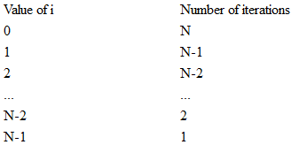
Example 5
for (i = 0; i < N; i++)
{
for (j = i+1; j < N; j++)
{
sequence of statements;
}
}
So we can see that the total number of times the sequence of statements executes is: N + N-1 + N-2 + ... + 3 + 2 + 1.
We've seen that formula before: the total is O(N²).

Slide 32
Complexity Examples
int FindMaxElement(int array[])
{
int max = array[0];
for (int i=0; i<n; i++)
{
if (array[i] > max)
{
max = array[i];
}
}
return max;
}
Runs in O(n) where n is the size of the array
The number of elementary steps is ~ n

Slide 33
Complexity Examples (2)
long FindInversions(int array[])
{
long inversions = 0;
for (int i=0; i<n; i++)
for (int j = i+1; j<n; i++)
if (array[i] > array[j])
inversions++;
return inversions;
}
Runs in O(n²) where n is the size of the array
The number of elementary steps is ~ n*(n+1) / 2

Slide 34
Complexity Examples (3)
decimal Sum3(int n)
{
decimal sum = 0;
for (int a=0; a<n; a++)
for (int b=0; b<n; b++)
for (int c=0; c<n; c++)
sum += a*b*c;
return sum;
}
Runs in cubic time O(n³)
The number of elementary steps is ~ n³

Slide 35
Complexity Examples (4)
long SumMN(int n, int m)
{
long sum = 0;
for (int x=0; x<n; x++)
for (int y=0; y<m; y++)
sum += x*y;
return sum;
}
Runs in quadratic time O(n*m)
The number of elementary steps is ~ n*m

Slide 36
Complexity Examples (5)
long SumMN(int n, int m)
{
long sum = 0;
for (int x=0; x<n; x++)
for (int y=0; y<m; y++)
if (x==y)
for (int i=0; i<n; i++)
sum += i*x*y;
return sum;
}
Runs in quadratic time O(n*m)
The number of elementary steps is
~ n*m + min(m,n)*n

Slide 37
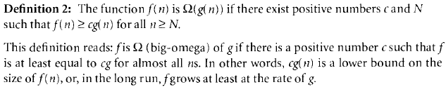
Big - Ω notation
It refers to lower bound of functions.
Example :
5n^2 is Ω(n) because 5n^2 ≥ 5n for n ≥ 1.
lim n->∞ f(n) / g(n) = c //`c closer to ∞`

Slide 38
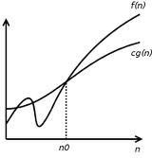
Graph for Omega Notation

Slide 39
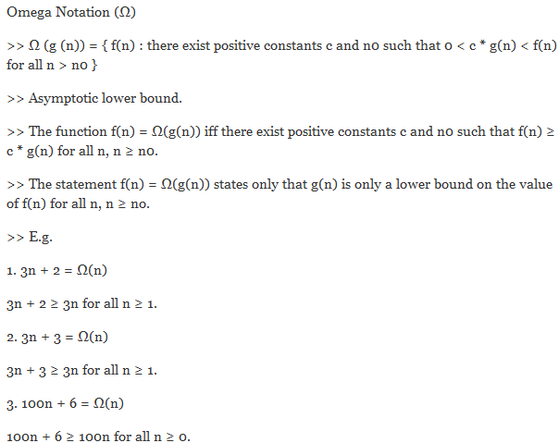

Slide 40
Ө notation
It refers to tight bound of functions.
Informally, if f(n) is Θ(g(n)) then both the functions have the same rate of increase.
Example:
The same rate of increase for
f(n) = n + 5n^0.5 and g(n) = n
because
n ≤ (n + 5n^0.5) ≤ 6n for n > 1

Slide 41
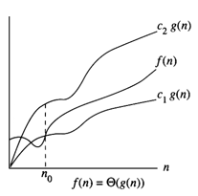
Theta notation

Slide 42
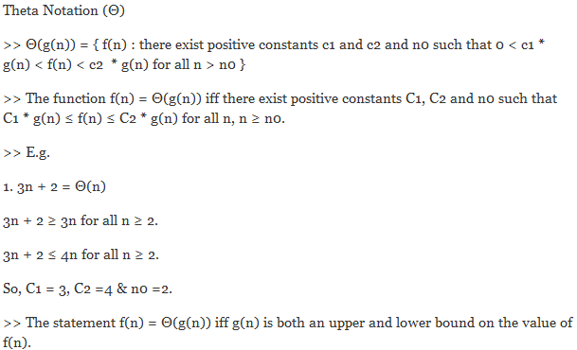

Slide 43
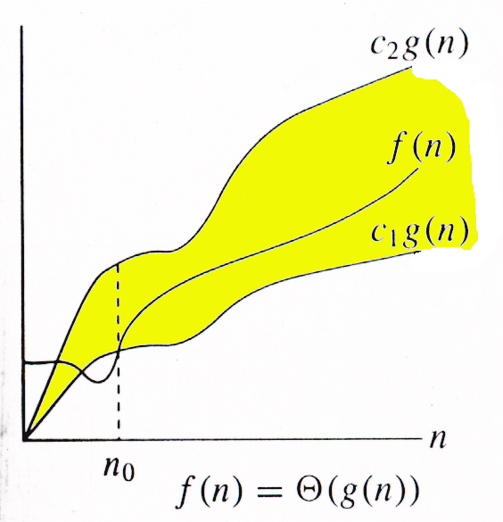
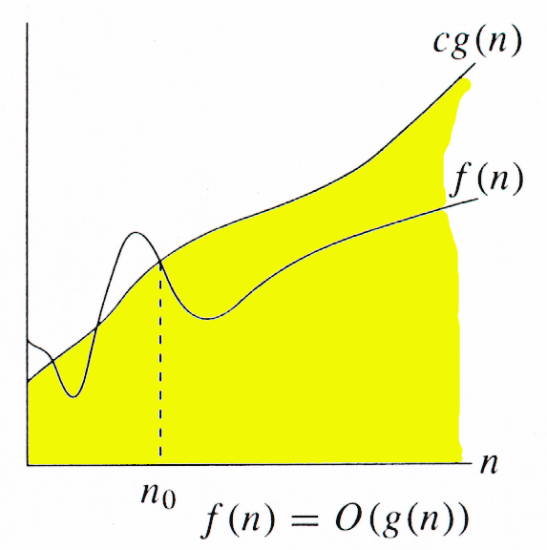
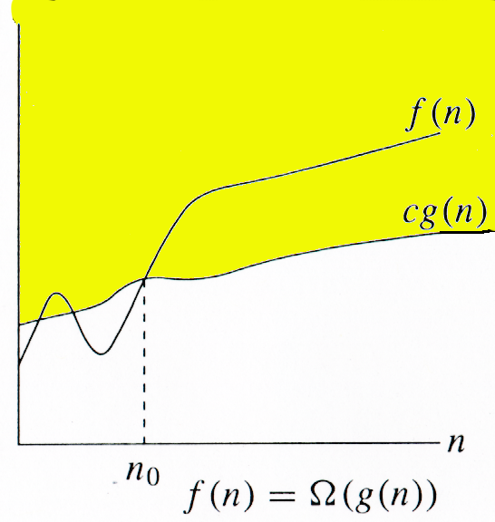
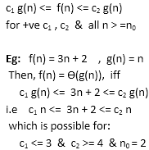
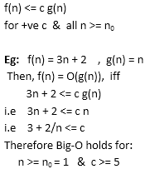
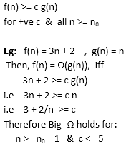
Relations Between Θ, O, Ω

Slide 44
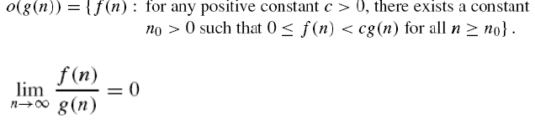
Little-o notation
The function f(n) is o(g(n)) if for any real constant c > 0, there exist an integer constant n₀ >=1 such that f(n) < c*g(n) for every integer n >= n₀

Slide 45

Little-omega notation
The function f(n) is ω(g(n)) if for any real constant c > 0, there exist an integer constant n₀ >=1 such that f(n) > c*g(n) for every integer n >= n₀

