Slide 1
Complexity Analysis

Slide 2
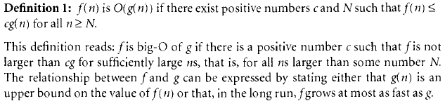
Big – O notation
It is most commonly used notation for specifying asymptotic complexity i.e rate of function growth.
It refers to upper bound of functions.
For example:

Slide 3
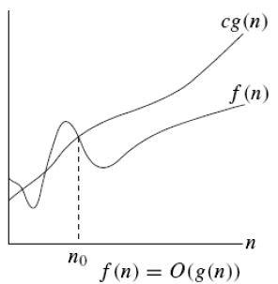
Graph for O Notation

Slide 4
Basic rules for finding Big - O
1. Nested loops are multiplied together.
2. Sequential loops are added.
3. Only the largest term is kept, all others are dropped.
4. Constants are dropped.
5. Conditional checks are constant (i.e. 1).

Slide 5
Example 1
//linear
for(int i = 0; i < n; i++) {
cout << i << endl;
}

Slide 6
Ans: O(n)

Slide 7
Example 2
//quadratic
for(int i = 0; i < n; i++) {
for(int j = 0; j < n; j++){
//do swap stuff, constant time
}
}

Slide 8
Ans O(n^2)

Slide 9
Example 3
//quadratic
for(int i = 0; i < n; i++) {
for(int j = i+1; j < n; j++){
//do swap stuff, constant time
}
}

Slide 10
Ans: (n(n+1)/2). This is still in the bound of O(n^2)

Slide 11
Example 4
for(int i = 0; i < 2*n; i++) {
cout << i << endl;
}

Slide 12
At first you might say that the upper bound is O(2n); however, we drop constants so it becomes O(n)

Slide 13
Example 5
//linear
for(int i = 0; i < n; i++) {
cout << i << endl;
}
//quadratic
for(int i = 0; i < n; i++) {
for(int j = 0; j < i; j++){
//do constant time stuff
}
}

Slide 14
Ans : In this case we add each loop's Big O, in this case n+n^2. O(n^2+n) is not an acceptable answer since we must drop the lowest term. The upper bound is O(n^2). Why? Because it has the largest growth rate

Slide 15
Example 6
for(int i = 0; i < n; i++) {
for(int j = 0; j < 2; j++){
//do stuff
}
}

Slide 16
Ans: Outer loop is 'n', inner loop is 2, this we have 2n, dropped constant gives up O(n)

Slide 17
Example 7
for(int i = 1; i < n; i *= 2) {
cout << i << endl;
}

Slide 18
There are n iterations, however, instead of simply incrementing, 'i' is increased by 2*itself each run. Thus the loop is log(n).

Slide 19
Example 8
for(int i = 0; i < n; i++) { //linear
for(int j = 1; j < n; j *= 2){ // log (n)
//do constant time stuff
}
}

Slide 20
Ans: n*log(n)

Slide 21
Examples
  3 * n² + n/2 + 12 ∈ O(n²)
  4*n*log₂(3*n+1) + 2*n-1 ∈ O(n * log n)

Slide 22
Typical Complexities
Complexity | Notation | Description
constant | O(1) | Constant number of operations, not depending on the input data size, e.g. n = 1 000 000 → 1-2 operations
logarithmic | O(log n) | Number of operations propor-tional of log₂(n) where n is the size of the input data, e.g. n = 1 000 000 000 → 30 operations
linear | O(n) | Number of operations proportional to the input data size, e.g. n = 10 000 → 5 000 operations

Slide 23
Typical Complexities
Complexity | Notation | Description
quadratic | O(n²) | Number of operations proportional to the square of the size of the input data, e.g. n = 500 → 250 000 operations
cubic | O(n³) | Number of operations propor-tional to the cube of the size of the input data, e.g. n = 200 → 8 000 000 operations
exponential | O(2^{n}), O(k^{n}), O(n!) | Exponential number of operations, fast growing, e.g. n = 20 → 1 048 576 operations

Slide 24
Time Complexity and Speed
Complexity | 10 | 20 | 50 | 100 | 1 000 | 10 000 | 100 000
O(1) | < 1 s | < 1 s | < 1 s | < 1 s | < 1 s | < 1 s | < 1 s
O(log(n)) | < 1 s | < 1 s | < 1 s | < 1 s | < 1 s | < 1 s | < 1 s
O(n) | < 1 s | < 1 s | < 1 s | < 1 s | < 1 s | < 1 s | < 1 s
O(n*log(n)) | < 1 s | < 1 s | < 1 s | < 1 s | < 1 s | < 1 s | < 1 s
O(n²) | < 1 s | < 1 s | < 1 s | < 1 s | < 1 s | 2 s | 3-4 min
O(n³) | < 1 s | < 1 s | < 1 s | < 1 s | 20 s | 5 hours | 231 days
O(2^{n}) | < 1 s | < 1 s | 260 days | hangs | hangs | hangs | hangs
O(n!) | < 1 s | hangs | hangs | hangs | hangs | hangs | hangs
O(n^{n}) | 3-4 min | hangs | hangs | hangs | hangs | hangs | hangs

Slide 25
How to determine Complexities
Example 1
Sequence of statements
statement 1;
statement 2;
...
statement k;
total time = time(statement 1) + time(statement 2) + ... + time(statement k)
If each statement is "simple" (only involves basic operations) then the time for each statement is constant and the total time is also constant: O(1).

Slide 26
Example 2
if-then-else statements
if (condition)
{
  sequence of statements 1
  }
else
{
  sequence of statements 2
  }
Here, either sequence 1 will execute, or sequence 2 will execute.
Therefore, the worst-case time is the slowest of the two possibilities: max(time(sequence 1), time(sequence 2)).
For example, if sequence 1 is O(N) and sequence 2 is O(1) the worst-case time for the whole if-then-else statement would be O(N).

Slide 27
Example 3
for loops
for (i = 0; i < N; i++)
{
sequence of statements
}
The loop executes N times, so the sequence of statements also executes N times.
Since we assume the statements are O(1), the total time for the for loop is N * O(1), which is O(N) overall.

Slide 28
Example 4
for (i = 0; i < N; i++)
{
for (j = 0; j < M; j++)
{
sequence of statements ;
}
}
The outer loop executes N times. Every time the outer loop executes, the inner loop executes M times. As a result, the statements in the inner loop execute a total of N * M times. Thus, the complexity is O(N * M).
In a common special case where the stopping condition of the inner loop is j < N instead of j < M (i.e., the inner loop also executes N times), the total complexity for the two loops is O(N²).

Slide 29
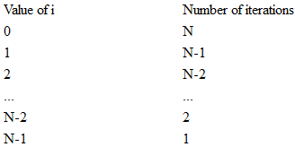
Example 5
for (i = 0; i < N; i++)
{
for (j = i+1; j < N; j++)
{
sequence of statements;
}
}
So we can see that the total number of times the sequence of statements executes is: N + N-1 + N-2 + ... + 3 + 2 + 1.
We've seen that formula before: the total is O(N²).

Slide 30
Complexity Examples
int FindMaxElement(int array[])
{
int max = array[0];
for (int i=0; i<n; i++)
{
if (array[i] > max)
{
max = array[i];
}
}
return max;
}
Runs in O(n) where n is the size of the array
The number of elementary steps is ~ n
Notes:
(c) 2005 National Academy for Software Development - http://academy.devbg.org. All rights reserved. Unauthorized copying or re-distribution is strictly prohibited.*
<number>##

Slide 31
Complexity Examples (2)
long FindInversions(int array[])
{
long inversions = 0;
for (int i=0; i<n; i++)
for (int j = i+1; j<n; i++)
if (array[i] > array[j])
inversions++;
return inversions;
}
Runs in O(n²) where n is the size of the array
The number of elementary steps is ~ n*(n+1) / 2
Notes:
(c) 2005 National Academy for Software Development - http://academy.devbg.org. All rights reserved. Unauthorized copying or re-distribution is strictly prohibited.*
<number>##

Slide 32
Complexity Examples (3)
decimal Sum3(int n)
{
decimal sum = 0;
for (int a=0; a<n; a++)
for (int b=0; b<n; b++)
for (int c=0; c<n; c++)
sum += a*b*c;
return sum;
}
Runs in cubic time O(n³)
The number of elementary steps is ~ n³
Notes:
(c) 2005 National Academy for Software Development - http://academy.devbg.org. All rights reserved. Unauthorized copying or re-distribution is strictly prohibited.*
<number>##

Slide 33
Complexity Examples (4)
long SumMN(int n, int m)
{
long sum = 0;
for (int x=0; x<n; x++)
for (int y=0; y<m; y++)
sum += x*y;
return sum;
}
Runs in quadratic time O(n*m)
The number of elementary steps is ~ n*m
Notes:
(c) 2005 National Academy for Software Development - http://academy.devbg.org. All rights reserved. Unauthorized copying or re-distribution is strictly prohibited.*
<number>##

Slide 34
Complexity Examples (5)
long SumMN(int n, int m)
{
long sum = 0;
for (int x=0; x<n; x++)
for (int y=0; y<m; y++)
if (x==y)
for (int i=0; i<n; i++)
sum += i*x*y;
return sum;
}
Runs in quadratic time O(n*m)
The number of elementary steps is
~ n*m + min(m,n)*n
Notes:
(c) 2005 National Academy for Software Development - http://academy.devbg.org. All rights reserved. Unauthorized copying or re-distribution is strictly prohibited.*
<number>##

Slide 35
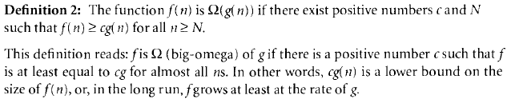
Big - Ω notation
It refers to lower bound of functions.
Example :
  5n2 is Ω(n) because 5n2 ≥ 5n for n ≥ 1.

Slide 36
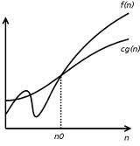
Graph for Omega Notation

Slide 37
Ө notation
It refers to tight bound of functions.
Informally, if f(n) is Θ(g(n)) then both the functions have the same rate of increase.
Example:
  The same rate of increase for
  f(n) = n + 5n0.5 and g(n) = n
  because
  n ≤ (n + 5n0.5) ≤ 6n for n > 1

Slide 38
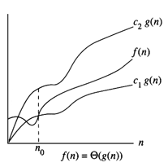
Theta notation

Slide 39



Relations Between Θ, O, Ω

Slide 40

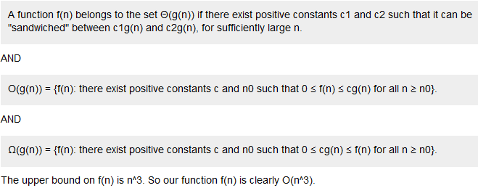
Big O vs. Big - Ω vs. Ө notation
(Example 1)

Slide 41
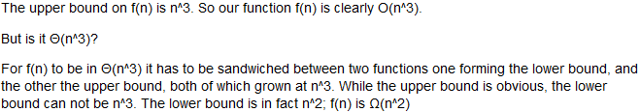


Slide 42
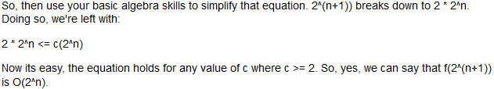
Big O vs. Big - Ω vs. Ө notation
(Example 2)

Slide 43
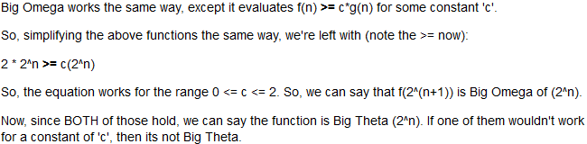

Slide 44
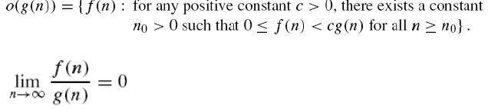
Little-o notation

Slide 45
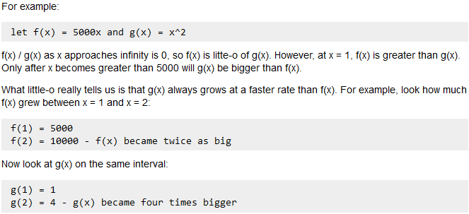

Slide 46

Little-omega notation

