Slide 1
TREES

Slide 2
A tree is a hiearchical structure .
Collection of nodes or Finite set of nodes This collection can be empty Nodes and Edges.

Slide 3
TREE TERMINOLOGY
NODE:A node is the key component of the tree data structure that stores the data element and may contain zero,one or more link to other sucessor node for connectivity. A tree consist of finite set of nodes.
EDGE or LINK: A directed line from one node to the other successor node is called edge of the tree.
It is also known as link or arc or branch of a tree.
A tree consists of a finite set of edges that connects node.

Slide 4
PARENT: The immediate predecessor of a node is called its parent.All the nodes except the root node have exactly one parent.
CHILD: All the immediate successors of a node are known as its child. If a node has two child then one on the left is called left child and other on the right is called right child.
SIBLING: Two or more nodes with same parents are called siblings.
ROOT: The topmost node of the tree is called the root of the tree.One can reach any node of the tree from the root node by following the edges.

Slide 5
LEAF: The node that does not have any child node is called leaf node.
PATH: A path is a result in sequence of nodes when we traverse from a node to a node along the edges that connect them. There is always a unique path from the root to any other node in a tree.
LEVEL: The level of the node is an integer value that measures the distance of a node from the root.As the root is at zero distance from itself so it is at level 0.
DEGREE: The maximum number of children that are possible for a node is known as degree ,like in binary tree max 2 children can be there so degree is 2

Slide 6
DEPTH: The depth of a node is the length(number of edges) of the path from the root to the node of the tree.
Depth of the node is sometimes also referred to the level of a node.
HEIGHT: The height of a tree is the length (number of edges) of the path from the node to its furthest leaf .

Slide 7
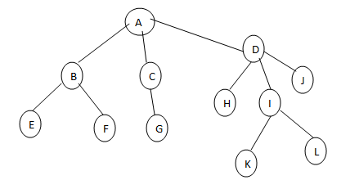
Example

Slide 8
Answer the following questions:
Find the parent of node F, sibling of node H, child of node D.
Identify the longest path in the tree.
Identify the level of node C, I
Find the degree of tree.
Find the height of the root.

Slide 9
Solutions:
Parent of node F is B, Sibling of node H are I and J. Children of node D are H,I,J.
The longest path comprises the path from node A to node K and node A to node L.
Level of node C is 1 and level of node I is 2.
As the maximum number of children possible for a node in the given tree is 3 so its degree is 3.
The height of the tree is the height of the node which is 3.

