Slide 1
Entity-Relationship Model
Entity Sets
Relationship Sets
Design Issues
Mapping Constraints
Keys
E-R Diagram
Extended E-R Features
Design of an E-R Database Schema
Reduction of an E-R Schema to Tables

Slide 2
Entity Sets
A database can be modeled as:
  a collection of entities,
  relationship among entities.
An entity is an object that exists and is distinguishable from other objects.
  Example: specific person, company, event, plant
Entities have attributes
  Example: people have names and addresses
An entity set is a set of entities of the same type that share the same properties.
  Example: set of all persons, companies, trees, holidays

Slide 3
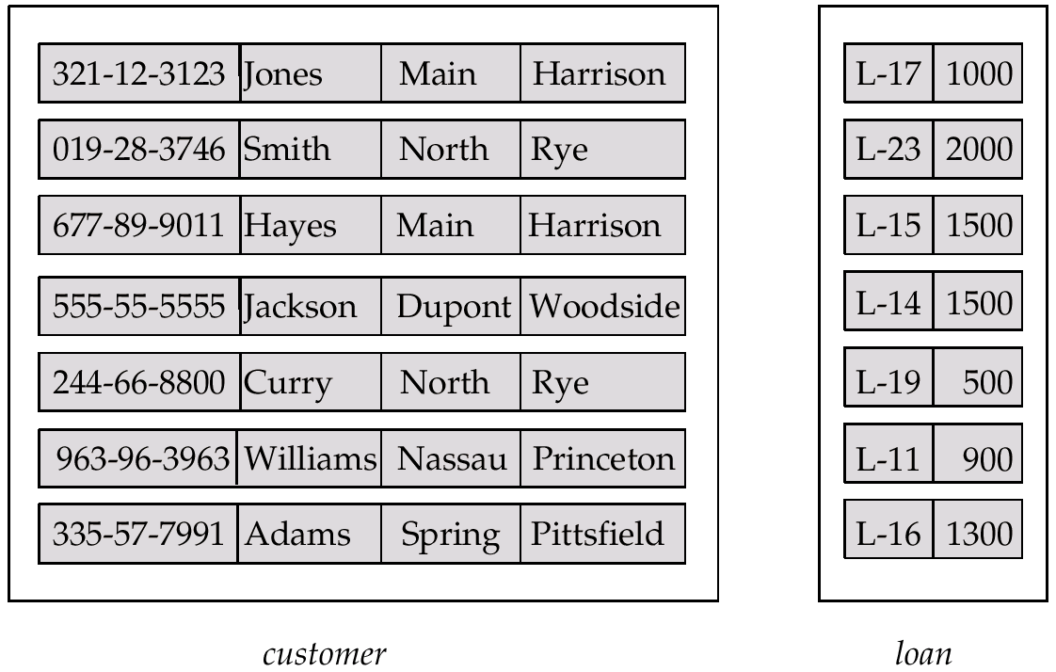
Entity Sets customer and loan
customer-id customer- customer- customer- loan- amount
name street city number

Slide 4
Attributes
An entity is represented by a set of attributes, that is descriptive properties possessed by all members of an entity set.
Domain – the set of permitted values for each attribute
Attribute types:
  Simple and composite attributes.
  Single-valued and multi-valued attributes
    E.g. multivalued attribute: phone-numbers
  Derived attributes
    Can be computed from other attributes
    E.g. age, given date of birth
Example:
customer = (customer-id, customer-name, customer-street, customer-city)
loan = (loan-number, amount)

Slide 5

Composite Attributes

Slide 6
Relationship Sets
A relationship is an association among several entities
Example:
Hayes depositor A-102
customer entity relationship set account entity
A relationship set is a mathematical relation among n ≥ 2 entities, each taken from entity sets
{(e₁, e₂, … e_{n}) | e₁ ∈ E₁, e₂ ∈ E₂, …, e_{n} ∈ E_{n}}
where (e₁, e₂, …, e_{n}) is a relationship
  Example:
  (Hayes, A-102) ∈ depositor

Slide 7

Relationship Set borrower

Slide 8

Relationship Sets (Cont.)
An attribute can also be property of a relationship set.
For instance, the depositor relationship set between entity sets customer and account may have the attribute access-date

Slide 9
Degree of a Relationship Set
Refers to number of entity sets that participate in a relationship set.
Relationship sets that involve two entity sets are binary (or degree two). Generally, most relationship sets in a database system are binary.
Relationship sets may involve more than two entity sets.
Relationships between more than two entity sets are rare. Most relationships are binary. (More on this later.)
  E.g. Suppose employees of a bank may have jobs (responsibilities) at multiple branches, with different jobs at different branches. Then there is a ternary relationship set between entity sets employee, job and branch

Slide 10
Mapping Cardinalities
Express the number of entities to which another entity can be associated via a relationship set.
Most useful in describing binary relationship sets.
For a binary relationship set the mapping cardinality must be one of the following types:
  One to one
  One to many
  Many to one
  Many to many

Slide 11

Mapping Cardinalities
One to one
One to many
Note: Some elements in A and B may not be mapped to any
elements in the other set

Slide 12

Mapping Cardinalities
Many to one
Many to many
Note: Some elements in A and B may not be mapped to any
elements in the other set

Slide 13
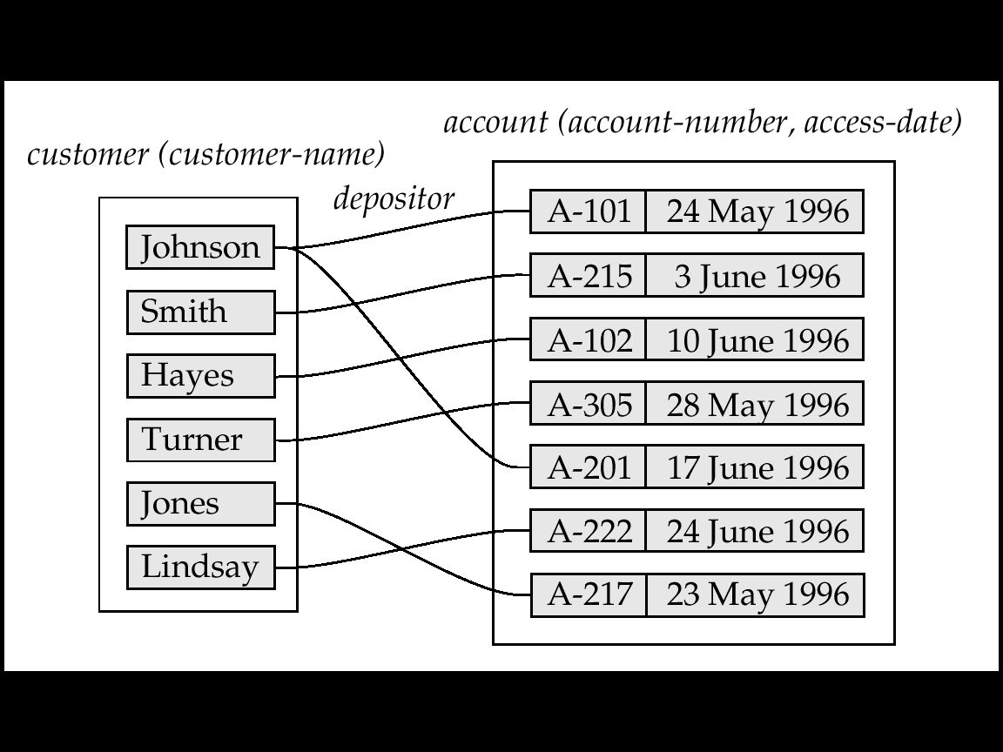
Mapping Cardinalities affect ER Design
Can make access-date an attribute of account, instead of a relationship attribute, if each account can have only one customer
  I.e., the relationship from account to customer is many to one, or equivalently, customer to account is one to many

Slide 14

E-R Diagrams
Rectangles represent entity sets.
Diamonds represent relationship sets.
Lines link attributes to entity sets and entity sets to relationship sets.
Ellipses represent attributes
  Double ellipses represent multivalued attributes.
  Dashed ellipses denote derived attributes.
Underline indicates primary key attributes (will study later)

Slide 15

E-R Diagram With Composite, Multivalued, and Derived Attributes

Slide 16

Relationship Sets with Attributes

Slide 17

Roles
Entity sets of a relationship need not be distinct
The labels “manager” and “worker” are called roles; they specify how employee entities interact via the works-for relationship set.
Roles are indicated in E-R diagrams by labeling the lines that connect diamonds to rectangles.
Role labels are optional, and are used to clarify semantics of the relationship

Slide 18

Cardinality Constraints
We express cardinality constraints by drawing either a directed line (→), signifying “one,” or an undirected line (—), signifying “many,” between the relationship set and the entity set.
E.g.: One-to-one relationship:
  A customer is associated with at most one loan via the relationship borrower
  A loan is associated with at most one customer via borrower

Slide 19


Slide 20
One-To-Many Relationship
In the one-to-many relationship a loan is associated with at most one customer via borrower, a customer is associated with several (including 0) loans via borrower

Slide 21
Many-To-One Relationships
In a many-to-one relationship a loan is associated with several (including 0) customers via borrower, a customer is associated with at most one loan via borrower

Slide 22
Many-To-Many Relationship
A customer is associated with several (possibly 0) loans via borrower
A loan is associated with several (possibly 0) customers via borrower

Slide 23

Participation of an Entity Set in a Relationship Set
Total participation (indicated by double line): every entity in the entity set participates in at least one relationship in the relationship set
  E.g. participation of loan in borrower is total
    every loan must have a customer associated to it via borrower
Partial participation: some entities may not participate in any relationship in the relationship set
  E.g. participation of customer in borrower is partial

Slide 24
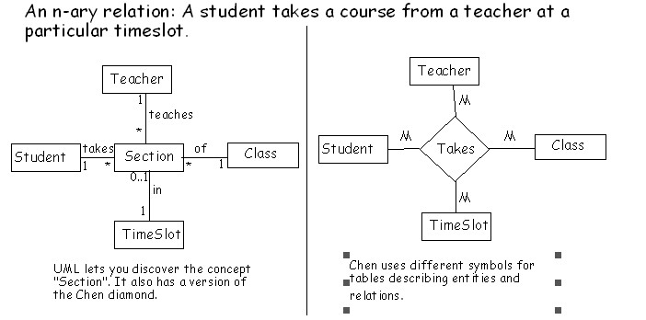

Slide 25

Alternative Notation for Cardinality Limits
Cardinality limits can also express participation constraints

Slide 26
Keys
A super key of an entity set is a set of one or more attributes whose values uniquely determine each entity.
A candidate key of an entity set is a minimal super key
  Customer-id is candidate key of customer
  account-number is candidate key of account
Although several candidate keys may exist, one of the candidate keys is selected to be the primary key.

Slide 27
Keys for Relationship Sets
The combination of primary keys of the participating entity sets forms a super key of a relationship set.
  (customer-id, account-number) is the super key of depositor
  NOTE: this means a pair of entity sets can have at most one relationship in a particular relationship set.
    E.g. if we wish to track all access-dates to each account by each customer, we cannot assume a relationship for each access. We can use a multivalued attribute though
Must consider the mapping cardinality of the relationship set when deciding the what are the candidate keys
Need to consider semantics of relationship set in selecting the primary key in case of more than one candidate key

Slide 28

E-R Diagram with a Ternary Relationship

Slide 29
Cardinality Constraints on Ternary Relationship
We allow at most one arrow out of a ternary (or greater degree) relationship to indicate a cardinality constraint
E.g. an arrow from works-on to job indicates each employee works on at most one job at any branch.
If there is more than one arrow, there are two ways of defining the meaning.
  E.g a ternary relationship R between A, B and C with arrows to B and C could mean
  1. each A entity is associated with a unique entity from B and C or
  2. each pair of entities from (A, B) is associated with a unique C entity, and each pair (A, C) is associated with a unique B
  Each alternative has been used in different formalisms
  To avoid confusion we outlaw more than one arrow

Slide 30
Binary Vs. Non-Binary Relationships
Some relationships that appear to be non-binary may be better represented using binary relationships
  E.g. A ternary relationship parents, relating a child to his/her father and mother, is best replaced by two binary relationships, father and mother
    Using two binary relationships allows partial information (e.g. only mother being know)
  But there are some relationships that are naturally non-binary
    E.g. works-on

Slide 31

Converting Non-Binary Relationships to Binary Form
In general, any non-binary relationship can be represented using binary relationships by creating an artificial entity set.
  Replace R between entity sets A, B and C by an entity set E, and three relationship sets:
1. R_{A}, relating E and A 2.R_{B}, relating E and B
3. R_{C}, relating E and C
  Create a special identifying attribute for E
  Add any attributes of R to E
  For each relationship (a_{i} , b_{i} , c_{i}) in R, create
1. a new entity e_{i} in the entity set E 2. add (e_{i} , a_{i} ) to R_{A}
3. add (e_{i} , b_{i} ) to R_{B} 4. add (e_{i} , c_{i} ) to R_{C}

Slide 32
Converting Non-Binary Relationships (Cont.)
Also need to translate constraints
  Translating all constraints may not be possible
  There may be instances in the translated schema that
  cannot correspond to any instance of R
    Exercise: add constraints to the relationships R_{A}, R_{B} and R_{C} to ensure that a newly created entity corresponds to exactly one entity in each of entity sets A, B and C
  We can avoid creating an identifying attribute by making E a weak entity set (described shortly) identified by the three relationship sets

Slide 33
Design Issues
Use of entity sets vs. attributes
Choice mainly depends on the structure of the enterprise being modeled, and on the semantics associated with the attribute in question.
Use of entity sets vs. relationship sets
Possible guideline is to designate a relationship set to describe an action that occurs between entities
Binary versus n-ary relationship sets
Although it is possible to replace any nonbinary (n-ary, for n > 2) relationship set by a number of distinct binary relationship sets, a n-ary relationship set shows more clearly that several entities participate in a single relationship.
Placement of relationship attributes

Slide 34
How about doing an ER design interactively on the board?
Suggest an application to be modeled.

Slide 35
Weak Entity Sets
An entity set that does not have a primary key is referred to as a weak entity set.
The existence of a weak entity set depends on the existence of a identifying entity set
  it must relate to the identifying entity set via a total, one-to-many relationship set from the identifying to the weak entity set
  Identifying relationship depicted using a double diamond
The discriminator (or partial key) of a weak entity set is the set of attributes that distinguishes among all the entities of a weak entity set.
The primary key of a weak entity set is formed by the primary key of the strong entity set on which the weak entity set is existence dependent, plus the weak entity set’s discriminator.

Slide 36

Weak Entity Sets (Cont.)
We depict a weak entity set by double rectangles.
We underline the discriminator of a weak entity set with a dashed line.
payment-number – discriminator of the payment entity set
Primary key for payment – (loan-number, payment-number)

Slide 37
Weak Entity Sets (Cont.)
Note: the primary key of the strong entity set is not explicitly stored with the weak entity set, since it is implicit in the identifying relationship.
If loan-number were explicitly stored, payment could be made a strong entity, but then the relationship between payment and loan would be duplicated by an implicit relationship defined by the attribute loan-number common to payment and loan

Slide 38
More Weak Entity Set Examples
In a university, a course is a strong entity and a course-offering can be modeled as a weak entity
The discriminator of course-offering would be semester (including year) and section-number (if there is more than one section)
If we model course-offering as a strong entity we would model course-number as an attribute.
Then the relationship with course would be implicit in the course-number attribute

Slide 39
Specialization
Top-down design process; we designate subgroupings within an entity set that are distinctive from other entities in the set.
These subgroupings become lower-level entity sets that have attributes or participate in relationships that do not apply to the higher-level entity set.
Depicted by a triangle component labeled ISA (E.g. customer “is a” person).
Attribute inheritance – a lower-level entity set inherits all the attributes and relationship participation of the higher-level entity set to which it is linked.

Slide 40

Specialization Example

Slide 41
Generalization
A bottom-up design process – combine a number of entity sets that share the same features into a higher-level entity set.
Specialization and generalization are simple inversions of each other; they are represented in an E-R diagram in the same way.
The terms specialization and generalization are used interchangeably.

Slide 42
Specialization and Generalization (Contd.)
Can have multiple specializations of an entity set based on different features.
E.g. permanent-employee vs. temporary-employee, in addition to officer vs. secretary vs. teller
Each particular employee would be
  a member of one of permanent-employee or temporary-employee,
  and also a member of one of officer, secretary, or teller
The ISA relationship also referred to as superclass - subclass relationship

Slide 43
Design Constraints on a Specialization/Generalization
Constraint on which entities can be members of a given lower-level entity set.
  condition-defined
    E.g. all customers over 65 years are members of senior-citizen entity set; senior-citizen ISA person.
  user-defined
Constraint on whether or not entities may belong to more than one lower-level entity set within a single generalization.
  Disjoint
    an entity can belong to only one lower-level entity set
    Noted in E-R diagram by writing disjoint next to the ISA triangle
  Overlapping
    an entity can belong to more than one lower-level entity set

Slide 44
Design Constraints on a Specialization/Generalization (Contd.)
Completeness constraint -- specifies whether or not an entity in the higher-level entity set must belong to at least one of the lower-level entity sets within a generalization.
  total : an entity must belong to one of the lower-level entity sets
  partial: an entity need not belong to one of the lower-level entity sets

Slide 45
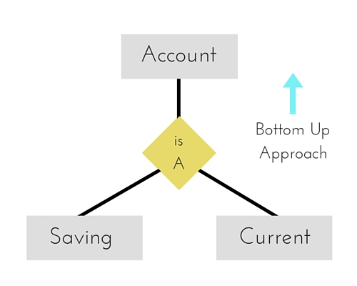
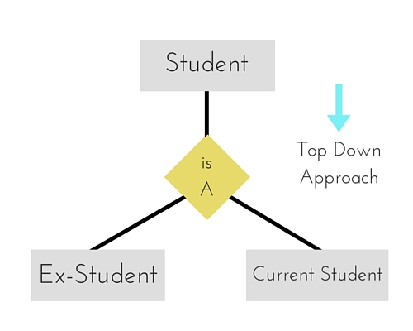

Slide 46
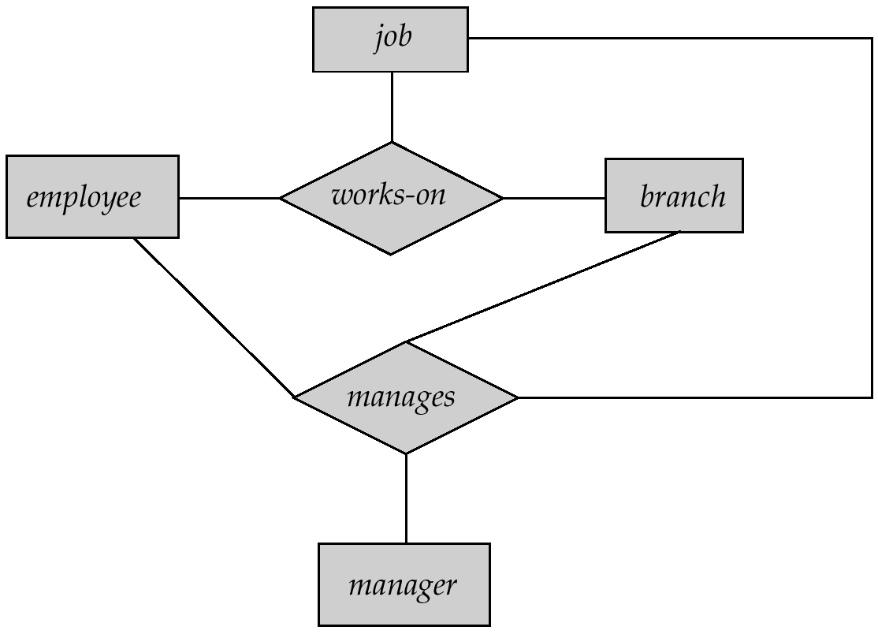
Aggregation
Consider the ternary relationship works-on, which we saw earlier
Suppose we want to record managers for tasks performed by an
employee at a branch

Slide 47
Aggregation (Cont.)
Relationship sets works-on and manages represent overlapping information
  Every manages relationship corresponds to a works-on relationship
  However, some works-on relationships may not correspond to any manages relationships
    So we can’t discard the works-on relationship
Eliminate this redundancy via aggregation
  Treat relationship as an abstract entity
  Allows relationships between relationships
  Abstraction of relationship into new entity
Without introducing redundancy, the following diagram represents:
  An employee works on a particular job at a particular branch
  An employee, branch, job combination may have an associated manager

Slide 48
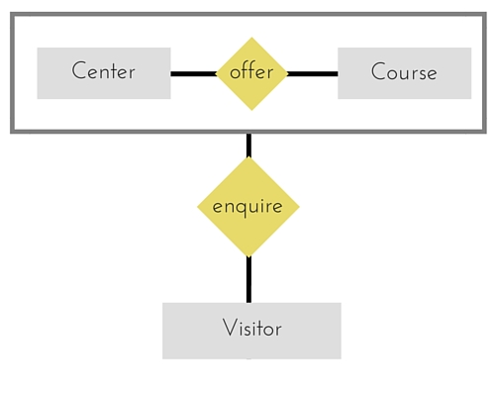

Slide 49

E-R Diagram With Aggregation

Slide 50
E-R Design Decisions
The use of an attribute or entity set to represent an object.
Whether a real-world concept is best expressed by an entity set or a relationship set.
The use of a ternary relationship versus a pair of binary relationships.
The use of a strong or weak entity set.
The use of specialization/generalization – contributes to modularity in the design.
The use of aggregation – can treat the aggregate entity set as a single unit without concern for the details of its internal structure.

Slide 51

E-R Diagram for a Banking Enterprise

Slide 52
How about doing another ER design interactively on the board?

Slide 53

Summary of Symbols Used in E-R Notation

Slide 54
Summary of Symbols (Cont.)

Slide 55

Alternative E-R Notations

Slide 56
UML
UML: Unified Modeling Language
UML has many components to graphically model different aspects of an entire software system
UML Class Diagrams correspond to E-R Diagram, but several differences.

Slide 57
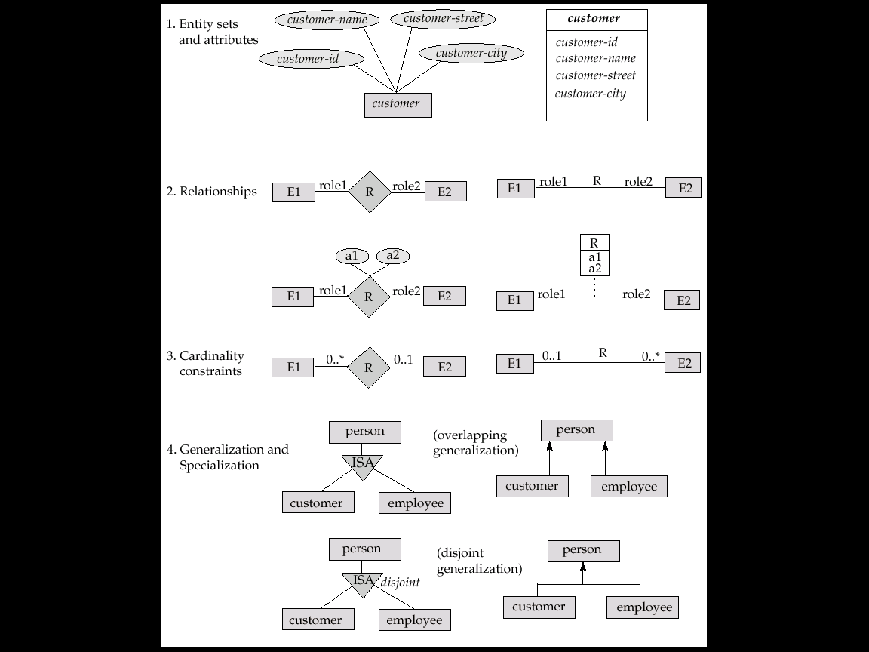
Summary of UML Class Diagram Notation

Slide 58
UML Class Diagrams (Contd.)
Entity sets are shown as boxes, and attributes are shown within the box, rather than as separate ellipses in E-R diagrams.
Binary relationship sets are represented in UML by just drawing a line connecting the entity sets. The relationship set name is written adjacent to the line.
The role played by an entity set in a relationship set may also be specified by writing the role name on the line, adjacent to the entity set.
The relationship set name may alternatively be written in a box, along with attributes of the relationship set, and the box is connected, using a dotted line, to the line depicting the relationship set.
Non-binary relationships drawn using diamonds, just as in ER diagrams

Slide 59
UML Class Diagram Notation (Cont.)
overlapping
disjoint
*Note reversal of position in cardinality constraint depiction
*Generalization can use merged or separate arrows independent
of disjoint/overlapping

Slide 60
UML Class Diagrams (Contd.)
Cardinality constraints are specified in the form l..h, where l denotes the minimum and h the maximum number of relationships an entity can participate in.
Beware: the positioning of the constraints is exactly the reverse of the positioning of constraints in E-R diagrams.
The constraint 0..* on the E2 side and 0..1 on the E1 side means that each E2 entity can participate in at most one relationship, whereas each E1 entity can participate in many relationships; in other words, the relationship is many to one from E2 to E1.
Single values, such as 1 or * may be written on edges; The single value 1 on an edge is treated as equivalent to 1..1, while * is equivalent to 0..*.

Slide 61
Reduction of an E-R Schema to Tables
Primary keys allow entity sets and relationship sets to be expressed uniformly as tables which represent the contents of the database.
A database which conforms to an E-R diagram can be represented by a collection of tables.
For each entity set and relationship set there is a unique table which is assigned the name of the corresponding entity set or relationship set.
Each table has a number of columns (generally corresponding to attributes), which have unique names.
Converting an E-R diagram to a table format is the basis for deriving a relational database design from an E-R diagram.

Slide 62
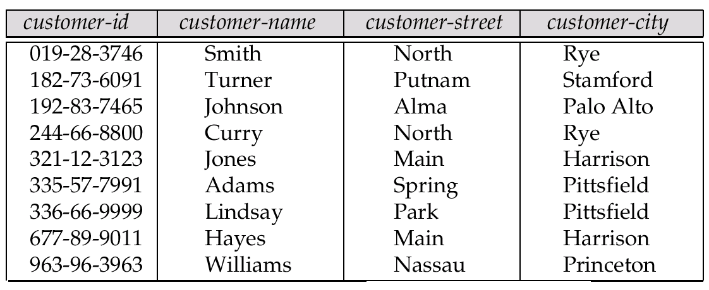
Representing Entity Sets as Tables
A strong entity set reduces to a table with the same attributes.

Slide 63
Composite and Multivalued Attributes
Composite attributes are flattened out by creating a separate attribute for each component attribute
  E.g. given entity set customer with composite attribute name with component attributes first-name and last-name the table corresponding to the entity set has two attributes
  name.first-name and name.last-name
A multivalued attribute M of an entity E is represented by a separate table EM
  Table EM has attributes corresponding to the primary key of E and an attribute corresponding to multivalued attribute M
  E.g. Multivalued attribute dependent-names of employee is represented by a table
  employee-dependent-names( employee-id, dname)
  Each value of the multivalued attribute maps to a separate row of the table EM
    E.g., an employee entity with primary key John and
    dependents Johnson and Johndotir maps to two rows:
    (John, Johnson) and (John, Johndotir)

Slide 64
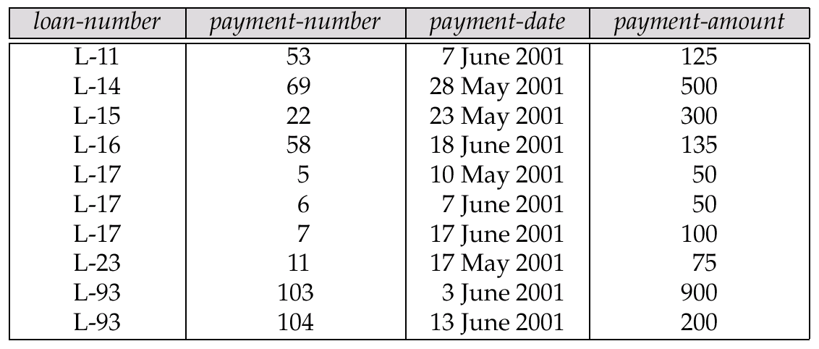
Representing Weak Entity Sets
A weak entity set becomes a table that includes a column for the primary key of the identifying strong entity set

Slide 65
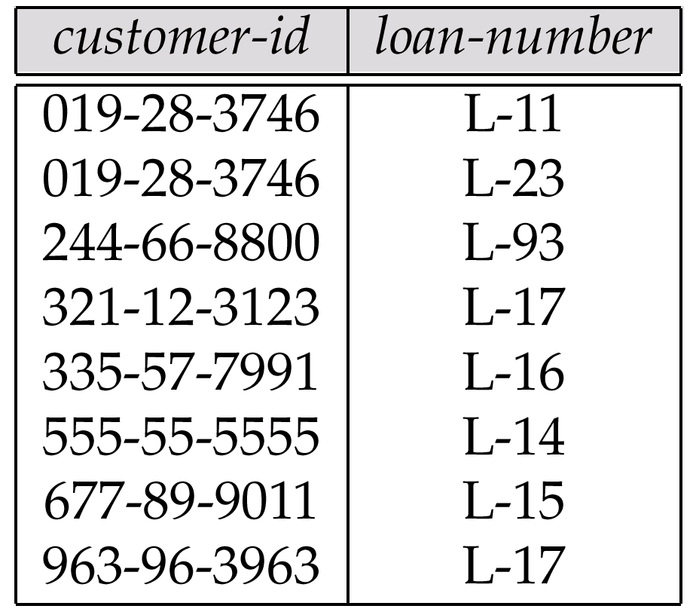
Representing Relationship Sets as Tables
A many-to-many relationship set is represented as a table with columns for the primary keys of the two participating entity sets, and any descriptive attributes of the relationship set.
E.g.: table for relationship set borrower

Slide 66

Redundancy of Tables
Many-to-one and one-to-many relationship sets that are total on the many-side can be represented by adding an extra attribute to the many side, containing the primary key of the one side
E.g.: Instead of creating a table for relationship account-branch, add an attribute branch to the entity set account

Slide 67
Redundancy of Tables (Cont.)
For one-to-one relationship sets, either side can be chosen to act as the “many” side
  That is, extra attribute can be added to either of the tables corresponding to the two entity sets
If participation is partial on the many side, replacing a table by an extra attribute in the relation corresponding to the “many” side could result in null values
The table corresponding to a relationship set linking a weak entity set to its identifying strong entity set is redundant.
  E.g. The payment table already contains the information that would appear in the loan-payment table (i.e., the columns loan-number and payment-number).

Slide 68
Representing Specialization as Tables
Method 1:
  Form a table for the higher level entity
  Form a table for each lower level entity set, include primary key of higher level entity set and local attributes
  table table attributes
  person name, street, city
  customer name, credit-rating
  employee name, salary
  Drawback: getting information about, e.g., employee requires accessing two tables

Slide 69
Representing Specialization as Tables (Cont.)
Method 2:
  Form a table for each entity set with all local and inherited attributes
  table table attributes
  person name, street, city
  customer name, street, city, credit-rating
  employee name, street, city, salary
  If specialization is total, table for generalized entity (person) not required to store information
    Can be defined as a “view” relation containing union of specialization tables
    But explicit table may still be needed for foreign key constraints
  Drawback: street and city may be stored redundantly for persons who are both customers and employees

Slide 70
Relations Corresponding to Aggregation
To represent aggregation, create a table containing
  primary key of the aggregated relationship,
  the primary key of the associated entity set
  Any descriptive attributes

Slide 71
Relations Corresponding to Aggregation (Cont.)
E.g. to represent aggregation manages between relationship works-on and entity set manager, create a table
manages(employee-id, branch-name, title, manager-name)
Table works-on is redundant provided we are willing to store null values for attribute manager-name in table manages

Slide 72
End of Chapter 2

Slide 73
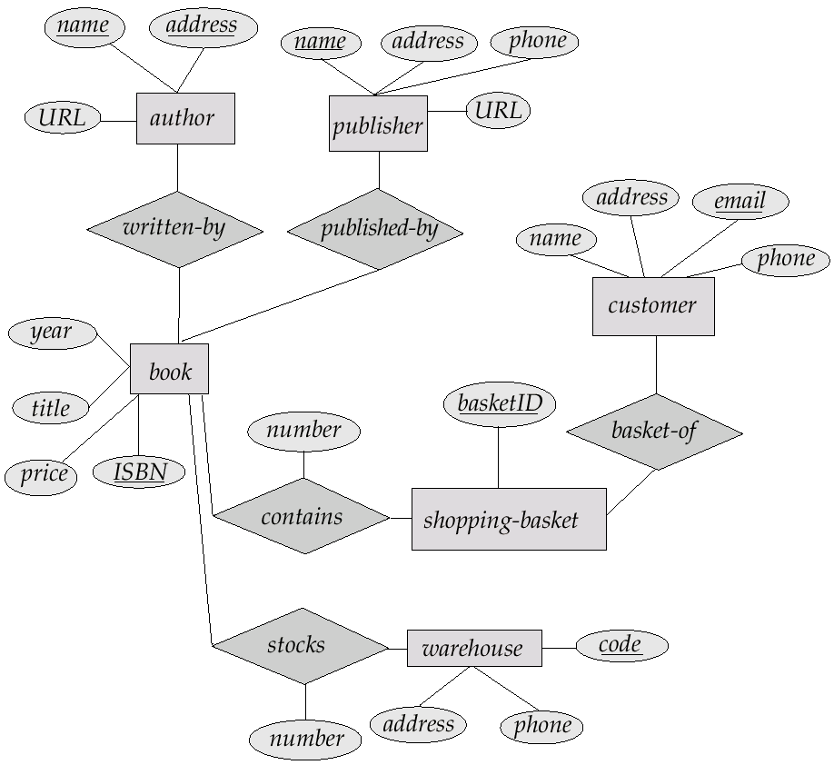
E-R Diagram for Exercise 2.10

Slide 74
E-R Diagram for Exercise 2.15

Slide 75
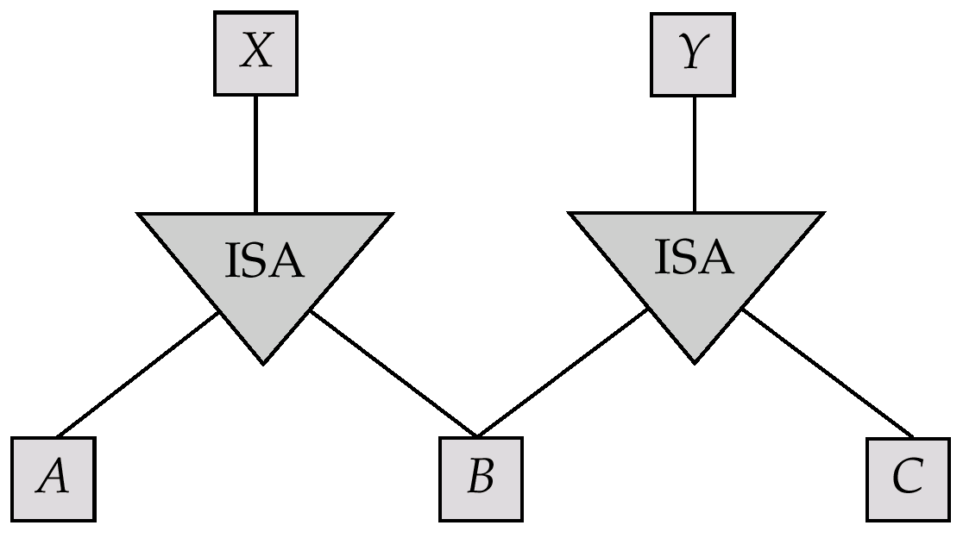
E-R Diagram for Exercise 2.22

Slide 76
E-R Diagram for Exercise 2.15

Slide 77
Existence Dependencies
If the existence of entity x depends on the existence of entity y, then x is said to be existence dependent on y.
  y is a dominant entity (in example below, loan)
  x is a subordinate entity (in example below, payment)
loan-payment
loan
payment
If a loan entity is deleted, then all its associated payment entities must be deleted also.

