Slide 1
Chapter 12: Indexing and Hashing
Rev. Sep 17, 2008

Slide 2
Overview of Storage and Indexing
Notes:
1
The slides for this text are organized into chapters. This lecture covers Chapter 8.
Chapter 1: Introduction to Database Systems
Chapter 2: The Entity-Relationship Model
Chapter 3: The Relational Model
Chapter 4 (Part A): Relational Algebra
Chapter 4 (Part B): Relational Calculus
Chapter 5: SQL: Queries, Programming, Triggers
Chapter 6: Query-by-Example (QBE)
Chapter 7: Storing Data: Disks and Files
Chapter 8: File Organizations and Indexing
Chapter 9: Tree-Structured Indexing
Chapter 10: Hash-Based Indexing
Chapter 11: External Sorting
Chapter 12 (Part A): Evaluation of Relational Operators
Chapter 12 (Part B): Evaluation of Relational Operators: Other Techniques
Chapter 13: Introduction to Query Optimization
Chapter 14: A Typical Relational Optimizer
Chapter 15: Schema Refinement and Normal Forms
Chapter 16 (Part A): Physical Database Design
Chapter 16 (Part B): Database Tuning
Chapter 17: Security
Chapter 18: Transaction Management Overview
Chapter 19: Concurrency Control
Chapter 20: Crash Recovery
Chapter 21: Parallel and Distributed Databases
Chapter 22: Internet Databases
Chapter 23: Decision Support
Chapter 24: Data Mining
Chapter 25: Object-Database Systems
Chapter 26: Spatial Data Management
Chapter 27: Deductive Databases
Chapter 28: Additional Topics

Slide 3
Data on External Storage
Disks: Can retrieve random page at fixed cost
  But reading several consecutive pages is much cheaper than reading them in random order
Tapes: Can only read pages in sequence
  Cheaper than disks; used for archival storage
File organization: Method of arranging a file of records on external storage.
  Record id (rid) is sufficient to physically locate record
  Indexes are data structures that allow us to find the record ids of records with given values in index search key fields
Architecture: Buffer manager stages pages from external storage to main memory buffer pool. File and index layers make calls to the buffer manager. Page: typically 4 Kbytes.

Slide 4
Organization of Records in Files
Heap – a record can be placed anywhere in the file where there is space
Sequential – store records in sequential order, based on the value of the search key of each record
Hashing – a hash function computed on some attribute of each record; the result specifies in which block of the file the record should be placed
Records of each relation may be stored in a separate file. In a multitable clustering file organization records of several different relations can be stored in the same file
  Motivation: store related records on the same block to minimize I/O

Slide 5

Sequential File Organization
Suitable for applications that require sequential processing of the entire file
The records in the file are ordered by a search-key

Slide 6

Sequential File Organization (Cont.)
Deletion – use pointer chains
Insertion –locate the position where the record is to be inserted
  if there is free space insert there
  if no free space, insert the record in an overflow block
  In either case, pointer chain must be updated
Need to reorganize the file
from time to time to restore
sequential order

Slide 7
Alternative File Organizations
Many alternatives exist, each ideal for some situations, and not so good in others:
  Heap (random order) files: Suitable when typical access is a file scan retrieving all records.
  Sorted Files: Best if records must be retrieved in some order, or only a `range’ of records is needed.
  Indexes: Data structures to organize records via trees or hashing.
    Like sorted files, they speed up searches for a subset of records, based on values in certain (“search key”) fields
    Updates are much faster than in sorted files.
Notes:
2

Slide 8
Indexes
Indexes are additional auxiliary access structures with typically provide either faster access to data or secondary access paths without effecting the physical storage of the data.
They are based on indexing field(s) that are used to construct the index.
Chapter 6

Slide 9
Types of Indexes
Single-Level Indexes
  Primary
  Secondary
  Clustering
Notes:
ISAM Indexed Sequential Access Method

Slide 10
Primary Index − Primary index is defined on an ordered data file. The data file is ordered on a key field. The key field is generally the primary key of the relation.
Secondary Index − Secondary index may be generated from a field which is a candidate key and has a unique value in every record, or a non-key with duplicate values.
Clustering Index − Clustering index is defined on an ordered data file. The data file is ordered on a non-key field.

Slide 11
Indexes
An index on a file speeds up selections on the search key fields for the index.
  Any subset of the fields of a relation can be the search key for an index on the relation.
  Search key is not the same as key (minimal set of fields that uniquely identify a record in a relation).
An index contains a collection of data entries, and supports efficient retrieval of all data entries k* with a given key value k.
Notes:
7

Slide 12
Primary Indexes
A Primary Index is constructed of two parts: The first field is the same data type of the primary key of a file block of the data file and the second field is file block pointer.
The Anchor Record or Block anchor is the first record in a file block. This is where the value for the first field of the primary index come from along with the respective address of that block.
Chapter 6
Notes:
Mention that this is a sparse index Vs a dense index which has an entry for every key search value.

Slide 13
Secondary Indexes
A Secondary Index is an ordered file with two fields. The first is of the same data type as some nonordering field and the second is either a block or a record pointer.
If the entries in this nonordering field must be unique this field is sometime referred to as a Secondary Key. This results in a dense index.
Chapter 6

Slide 14
Index Classification
Primary vs. secondary: If search key contains primary key, then called primary index.
  Unique index: Search key contains a candidate key.
Clustered vs. unclustered: If order of data records is the same as order of data entries, then called clustered index.
  A file can be clustered on at most one search key.
  Cost of retrieving data records through index varies greatly based on whether index is clustered or not!
Notes:
11

Slide 15
Index Classification
Dense vs Sparse: If there is an entry in the index for each key value -> dense index (unclustered indices are dense). If there is an entry for each page -> sparse index.
1
5
..
..
1 Brown ..
Brown
Chen
Peterson
Rhodes
Smith
Yu
White
2 Smith..
3 White ..
4 Yu ..
5 Chen ..
6 Peterson..
7 Rhodes..
………..
Notes:
11

Slide 16
Clustered vs. Unclustered Index
To build clustered index, first sort the Heap file (with some free space on each page for future inserts).
  Overflow pages may be needed for inserts. (Thus, order of data recs is `close to’, but not identical to, the sort order.)
Index entries
UNCLUSTERED
CLUSTERED
direct search for
data entries
Data entries
Data entries
(Index File)
(Data file)
Data Records
Data Records
Notes:
12

Slide 17
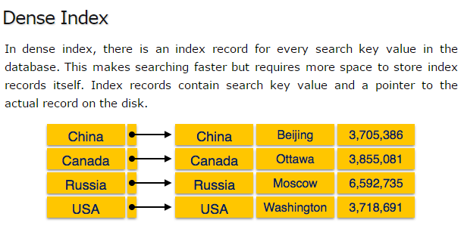
Other types

Slide 18
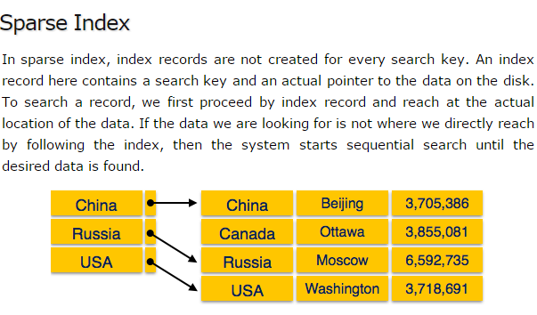

Slide 19
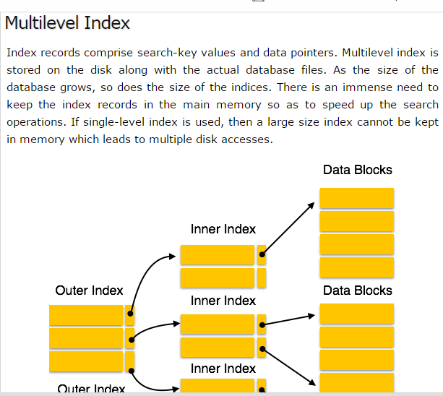

Slide 20
Chapter 12: Indexing and Hashing
Basic Concepts
Ordered Indices
Static Hashing
Dynamic Hashing
Comparison of Ordered Indexing and Hashing
Index Definition in SQL
Multiple-Key Access

Slide 21
Basic Concepts
Indexing mechanisms used to speed up access to desired data.
  E.g., author catalog in library
Search Key - attribute to set of attributes used to look up records in a file.
An index file consists of records (called index entries) of the form
Index files are typically much smaller than the original file
Two basic kinds of indices:
  Ordered indices: search keys are stored in sorted order
  Hash indices: search keys are distributed uniformly across “buckets” using a “hash function”.
search-key
pointer

Slide 22
Index Evaluation Metrics
Access types supported efficiently. E.g.,
  records with a specified value in the attribute
  or records with an attribute value falling in a specified range of values (e.g. 10000 < salary < 40000)
Access time
Insertion time
Deletion time
Space overhead

Slide 23
Ordered Indices
In an ordered index, index entries are stored sorted on the search key value. E.g., author catalog in library.
Primary index: in a sequentially ordered file, the index whose search key specifies the sequential order of the file.
  Also called clustering index
  The search key of a primary index is usually but not necessarily the primary key.
Secondary index: an index whose search key specifies an order different from the sequential order of the file. Also called
non-clustering index.
Index-sequential file: ordered sequential file with a primary index.

Slide 24
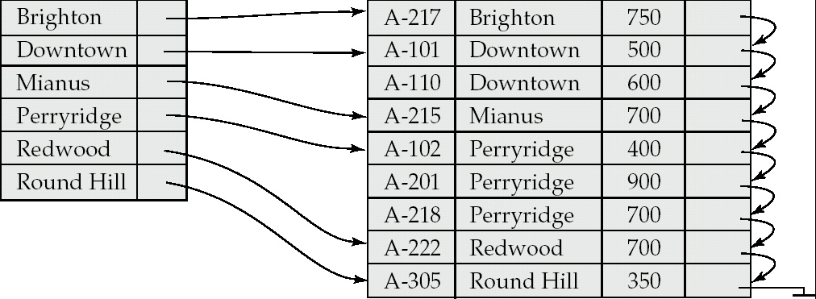
Dense Index Files
Dense index — Index record appears for every search-key value in the file.

Slide 25
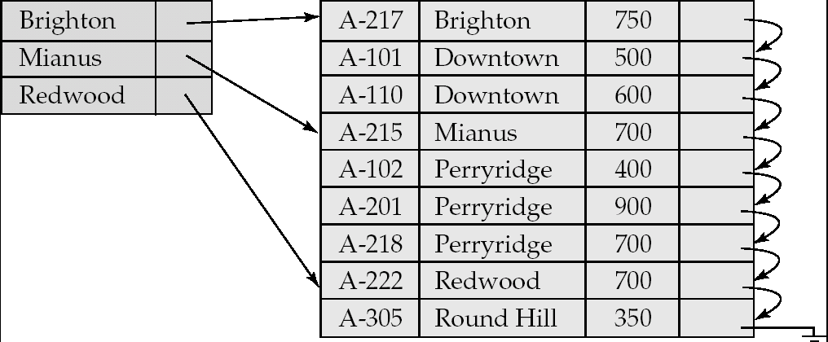
Sparse Index Files
Sparse Index: contains index records for only some search-key values.
  Applicable when records are sequentially ordered on search-key
To locate a record with search-key value K we:
  Find index record with largest search-key value < K
  Search file sequentially starting at the record to which the index record points

Slide 26
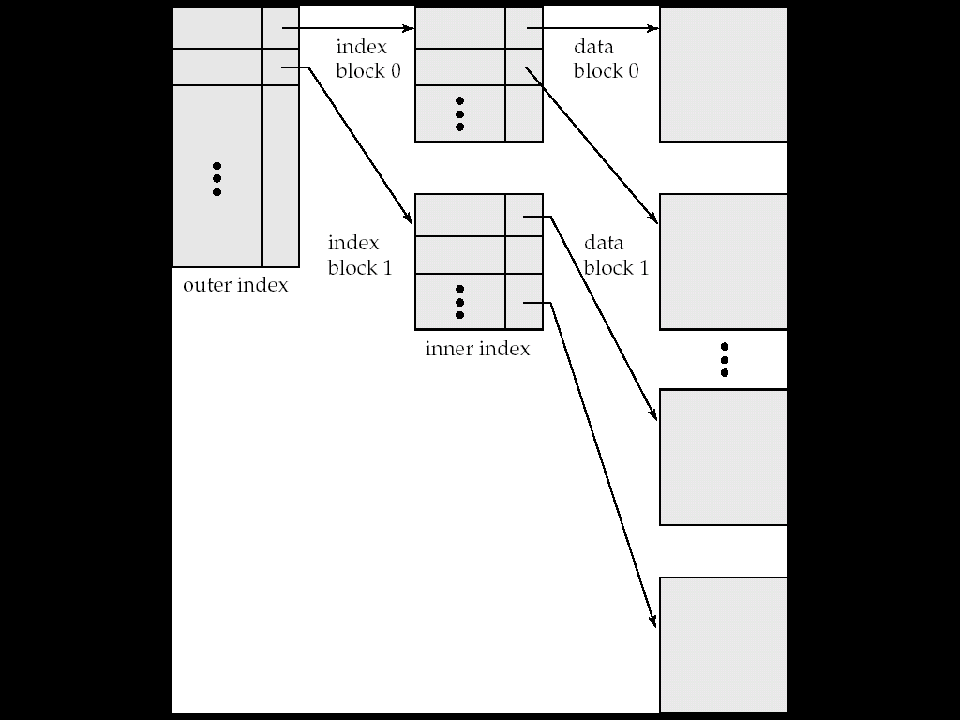
Sparse Index Files (Cont.)
Compared to dense indices:
  Less space and less maintenance overhead for insertions and deletions.
  Generally slower than dense index for locating records.
Good tradeoff: sparse index with an index entry for every block in file, corresponding to least search-key value in the block.

Slide 27
Multilevel Index
If primary index does not fit in memory, access becomes expensive.
Solution: treat primary index kept on disk as a sequential file and construct a sparse index on it.
  outer index – a sparse index of primary index
  inner index – the primary index file
If even outer index is too large to fit in main memory, yet another level of index can be created, and so on.
Indices at all levels must be updated on insertion or deletion from the file.

Slide 28
Multilevel Index (Cont.)

Slide 29
Index Update: Record Deletion
If deleted record was the only record in the file with its particular search-key value, the search-key is deleted from the index also.
Single-level index deletion:
  Dense indices – deletion of search-key: similar to file record deletion.
  Sparse indices –
    if deleted key value exists in the index, the value is replaced by the next search-key value in the file (in search-key order).
    If the next search-key value already has an index entry, the entry is deleted instead of being replaced.

Slide 30
Index Update: Record Insertion
Single-level index insertion:
  Perform a lookup using the key value from inserted record
  Dense indices – if the search-key value does not appear in the index, insert it.
  Sparse indices – if index stores an entry for each block of the file, no change needs to be made to the index unless a new block is created.
    If a new block is created, the first search-key value appearing in the new block is inserted into the index.
Multilevel insertion (as well as deletion) algorithms are simple extensions of the single-level algorithms

Slide 31
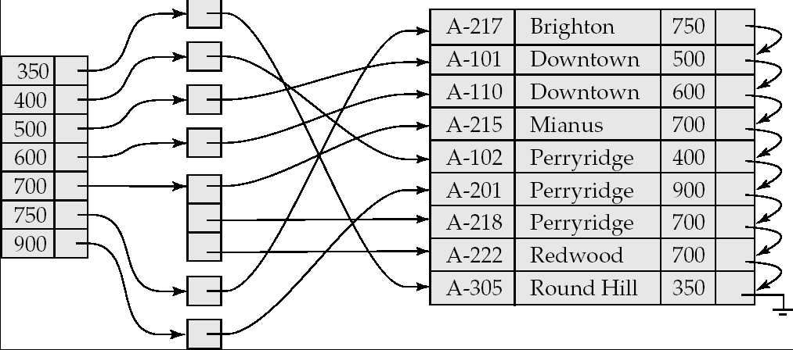
Secondary Indices Example
Secondary index on balance field of account
Index record points to a bucket that contains pointers to all the actual records with that particular search-key value.
Secondary indices have to be dense

Slide 32
Primary and Secondary Indices
Indices offer substantial benefits when searching for records.
BUT: Updating indices imposes overhead on database modification --when a file is modified, every index on the file must be updated,
Sequential scan using primary index is efficient, but a sequential scan using a secondary index is expensive
  Each record access may fetch a new block from disk
  Block fetch requires about 5 to 10 micro seconds, versus about 100 nanoseconds for memory access

Slide 33
Hashing

Slide 34
Static Hashing
A bucket is a unit of storage containing one or more records (a bucket is typically a disk block).
In a hash file organization we obtain the bucket of a record directly from its search-key value using a hash function.
Hash function h is a function from the set of all search-key values K to the set of all bucket addresses B.
Hash function is used to locate records for access, insertion as well as deletion.
Records with different search-key values may be mapped to the same bucket; thus entire bucket has to be searched sequentially to locate a record.

Slide 35
Example of Hash File Organization
Hash file organization of account file, using branch_name as key
(See figure in next slide.)
There are 10 buckets,
The binary representation of the ith character is assumed to be the integer i.
The hash function returns the sum of the binary representations of the characters modulo 10
  E.g. h(Perryridge) = 5 h(Round Hill) = 3 h(Brighton) = 3

Slide 36
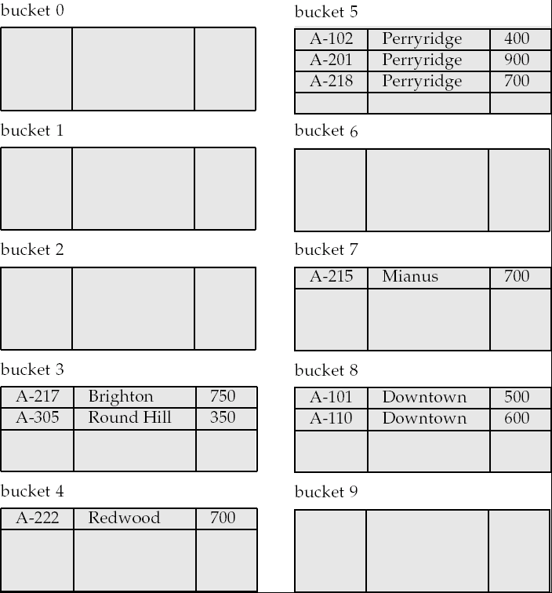
Example of Hash File Organization
Hash file organization of account file, using branch_name as key
(see previous slide for details).

Slide 37
Hash Functions
Worst hash function maps all search-key values to the same bucket; this makes access time proportional to the number of search-key values in the file.
An ideal hash function is uniform, i.e., each bucket is assigned the same number of search-key values from the set of all possible values.
Ideal hash function is random, so each bucket will have the same number of records assigned to it irrespective of the actual distribution of search-key values in the file.
Typical hash functions perform computation on the internal binary representation of the search-key.
  For example, for a string search-key, the binary representations of all the characters in the string could be added and the sum modulo the number of buckets could be returned. .

Slide 38
Handling of Bucket Overflows
Bucket overflow can occur because of
  Insufficient buckets
  Skew in distribution of records. This can occur due to two reasons:
    multiple records have same search-key value
    chosen hash function produces non-uniform distribution of key values
Although the probability of bucket overflow can be reduced, it cannot be eliminated; it is handled by using overflow buckets.

Slide 39
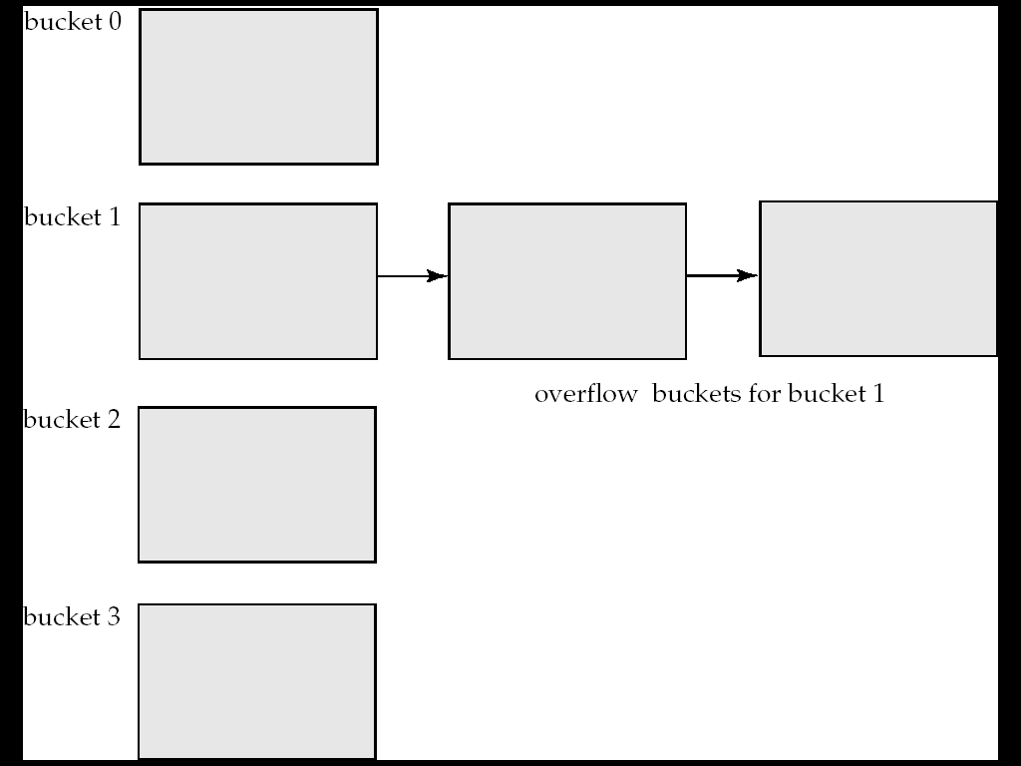
Handling of Bucket Overflows (Cont.)
Overflow chaining – the overflow buckets of a given bucket are chained together in a linked list.
Above scheme is called closed hashing.
  An alternative, called open hashing, which does not use overflow buckets, is not suitable for database applications.

Slide 40
Hash Indices
Hashing can be used not only for file organization, but also for index-structure creation.
A hash index organizes the search keys, with their associated record pointers, into a hash file structure.
Strictly speaking, hash indices are always secondary indices
  if the file itself is organized using hashing, a separate primary hash index on it using the same search-key is unnecessary.
  However, we use the term hash index to refer to both secondary index structures and hash organized files.

Slide 41
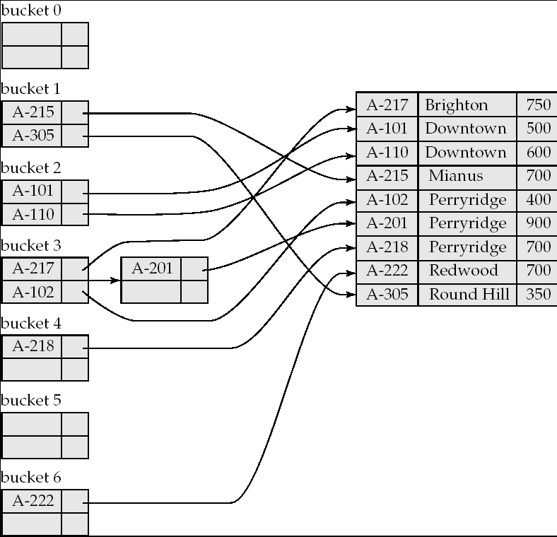
Example of Hash Index

Slide 42
Deficiencies of Static Hashing
In static hashing, function h maps search-key values to a fixed set of B of bucket addresses. Databases grow or shrink with time.
  If initial number of buckets is too small, and file grows, performance will degrade due to too much overflows.
  If space is allocated for anticipated growth, a significant amount of space will be wasted initially (and buckets will be underfull).
  If database shrinks, again space will be wasted.
One solution: periodic re-organization of the file with a new hash function
  Expensive, disrupts normal operations
Better solution: allow the number of buckets to be modified dynamically.

Slide 43
Dynamic Hashing
Good for database that grows and shrinks in size
Allows the hash function to be modified dynamically
Extendable hashing – one form of dynamic hashing
  Hash function generates values over a large range — typically b-bit integers, with b = 32.
  At any time use only a prefix of the hash function to index into a table of bucket addresses.
  Let the length of the prefix be i bits, 0 ≤ i ≤ 32.
    Bucket address table size = 2^{i.} Initially i = 0
    Value of i grows and shrinks as the size of the database grows and shrinks.
  Multiple entries in the bucket address table may point to a bucket (why?)
  Thus, actual number of buckets is < 2^{i}
    The number of buckets also changes dynamically due to coalescing and splitting of buckets.

Slide 44
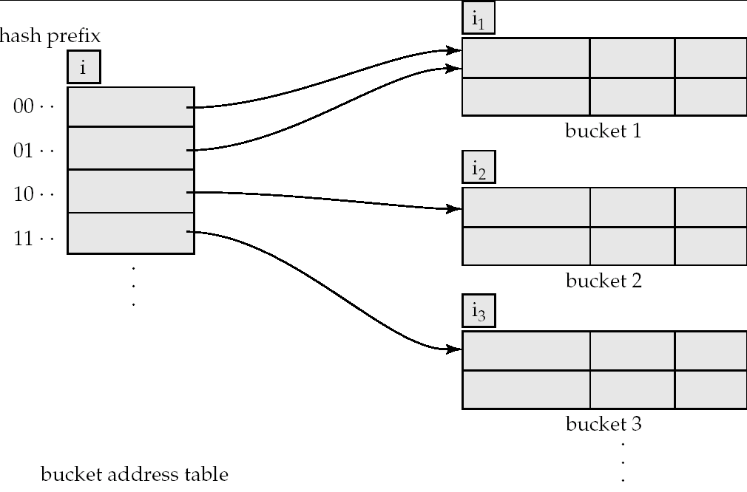
General Extendable Hash Structure
In this structure, i₂ = i₃ = i, whereas i₁ = i – 1 (see next slide for details)

Slide 45
Use of Extendable Hash Structure
Each bucket j stores a value i_{j}
  All the entries that point to the same bucket have the same values on the first i_{j} bits.
To locate the bucket containing search-key K_{j}:
  1. Compute h(K_{j}) = X
  2. Use the first i high order bits of X as a displacement into bucket address table, and follow the pointer to appropriate bucket
To insert a record with search-key value K_{j}
  follow same procedure as look-up and locate the bucket, say j.
  If there is room in the bucket j insert record in the bucket.
  Else the bucket must be split and insertion re-attempted (next slide.)
    Overflow buckets used instead in some cases (will see shortly)

Slide 46
Insertion in Extendable Hash Structure (Cont)
To split a bucket j when inserting record with search-key value K_{j}:
If i > i_{j} (more than one pointer to bucket j)
  allocate a new bucket z, and set i_{j} = i_{z} = (i_{j} + 1)
  Update the second half of the bucket address table entries originally pointing to j, to point to z
  remove each record in bucket j and reinsert (in j or z)
  recompute new bucket for K_{j} and insert record in the bucket (further splitting is required if the bucket is still full)
If i = i_{j} (only one pointer to bucket j)
  If i reaches some limit b, or too many splits have happened in this insertion, create an overflow bucket
  Else
    increment i and double the size of the bucket address table.
    replace each entry in the table by two entries that point to the same bucket.
    recompute new bucket address table entry for K_{j}
    Now i > i_{j} so use the first case above.

Slide 47
Deletion in Extendable Hash Structure
To delete a key value,
  locate it in its bucket and remove it.
  The bucket itself can be removed if it becomes empty (with appropriate updates to the bucket address table).
  Coalescing of buckets can be done (can coalesce only with a “buddy” bucket having same value of i_{j} and same i_{j} –1 prefix, if it is present)
  Decreasing bucket address table size is also possible
    Note: decreasing bucket address table size is an expensive operation and should be done only if number of buckets becomes much smaller than the size of the table

Slide 48
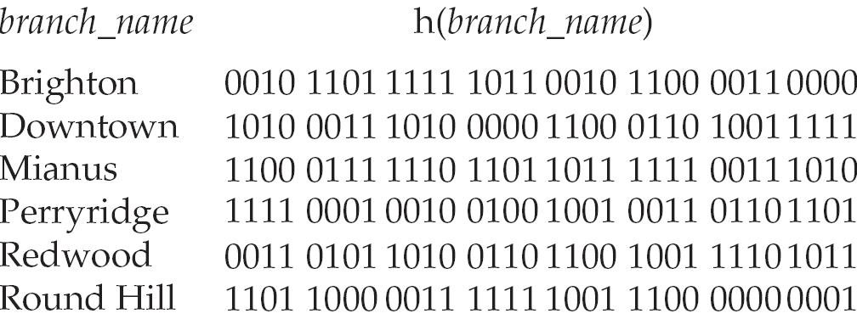
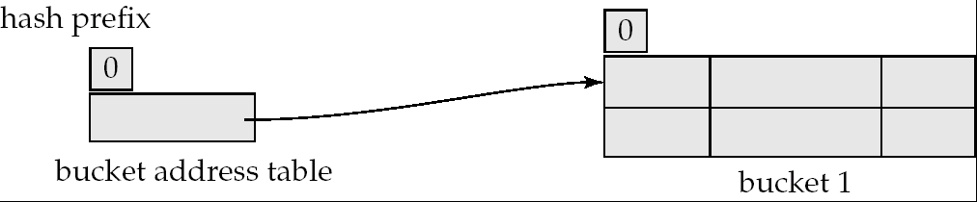
Use of Extendable Hash Structure: Example
Initial Hash structure, bucket size = 2

Slide 49
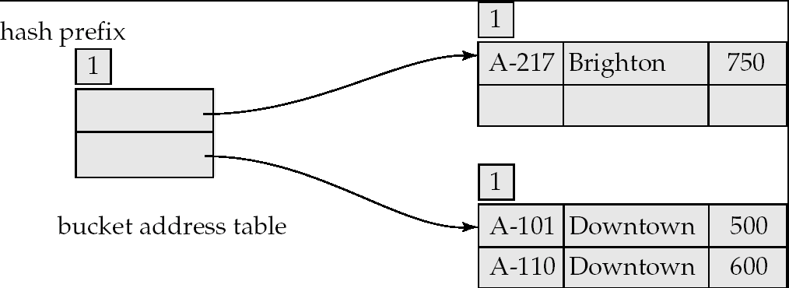
Example (Cont.)
Hash structure after insertion of one Brighton and two Downtown records

Slide 50
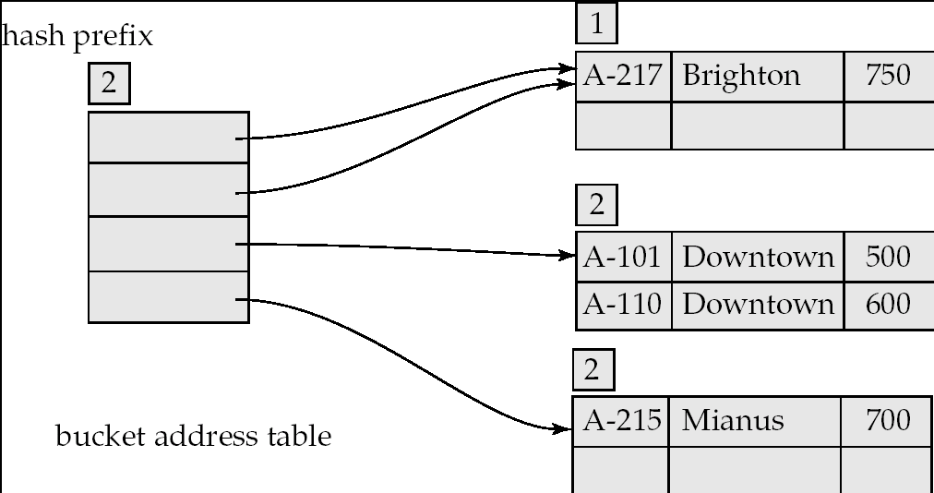
Example (Cont.)
Hash structure after insertion of Mianus record

Slide 51
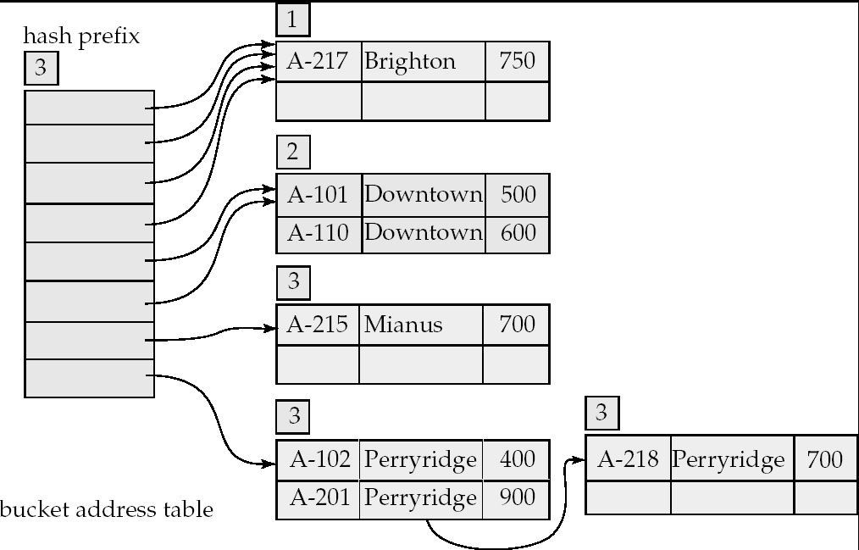
Example (Cont.)
Hash structure after insertion of three Perryridge records

Slide 52
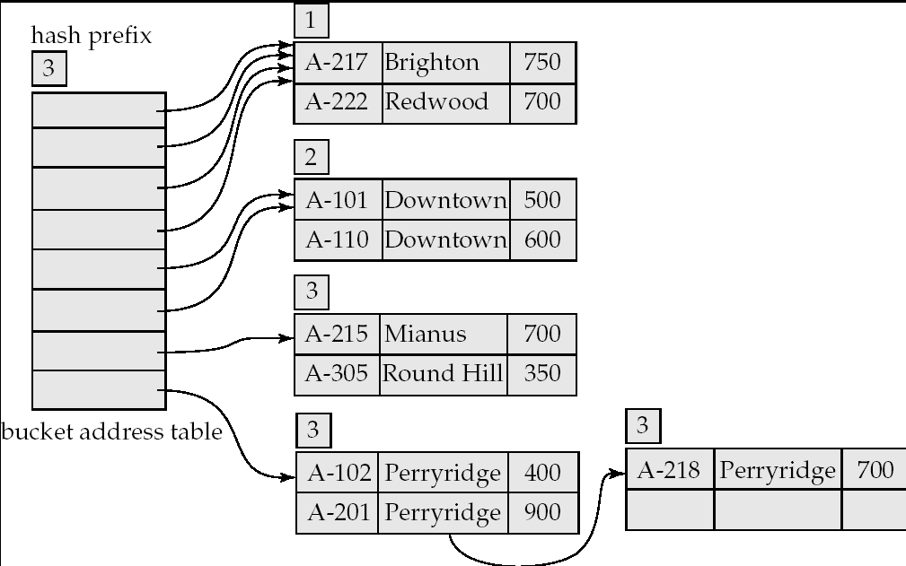
Example (Cont.)
Hash structure after insertion of Redwood and Round Hill records

Slide 53
Extendable Hashing vs. Other Schemes
Benefits of extendable hashing:
  Hash performance does not degrade with growth of file
  Minimal space overhead
Disadvantages of extendable hashing
  Extra level of indirection to find desired record
  Bucket address table may itself become very big (larger than memory)
    Cannot allocate very large contiguous areas on disk either
    Solution: B⁺-tree file organization to store bucket address table
  Changing size of bucket address table is an expensive operation
Linear hashing is an alternative mechanism
  Allows incremental growth of its directory (equivalent to bucket address table)
  At the cost of more bucket overflows

Slide 54
Comparison of Ordered Indexing and Hashing
Cost of periodic re-organization
Relative frequency of insertions and deletions
Is it desirable to optimize average access time at the expense of worst-case access time?
Expected type of queries:
  Hashing is generally better at retrieving records having a specified value of the key.
  If range queries are common, ordered indices are to be preferred
In practice:
  PostgreSQL supports hash indices, but discourages use due to poor performance
  Oracle supports static hash organization, but not hash indices
  SQLServer supports only B⁺-trees

