Slide 1

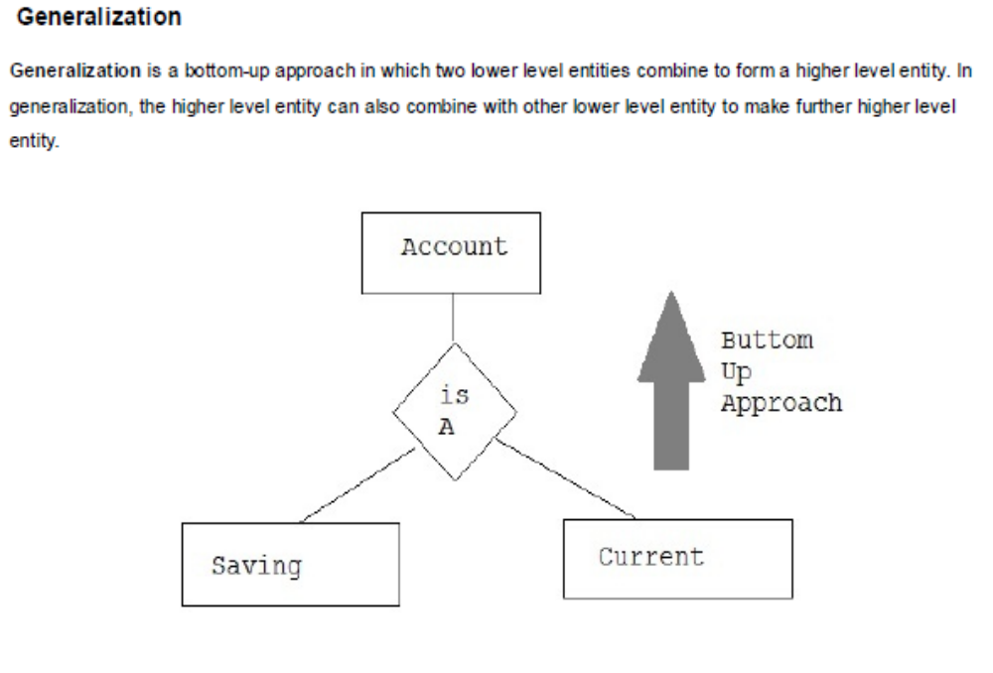
Generalization

Slide 2
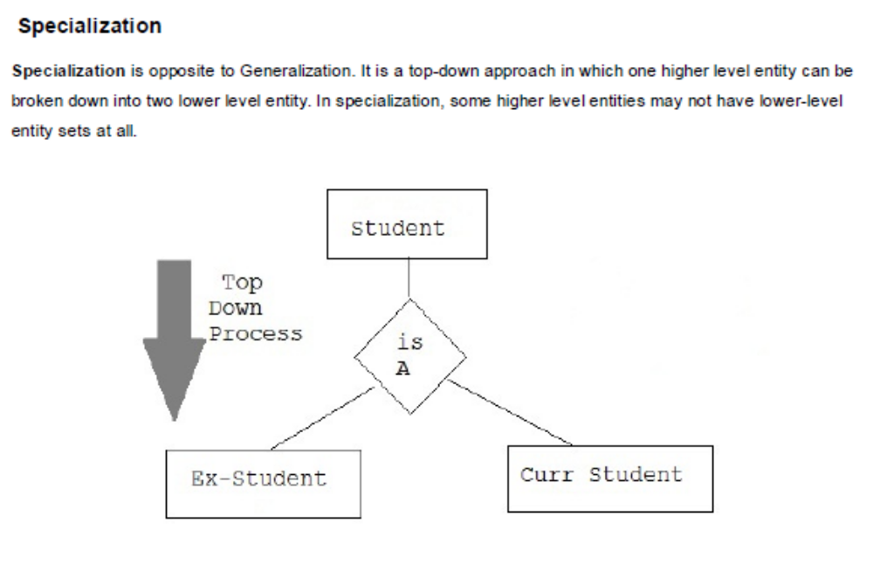
Specialization

Slide 3
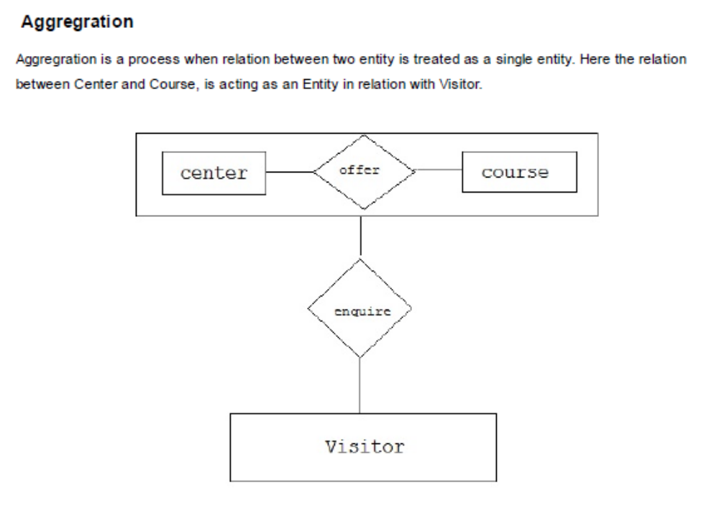
Aggregation

Slide 4
Clauses
Group By
Having
Where
Order by

Slide 5
Find the deptno and max salary of the departments which has max salary of more than 50000
Find the salary department wise
Find all the dept where more than 4 employees are working

Slide 6
Operators
AND
OR
BETWEEN
IN
LIKE
ANY
ALL

Slide 7
Sub queries
Find all the employees having salary is greater than the average salary
Find the 2nd highest salary in employee table
Creation of tables from existing tables

Slide 8
INTEGRITY RULES
Entity integrity
This rule states that if an attribute A of relation R is a primary key then A cann’t accept null values.

Slide 9
INTEGRITY RULES
Referential Integrity
EMP-DEPT database
Foreign key values are derived from primary key of master table
Foreign key value can be null

