Slide 1

2
SQL Joins
Introduction to SQL Joins
Technically Joins are SQL operations which help us in retrieving data from two or more tables that share a common field

Slide 2
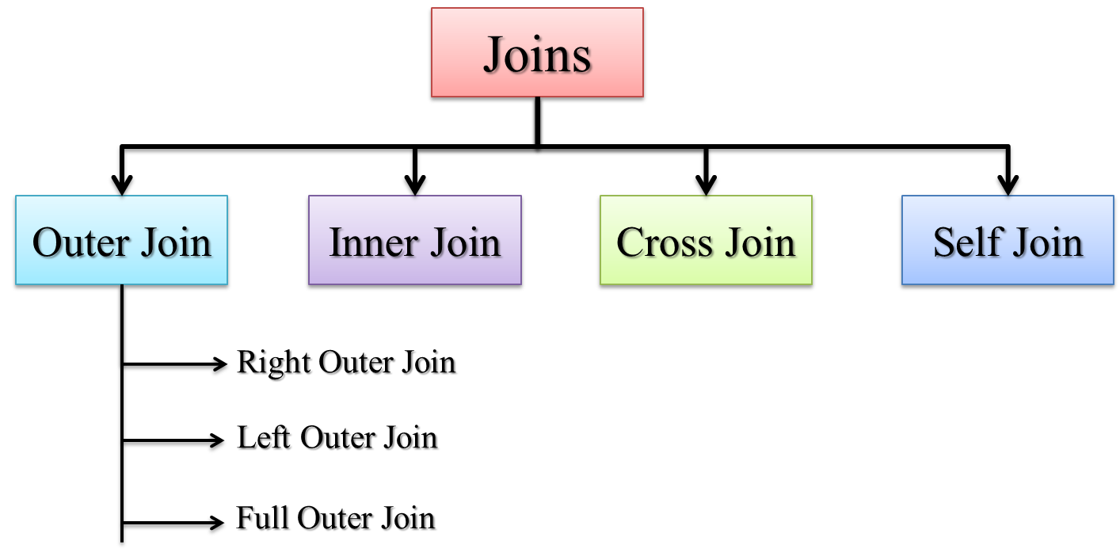
Types of Joins

Slide 3
conditions
Equi Join: this type of Join looks for common records in two tables on the basis of equality condition and then combines them. Equi-Join is constructed with the help of equality operator (=) where the values of Primary key and Foreign key are compared. Hence the common or matching records from the two tables are presented in the result.
Non Equi Join: Here equality operator is not used, instead operators such as <, >, BETWEEN etc. are employed. Therefore Non Equi-Join is the opposite of Equi-Join, and uses joining conditions excluding equal operator. For example, in a non Equi-Join condition you can use !=, <=,>=,<,> or BETWEEN etc. operators can be used for joining.

Slide 5
JOINs
JOINs can be used to combine tables
  There are many types of JOIN
    CROSS JOIN
    INNER JOIN
    NATURAL JOIN
    OUTER JOIN
  OUTER JOINs are linked with NULLs - more later
A CROSS JOIN B
  returns all pairs of rows from A and B
A NATURAL JOIN B
  returns pairs of rows with common values for identically named columns and without duplicating columns
A INNER JOIN B
  returns pairs of rows satisfying a condition

Slide 6
CROSS and NATURAL JOIN
SELECT * FROM
A CROSS JOIN B
is the same as
SELECT * FROM A, B
SELECT * FROM
A NATURAL JOIN B
is the same as
SELECT A.col1,… A.coln, [and all other columns apart from B.col1,…B.coln]
FROM A, B
WHERE A.col1 = B.col1
AND A.col2 = B.col2
...AND A.coln = B.col.n
(this assumes that col1… coln in A and B have common names)

Slide 7
INNER JOIN
SELECT * FROM
A INNER JOIN B
ON <condition>
is the same as
SELECT * FROM A, B
WHERE <condition>
SELECT * FROM
A INNER JOIN B
USING(col1, col2,...)
is the same as
SELECT * FROM A, B
WHERE A.col1 = B.col1
AND A.col2 = B.col2
AND ...

Slide 8
Types of Joins
Inner joins
  return only matching rows
  enable a maximum of 256 tables to be joined
  at the same time.

Slide 9
Types of Joins
Outer joins
  return all matching rows, plus nonmatching rows
  from one or both tables
  can be performed on only two tables or views
  at a time.
Left
Full
Right

Slide 10
Cartesian Product
To understand how SQL processes a join, it is important to understand the concept of the Cartesian product.
A query that lists multiple tables in the FROM clause without a WHERE clause produces all possible combinations of rows from all tables. This result is called the Cartesian product.
select *
from one, two;
s105d01
Notes:
s105d01

Slide 11
Cartesian Product
Table One
X | A
1 | a
4 | d
2 | b
Table Two
X | B
2 | x
3 | y
5 | v
s105d01
...

Slide 12
Cartesian Product
Table One
X | A
1 | a
4 | d
2 | b
Table Two
X | B
2 | x
3 | y
5 | v
Result Set
X | A | X | B
1 | a | 2 | x
s105d01
...

Slide 13
Cartesian Product
Table One
X | A
1 | a
4 | d
2 | b
Table Two
X | B
2 | x
3 | y
5 | v
Result Set
X | A | X | B
1 | a | 2 | x
1 | a | 3 | y
s105d01
...

Slide 14
Cartesian Product
Table One
X | A
1 | a
4 | d
2 | b
Table Two
X | B
2 | x
3 | y
5 | v
Result Set
X | A | X | B
1 | a | 2 | x
1 | a | 3 | y
1 | a | 5 | v
s105d01
...

Slide 15
Cartesian Product
Table One
X | A
1 | a
4 | d
2 | b
Table Two
X | B
2 | x
3 | y
5 | v
Result Set
X | A | X | B
1 | a | 2 | x
1 | a | 3 | y
1 | a | 5 | v
4 | d | 2 | x
s105d01
...

Slide 16
Cartesian Product
Table One
X | A
1 | a
4 | d
2 | b
Table Two
X | B
2 | x
3 | y
5 | v
Result Set
X | A | X | B
1 | a | 2 | x
1 | a | 3 | y
1 | a | 5 | v
4 | d | 2 | x
4 | d | 3 | y
s105d01
...

Slide 17
Cartesian Product
Table One
X | A
1 | a
4 | d
2 | b
Table Two
X | B
2 | x
3 | y
5 | v
Result Set
X | A | X | B
1 | a | 2 | x
1 | a | 3 | y
1 | a | 5 | v
4 | d | 2 | x
4 | d | 3 | y
4 | d | 5 | v
s105d01
...

Slide 18
Cartesian Product
Table One
X | A
1 | a
4 | d
2 | b
Table Two
X | B
2 | x
3 | y
5 | v
Result Set
X | A | X | B
1 | a | 2 | x
1 | a | 3 | y
1 | a | 5 | v
4 | d | 2 | x
4 | d | 3 | y
4 | d | 5 | v
2 | b | 2 | x
s105d01
...

Slide 19
Cartesian Product
Table One
X | A
1 | a
4 | d
2 | b
Table Two
X | B
2 | x
3 | y
5 | v
Result Set
X | A | X | B
1 | a | 2 | x
1 | a | 3 | y
1 | a | 5 | v
4 | d | 2 | x
4 | d | 3 | y
4 | d | 5 | v
2 | b | 2 | x
2 | b | 3 | y
s105d01
...

Slide 20
Cartesian Product
Table One
X | A
1 | a
4 | d
2 | b
Table Two
X | B
2 | x
3 | y
5 | v
Result Set
X | A | X | B
1 | a | 2 | x
1 | a | 3 | y
1 | a | 5 | v
4 | d | 2 | x
4 | d | 3 | y
4 | d | 5 | v
2 | b | 2 | x
2 | b | 3 | y
2 | b | 5 | v
s105d01
...

Slide 21
Cartesian Product
Table One
X | A
1 | a
4 | d
2 | b
Table Two
X | B
2 | x
3 | y
5 | v
Result Set
X | A | X | B
1 | a | 2 | x
1 | a | 3 | y
1 | a | 5 | v
4 | d | 2 | x
4 | d | 3 | y
4 | d | 5 | v
2 | b | 2 | x
2 | b | 3 | y
2 | b | 5 | v
s105d01

Slide 22
Cartesian Product
Table One
X | A
1 | a
4 | d
2 | b
Table Two
X | B
2 | x
3 | y
5 | v
3 rows
Result Set
X | A | X | B
1 | a | 2 | x
1 | a | 3 | y
1 | a | 5 | v
4 | d | 2 | x
4 | d | 3 | y
4 | d | 5 | v
2 | b | 2 | x
2 | b | 3 | y
2 | b | 5 | v
...

Slide 23
Cartesian Product
Table One
X | A
1 | a
4 | d
2 | b
Table Two
X | B
2 | x
3 | y
5 | v
3 rows
3 rows
Result Set
X | A | X | B
1 | a | 2 | x
1 | a | 3 | y
1 | a | 5 | v
4 | d | 2 | x
4 | d | 3 | y
4 | d | 5 | v
2 | b | 2 | x
2 | b | 3 | y
2 | b | 5 | v
...

Slide 24
Cartesian Product
Table One
X | A
1 | a
4 | d
2 | b
Table Two
X | B
2 | x
3 | y
5 | v
3 rows
X
3 rows
Result Set
X | A | X | B
1 | a | 2 | x
1 | a | 3 | y
1 | a | 5 | v
4 | d | 2 | x
4 | d | 3 | y
4 | d | 5 | v
2 | b | 2 | x
2 | b | 3 | y
2 | b | 5 | v
9 rows

Slide 25
Cartesian Product
The number of rows in a Cartesian product is the product of the number of rows in the contributing tables.
3 x 3 = 9
1,000 x 1,000 = 1,000,000
100,000 x 100,000 = 10,000,000,000
A Cartesian product is rarely the desired result of a query.

Slide 26
Quiz
How many rows are returned from this query?
select *
from three, four;
Table Three
X | A
1 | a1
1 | a2
2 | b1
2 | b2
4 | d
Table Four
X | B
2 | x1
2 | x2
3 | y
5 | v
s105a01
Notes:
The query produces 20 rows

Slide 27
5.02 Quiz – Correct Answer
How many rows are returned from this query?
The query produces 20 rows.
select *
from three, four;
Table Three
X | A
1 | a1
1 | a2
2 | b1
2 | b2
4 | d
Table Four
X | B
2 | x1
2 | x2
3 | y
5 | v
Partial Results Set
X | A | X | B
1 | a1 | 2 | x1
1 | a1 | 2 | x2
1 | a1 | 3 | y
1 | a1 | 5 | v
1 | a2 | 2 | x1
1 | a2 | 2 | x2
1 | a2 | 3 | y
1 | a2 | 5 | v
2 | b1 | 2 | x1
2 | b1 | 2 | x2
5*4=20
s105a01
Notes:
Type answer here

Slide 28
Inner Joins
Inner join syntax resembles Cartesian product syntax,
but a WHERE clause restricts which rows are returned.
General form of an inner join:
SELECT column-1<, …column-n>
FROM table-1|view-1<, … table-n|view-n>
WHERE join-condition(s)
<AND other subsetting conditions>
<other clauses>;
...

Slide 29
Inner Joins
Inner join syntax resembles Cartesian product syntax,
but a WHERE clause restricts which rows are returned.
General form of an inner join:
SELECT column-1<, …column-n>
FROM table-1|view-1<, … table-n|view-n>
WHERE join-condition(s)
<AND other subsetting conditions>
<other clauses>;
Significant syntax changes from earlier queries:
  The FROM clause references multiple tables.
  The WHERE clause includes join conditions in addition to other subsetting specifications.

Slide 30
Inner Joins
Conceptually, when processing an inner join, PROC SQL does the following:
builds the Cartesian product of all the tables listed
applies the WHERE clause to limit the rows returned

Slide 31
Inner Joins: Cartesian Product Built
Table One
X | A
1 | a
4 | d
2 | b
Table Two
X | B
2 | x
3 | y
5 | v
select *
from one, two
X | A | X | B
1 | a | 2 | x
1 | a | 3 | y
1 | a | 5 | v
4 | d | 2 | x
4 | d | 3 | y
4 | d | 5 | v
2 | b | 2 | x
2 | b | 3 | y
2 | b | 5 | v
s105d02
...
Notes:
s105d02

Slide 32
Inner Joins: WHERE Clause Restricts Rows
Table One
X | A
1 | a
4 | d
2 | b
Table Two
X | B
2 | x
3 | y
5 | v
select *
from one, two
where one.x=two.x;
X | A | X | B
1 | a | 2 | x
1 | a | 3 | y
1 | a | 5 | v
4 | d | 2 | x
4 | d | 3 | y
4 | d | 5 | v
2 | b | 2 | x
2 | b | 3 | y
2 | b | 5 | v
s105d02
...
Notes:
s105d02

Slide 33
Inner Joins: Results Are Returned
Table One
X | A
1 | a
4 | d
2 | b
Table Two
X | B
2 | x
3 | y
5 | v
select *
from one, two
where one.x=two.x;
X | A | X | B
2 | b | 2 | x
 Tables do not have to be sorted before they are joined.
s105d02
Notes:
s105d02

Slide 34
Inner Joins
One method of displaying the X column only once is to use a table qualifier in the SELECT list.
Table One
X | A
1 | a
4 | d
2 | b
Table Two
X | B
2 | x
3 | y
5 | v
select one.x, a, b
from one, two
where one.x=two.x;
X | A | B
2 | b | x
s105d03
Notes:
s105d03

Slide 35
Outer Joins
Inner joins returned only matching rows. When you join tables, you might want to include nonmatching rows as well as matching rows.

Slide 36
Outer Joins
You can retrieve both nonmatching and matching rows using an outer join.
Outer joins include left, full, and right outer joins. Outer joins can process only two tables at a time.
Left
Full
Right

Slide 37
Outer Joins
Outer join syntax is similar to the inner join alternate syntax.
General form of an outer join:
The ON clause specifies the join criteria in outer joins.
SELECT column-1 <, …column-n>
FROM table-1
LEFT|RIGHT|FULL JOIN
table-2
ON join-condition(s)
<other clauses>;

Slide 38
Determining Left and Right
Consider the position of the tables in the FROM clause.
  Left joins include all rows from the first (left) table, even if there are no matching rows in the second (right) table.
  Right joins include all rows from the second (right) table, even if there are no matching rows in the first (left) table.
  Full joins include all rows from both tables, even if there are no matching rows in either table.
Left table
Right table
FROM table-1 join-type table-2
ON join-condition(s);

Slide 39
Left Join
Table One
X | A
1 | a
4 | d
2 | b
Table Two
X | B
2 | x
3 | y
5 | v
select *
from one left join two
on one.x = two.x;
X | A | X | B
1 | a | .
2 | b | 2 | x
4 | d | .
s105d07
Notes:
s105d07

Slide 40
Right Join
Table Two
X | B
2 | x
3 | y
5 | v
Table One
X | A
1 | a
4 | d
2 | b
select *
from two right join one
on one.x = two.x;
X | B | X | A
. |  | 1 | a
2 | x | 2 | b
. |  | 4 | d
s105d08
Notes:
s105d08

Slide 41
Full Join
Table One
X | A
1 | a
4 | d
2 | b
Table Two
X | B
2 | x
3 | y
5 | v
select *
from one full join two
on one.x = two.x;
X | A | X | B
1 | a | .
2 | b | 2 | x
. |  | 3 | y
4 | d | .
. |  | 5 | v
s105d09
Notes:
s105d09

