Slide 1
Conditionals

Slide 2
The modulus operator
The modulus operator works on integers (and integer expressions) and yields the remainder when the first operand is divided by the second.
In Python, the modulus operator is a percent sign (%).

Slide 3
Example
The syntax is the same as for other operators:
>>> quotient = 7 / 3
>>> print quotient
2
>>> remainder = 7 % 3
>>> print remainder
1
So 7 divided by 3 is 2 with 1 left over.

Slide 4
Uses
Check whether one number is divisible by another if x % y is zero, then x is divisible by y.
you can extract the right-most digit or digits from a number.
For example,
x % 10 yields the right-most digit of x (in base 10). Similarly x % 100 yields the last two digits.

Slide 5
Boolean expressions
A Boolean expression is an expression that is either true or false.
One way to write a Boolean expression is to use the operator ==, which compares two values and produces a Boolean value:
>>> 5 == 5
True
>>> 5 == 6
False
True and False are special values that are built into Python.

Slide 6
Comparison Operators
x != y # x is not equal to y
x > y # x is greater than y
x < y # x is less than y
x >= y # x is greater than or equal to y
x <= y # x is less than or equal to y
NOTE: “= is an assignment operator and == is a comparison operator”. Also, there is no such thing as =< or =>.

Slide 7
Logical operators
There are three logical operators:
and,
or
not
For example, x > 0 and x < 10 is true only if x is greater than 0 and less than 10.
n%2 == 0 or n%3 == 0
not(x > y) is true if (x > y) is false, that is, if x is less than or equal to y.

Slide 8
Continue…
Any nonzero number is interpreted as “true."
>>> x = 5
>>> x and 1
1
>>> y = 0
>>> y and 1
0

Slide 9
Conditional Execution
To write useful programs we need the ability to check conditions and change the behaviour of the program accordingly.
Conditional statements give us this ability. The simplest form is the if statement:
if x > 0:
print "x is positive“
The Boolean expression after the if statement is called the condition.

Slide 10
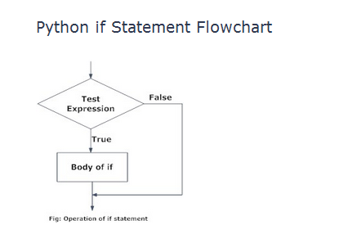
Basic Structure of If Statement
Decision making is required when we want to execute a code only if a certain condition is satisfied. The if…elif…else statement is used in Python for decision making.
Python if Statement Syntax
if test expression:
statement(s)

Slide 11
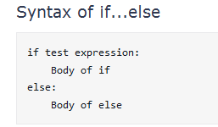
Alternative execution
A second form of the if statement is alternative execution, in which there are two possibilities and the condition determines which one gets executed.
The syntax looks like this:
>>if x%2 == 0:
print x, "is even“
>>else:
print x, "is odd"

Slide 12
Wrapping of IF-ELSE into one function.
def printParity(x):
if x%2 == 0:
print x, "is even"
else:
print x, "is odd“
For any value of x, printParity displays an appropriate message. When you call it, you can provide any integer expression as an argument.

Slide 13
Example
>>> printParity(17)
17 is odd
>>> y = 17
>>> printParity(y+1)
18 is even

Slide 14
Chained Conditionals
Sometimes there are more than two possibilities and we need more than two branches.
if x < y:
print x, "is less than", y
elif x > y:
print x, "is greater than", y
else:
print x, "and", y, "are equal“
NOTE: There is no limit of the number of elif statements, but the last branch has to be an else statement

Slide 15
Example
if choice == 'A':
functionA()
elif choice == 'B':
functionB()
elif choice == 'C':
functionC()
else:
print "Invalid choice."

Slide 16
Assignment :
“Calculator in Python”
..\..\..\..\Python27\cal.py

Slide 17
Nested conditionals
One conditional can also be nested within another.
if x == y:
print x, "and", y, "are equal"
else:
if x < y:
print x, "is less than", y
else:
print x, "is greater than", y

Slide 18
Avoid Nested If
For example, We can rewrite the following code using a single conditional:
if 0 < x:
if x < 10:
print "x is a positive single digit.“
Better way:
if 0 < x and x < 10:
print "x is a positive single digit."

Slide 19
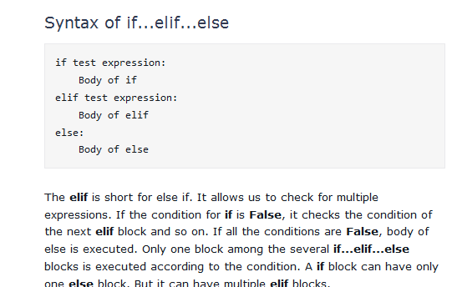

Slide 20
Python Break and Continue
In Python, break and continue statements can alter the flow of a normal loop. Loops iterate over a block of code until test expression is false, but sometimes we wish to terminate the current iteration or even the whole loop without checking test expression. The break and continue statements are used in these cases.
Break Statement
The break statement terminates the loop containing it. Control of the program flows to the statement immediately after the body of the loop. If it is inside a nested loop (loop inside another loop), break will terminate the innermost loop.

Slide 21
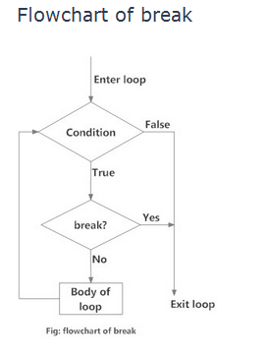
Break

Slide 22
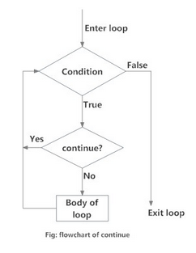
continue statement
The continue statement is used to skip the rest of the code inside a loop for the current iteration only. Loop does not terminate but continues on with the next iteration.

Slide 23
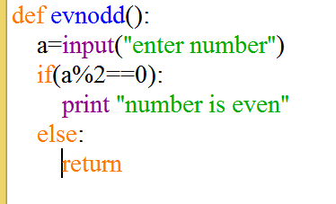
The Return Statement
The return statement allows you to terminate the execution of a function before you reach the end.

Slide 24
ITERATION

Slide 25
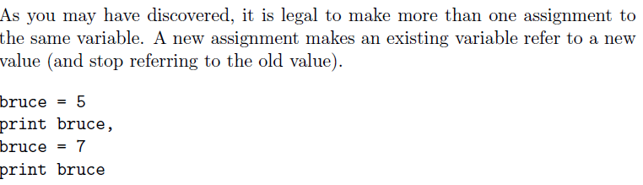
Multiple assignment
Notes:
Output : 5 7

Slide 26
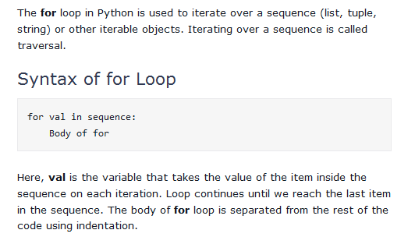
Python for Loop

Slide 27
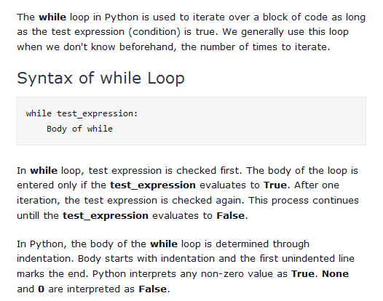

Slide 28
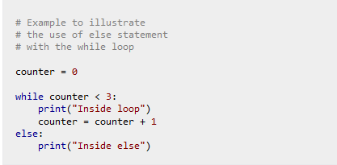
while loop with else
Same as that of for loop, we can have an optional else block with while loop as well. The else part is executed if the condition in the while loop evaluates to False. while loop can be terminated with a break statement. In such case, the else part is ignored. Hence, a while loop's else part runs if no break occurs and the condition is false.

Slide 29
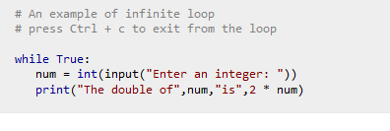
The infinite loop
Python programming offers two kinds of loop, the for loop and the while loop. Using these loops along with loop control statements like break and continue, we can create various forms of loop.
We can create an infinite loop using while statement. If the condition of while loop is always True, we get an infinite loop.

Slide 30
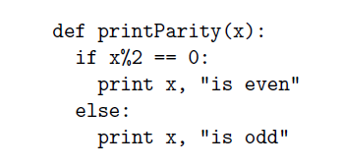
Encapsulation
Encapsulation is the process of wrapping a piece of code in a function, allowing you to take advantage of all the things functions are good for.
Example:

Slide 31
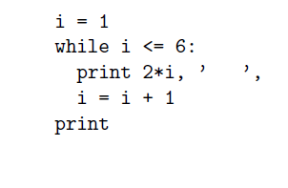
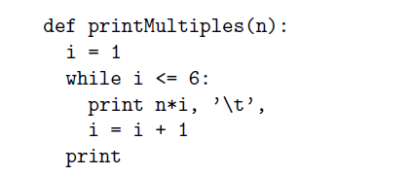
Generalization
Generalization means taking something specific and making it more general, such as printing the multiples of 2 as printing the multiples of any integer.
Specific code
Generalization

Slide 32
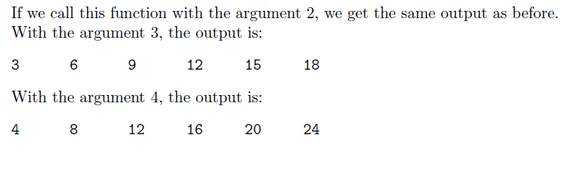
Output of Example

Slide 33
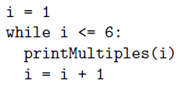
Another Example

Slide 34
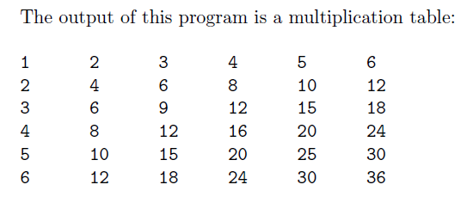
OUTPUT

