Slide 1
CHAPTER 7
STRINGS

Slide 2
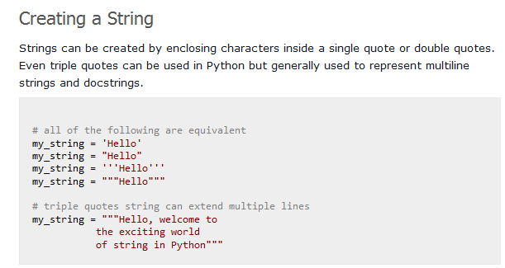

Slide 3
Accessing Characters in a String
We can access individual characters using indexing and a range of characters using slicing. Index starts from 0. Trying to access a character out of index range will raise an IndexError. The index must be an integer. We can't use float or other types, this will result into TypeError.
Python allows negative indexing for its sequences. The index of -1 refers to the last item, -2 to the second last item and so on. We can access a range of items in a string by using the slicing operator (colon).

Slide 4
For Eg.
fruit = “apple”
letter = fruit[1]
print letter
Output : p // (index value starts from 0 as in C & C++)
Try
fruit[-1], fruit[9]

Slide 5
STRING SLICES
A segment of a string is called a slice, i.e. a character.
The syntax to select a slice from a string is a[n:m], where a contains strings, n is the starting index and m is the end index.
Includes the first index and excluding the last index.
Eg:
s= “Peter, Paul, and Mary”
print s =[0:5] # Peter
print s =[7:11] # Paul
print s =[17:21] # Mary

Slide 6

STRING SLICES (to be continued…..)
fruit = “banana”
fruit[ : 3] #ban
fruit[ 3 :] #ana
fruit[:] ?

Slide 7
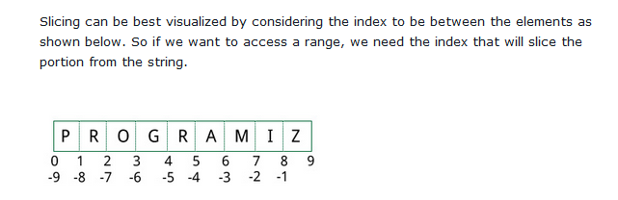

Slide 8
STRINGS ARE IMMUTABLE
An existing string cannot be modified.
For Eg :
greeting = "Hello, world!“ greeting[0] = ’J’ # ERROR! print greeting
Output : Hello, world

Slide 9
STRINGS ARE IMMUTABLE (to be continued….)
The Solution of the problem is
greeting = "Hello, world!“ newGreeting = ’J’ + greeting[1:] print newGreeting
Output : Jello, World
The original string remains intact.

Slide 10
Python String Operations
Concatenation of Strings
String Membership Test
We can test if a sub string exists within a string or not, using the keyword “in” and “not in”.
Built-in functions

Slide 11
LENGTH OF STRINGS
The inbuilt function to find the length of a string is ‘len()’.
For Eg.
fruit = “banana”
len(fruit)
Output : 6

Slide 12
Lower()
Upper()
Capitalize()
Title()

Slide 13
TRAVERSAL USING WHILE LOOP
Processing one character at one time.
For Eg.
index = 0
while index < len(fruit):
letter = fruit[index]
print letter
index = index + 1
(Take care of the indentation)

Slide 14
TRAVERSAL USING FOR LOOP
For loop provides us a privilege to access the characters without using index.
For Eg.
fruit=[“apple”,”banana”,”orange”]
for char in fruit:
print char
(Each time through the loop a character is assigned to the variable char)

Slide 15
TRAVERSAL USING FOR LOOP (to be continued…..)
ABECEDARIAN SERIES – Print using for loop
A series or list in which the elements appear in alphabetical order.
For Eg. In Robert McCloskey’s book Make way for Duckings the names of the ducklings were Jack, Kack, Lack, Mack, Nack, Ouack, Pack, Quack
To print them in order the code is :
prefixes = “JKLMNOPQ”
suffix = “ack”
for letter in prefixes:
print letter+suffix

Slide 16
String comparison
You can use ( > , < , <= , <= , == , != ) to compare two strings. Python compares string lexicographically i.e using ASCII value of the characters.
Suppose you have str1 as "Jane" and str2 as "Jake" . The first two characters from str1 and str2 ( J and J ) are compared. As they are equal, the second two characters are compared. Because they are also equal, the third two characters ( n and k ) are compared. And because 'n' has greater ASCII value than 'k' , str1 is greater than str2 .

Slide 17
STRING COMPARISON
Equality Comparison
if word ==“banana!”
Other Comparisons
if word < “banana”:
print ”Your word,”+ word + “,comes before banana.”
elif word > “banana”:
print ”Your word,”+ word + “,comes after banana.”
else:
print “ Yes, we have no bananas!”

Slide 18
STRING COMPARISON (to be continued…..)
Uppercase letters comes before Lowercase letters in Python.
Need to maintain a standard format of the strings.

Slide 19
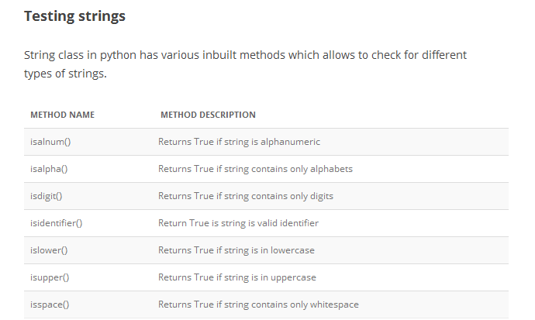

Slide 20
Creation of Find Function in Strings
Find function is used to find the index of a particular character inside the string, else it returns void.
It is opposite to that of the [] operator.
def find(str, ch): index = 0 while index < len(str): if str[index] == ch: return index index = index + 1 return -1

Slide 21
LOOPING AND COUNTING
For and while loops can be used for looping and counting.
The following code counts the no of times a appears in the string.
fruit = “grapes" count = 0 for char in fruit: if char == ’a’: count = count + 1 print count
Output : 1

Slide 22
STRING MODULE
String module is a package which contains useful functions for manipulating strings.
To use the string module we need to import it first by using the following line of code i.e.
import string
Find Function : This inbuilt function finds the index of the character in the string.
fruit = “guava”
index = string.find(fruit,”a”)
Output : 2

Slide 23
STRING MODULE (to be continued….)
Find Function :
Try out
string.find(“banana”,”na”) #2
string.find(“banana”,”na”,3) #4, (starts from index 3)
string.find(“bob”,”b”,1,2) #-1, (checks between 1 to 2 excluding 2 index)

Slide 24
CHARACTER CLASSIFICATION
Character Classification is a recognition of character (lowercase or uppercase) or it’s a digit.
String module provides several constants that are useful for these purposes.
string.lowercase contains all the letters that the system considers to be lowercase.
string.uppercase contains all the letters that the system considers to be uppercase.
print string.lowercase
print string.uppercase
print string.digits
print string.whitespace #moves the cursor without printing anything

Slide 25
CHARACTER CLASSIFICATION
Three ways to recognize lowercase
Method 1 :
def isLower(ch): return string.find(string.lowercase, ch) != -1
Method 2 :
def isLower(ch): return ch in string.lowercase
Method 3 :
def isLower(ch): return ’a’ <= ch <= ’z’

