Slide 1
Tuples

Slide 2
Tuple
Similar to a list except it is immutable.
Syntactically, it is comma-seperated list of values.
  tuple = 'a', 'b', 'c', 'd', 'e‘
To create a tuple with a single element, we have to include the comma:
  t1 = ('a',)
  type(t1)
  <type 'tuple'>
Without the comma, Python treats ('a') as a string in parentheses:
  t2 = ('a')
  type(t2) ??

Slide 3
The operations on tuples are the same as the operations on lists
The index operator selects an element from a tuple.
  tuple = ('a', 'b', 'c', 'd', 'e')
  tuple[0]
  'a‘
The slice operator selects a range of elements.
  tuple[1:3]
  ('b', 'c‘)
But if we try to modify one of the elements of the tuple, we get an error.
  tuple[0] = 'A'
  TypeError: object doesn't support item assignment

Slide 4
Example
we can't modify the elements of a tuple, we can replace it with a different tuple:
  tuple = ('A',) + tuple[1:]
  tuple
  ('A', 'b', 'c', 'd', 'e')

Slide 5
Tuple Assignmnt
To swap the values, using conventional assignment statements, we have to use the assignment statement with a temporary variable.
  temp = a
  a = b
  b = temp
Python provides a form of tuple assignment that solves this problem neatly:
  a, b = b, a
The number of variables on the left and the number of values on the right have to be the same.

Slide 6
Tuples as Return Values
Functions can return tuples as return values.
For example:
  def swap(x, y):
    return y, x
Then we can assign the return value to a tuple with two variables:
  a, b = swap(a, b)

Slide 7
def swap(x, y): # incorrect version
x, y = y, x
If we call this function like this:
swap(a, b)
a and x are aliases for the same value. Changing x inside swap makes x refer to a different value, but it has no effect on a in main . Similarly, changing y has no effect on b.

Slide 8
Random Numbers
The random module contains a function called random that returns a floating point number between 0.0 and 1.0.
Each time you call random, you get the next number in a long series.
from random import*
  for i in range(10):
x=random()
print x

Slide 9
List of Random Numbers
def randomList(n):
  s = [0] * n
for i in range(n):
s[i] = random.random()
return s
Output:
randomList(8)
0.15156642489
0.498048560109
0.810894847068
0.360371157682
0.275119183077
0.328578797631
0.759199803101
0.800367163582

Slide 10
Counting
Divide the problem into sub problems and look for sub problems that fit a computational pattern
Traverse a list of numbers and count the number of times a value falls in a given range.
Eg:
def inBucket(t, low, high):
count = 0
for num in t:
if low < num < high:
count = count + 1
return count
This development plan is known as pattern matching.

Slide 11
Many Buckets
With two buckets, range will be:
  low = inBucket(a, 0.0, 0.5)
  high = inBucket(a, 0.5, 1)
But with four buckets it is:
  bucket1 = inBucket(a, 0.0, 0.25)
  bucket2 = inBucket(a, 0.25, 0.5)
  bucket3 = inBucket(a, 0.5, 0.75)
  bucket4 = inBucket(a, 0.75, 1.0)

Slide 12
If the number of buckets is numBuckets, then the width of each bucket is 1.0 / numBuckets.
numBuckets = 8
buckets = [0] * numBuckets
bucketWidth = 1.0 / numBuckets
for i in range(numBuckets):
low = i * bucketWidth
high = low + bucketWidth
buckets[i] = inBucket(t, low, high)
print buckets

Slide 13
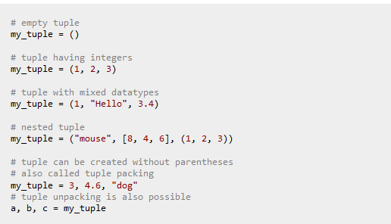
In Python programming, tuple is similar to a list. The difference between the two is that we cannot change the elements of a tuple once it is assigned whereas in a list, elements can be changed.

Slide 14

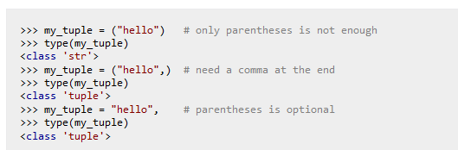

Slide 15
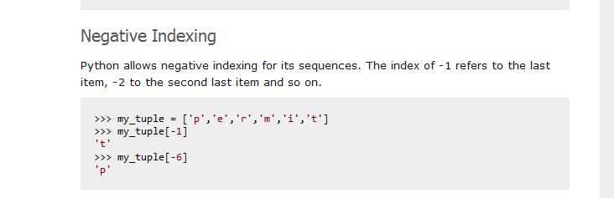
Indexing
We can use the index operator [] to access an item in a tuple. Index starts from 0. So, a tuple having 6 elements will have index from 0 to 5. Trying to access an element other that this will raise an IndexError. The index must be an integer. We can't use float or other types, this will result into TypeError. Nested tuple are accessed using nested indexing.

Slide 16
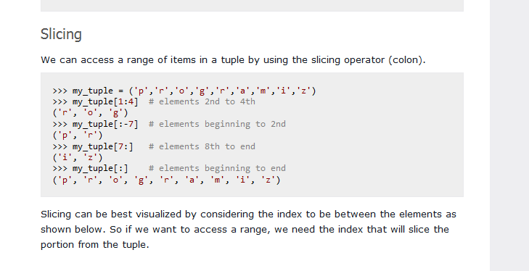

Slide 17
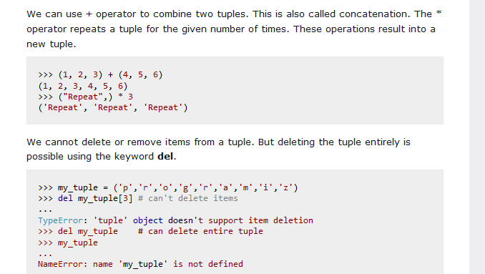

Slide 18
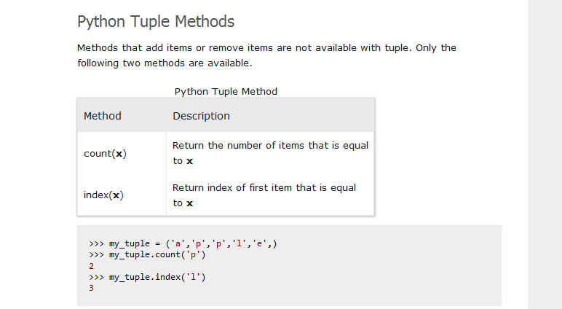

Slide 19
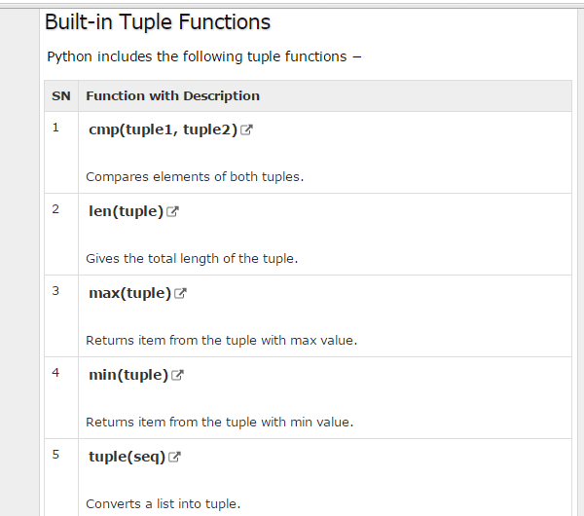

Slide 20
