Slide 1
Object Oriented
Design Patterns
Krishna Mohan Koyya Glarimy Technology Services
G l a r i m y
© 2021, Glarimy. All rights reserved. https://www.glarimy.com

Slide 2
Creational Patterns
G l a r i m y
© 2021, Glarimy. All rights reserved. https://www.glarimy.com

Slide 3
Factory
&
Factory Method
G l a r i m y
© 2021, Glarimy. All rights reserved. https://www.glarimy.com

Slide 4
Factory and Factory Method
G l a r i m y
Intent
To separate the responsibility of object creation from its user
Applicability
In all applications while creating an object against an interface
Benefit
Helps in decoupling the application code from the service implementation
© 2021, Glarimy. All rights reserved. https://www.glarimy.com

Slide 5
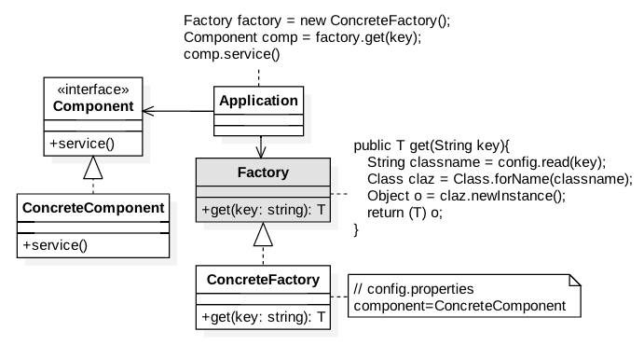
Factory and Factory Method
G l a r i m y
© 2021, Glarimy. All rights reserved. https://www.glarimy.com

Slide 6
Problem
G l a r i m y
© 2021, Glarimy. All rights reserved. https://www.glarimy.com

Slide 7
Factory and Factory Method
G l a r i m y
Component.java
package com.glarimy.factory;
public class Component {
public void service() {
System.out.println("Component::service()");
}
}
© 2021, Glarimy. All rights reserved. https://www.glarimy.com

Slide 8
Factory and Factory Method
G l a r i m y
Application.java
package com.glarimy.factory;
public class Application {
public static void main(String[] args) {
Component component = new Component();
component.service();
}
}
© 2021, Glarimy. All rights reserved. https://www.glarimy.com

Slide 9
Solution
G l a r i m y
© 2021, Glarimy. All rights reserved. https://www.glarimy.com

Slide 10
Factory and Factory Method
G l a r i m y
Component.java
package com.glarimy.factory;
public interface Component {
public void service();
}
© 2021, Glarimy. All rights reserved. https://www.glarimy.com

Slide 11
Factory and Factory Method
G l a r i m y
ConcreteComponent.java
package com.glarimy.factory;
public class ConcreteComponent implements Component {
@Override
public void service() {
System.out.println("ConcreteComponent::service");
}
}
© 2021, Glarimy. All rights reserved. https://www.glarimy.com

Slide 12
Factory and Factory Method
G l a r i m y
Factory.java package com.glarimy.factory;
public interface Factory<T> {
T get(String key) throws Exception;
}
© 2021, Glarimy. All rights reserved. https://www.glarimy.com

Slide 13
Factory and Factory Method
G l a r i m y
ConcreteFactory.java
package com.glarimy.factory;
public class ConcreteFactory<T> implements Factory<T> {
private Properties props;
public ConcreteFactory() throws Exception {
props = new Properties();
props.load(new FileReader("config.properties"));
}
@Override
@SuppressWarnings({ "rawtypes", "unchecked" })
public T get(String key) throws Exception {
Class claz = Class.forName(props.getProperty(key));
return (T)claz.newInstance();
}
}
© 2021, Glarimy. All rights reserved. https://www.glarimy.com

Slide 14
Factory and Factory Method
G l a r i m y
config.properties
component=com.glarimy.factory.ConcreteComponent
© 2021, Glarimy. All rights reserved. https://www.glarimy.com

Slide 15
Factory and Factory Method
G l a r i m y
Application.java
package com.glarimy.factory;
public class Application {
public static void main(String[] args) throws Exception {
Factory<Component> factory = new ConcreteFactory<>();
Component component = factory.get("component");
component.service();
}
}
© 2021, Glarimy. All rights reserved. https://www.glarimy.com
© 2021, Glarimy. All rights reserved. https://www.glarimy.com

Slide 16
Abstract Factory
G l a r i m y
© 2021, Glarimy. All rights reserved. https://www.glarimy.com

Slide 17
Abstract Factory
G l a r i m y
Intent
To choose a factory from several available factories for a given interface
Benefits
Helps in decoupling client applications from the vendor implementations
Applicability
In cases where the API and its implementation are done by different vendors
© 2021, Glarimy. All rights reserved. https://www.glarimy.com

Slide 18
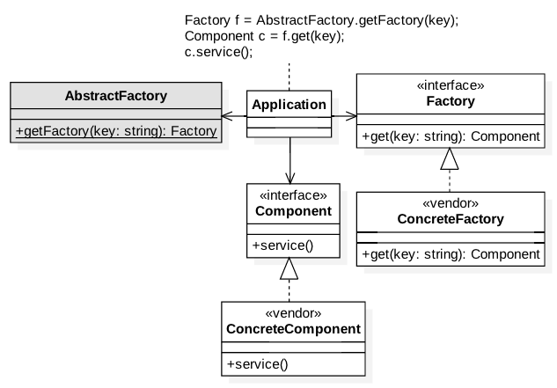
Abstract Factory
G l a r i m y
© 2021, Glarimy. All rights reserved. https://www.glarimy.com

Slide 19
Singleton
G l a r i m y
© 2021, Glarimy. All rights reserved. https://www.glarimy.com

Slide 20
Singleton
G l a r i m y
Intent
To limit the number of instances of a class to a maximum of one
Applicability
Normally used in configuration, cache and etc.,
Benefit
Helps in maintaining the application context in memory
© 2021, Glarimy. All rights reserved. https://www.glarimy.com

Slide 21
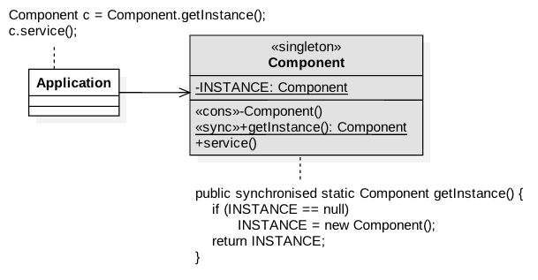
Singleton
G l a r i m y
© 2021, Glarimy. All rights reserved. https://www.glarimy.com

Slide 22
Problem
G l a r i m y
© 2021, Glarimy. All rights reserved. https://www.glarimy.com

Slide 23
Singleton
G l a r i m y
Component.java
package com.glarimy.singleton;
public class Component {
public void service() {
System.out.println("Component::execute");
}
}
© 2021, Glarimy. All rights reserved. https://www.glarimy.com

Slide 24
Singleton
G l a r i m y
Application.java
package com.glarimy.singleton;
public class Application {
public static void main(String[] args) throws Exception {
Component component = new Component();
component.service();
}
}
© 2021, Glarimy. All rights reserved. https://www.glarimy.com

Slide 25
Solution
G l a r i m y
© 2021, Glarimy. All rights reserved. https://www.glarimy.com

Slide 26
Singleton
G l a r i m y
Component.java
package com.glarimy.singleton;
public class Component {
private static Component INSTANCE = null;
private Component() {
}
public static synchronized Component getInstance() {
if (INSTANCE == null)
INSTANCE = new Component();
return INSTANCE;
}
public void service() {
System.out.println("Component::execute");
}
}
© 2021, Glarimy. All rights reserved. https://www.glarimy.com

Slide 27
Singleton
G l a r i m y
Application.java
package com.glarimy.singleton;
public class Application {
public static void main(String[] args) throws Exception {
Component component = Component.getInstance();
component.service();
}
}
© 2021, Glarimy. All rights reserved. https://www.glarimy.com

Slide 28
Builder
G l a r i m y
© 2021, Glarimy. All rights reserved. https://www.glarimy.com

Slide 29
Builder
G l a r i m y
Intent
To build an immutable object interactively
Applicability
Often used in query builders, request builders and etc.,
Benefits
Defers creation of heavy and complex objects as much as possible
© 2021, Glarimy. All rights reserved. https://www.glarimy.com

Slide 30
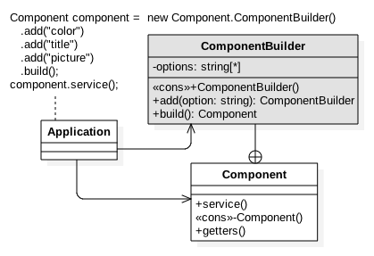
Builder
G l a r i m y
© 2021, Glarimy. All rights reserved. https://www.glarimy.com

Slide 31
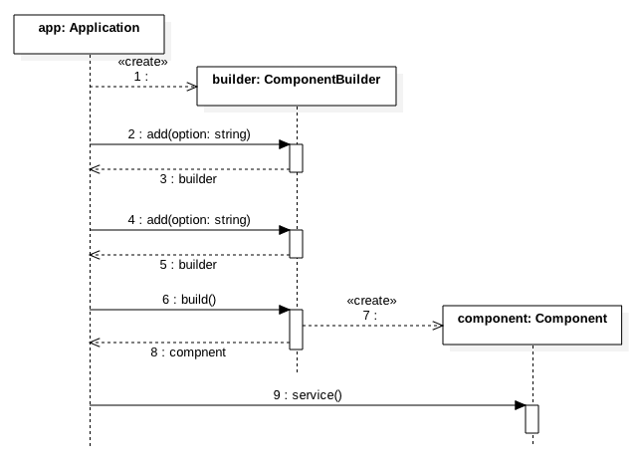
Builder
G l a r i m y
© 2021, Glarimy. All rights reserved. https://www.glarimy.com

Slide 32
Problem
G l a r i m y
© 2021, Glarimy. All rights reserved. https://www.glarimy.com

Slide 33
Builder
G l a r i m y
Component.java
package com.glarimy.builder;
import java.util.ArrayList;
import java.util.List;
public class Component {
private List<String> options = new ArrayList<String>();
public Component(String first, String second, String third) {
this.options.add(first);
this.options.add(second);
this.options.add(third);
}
public List<String> getOptions() {
return options;
}
public void setOptions(List<String> options) {
this.options = options;
}
public void service() {
System.out.println(this.options);
}
}
© 2021, Glarimy. All rights reserved. https://www.glarimy.com

Slide 34
Builder
G l a r i m y
Application.java
package com.glarimy.builder;
public class Application {
public static void main(String[] args) throws Exception {
Component order = new Component("color", "title", "picture");
order.service();
}
}
© 2021, Glarimy. All rights reserved. https://www.glarimy.com

Slide 35
Solution
G l a r i m y
© 2021, Glarimy. All rights reserved. https://www.glarimy.com

Slide 36
Builder
G l a r i m y
Component.java
package com.glarimy.builder;
import java.util.ArrayList;
import java.util.List;
public class Component {
private List<String> options = new ArrayList<String>();
private Component(String first, String second, String third) {
this.options.add(first);
this.options.add(second);
this.options.add(third);
}
public String[] getOptions() {
return (String[]) options.toArray();
}
public void service() {
System.out.println(this.options);
}
public static class ComponentBuilder{
private List<String> options = new ArrayList<String>();
public ComponentBuilder add(String option) {
options.add(option);
return this;
}
public Component build() {
return new Component(options.get(0), options.get(1), options.get(2));
}
}
}
© 2021, Glarimy. All rights reserved. https://www.glarimy.com

Slide 37
Builder
G l a r i m y
Application.java
package com.glarimy.builder;
public class Application {
public static void main(String[] args) throws Exception {
Component component = new Component.ComponentBuilder().add("color").add("title").add("picture").build();
component.service();
}
}
© 2021, Glarimy. All rights reserved. https://www.glarimy.com

Slide 38
Structural Patterns
G l a r i m y
© 2021, Glarimy. All rights reserved. https://www.glarimy.com

Slide 39
Adapter
G l a r i m y
© 2021, Glarimy. All rights reserved. https://www.glarimy.com

Slide 40
Adapter
G l a r i m y
Intent
To provide a known interface to an unknown object
Applicability
Often used as a protection layer between application and third-party components
Benefits
Avoids tight coupling with third-party code
© 2021, Glarimy. All rights reserved. https://www.glarimy.com

Slide 41
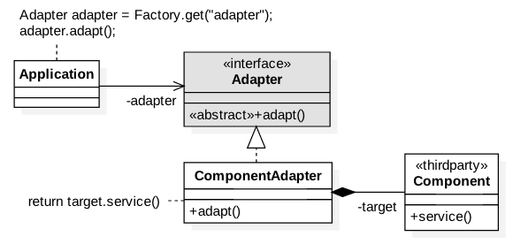
Adapter
G l a r i m y
© 2021, Glarimy. All rights reserved. https://www.glarimy.com

Slide 42
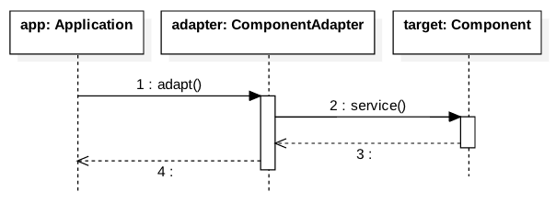
Adapter
G l a r i m y
© 2021, Glarimy. All rights reserved. https://www.glarimy.com

Slide 43
Problem
G l a r i m y
© 2021, Glarimy. All rights reserved. https://www.glarimy.com

Slide 44
Adapter
G l a r i m y
Component.java
package com.glarimy.adapter;
public class Component {
public void service() {
System.out.println("Component::service()");
}
}
© 2021, Glarimy. All rights reserved. https://www.glarimy.com

Slide 45
Adapter
G l a r i m y
Application.java
package com.glarimy.adapter;
public class Application {
public static void main(String[] args) {
Component component = new Component();
component.service();
}
}
© 2021, Glarimy. All rights reserved. https://www.glarimy.com

Slide 46
Solution
G l a r i m y
© 2021, Glarimy. All rights reserved. https://www.glarimy.com

Slide 47
Adapter
G l a r i m y
Component.java
package com.glarimy.thirdparty;
public class Component {
public void service() {
System.out.println("Component::service()");
}
}
© 2021, Glarimy. All rights reserved. https://www.glarimy.com

Slide 48
Adapter
G l a r i m y
Adapter.java
package com.glarimy.app;
public interface Adapter {
public void adapt();
}
© 2021, Glarimy. All rights reserved. https://www.glarimy.com

Slide 49
Adapter
G l a r i m y
ConcreteAdapter.java
package com.glarimy.app;
import com.glarimy.thirdparty.Component;
public class ComponentAdapter implements Adapter {
private Component component;
public ComponentAdapter() {
this.component = new Component();
}
@Override
public void adapt() {
this.component.service();
}
}
© 2021, Glarimy. All rights reserved. https://www.glarimy.com

Slide 50
Adapter
G l a r i m y
Application.java
package com.glarimy.app;
public class Application {
public static void main(String[] args) {
Adapter adapter = new ComponentAdapter();
adapter.adapt();
}
}
© 2021, Glarimy. All rights reserved. https://www.glarimy.com

Slide 51
Proxy
G l a r i m y
© 2021, Glarimy. All rights reserved. https://www.glarimy.com

Slide 52
Proxy
G l a r i m y
Intent
To do pre and post processing anonymously
Applicability
Popular in offering pluggable quality features
Benefits
Helps in separating the concerns
© 2021, Glarimy. All rights reserved. https://www.glarimy.com

Slide 53
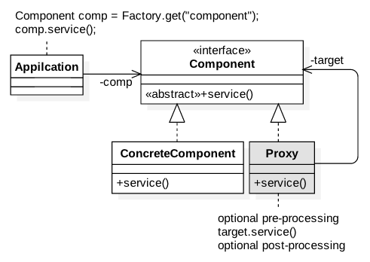
Proxy
G l a r i m y
© 2021, Glarimy. All rights reserved. https://www.glarimy.com

Slide 54
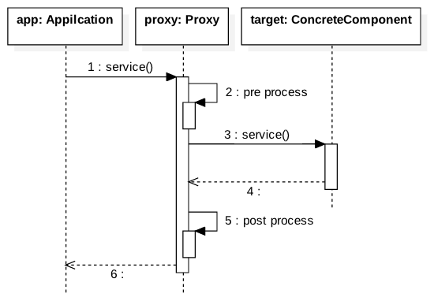
Proxy
G l a r i m y
© 2021, Glarimy. All rights reserved. https://www.glarimy.com

Slide 55
Problem
G l a r i m y
© 2021, Glarimy. All rights reserved. https://www.glarimy.com

Slide 56
Proxy
G l a r i m y
Component.java
package com.glarimy.proxy;
public class Component {
public void service() throws Exception {
System.out.println("Component::service");
}
}
© 2021, Glarimy. All rights reserved. https://www.glarimy.com

Slide 57
Proxy
G l a r i m y
Application.java
package com.glarimy.proxy;
public class Application {
public static void main(String[] args) throws Exception {
Component comp = new Component();
comp.service();
}
}
© 2021, Glarimy. All rights reserved. https://www.glarimy.com

Slide 58
Solution
G l a r i m y
© 2021, Glarimy. All rights reserved. https://www.glarimy.com

Slide 59
Proxy
G l a r i m y
Component.java
package com.glarimy.proxy;
public interface Component {
public void service() throws Exception;
}
© 2021, Glarimy. All rights reserved. https://www.glarimy.com

Slide 60
Proxy
G l a r i m y
ConcreteComponent.java
package com.glarimy.proxy;
public class ConcreteComponent implements Component {
public void service() throws Exception {
System.out.println("ConcreteComponent::service");
}
}
© 2021, Glarimy. All rights reserved. https://www.glarimy.com

Slide 61
Proxy
G l a r i m y
Proxy.java
package com.glarimy.proxy;
public class Proxy implements Component {
private Component target;
public Proxy(Component target) {
this.target = target;
}
public void service() throws Exception {
System.out.println("Proxy::pre processing");
try {
target.service();
System.out.println("Proxy::post processing");
}catch(Exception e) {
System.out.println("Proxy::error handling");
throw e;
}
}
}
© 2021, Glarimy. All rights reserved. https://www.glarimy.com

Slide 62
Proxy
G l a r i m y
Application.java
package com.glarimy.proxy;
public class Application {
public static void main(String[] args) throws Exception {
Component target = new ConcreteComponent();
Component proxy = new Proxy(target);
proxy.service();
}
}
© 2021, Glarimy. All rights reserved. https://www.glarimy.com

Slide 63
Decorator
G l a r i m y
© 2021, Glarimy. All rights reserved. https://www.glarimy.com

Slide 64
Decorator
G l a r i m y
Intent
To extend an object
Applicability
Often used to provide add-on features
Benefits
Offloads optional functionality from objects
© 2021, Glarimy. All rights reserved. https://www.glarimy.com

Slide 65
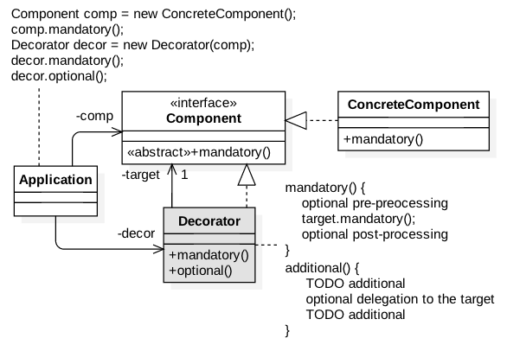
Decorator
G l a r i m y
© 2021, Glarimy. All rights reserved. https://www.glarimy.com

Slide 66
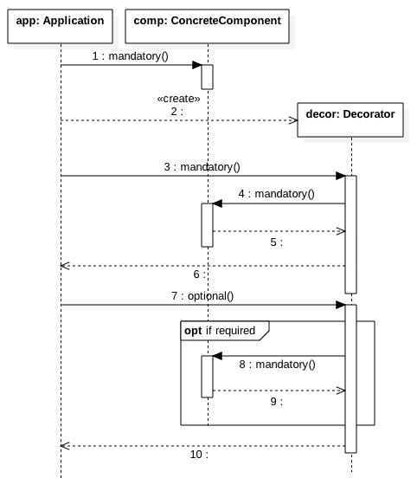
Decorator
G l a r i m y
© 2021, Glarimy. All rights reserved. https://www.glarimy.com

Slide 67
Problem
G l a r i m y
© 2021, Glarimy. All rights reserved. https://www.glarimy.com

Slide 68
Decorator
G l a r i m y
Component.java
package com.glarimy.decorator;
public class Component {
public void mandatory() {
System.out.println("Component::mandatory");
}
public void optional() {
System.out.println("Component::optional");
}
}
© 2021, Glarimy. All rights reserved. https://www.glarimy.com

Slide 69
Decorator
G l a r i m y
Application.java
package com.glarimy.decorator;
public class Application {
public static void main(String[] args) throws Exception {
Component comp = new Component();
comp.mandatory();
comp.optional();
}
}
© 2021, Glarimy. All rights reserved. https://www.glarimy.com

Slide 70
Solution
G l a r i m y
© 2021, Glarimy. All rights reserved. https://www.glarimy.com

Slide 71
Decorator
G l a r i m y
Component.java
package com.glarimy.decorator;
public interface Component {
public void mandatory();
}
© 2021, Glarimy. All rights reserved. https://www.glarimy.com

Slide 72
Decorator
G l a r i m y
ConcreteComponent.java
package com.glarimy.decorator;
public class ConcreteComponent implements Component {
@Override
public void mandatory() {
System.out.println("Component::mandatory");
}
}
© 2021, Glarimy. All rights reserved. https://www.glarimy.com

Slide 73
Decorator
G l a r i m y
Decorator.java
package com.glarimy.decorator;
public class Decorator implements Component {
private Component target;
public Decorator(Component target) {
this.target = target;
}
public void mandatory() {
this.target.mandatory();
}
public void optional() {
System.out.println("Decorator::optional pre processing");
this.target.mandatory();
System.out.println("Decorator::optional post processing");
}
}
© 2021, Glarimy. All rights reserved. https://www.glarimy.com

Slide 74
Decorator
G l a r i m y
Application.java
package com.glarimy.decorator;
public class Application {
public static void main(String[] args) throws Exception {
Component comp = new ConcreteComponent();
comp.mandatory();
Decorator decorator = new Decorator(comp);
decorator.mandatory();
decorator.optional();
}
}
© 2021, Glarimy. All rights reserved. https://www.glarimy.com

Slide 75
Composite
G l a r i m y
© 2021, Glarimy. All rights reserved. https://www.glarimy.com

Slide 76
Composite
G l a r i m y
Intent
To treat sum of the parts as a whole
Applicability
Often used in GUI widget systems
Benefits
Enables addition and removal of objects from a heirarchy without disturbance
© 2021, Glarimy. All rights reserved. https://www.glarimy.com

Slide 77
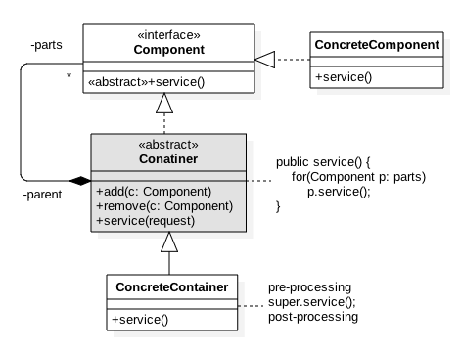
Composite
G l a r i m y
© 2021, Glarimy. All rights reserved. https://www.glarimy.com

Slide 78
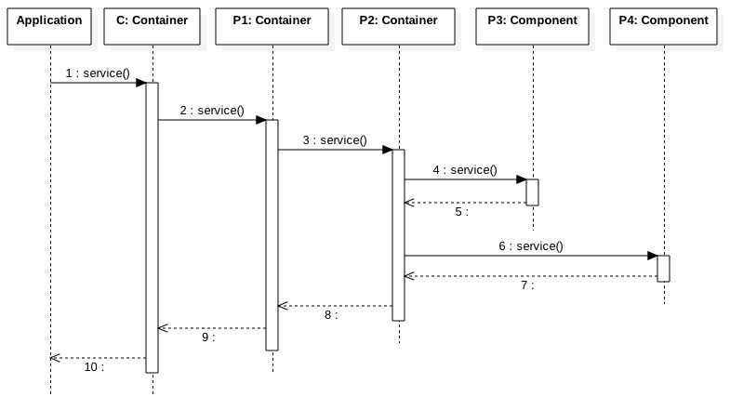
Composite
G l a r i m y
© 2021, Glarimy. All rights reserved. https://www.glarimy.com

Slide 79
Solution
G l a r i m y
© 2021, Glarimy. All rights reserved. https://www.glarimy.com

Slide 80
Composite
G l a r i m y
Component.java
package com.glarimy.composit;
public interface Component {
public void service();
}
© 2021, Glarimy. All rights reserved. https://www.glarimy.com

Slide 81
Composite
G l a r i m y
Container.java
package com.glarimy.composit;
import java.util.ArrayList;
import java.util.List;
public abstract class Container implements Component {
private List<Component> parts = new ArrayList<>();
public void add(Component part) {
parts.add(part);
}
public void remove(Component part) {
parts.remove(part);
}
public void service() {
for(Component part: parts)
part.service();
}
}
© 2021, Glarimy. All rights reserved. https://www.glarimy.com

Slide 82
Composite
G l a r i m y
ConcreteComponent.java
package com.glarimy.composit;
public class ConcreteComponent implements Component {
@Override
public void service() {
System.out.println("ConcreteComponent::service");
}
}
© 2021, Glarimy. All rights reserved. https://www.glarimy.com

Slide 83
Composite
G l a r i m y
ConcreteContainer.java
package com.glarimy.composit;
public class ConcreteContainer extends Container {
@Override
public void service() {
System.out.println("ConcreteContainer::service - start");
super.service();
System.out.println("ConcreteContainer::service - stop");
}
}
© 2021, Glarimy. All rights reserved. https://www.glarimy.com

Slide 84
Composite
G l a r i m y
Application.java
package com.glarimy.composit;
public class Application {
public static void main(String[] args) throws Exception {
Container container = new ConcreteContainer();
Container partOne = new ConcreteContainer();
Container partTwo = new ConcreteContainer();
Component partThree = new ConcreteComponent();
Component partFour = new ConcreteComponent();
partTwo.add(partThree);
partTwo.add(partFour);
partOne.add(partTwo);
container.add(partOne);
container.service();
}
}
© 2021, Glarimy. All rights reserved. https://www.glarimy.com

Slide 85
Facade
G l a r i m y
© 2021, Glarimy. All rights reserved. https://www.glarimy.com

Slide 86
Facade
G l a r i m y
Intent
To hide internal collaboration of objects
Applicability
Often provided as a front-end gateway to a reusable system
Benefits
Protects the client applications from changes in the reusable system
© 2021, Glarimy. All rights reserved. https://www.glarimy.com

Slide 87
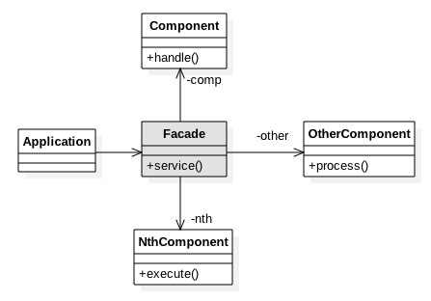
Facade
G l a r i m y
© 2021, Glarimy. All rights reserved. https://www.glarimy.com

Slide 88
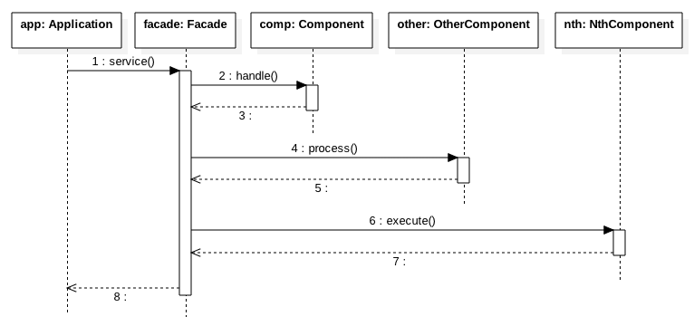
Facade
G l a r i m y
© 2021, Glarimy. All rights reserved. https://www.glarimy.com

Slide 89
Behaviroual Patterns
G l a r i m y
© 2021, Glarimy. All rights reserved. https://www.glarimy.com

Slide 90
Chain of Responsibilities
G l a r i m y
© 2021, Glarimy. All rights reserved. https://www.glarimy.com

Slide 91
Chain of Responsibilities
G l a r i m y
Intent
To escalate a call conditionally
Applicability
Found MVC frameworks and Middleware with interceptors
Benefits
Helps in plugging and plugging out interceptors without disturbing the heirarchy
© 2021, Glarimy. All rights reserved. https://www.glarimy.com

Slide 92
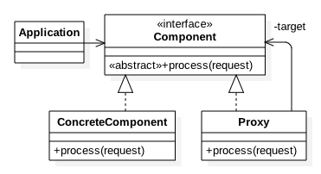
Chain of Responsibilities
G l a r i m y
© 2021, Glarimy. All rights reserved. https://www.glarimy.com

Slide 93
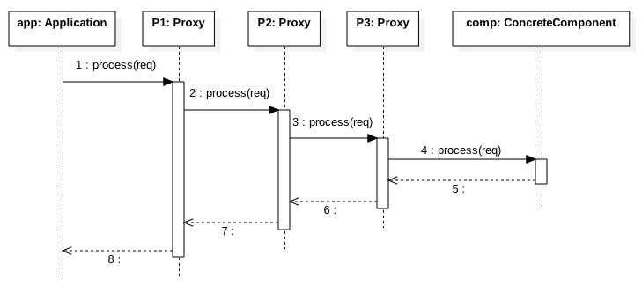
Chain of Responsibilities
G l a r i m y
© 2021, Glarimy. All rights reserved. https://www.glarimy.com

Slide 94
Mediator
G l a r i m y
© 2021, Glarimy. All rights reserved. https://www.glarimy.com

Slide 95
Mediator
G l a r i m y
Intent
To enable intra-group communication asynchronously
Applicability
Found in cluster management systems
Benefits
Decouples the group members
© 2021, Glarimy. All rights reserved. https://www.glarimy.com

Slide 96
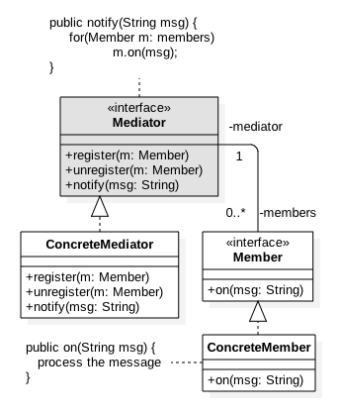
Mediator
G l a r i m y
© 2021, Glarimy. All rights reserved. https://www.glarimy.com

Slide 97
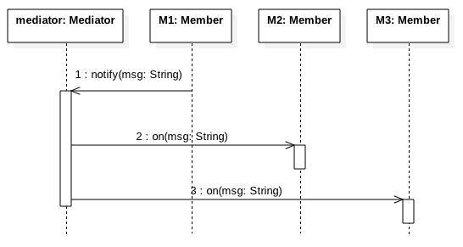
Mediator
G l a r i m y
© 2021, Glarimy. All rights reserved. https://www.glarimy.com

Slide 98
Observer
G l a r i m y
© 2021, Glarimy. All rights reserved. https://www.glarimy.com

Slide 99
Observer
G l a r i m y
Intent
To enable inter-group communication asynchronously
Applicability
Found in messaging systems
Benefits
Decouples the publishers and subscribers
© 2021, Glarimy. All rights reserved. https://www.glarimy.com

Slide 100
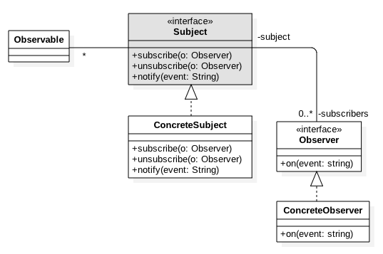
Observer
G l a r i m y
© 2021, Glarimy. All rights reserved. https://www.glarimy.com

Slide 101
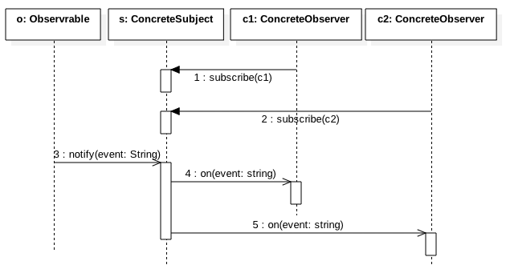
Observer
G l a r i m y
© 2021, Glarimy. All rights reserved. https://www.glarimy.com

Slide 102
Strategy
G l a r i m y
© 2021, Glarimy. All rights reserved. https://www.glarimy.com

Slide 103
Strategy
G l a r i m y
Intent
To choose an algorithm at runtime
Applicability
Often used to offer customizable solutions
Benefits
Helps in picking context specific implementation
© 2021, Glarimy. All rights reserved. https://www.glarimy.com

Slide 104
Template Method
G l a r i m y
© 2021, Glarimy. All rights reserved. https://www.glarimy.com

Slide 105
Template Method
G l a r i m y
Intent
To build a generic algorithm
Applicability
Often used when different algorithms share some common steps
Benefits
Avoids code duplication
© 2021, Glarimy. All rights reserved. https://www.glarimy.com

Slide 106
Iterator
G l a r i m y
© 2021, Glarimy. All rights reserved. https://www.glarimy.com

Slide 107
Iterator
G l a r i m y
Intent
To travers through an datastructure without knowing the structure
Applicability
Often used lists, collections, trees, graphs and etc.,
Benefits
Provides unified way to iterate through a collection of elements
© 2021, Glarimy. All rights reserved. https://www.glarimy.com

Slide 108
Visitor
G l a r i m y
© 2021, Glarimy. All rights reserved. https://www.glarimy.com

Slide 109
Visitor
G l a r i m y
Intent
To decorate an object graph
Applicability
Helps in offering new features without disturbing the interface
Benefits
Easy to add additional functionality
© 2021, Glarimy. All rights reserved. https://www.glarimy.com

Slide 110
State
G l a r i m y
© 2021, Glarimy. All rights reserved. https://www.glarimy.com

Slide 111
State
G l a r i m y
Intent
To build state machine
Applicability
Obvious
Benefits
Helps in adding and removing states easily
© 2021, Glarimy. All rights reserved. https://www.glarimy.com

Slide 112
Command
G l a r i m y
© 2021, Glarimy. All rights reserved. https://www.glarimy.com

Slide 113
Command
G l a r i m y
Intent
To act as a callback object
Applicability
Used in event driven systems
Benefits
Helps in non-blocking asynchronous systems
© 2021, Glarimy. All rights reserved. https://www.glarimy.com

Slide 114
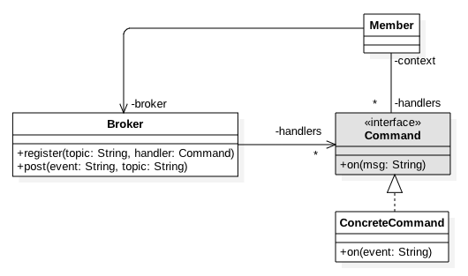
Command
G l a r i m y
© 2021, Glarimy. All rights reserved. https://www.glarimy.com

Slide 115
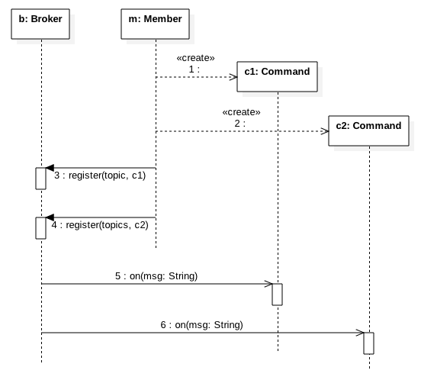
Command
G l a r i m y
© 2021, Glarimy. All rights reserved. https://www.glarimy.com

