Slide 1
SCREEN
ADMIT ONE
Seat A1 | Screen 1
Cinema Seat Booking System
A Java-Based Cinema Ticket and Seat Reservation Application
Problem Solving Using Programming in Java (PSPJ) | KL University / KLH | Team No: [add from reference PPT]
A. Saketh
Roll No: 2620030597
P. Madhava NagaSai
Roll No: 2620030534
Mohit Swami
Roll No: 2620030381
Presentation Date: 15-10-2026

Slide 2
Abstract
What the system does
TICKET
Seat B3 | Rs. __
A Java application for managing cinema ticket bookings
Shows available movies and seats
Books seats and calculates ticket price
Prevents the same seat being booked twice
Keeps booking records for future reference
File handling / collections are mentioned only where the code uses them
SCREEN
Teal = available Grey = booked (illustration)

Slide 3
Understanding the Problem Statement
Existing Problems
Proposed Solution
Manual ticket booking takes time
Customers may not know which seats are free
Duplicate reservations when records are poorly managed
Manual booking records are hard to maintain
Menu-driven Java application
Displays movie and seat information
Validates booking requests
Updates seat availability after booking
Stores/displays bookings (if in code)
Manual process
→
Seat confusion
→
Java menu app
→
Validated booking

Slide 4
CO1: Java Foundations
Code below is an ILLUSTRATIVE EXAMPLE
Concepts to show
Scanner sc = new Scanner(System.in);
int seats = sc.nextInt();
double price = seats * 150;
System.out.println("Total: " + price);
Variables and data types (int, double, String, boolean)
Operators and expressions (price = seats * rate)
Constants (final), where used
Scanner for keyboard input
System.out.println() for output
Basic program structure: class + main()
EXAMPLE only: replace with the project's real code
Input → calculation → output is the core pattern of booking a ticket.

Slide 5
CO2: Control Flow
DRAFT: verify against source code
Used for decisions
do {
showMenu();
choice = sc.nextInt();
if (seatIsFree(row, col)) { book(row, col); }
else { System.out.println("Seat taken"); }
} while (choice != 0);
if / if-else: validate booking
switch: menu options (if used)
Loops: repeat menu until exit
Boolean check: is seat available?
Start
→
Display Menu
→
Select Option
→
Validate Input
→
Perform Operation
→
Display Result
→
Menu or Exit
Flowchart follows the template in the prompt; adjust to match the real code.

Slide 6
CO3: Methods and Arrays
Seat map is an ILLUSTRATION
What to explain
SCREEN
Methods: show movies, book seat, check availability
Parameters and return values
1D arrays: movie names / prices (if used)
2D array: rows × columns of seats
Nested loops to print seats
Overloading / recursion only if in the code
Col 1
2
3
4
5
Row A
O
O
X
O
O
Row B
O
X
X
O
O
Row C
O
O
O
O
O
Row D
O
O
O
O
X
O = available (teal) X = booked (red)
boolean[][] booked = new boolean[4][5];

Slide 7
CO4: OOP and Exceptions
DRAFT: verify against source code
Concept | What to show | Status
Classes & objects | e.g. Movie / Booking class | Verify
Constructors | Initialise object fields | Verify
Encapsulation | private fields + getters/setters | Verify
Inheritance / interfaces | Only if present in code | Verify
try-catch | e.g. InputMismatchException on bad input | Verify
Validation | Reject invalid row/column/seat count | Verify
Mark each row Implemented / Not implemented after checking the source. Add a class diagram only if the code has multiple classes.

Slide 8
CO5: Strings and File I/O
DRAFT: verify against source code
What to explain
Sample booking record (ILLUSTRATIVE)
String for movie / customer names
equals() / equalsIgnoreCase() to compare or search
File classes (FileWriter, BufferedReader, Scanner(File)) if used
Saving bookings to a file
Reloading saved records on restart (if supported)
Movie: ____ | Seat: B3 | Price: ____
FileWriter fw = new FileWriter("bookings.txt", true);
fw.write("B3,Movie,150\n");
fw.close();
EXAMPLE only: replace with real project code

Slide 9
CO6: Collections and Streams
DRAFT: verify against source code
Concept | Possible use in this project | Status
ArrayList | Store movies / bookings | Verify
HashMap | Map movie ID → details | Verify
HashSet | Track unique booked seats | Verify
Lambda | Short inline functions | Verify
Stream API | Filter, sort, summarise bookings | Verify
Keep only what the code really uses. Anything unused goes on the slide as a "possible extension", not an implemented feature.

Slide 10
Conclusion
Implemented (confirm with code)
Future enhancements
Menu-driven Java booking program
Seat availability and duplicate-booking check
Ticket price calculation
Booking records (if file/collections used)
Demonstrates CO1–CO6 concepts
Graphical interface
Database integration
Multiple showtimes
User login
Booking cancellation
Java can automate basic cinema booking and keep seats and records organised.

Slide 11
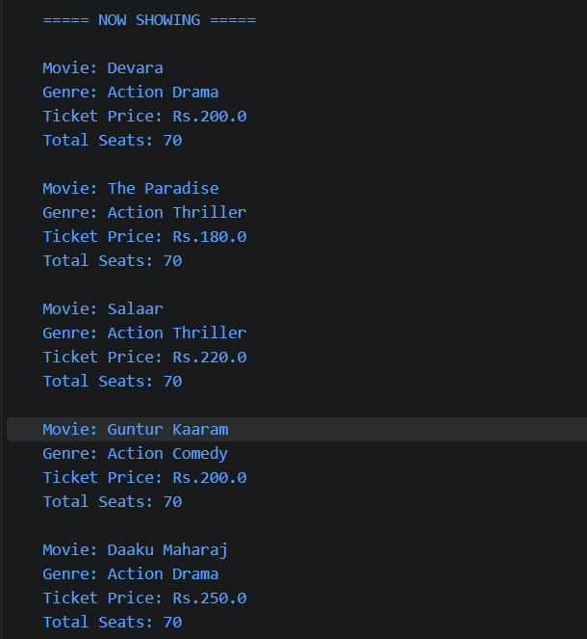
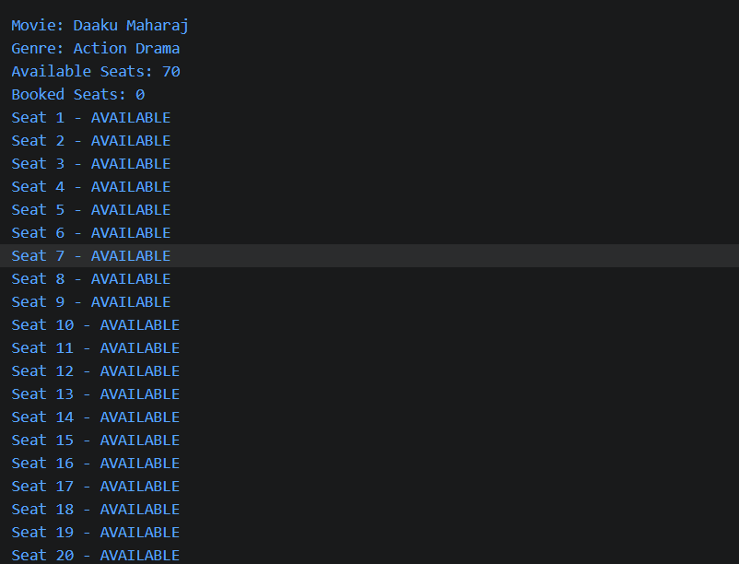
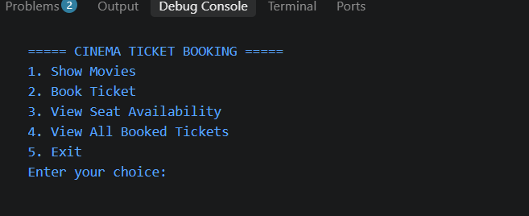
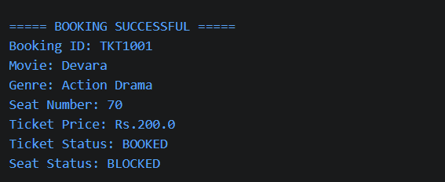
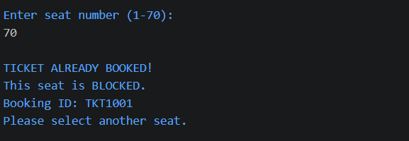
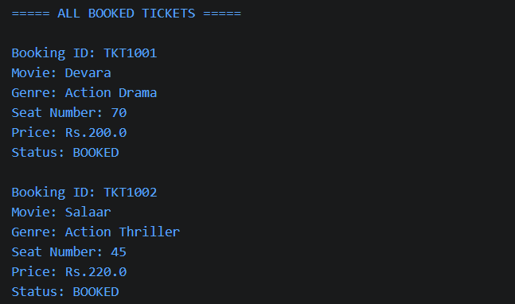
Screenshots
[ Screenshot placeholder ]
[ Screenshot placeholder ]
[ Screenshot placeholder ]
Main menu
Movie listing
Seat availability
[ Screenshot placeholder ]
[ Screenshot placeholder ]
[ Screenshot placeholder ]
Successful booking
Invalid / unavailable seat
Booking history / saved records

Slide 12
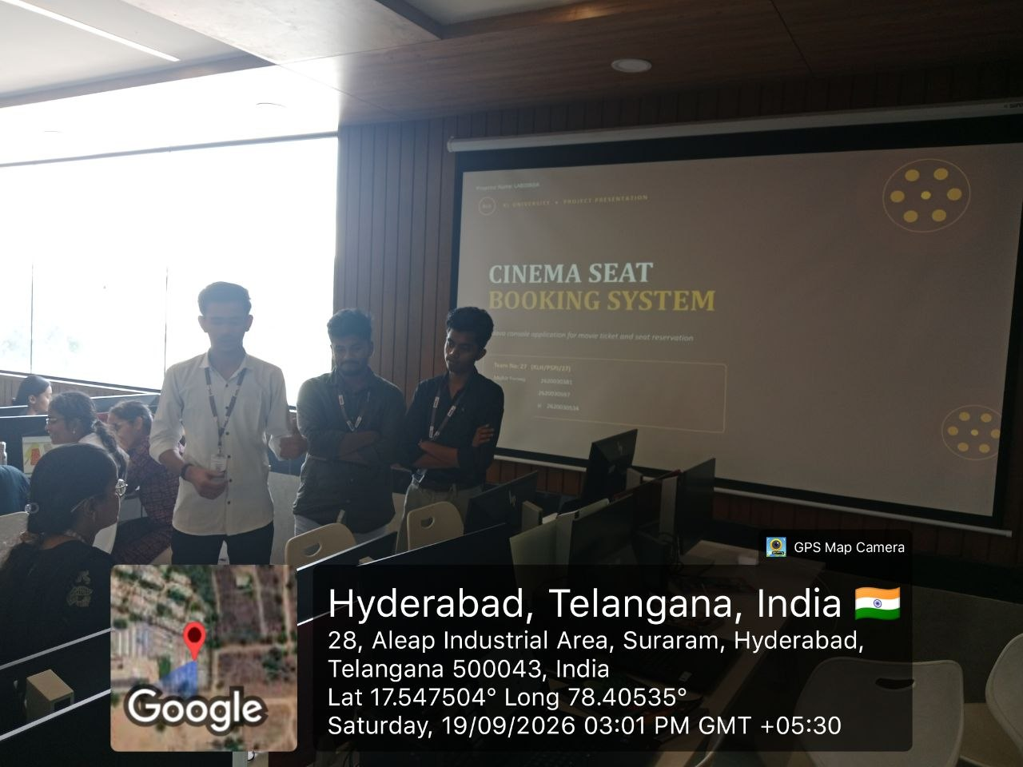
Team Photo and Repository
[ Geo-tagged team photo placeholder ]
GitHub repository
https://github.com/mohitswami77377-collab/Cinema-Seat-Booking-System
Java source code and documentation for the Cinema Seat Booking System.
A. Saketh | 2620030597
P. Madhava NagaSai | 2620030534
Mohit Swami | 2620030381
Thank You

