Slide 1
Churn Prediction & Retention Strategy (Capstone Project)
Author: Mohit Taluja
End-to-End ML Project

Slide 2
Problem Statement
Customer churn impacts revenue.
Goal: Predict churn & reduce it using ML.

Slide 3
Dataset Overview
Includes demographics, billing, usage.
Target: is_churn.

Slide 4
Data Cleaning
Handled missing values & duplicates.
Prepared clean dataset.

Slide 5
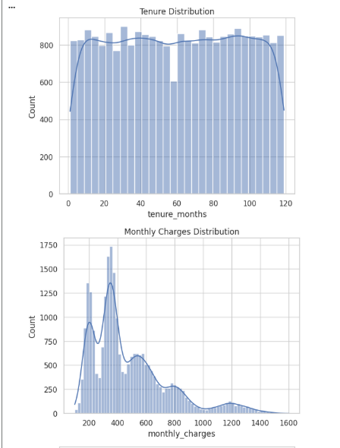
EDA - Distribution

Slide 6
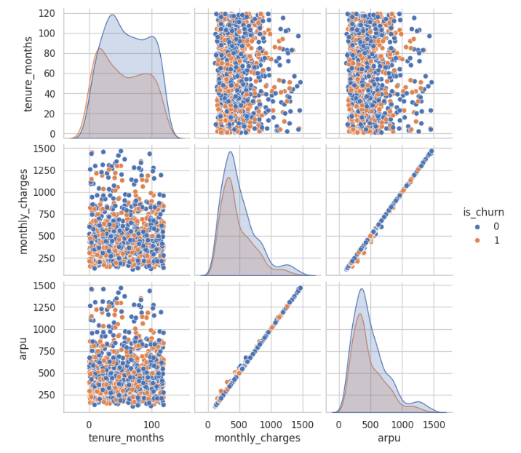
EDA - Relationships

Slide 7
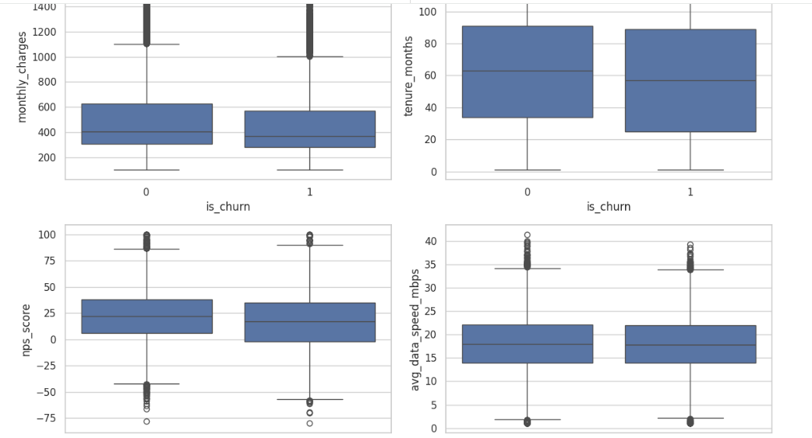
EDA - Boxplots

Slide 8
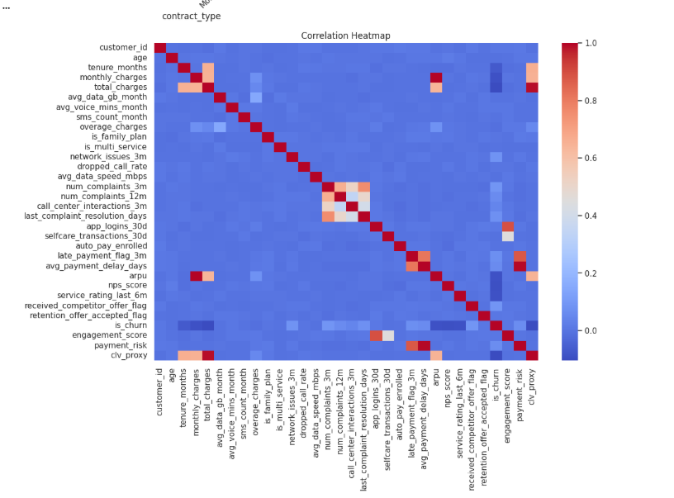
EDA - Correlation

Slide 9
Feature Engineering
Created engagement_score, payment_risk, CLV proxy.
Improved model performance.

Slide 10
Model Building
Used XGBoost with pipeline.
Handled scaling & encoding.

Slide 11
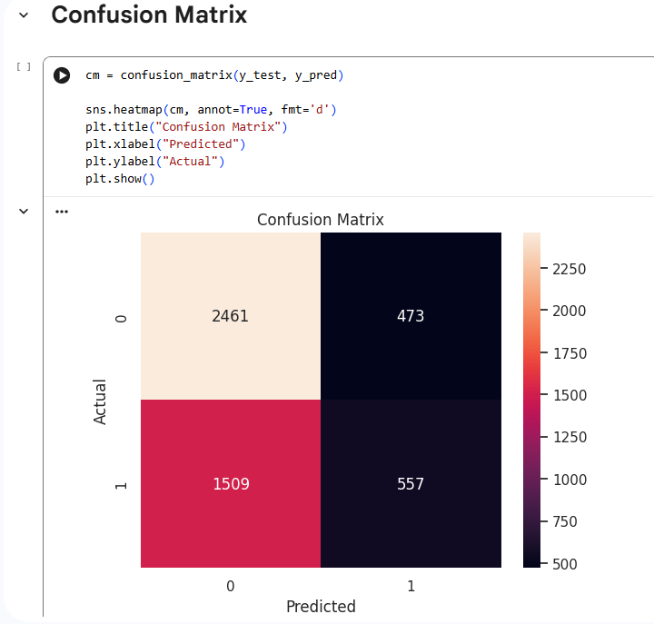
Confusion Matrix

Slide 12
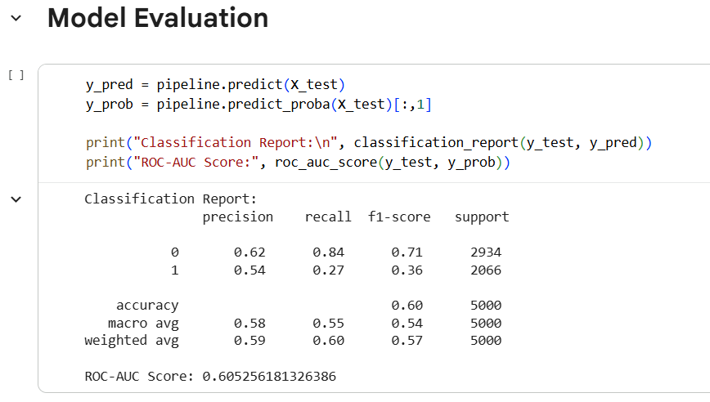
ROC Curve

Slide 13
Streamlit App
Interactive UI for prediction.
Includes dashboard & recommendations.

Slide 14
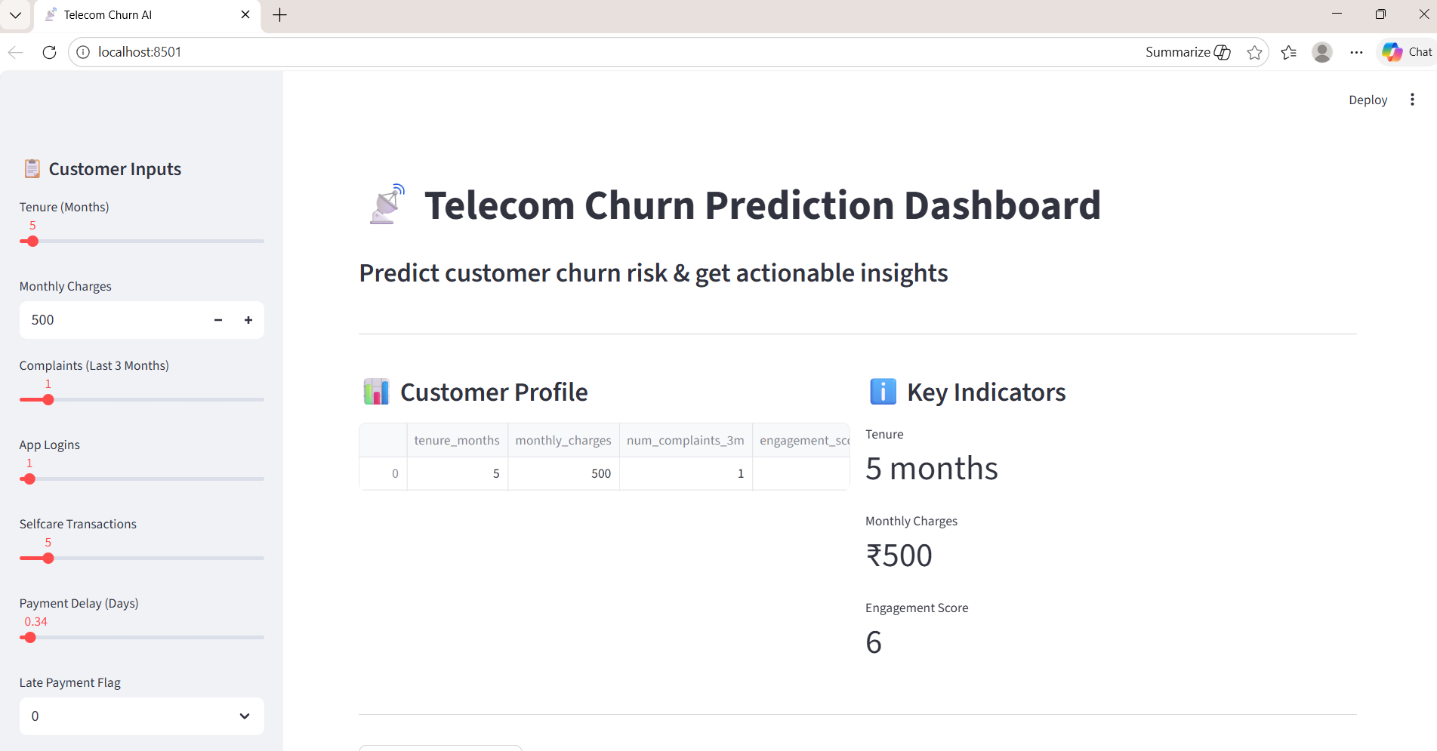
App UI

Slide 15
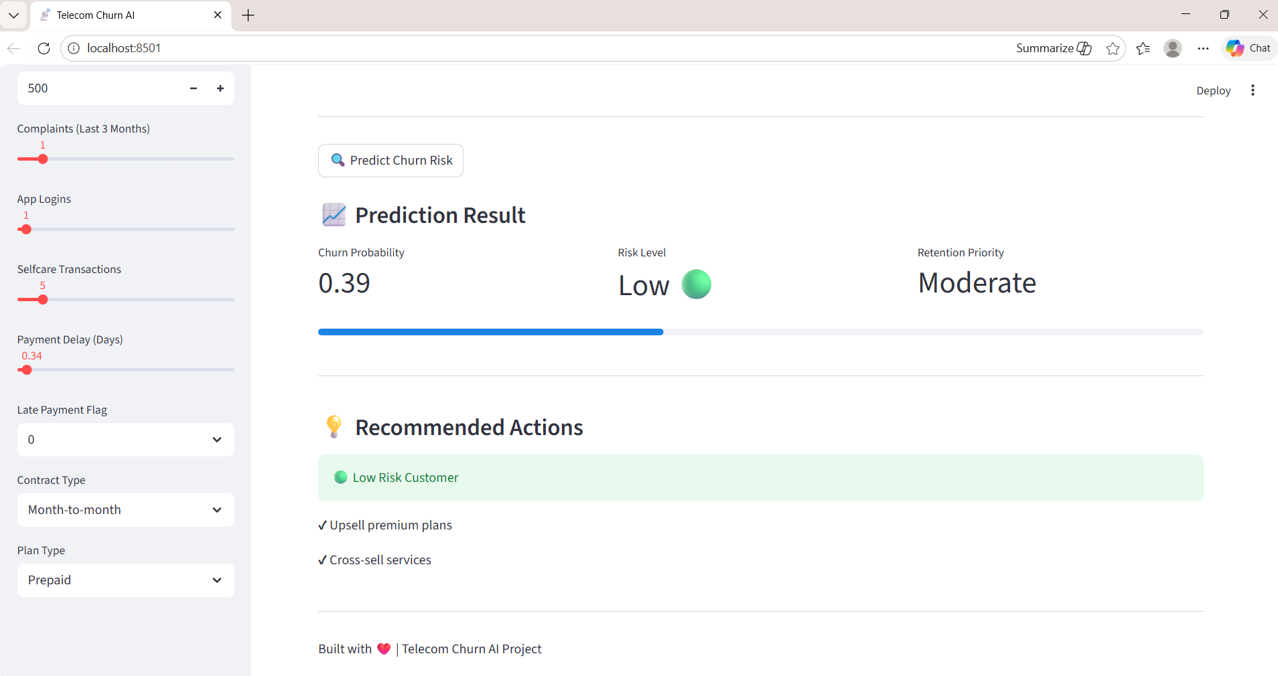
Prediction Results

Slide 16
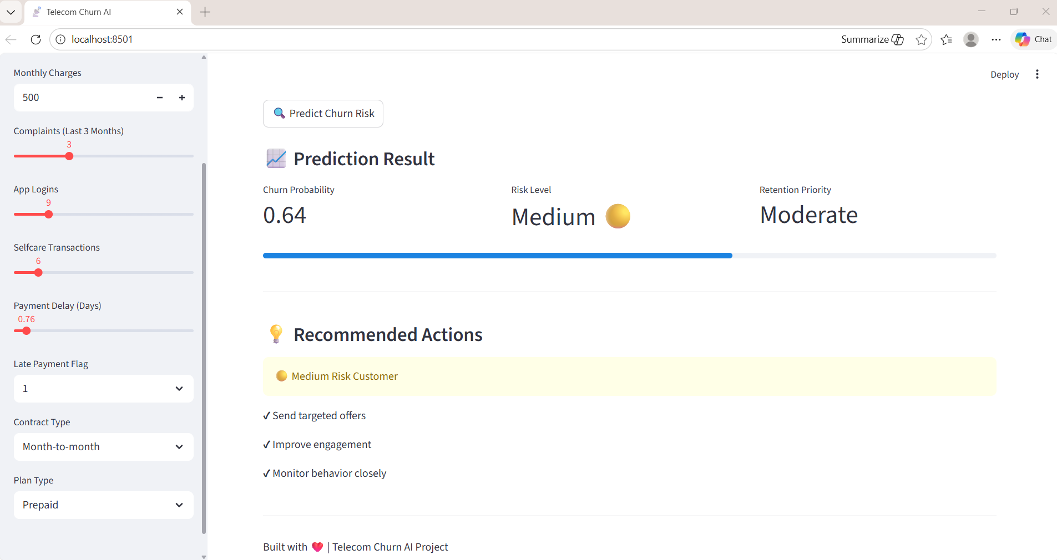
Medium Risk Case

Slide 17
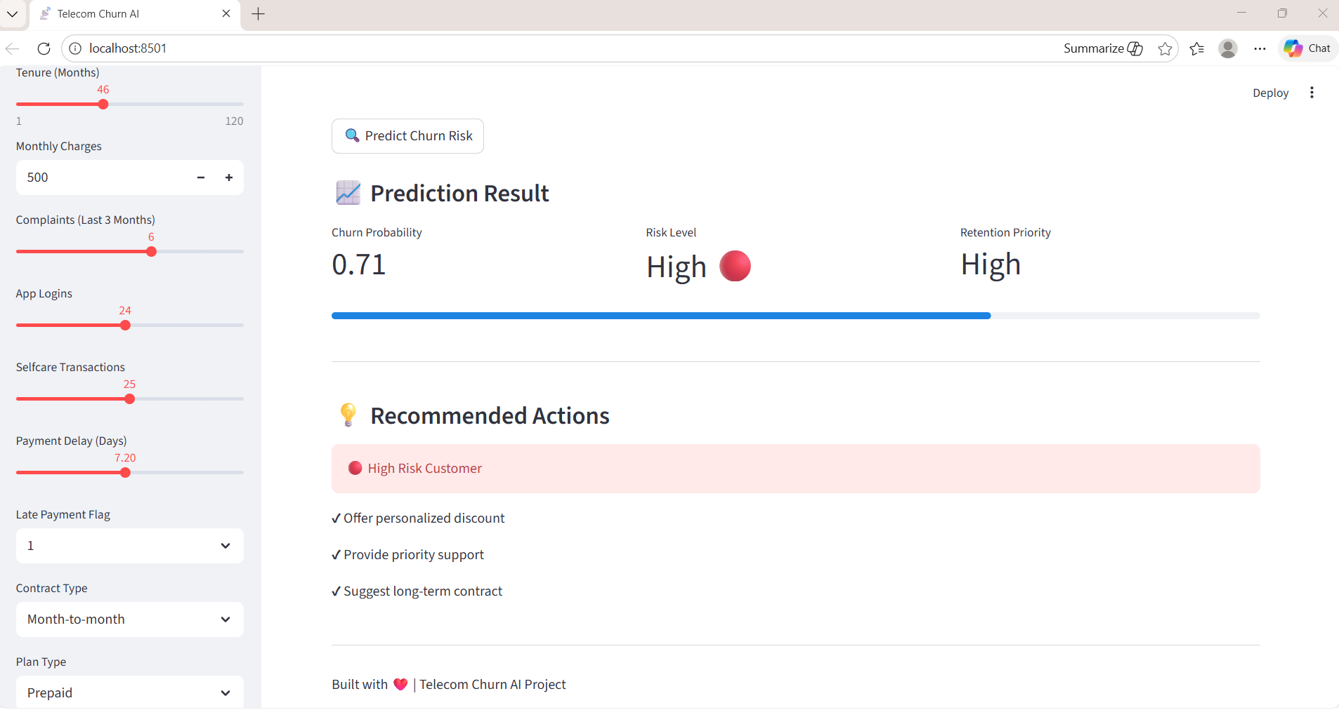
High Risk Case

Slide 18
Business Recommendations
Target high-risk users.
Improve service & engagement.

Slide 19
Conclusion
ML enables proactive churn reduction.
Improves retention & revenue.

